Slide 1
FFAPP Discussion
Shao Weixiang (ZTE)

Slide 2
FFAPP WID status
UID | Name | Acronym | Rel | WG | Target | Old % | New % | Change or comment
930015 | Application layer support for Factories of the Future (FF) | FFAPP | Rel-18 | S6 | Dec-2022 | 50 | 55% | Delay and forward puzzled
Progress since SA#96-e:
1 pCR for TS 23.545 was approved.
1 CR for TS 23.434 was agreed
RAN impacts and dependencies:
None identified
Next steps:
Discuss how to finish or withdraw

Slide 3
FFAPP WID Objective
WID Objective | Current status
Defining architecture requirements | Support in Clause 4.1.2
functional architecture of the FF application layer | Support in Clause 5
Procedures and information flows supporting the related solutions and usage of SEAL procedures | No any new FFAPP solution Only usage of SEAL IM, KM
Support integration of Operation Technologies (e.g. OPC-UA) | No
Enhancements related to geographic location and positioning information support | Support in TS 23.434 9.3
Support for Private slice monitoring | Support in TR 23.700-99, continue will support in TS 23.434
Support for Edge computing deployment | Support in A.3
Message communication support for non-TSN messaging communications | No
Support for TSC services | Support in TS 23.434 14.3.7 & 14.3.8
Establishing communication with FF application service requirements | Move to TS 23.434

Slide 4
TR23.745 solutions considered for normative work
TR23.745 solutions considered for normative work | TS 23.434 support
Solution #2: Establishing communication with FF application service requirements | Support in SEAL Network resource management, clause 14.3
Solution #7 Geographic location and positioning information support | Support in SEAL Location management, clause 9.3
Solution #9: 5GLAN group management | Support in SEAL Group management, clause 10.3
Solution #10: QoS monitoring for TSC services | Support in SEAL Network resource management, clause 14.3
Solution #11: Establishing communication connectivity between FF Application Specific Clients with FF application service requirements | Support in SEAL Network resource management, clause 14.3
Solution #12: Private Slice | Support in TR 23.700-99, continue will support in TS 23.434
Solution 15: Time Synchronization Management | Support in SEAL Network resource management, clause 14.3
Solution #18: Device monitoring | Support in SEAL Network resource management, clause 14.3
Solution #20: SEAL support for CoAP to address constrained devices | Support in annex C.2
Solution #21: Enabling 5G CN capabilities for SEAL Groups | Support in SEAL Group management, clause 10.3
Solution #22: SEAL support for TSC services | Support in SEAL Network resource management, clause 14.3
Solution #23 (merging Sol#5, #6): Edge computing for FFAPP | /
Solution #24: Message communication using MSGin5G service | /

Slide 5
How to finish FFAPP - add usage of SEAL
S6-221544/S6-221794 Usage of SEAL Group management service
S6-221545/S6-221795 Usage of SEAL Location management service
S6-221546/S6-221796 Usage of SEAL Network resource management service
Since TR23.745 #2, #7, #9, #10, #11, #15, #18, #21, #22 cover SEAL GM, LM, NRM, why TS23.745 can’t input usage of SEAL procedures for GM, LM, NRM?
Ericssion comments : the use case needs to be defined in the TS before adding a service to the TS which the use case needs.
Question： what meaning about the use case needs to be defined in the TS before adding a service. Please give example, where and how to define the use case? In TS23.255 & TS 23.286 there are no use cases need to be defined for usage of SEAL GM, LM, NRM.

Slide 6
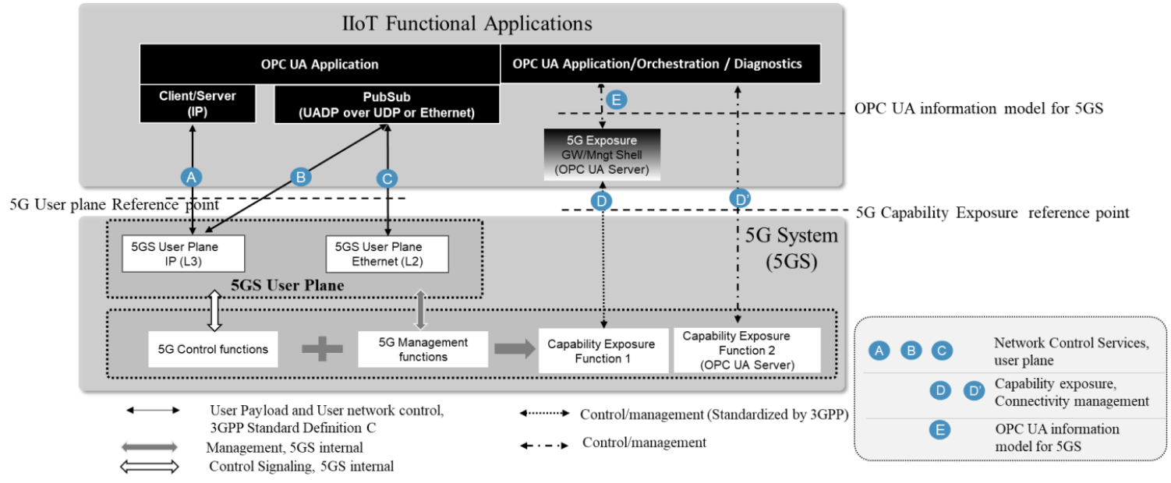
How to finish FFAPP - add integration OPC-UA
From 5G-ACIA WI051 Integration of OPC UA with the 5G system
FAE/SEAL layer can support interface D
FF application specific layer cansupport interface E
Under 3GPP SA6 context, identify which application enabler layer functions (eg. group management, firmware update) and information are useful for industry application development and operation from the perspective of application layer architecture.
Figure 7: high-level system architecture for OPC UA and 5G system integration

Slide 7
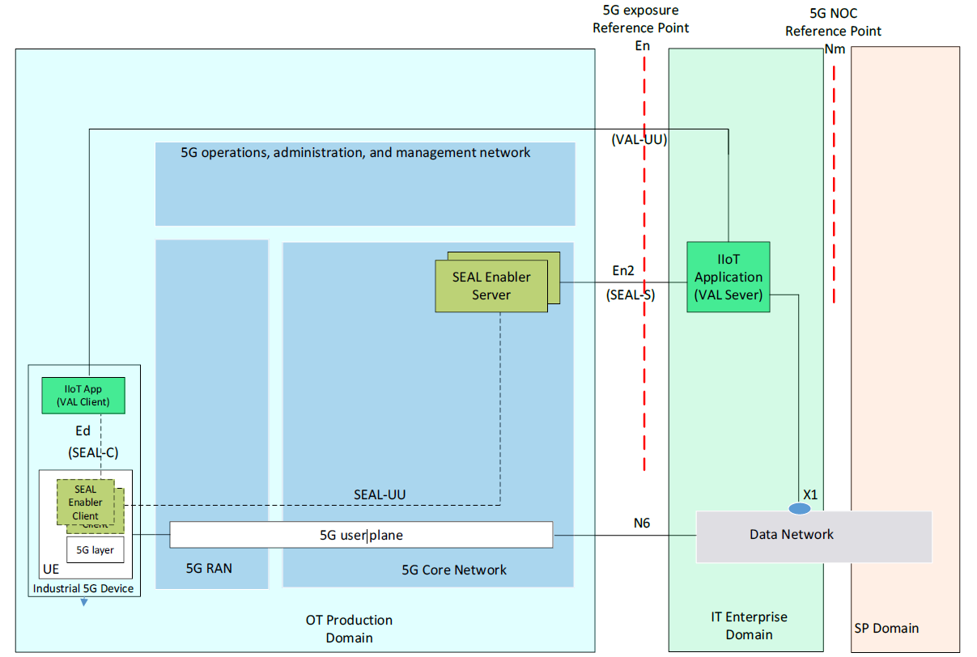
How to finish FFAPP – simplify FFAPP Arch
From 5G-ACIA WI062 Exposure of 5G capabilities to industrial applications - architecture and protocol aspects, IIoT Application (VAL Server/Client) direct access SEAL Enabler Server/Client
Since all services can be provided by SEAL layer, it is no meaning for FAE layer.
If no FAE layer, we can simplify TS23.545 clause 7 to use cases for invoke SEAL, use cases can be Device identity management, Device provisioning and onboarding, Device connectivity management, Device connectivity monitoring, Device group management, Device location information which list in 5G-ACIA WI062 clause 4 Mapping of 3GPP features to WI-039 requirements
Figure 3: SEAL functional architecture mapped to the high-level functional architecture in Figure 1.

Slide 8
Thank You!

