Slide 1
Clarification about the role of SEALDD and way forward
Yaxin (wangyaxin11@huawei.com)
Huawei, Hisilicon

Slide 2
Outline
Application server deployment architecture
Considerations for 3GPP system optimizations
SEALDD and NRM
SEALDD and MSGin5G
Communication services between VAL servers
SEALDD enabled Traffic control
Summary

Slide 3
Application server deployment architecture
Service logical component
Storage component
Application Server provides services to either Application Client or Web server by the manner of remote API(s).
Remote API(s) invocation is carried out by http signaling over TCP/IP
Application Server provides contents (data type could be data/video) to Application Clients or Web server via media server function.
(supported micro services)
Micro services
Micro services
Location
Data storage accessing
Data storage
3GPP
network
Client based APP
Signaling exchange
(e.g API gateway)
Media server function (video/data…)
Communication endpoint service towards
clients and servers
Browser based APP
Web server
External Communication component
Components of Instances of Application server
Storage component and External Communication component are generic to all type of application, and they are normally provided as services in the cloud platform. SEAL DD covers these components in its scope.

Slide 4
Considerations for 3GPP system optimizations
Signaling exchange
(e.g API gateway)
Media server (video/data…)
Signaling exchange
(e.g API gateway)
Media server function (video/data…)
5G adaptation
5G control plane related processing function
User-plane related processing function
Communication endpoint service
External Communication component
Communication endpoint service
External Communication over 5G
User-plane related processing function:
Sending/receiving packets via N6 interface: Application traffic <=> SEALDD traffic, for 5G specific optimization transmission.
5G control plane related processing function:
N33/N5 interaction function: Control plane interactions with 5GC(working as AF).
SEALDD also considers 5G adaptation function for application server.

Slide 5
SEALDD and NRM
Signaling exchange
(e.g API gateway)
Media server (video/data…)
Signaling exchange
(e.g API gateway)
Media server function (video/data…)
NRM server
(N33/N5 interaction)
NRM server
(N33/N5 interaction)
5G adaptation
NRM invoker
User-plane related processing function
Communication endpoint service
External Communication component
Communication endpoint service
External Communication over 5G
NRM function:
Control plane interactions with 5GC(working as AF).
Relationship between NRM and SEALDD:
NRM can be implemented in SEALDD server as an integrated function for N33/N5 support, or can be invoked by SEALDD server remotely in dedicated standalone NRM server
NRM can be part of 5G adaptation function.

Slide 6
SEALDD service and MSGin5G service integration
Main controversial points:
EN1: Whether and how to support MSGin5G-3 and MSGin5G-4 is FFS.
EN2: Whether and how MSGin5G can use SEALDD service for data delivery is FFS.
Current solution for SEALDD integrating MSGin5G:
MSGin5G functionalities are integrated in SEALDD server/client, SEALDD enabler can trigger MSGin5G service to send MSGin5G message.
MSGin5G is one part of SEALDD provided data distribution method, it will only be consumed by SEALDD, MSGin5G will not invoke SEALDD service for data transfer.
Conclusion:
MSGin5G-3 and MSGin5G-4 will be reused by MSGin5G functionality integrated by SEALDD.
MSGin5G functionality will not consume SEALDD service for data delivery.
NOTE: MSGin5G server function integrated in SEALDD server may send Message to non-3GPP UE or legacy 3GPP UE via MSGin5G-2 or MSGin5G-4 interfaces.
MSGin5G is part of 5G adaption function.

Slide 7
Communication services between VAL servers
Main controversial points:
Whether SEALDD can be used for communication between VAL servers.
As Clarified in previous slide, if SEALDD service is used, Application server only keeps computing module.
SEALDD is already used to communicated with clients. It might use SEALDD server service to communicate with other VAL server (especially VAL servers in other Data Center and associated with different SEALDD server)
NOTE: If SEALDD service is not used by the Application server, it is up to the Application server’s implementation to do the data transmission between the application servers. It is out of SEALDD’s scope.
Conclusion:
VAL server can also use SEALDD server to communicate with other VAL server.
Service logical component
Storage component
(supported micro services)
Micro services
Micro services
Location
Data storage accessing
Data storage
Signaling exchange
(e.g API gateway)
Media server function (video/data…)
Communication endpoint service towards
clients and servers
External Communication component
Components of Instances of Application server
In addition to server to client communication, VAL server can also use SEALDD server to communicate with other VAL server.
Notes:
As agreed principles in previous meetings:
SEALDD server provides data distribution service for VAL server, VAL server only keeps the application logic part.
Scenario A: VAL server can use SEALDD server for all the traffic transfer (including application signaling traffic and application data traffic)
Scenario B: VAL server can use SEALDD server for part of the application data traffic transfer.

Slide 8
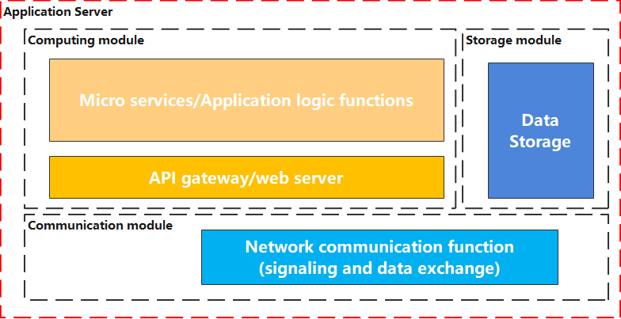
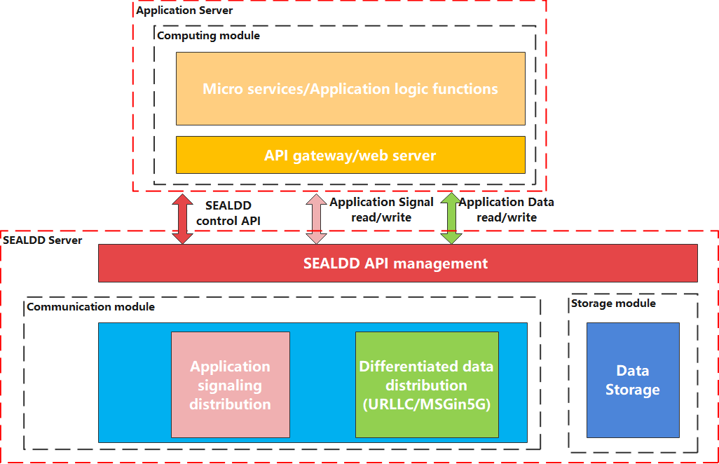
SEALDD enabled Traffic control
Main controversial points:
Whether traffic control should be done by VAL server itself or by the SEALDD server.
As Clarified in previous slide, if SEALDD service is used, Application server only keeps computing module. VAL server only read/write from SEALDD server. SEALDD server is in charge of communicating with Clients.
NOTE: If SEALDD service is not used by the Application server, it is up to the Application server’s implementation to do traffic control. It is out of SEALDD’s scope.
Data transmission related functions (such as traffic control) should be done in SEALDD server.
Conclusion:
For the VAL services consuming SEALDD service for data transfer, traffic control should be done in SEALDD server.
Traffic control can be done in SEALDD server.
Notes:
As agreed principles in previous meetings:
SEALDD server provides data distribution service for VAL server, VAL server only keeps the application logic part.
Scenario A: VAL server can use SEALDD server for all the traffic transfer (including application signaling traffic and application data traffic)
Scenario B: VAL server can use SEALDD server for part of the application data traffic transfer.

Slide 9
Summary
SEALDD covers data storage and external communication components in its scope.
SEALDD also considers 5G adaptation function for application server.
SEALDD server can consume NRM services for control plane interaction with 5GC.
MSGin5G-3 and MSGin5G-4 will be reused by MSGin5G functionality integrated by SEALDD. MSGin5G functionality will not invoke SEALDD service for data delivery.
In addition to server to client communication, VAL server can also use SEALDD server to communicate with other VAL server.
Traffic control can be done in SEALDD server.

