Slide 1
FS_ADAES - DP on potential topics and planned work
...
Manos Pateromichelakis
Lenovo

Slide 2
Contents
Analytics enablement value
Potential analytics capabilities in ADAES
App related
Edge related
API related
Slice related
Analytics enablement deployment & architecture
Key issues and work plan

Slide 3
Analytics enabler layer value
Application and Edge enablement services in principle aim to ease the integration of 3GPP network systems with verticals / ASPs
The use of data analytics in 3GPP network systems
SA2 → Analytics per UE, slice, network function
SA5 → Analytics for 3GPP Managed Elements (NF, NSI, NSSI, CS,..)
Analytics Enablement at App layer can provide DN/AS-specific stats/predictions which could offer optimized value-add services to the end consumers which can be:
Verticals
V2X scenarios→ 5GAA discusses data analytics at the OT domain. AECC envisions the use of an AI enabler at the edge
FF scenarios → analytics are needed e.g. for deterministic traffic to guarantee performance / availability
UAS scenarios → stats/predictions e.g. on the UAV / UAV-C session performance and failure rates can help avoiding drone hazardous operation
ASPs
Allow for ultra-light and high portable application design. Edge Analytics and analytics enablement at the platform will help reducing the application design complexity (no network logic is needed to be translated by end app, and ADAES could translate a network related predicted event to an application related event)
Edge / Cloud Provider
Support for edge native applications → optimize edge operation by pro-active dimensioning of resources, scale in-out, etc
Minimizing energy consumption for the edge platform
Using analytics based on API logs to evaluate service API availability / performance / conditions
Efficient Charging for edge services based on predicted resource usage per application
MNO
NWDAF could use ADAES analytics to improve analytic output→ e.g. DN Performance Analytics, NWDAF could receive some analytics from ADAES instead of collecting raw data
Pro-actively adapt network parameters based on predicted application layer changes

Slide 4
App related analytics
App layer analytics provide insight on the operation and performance of an application (VAL server, EAS, application session)
Example of such analytics
EAS / VAL server has 500 connections on average between 10-11am
EAS / VAL server receives 180 requests / sec at 10am
A connection to the VAL server fails with probability 0.012%
The content at URI-x is retrieved with an average delay 677ms
Retrieval of content at URI-x fails with probability 0.1% between 10-11am
The content at URI-x is requested 89 times / sec at 11am
RTT related stats / predictions for VAL server or for VAL UE sessions for a given time / area / access etc

Slide 5
Edge related analytics
Edge Analytics enablement take inputs from the DN and underlying 3GPP network and provide stats/predictions for e.g.
edge/cloud load parameters
edge server load/conditions,
edge service availability stats,
number of completed transactions,
edge platform/service failure rates,
edge service uptime/downtime stats,
conditions/availability of edge computational resources,
energy usage stats for an edge platform / EAS
Stats or predictions can trigger
EAS migration to a different EDN / central DN
New EAS instantiation at a target EDN
Change of EDN coverage / dimensioning / resources
Pro-active EAS reselection for a target UE or group of UEs
Observation: Such trigger will have impact on EDGEAPP procedures
As outcome this WID, possible impact to EDGEAPP spec (TS 23.558) to 1) introduce the Edge Analytics enablement capability or to 2) enhance EDGEAPP procedures to utilize ADAES (which can be a SEAL service consumed by EES)

Slide 6
Telco API related analytics
Telco-provided APIs include NEF APIs, CAPIF APIs, OAM APIs, SEAL/EDGEAPP APIs (incl client – server APIs (e.g. EDGE 1, EDGE 4))
There can be different use cases requiring that the ASP/vertical needs to be aware on the telco provided API status and analytics.
Multiple PLMNs may be offering similar services and the ASP needs to choose from which MNO he should invoke APIs for consuming telco services.
ASP may want to choose whether he shall invoke an API from the MNO or from the ECSP and one criterion for choosing this would be the service performance and availability which could be understood by the API status/analytics.
Different instances of the same service may be deployed in different edge/cloud platforms. For example, multiple NWDAF instances may provide analytics for the AF and reside in edge, regional or core clouds.
The support for API analytics at the edge (related to the API performance, failure, availability, throttling events etc), would be useful for the edge native applications to allow ASP for dynamically deciding to scale-in from the edge to the cloud in heavy load situations, or scale out from the cloud to the edge to improve the quality of experience for the end user.
Different notification methods may be used for client-server APIs (e.g. websocket, long polling). The analytics based on different notification methods may help the ASP to decide on the notification method to be used for different edge services.
Some services may be offered with different granularity by different domains of the MNO or from the UE side. The ASP may want to choose based on the API status/conditions what service to consume and what API to call.
An example for different granularities: 1) network QoS monitoring and prediction can be provided by 5GC, 2) Performance monitoring for a specific area can be provided by OAM, 3) application QoS monitoring (end to end QoS between two or more applications using 5GS for communicating) by the app of the UE, 4) QoS /QoE calculated at the edge.

Slide 7
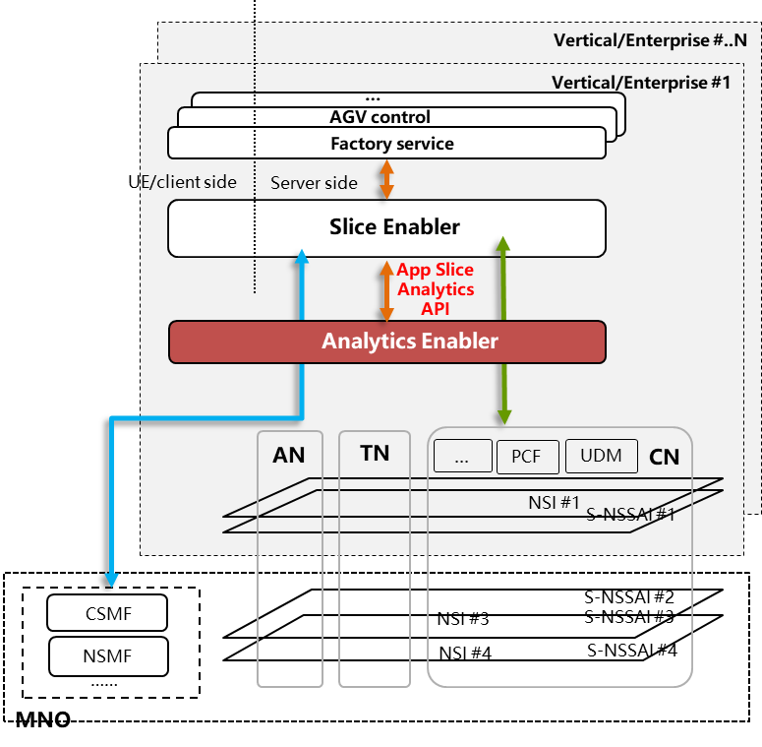
Slice related analytics
NSCALE discusses enhancements to NSCE SEAL service, where NSCE-S is expected to consume 5GS services related to analytics (from MDAS, NWDAF) and to re-expose them to the VAL server (slice customer)
If further analytics is required on top of the consumed analytics services (MDAS/NWDAF), the ADAES may be utilized by NSCE in a service-based manner to perform further analytics related to applications for certain slice / NSI
Data Analytics collection may not be particularly per slice; however, the resulting analytics will be for given slice (s). For example:
Analytics Event: “App QoS performance analytics for the subscribed slice(s) “
Consumer: NSCE server, or NWDAF (e.g. such analytics can be considered as “DN performance data”)
Inputs: QoS data / sustainability analytics for a target area (list of cells) and time from NWDAF, slice load analytics from NWDAF, PM analytics for a given area and slice / NSI .
Slice related data (e.g. on KQI) can be provided from NSCE server instead of the NWDAF/MDAS
Potential Output: stats or predictions on VAL server or application QoS performance (e.g. RTT, expected packet losses) for each of the requested slices

Slide 8
Analytics enabler layer possible deployments
ADAES may be have different deployments
Option 1: ADAES can be deployed as an edge enablement service at each EDN
Option 2: ADAES can be deployed as an application enablement service (e.g. as part of SEAL) which collects data from multiple EDNs
Option 3: Federated ADAES deployment, where multiple ADAE services are deployed in edge or central clouds (e.g. in hierarchical arch). Such deployment allows for local-global analytics for system wide optimization
Observation: Based on the ADAES deployment different signaling / impact over SA6-defined interfaces is expected for the data collection and analytics derivation
Proposal: It is proposed to map different deployments to different possible capabilities of ADAES and relations to EDGEAPP / SEAL

Slide 9
Analytics enabler layer UP protocol stack view
Below we provide a view on the user-plane protocol stack end-to-end (UE to DN)
The App Enablement layer (e.g. SEAL) sits on top of PDU layer and may support the delivery of application traffic
ADAE service may process data from networking stack (e.g. packet delays, number of message retransmissions, packet losses) and can derive analytics on the application QoS (e.g. predicted / statistic RTT for an application session)

Slide 10
Key Issues and work plan
Based on SID planning, FS_ADAES still has 4 meetings (3 e-meetings and 1 f2f meeting)
Progress in SA6 #47e was 15%
4 Key Issues have been approved (KI on edge enablement, KI on SEAL interactions, KI on Data Collection, KI on App layer performance analytics)
Minimum planned work for the SID
New KIs to be proposed for API-related analytics, slice-related analytics, etc [SA6#48, SA6#49]
Solutions, Requirements and Deployment scenarios to be provided [SA6#48, SA6#49, SA6#49-BIS]
Architecture to be finalized (relation with SEAL, EDGEAPP to be agreed) [SA6#49-BIS, SA6#50]
Evaluations and conclusions [SA6#49-BIS, SA6#50]
SID/WID | Schedule dependencies (on other WG)* | SA6#46-e Tus | SA6#47-e TUs | SA6#48 TUs | SA6#49 TUs | SA6#49-BIS TUs | SA6#50 TUs | SA6#51 TUs | SA6#52 TUs | SA6#52-BIS TUs | SA6#53 TUs | Total
FS_ADAES |  |  | 1 (SID) | 1.5 (SID) | 1.5 (SID) | 1 (SID) | 1 (SID) | 1 (WID) | 1 (WID) | 1 (WID) | 1 (WID) | 10 TUs

