Slide 1
FS_NSCALE KI discussion
3GPP TSG-SA WG6 SA6 ICC 12th Jan
CMCC
Shaowen Zheng

Slide 2
Topic
Key issue 5: Communication service management exposure
Key issue 12: Network slice capability exposure in the edge data network

Slide 3
Key issue 5: Communication service management exposure
What is Communication service in NSCALE？
NSCE as one of the functionalities of SEAL is responsible to provided the network slice related capability exposure to enable the communication services required by the vertical applications.
In SA1 TS 22.261, several types of communication services provided to the vertical applications are described, e.g., cyber-physical control services, video services, tactile and multi-modal. And the KQIs/QoEs and APIs required by different vertical applications may be diverse.
2. What is Communication service management exposure in NSCALE?
Following requirements related with network capability exposure are described by SA1 TS 22.261:
Based on operator policy, the 5G network shall expose a suitable API to allow an authorized third-party to define and reconfigure the properties of the communication services offered to the third-party.
The 5G system shall support the means for disengagement (tear down) of communication services by an authorized third-party.
The 5G system shall provide information on the current availability of a specific communication service in a particular area (e.g. cell ID) upon request of an authorized entity.
3. NSCE is responsible for the following capabilities:
Communication services availability (e.g.,KQIs/QoEs (resolution, frame freezing for video services)) assurance;
KQI translations from communications service KQIs to the network KPIs;
API translations from the APIs invoked by verticals to the APIs provided by NEF or OAM system;
Lifecycle management of the communication services(e.g., from an order of network slice for a video service, the network slice preparations and operations, until the order cancel) provided to the verticals.
Notes:
communication service availability: percentage value of the amount of time the end-to-end communication service is delivered according to a specified QoS, divided by the amount of time the system is expected to deliver the end-to-end service.

Slide 4
Application enable layer management of slice lifecycle
- What kinds of service APIs are required to be supported for application layer exposure of communication services life cycle management?
Step1: order/registration
Step2: Slice preparation
Step 3: Slice operation
Step 4: cancel order
The customers propose communication service requirements by ordering the network slice and network slice capability registration
Communication service preparation includes Authorization and authentication, SLA translation, API translation & configuration, subscription (subscribe to OAM and 5GC services to be used by the communication service consumers ).
After the preparation phase, the communication service could be use by communication service consumers. A communication service allows run-time operations includes the slice monitor/exposure and slice adaptation and other basic slice operations (modification etc.).
When the communication service is no longer needed, the lifecycle of the communication service ends.
Slice monitor/ exposure
Registration
Authorization and authentication
Based on collected information from 5GS/OAM and collected application layer information from either client or APP server, the function of slice monitor/exposure includes
- QoS verification per slice
- Performance and analytics exposure per slice
- Fault alert and diagnose
VAL server sends the registration request to the NSCE server with its identity, and may also include interested service and level of exposure requirement
configuration & translation
API configuration and translation
Description: Vertical applications requirement => suggested SLA & a bundled or combined API
Slice adaption suggestion
Based on slice status info exposure, Slice adaption suggestion could trigger Slice scaling or policy adjustment, like ：
- Automatic application layer network slice management
managing trusted third-party owned application(s)
order/registration
preparation
opreation
cancel order
CSI lifecycle management
Notes:
communication service API == slice API =>service API
CS 服务的注册；
服务的注册；
端到端的slice的LCM不能感知所有的信息；
服务开放的生命周期管理：注册；加载；
需要考虑的流程和事件；

Slide 5
Key issue 12: Network slice capability exposure in the edge data network
The network slice deployed in the core network has a certain distance from the customer, so the delay will be affected to a certain extent and cannot meet the operation requirements of low latency equipment. Moreover, a variety of service data need to be processed in the core network, the scale of data traffic is large, the backhaul network needs to bear a large load and consume more bandwidth. For example, the differential protection service has strict requirements for latency in power industry. In order to meet the personalized services requirements of vertical industries, network slices are deployed by using the computing, storage and communication capabilities of the edge date network, so as to realize the localized processing of the service, reduce the service transmission latency and enhance the service performance. How to expose the network slice capability deployed in the edge data network to the vertical industry or the third parties is worthy of our study.
Open issues: - How could the NSCE server deployed inside the EDN interact with the NSCE server outside the EDN? - Whether and how could the NSCE server inside the EDN manage the network slice that has resource outside the EDN? - Whether and how does SEAL need to be enhanced to support NSCE client to interact with NSCE server in the EDN and NSCE server outside the EDN?
Similarly, the server functions of an application enabler server can be made available only as an EAS, it is also possible that certain application enabler server functions are available both at the edge and in the cloud. When the server functions of an application are both available at the edge and the cloud, there may be a need for interaction between the two corresponding application servers, which is out of scope of this specification.

Slide 6
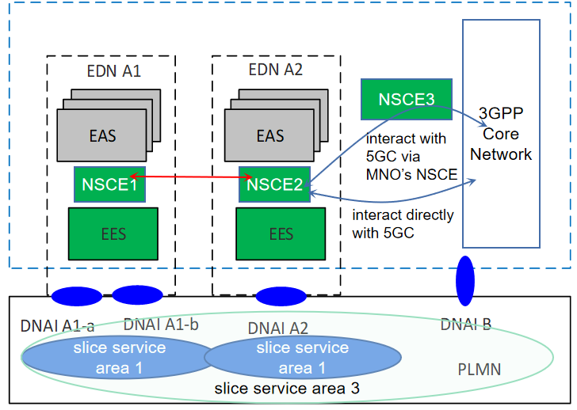
KI 12
Considering that users in the EDN need to access PLMN slices, the edge NSCE also needs to interact with 5GS to obtain PLMN slice information, etc; Also, when a user moves to another EDN, the NSCE(s) in the EDN(s) can cooperate to find an alternative slice, if the current slice cannot be supported in the target area.
Technically，either the NSCE deployed in the edge or elsewhere, it can be seen as a trusted AF, as long as it is a trusted third party, so they can interact with 5GS directly.
However, in practice, for MNO, it is not expected that the NSCE at the edge can directly manage the resources belonging to the operator, and may wish to manage and interact with 5GS via MNO’s NSCE.
Observation:
The interface between NSCE server is needed, the SEAL-E may be enhenced.
To distinguish different NSCEs, in addition to the NSCE ID, the service area, location and other attributes of the NSCE may be needed.
Some procedures need to be updated.

Slide 7
ANNEX

Slide 8
Lifecycle of a communication service defiend in SA5
- What kinds of service APIs are required to be supported for application layer exposure of communication services life cycle management?
from TS 28535, 28.805
- Preparation phase: Providing a communication service starts with preparation, which includes communication service design, pre-planning, feasibility check, i.e., checking the attainable communication service quality from both resource and service aspects, negotiation of the communication service attributes, preparing communication service and network requirements derived from SLA. - Commissioning phase: Once a communication service is prepared, it can be established by converting the communication service requirement to network requirements (interaction and use of NF resources including RAN, CN) to be deployed on the network resources and ready to be used by the communication service consumers (subscribers, UEs).
- Operation phase: After the commissioning phase, the communication service is activated for use by all communication service consumers (subscribers, UEs) that are allowed to use the communication service. The initial deployment or trail phase for the training of the communication service assurance algorithms has entered the operation phase. A communication service that is activated allows run-time operations e.g., quality of experience assurance, quality of service assurance,data exposure, CSI modification. The optimization of the utilization by communication services may continue during the operation phase of the communication service. - Decommissioning phase: When the communication service is no longer needed, after being de-activated, the lifecycle of the communication service ends with termination.
Figure 4.1.1: Lifecycle of a communication service

Slide 9
when the NSCE server inside the EDN wants to manage the network slice that has resource outside the EDN, some solutions would have to be updated, for example
Solution 1: Automatic application layer network slice management

Slide 10
- Whether and how does SEAL need to be enhanced to support NSCE client to interact with NSCE server in the EDN and NSCE server outside the EDN?
The interactions between the SEAL servers of the same type are generically referred to as SEAL-E reference point. The specific SEAL service reference point corresponding to SEAL-E is specified in the specific SEAL service functional model.
solution | SEAL-E may be enhanced to support the functionality such as:
Solution 1: Automatic application layer network slice management | support network slice management operation
Solution 2: Network slice fault management capability | fault management data exposure, fault management operation，
Solution 3: Slice API configuration and translation | transfer requirement and related info
Solution 4: QoS verification capability | PM data exposure, PM operation，
Solution 5: Network slice related performance and analytics exposure | PM data exposure, PM operation，
Solution 6: VAL server authorization and authentication via slice enabler layer | Support NSCE authentication and authorization as a consumer
Solution 7: network slice capability registration | Support NSCE registration as a consumer
Solution 8: Discovery of management service exposure | Depends on MNO’s policy, VAL server could do the management via edge NSCE directly if supported, or through the MNO's NSCE
Solution 9: Support for managing trusted third-party owned application(s) | Depends on MNO’s policy, VAL server could do the management via edge NSCE directly if supported, or through the MNO's NSCE

