Slide 1
New SID of Smart Grid APP
Su Zijian (suzijian@huawei.com)
Huawei

Slide 2
How to work with SA1 requirements
SA6 working scope is not 3GPP traditional part, enabler layer defined by SA6 is also not traditional way of developing application layer products. SA6 should not wait requirements and instruction, but investigate proactively requirements from markets and produce good choices for implementation of vertical applications. Actually many of SA6 outputs (e.g. MEC) are based on application layer knowledges from many ways (e.g. industrial realization, other SDOs).
Although SA1 will study use case and application layer service flows, normally SA1 will not put those service flows as the formal requirements (MCPTT is the only exception). But those service flows are still very useful for SA6 to know about applications and determine what kind of enabler layer features is useful to support the implementation of application.
SA1 will define requirements to 5G network, including KPI, functional requirements and network capabilities exposure. Some of the requirement may potentially requires cooperation from application layer/domain. Although not clearly specified, some application layer requirements can be easily deduced from those requirement, e.g. Application layer providing MBMS service information(TMGI) to the client when use 5G MBS capabilities.
SA1 identified use cases and service flows can be a good reference for SA6 to know about the applications, and determine which specific enabler layer functions are useful.

Slide 3
Purpose of this SID and Location of GRIDAPP
The 3GPP R18 SID FS_5GSEI studies the Use Cases, potential new Service Requirements and wherever applicable the corresponding distinct KPIs for 5G system to support various Smart Grid Services.
Some of the use case and service requirements (e.g. usage of with 5G network capabilities) can be well references for SA6 to study what kind of SEAL layer functions (either existed SEAL capabilities or potentially enhancement of SEAL) are useful.
Based on the FS_5GSEI, the Smart Grid APP (GRIDAPP) studied at SA6 focuses on the vertical enabler server and SEAL server for Energy services. The SID of GRIDAPP can be a guideline for energy utility interconnecting DSOs and SA6 application layer (e.g. SEAL, NSCALE). By the GRIDAPP, the utility can deploy different PLMNs with standard interface, mapping the specific Energy Application Communication KPI to Network KPI, and extract required communication indicator for Energy Service.
Smart Grid Application/Service
Smart Grid Communication Management Server（DSOs)
Smart Grid Enabler Server
GRIDAPP
5GS
SEAL
5G Control function
5G Mng function

Slide 4
Services from SA1 for smart Grid

Slide 5
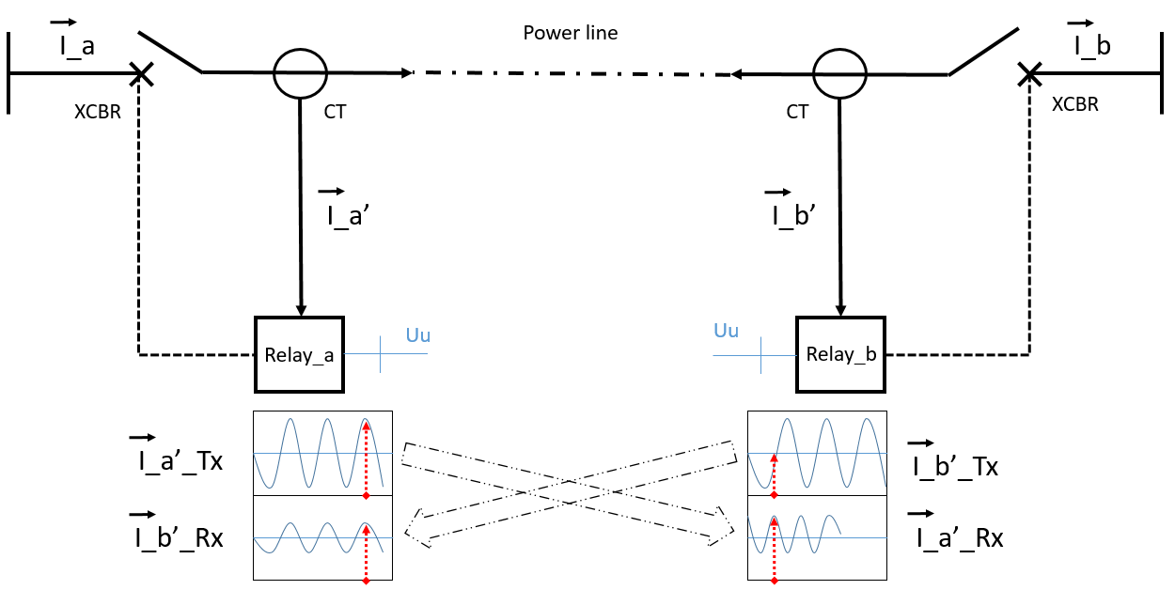
Use case of line current differential protection in power distribution grid (TR22.867 subclause 5.4)
Step 1
I_a’
TimeStamp a1
Relay_a
Relay_b
I_a’
Delay_a2b
I_b’
Time a1
Time a1 + delay_a2b
Step 2
I_b’
Relay_a
TimeStamp a1
Relay_b
Time a2
Delay_b2a
Time a1 + delay_a2b
I_b’
The 5G system shall support communication channel symmetry in terms of latency (latency from UE1 to UE2, and latency from UE2 to UE1) between the two relays, with the max asymmetry < 2ms.
The 5G system shall provide a UE with communication channel latency from the remote UE, with an accuracy of the provided latency < 1ms.
The 5G system shall provide the protection relay with timing information with the comparable precision as GNSS-based precision. The IEEE 1588 time master in NG-RAN should provide protection relays with IEC 61850-9-3 based power/utility profile.
Notes:
SLA
resource;

Slide 6
Analysis the potential capabilities of GRIDAPP
Use case/ Requirements | SA1 referenced | Potential requirement on GRIDAPP | Potential application enabler server capabilities | Potential SEAL capabilities
Use case of line current differential protection in power distribution grid/ The 5G system shall support communication channel symmetry in terms of latency (latency from UE1 to UE2, and latency from UE2 to UE1) between the two relays, with the max asymmetry < 2ms. | TR22.867 subclause 5.4 | Identify the symmetry latency communication requirement and configure the 5G determinate network (5GDN) to OAM | Identify the communication requirement of the latency symmetry for the differential protection service. | SEAL can potentially provide translation of the Service type to network layer transmission requirement.

Slide 7
Use case/ Requirements | SA1 referenced | Potential requirement on GRIDAPP | Potential application enabler server capabilities | Potential SEAL capabilities
Use case of line current differential protection in power distribution grid/ The 5G system shall provide a UE with communication channel latency from the remote UE, with an accuracy of the provided latency < 1ms. | TR22.867 subclause 5.4 | E2E latency measurement and prediction are implement by GRIDAPP, and the result can be exposed to the specific UEs. | Northbound API to exposure the calculated latency paraments to the specific UEs. | 1. Enhance the package delay measurement and prediction ability on SEAL 2. Latency prediction information transmit to the enabler server or the UE by NSCALE.
Use case of line current differential protection in power distribution grid/ The 5G system shall provide the protection relay with timing information with the comparable precision as GNSS-based precision. The IEEE 1588 time master in NG-RAN should provide protection relays with IEC 61850-9-3 based power/utility profile |  | automatic configuration of network service parameters required to support differential protection based on different algorithms and tripping criteria in the protection IEDs/RELAYS | Identify the IEC standard profile requirement of differential protection. | Time synchronize enhancement on SEAL

Slide 8
Use case of isolation demand for energy applications (TR22.867 subclause 5.9)
According to, different kinds of safety isolation requirements are applied to different safety zones:
a) The energy applications belong to production control category i.e. safety zone I and II need to be physically isolated from other applications which don’t belong to production control working category.
b) The energy applications belong to information management working category i.e. safety zone III and IV can be logically isolation from other applications including non-energy applications.
c) The energy applications belong to a same working category can be logically isolated each other.
d) The energy applications belong to a same safety zone can be logically isolated each other
When required by regulations, the 5G system shall be able to provide suitable mechanism for the energy application to monitor the communication link quality and network resource usage.
When required by regulations, the 5G system shall be able to utilize dedicated communication resource including core network and radio network to support physical isolation communication service for energy applications.
When required by regulations, the 5G system shall be able to utilize shared communication resource including core network and radio network to support logical isolation communication service for energy applications.
The 5G system shall be able to simultaneously support multiple communication links with different isolation requirements according to energy management regulation.

Slide 9
Use case/ Requirements | SA1 referenced | Potential requirement on GRIDAPP | Potential application enabler server capabilities | Potential SEAL capabilities
Use case of isolation demand for energy applications / support physical isolation communication service | TR22.867 subclause 5.9 | Support physical/logical isolation as required by Smart Grid communication management server | Identify the service requirements of isolation and configure the isolation requirement to SEAL | Mapping the energy service isolation requirements to SA2/SA5
Use case of isolation demand for energy applications / support logical isolation communication service

Slide 10
UC: Smart Energy Differentiated QoS For Transported Encrypted Data (TR22.867 subclause5.5)
A substation ‘S’ has a local network which serve several Classic Smart Grid Services such as AMI (Advanced Metering Infrastructure), DA(Distributed Automation), Power Line Differential Protection.
S serves as a router to the traffic. S is able to categorize the traffic into different classes, each requiring distinct QoS treatment in the 3GPP system. (TR22.867 subclause 5.5.3)
Smart Grid services specified by IEC generally are defined only at layer 7. This means there are no defined KPIs for lower layer implementation. These values are determined through measurements and analysis. (TR22.867 subclause 5.5.3)
The 5G system should support a KPI associated with the "stability of the connection with a PLMN associated with a subscriber" as a more specific KPI (although this can be part of Availability KPI.) This KPI shall be measured by the number of Service Availability Failure Events (where availability cannot be maintained as required) during a time period, as specified in the service level agreement. (TR22.867 subclause 5.5.6)
The KPI above is the Service level KPI.
SEAL has the ability to monitor the QoS of network on behalf of the Smart Grid Applications. However, there is a gap between network QoS monitoring and Smart Grid Service level KPI information.
How to generate meaningful information of service level KPIs for each of these classic Smart Grid Services (e.g. following IEC 61850 standard) and report subscription-level Service Availability Failure Events for Smart Grid by SEAL can be studied in this new SID.

Slide 11
Use case/ Requirements | SA1 referenced | Potential requirement on GRIDAPP | Potential application enabler server capabilities | Potential SEAL capabilities
Smart Energy Differentiated QoS For Transported Encrypted Data / The 5G system should support a KPI associated with the "stability of the connection with a PLMN associated with a subscriber" as a more specific KPI (although this can be part of Availability KPI.) This KPI shall be measured by the number of Service Availability Failure Events (where availability cannot be maintained as required) during a time period, as specified in the service level agreement. | TR22.867 subclause 5.5 | Generate meaningful statistics of service level KPIs for each of these classic Smart Grid Services (e.g. following IEC standard) Report subscription-level Service Availability Failure Events for Smart Grid | Identify energy service communication service KPI Support network indicator choice by Energy Utility to monitor the service communication qualities. | Service level KPI mapping to network KPI. Monitoring the corresponding network KPI exposure from SA2 and SA5 Calculate the service level KPIs in the required period of subscription/utility. Exposure the statistics service level KPIs to the energy utility. Exposure the network indicators to the enabler server

Slide 12
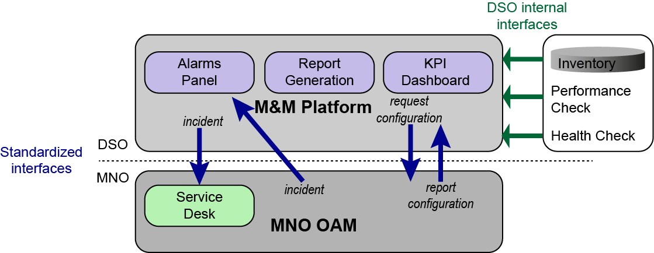
UC: Remote DSO management of connectivity for Smart Energy (TR22.867 subclause 5.7)
A DSO “U” has a service contract with a MNO “A” and MNO “B” to provide telecommunication service to U’s substations.
U has shared parameters for delivery of information (e.g. monitoring and alarms) with A and B in advance from a standard set of them grouped in a SNMP MIB or any similar standard artefact offering the needed functionality, and established standard communication interfaces (e.g. APIs) that allow secure and highly available exchange of management data between U and A and B.
a single utility-owned “Monitoring and Management” (M&M) platform are instrumental for the DSO
MNO 2
In subclause 5.7.2, the three elements on the DSO M&M platform are illustrated as follows:
The KPI Dashboard in the figure above contains information regarding the
Connectivity status of the UEs and their status with respect to their service with the MNOs A and/or B.
Stability of service of the UEs
Configuration is another aspect of stability, usually impacted by the configuration changes done by the operator
Information on average performance indicators
Report Generation
Network performance (latency and packet loss above threshold),
Network stability (the connection remains stable over time),
Accumulated alarms arising due to the MNOs network
Alarms Panel: Alarms are reported by U to A or B as part of the Incident Management process
M&M platform
DSO
GRIDAPP
MNO OAM / NEF

Slide 13
Use case/ Requirements | SA1 referenced | Potential requirement on GRIDAPP | Potential application enabler server capabilities | Potential SEAL capabilities
Remote DSO management of connectivity for Smart Energy / A DSO has service contract with different MNOs | TR22.867 subclause 5.7 | Smart Grid Application deployed with subscriptions to different PLMNs | A standard interface between DSOs and different PLMNs’ MNOs w.r.t. exposure (e.g. NSCALE) Multiple PLMNs services connection switch | Standard interface between 3GPP and IEC61850 standard
Remote DSO management of connectivity for Smart Energy / KPI Dashboard & Report Generation monitoring requirements |  | Stability of Service Monitoring, Network (Service) Stability | Identification the Energy Services Support network indicator choice by Energy Utility to monitor the service communication qualities. Mapping the communication service(CS) KPI to network KPI | Calculate the CS KPI by statistics and calculating the Network KPI exposed by SA5 and SA2. Report the CS KPI to Utility with different granularity Differentiated KPI statistics report on per subscription and per Smart Grid Service basis enabled by SEAL Services Services level incident exposure to DSOs.
Remote DSO management of connectivity for Smart Energy / Incident report |  | Service level incident report for DSOs

Slide 14
The requirements for New SID of Smart Grid APP
Based on SA1 Rel-18 FS_5GSEI and SEI, new Service Requirements on 5GS are identified for Smart Grid Services. Besides, the Smart Energy Services’ KPIs and the respective network performance have become more crucial for Energy Utilities than ever before, due energy sector’s fast adoption of Smart Grids with the prevailing energy transition as the background that is taking place in major regions of the world.
The value of Smart Grid APP studied here can be list as follow:
A standard interface between MNOs and DSOs for management data and monitor data communication between Smart Grid and 5GS provided by different PLMNs. Without this, DSO has to resort to proprietary implementations of the interface, usually different when M&M interfaces with different MNOs.
Service mapping and respective network QoS monitoring, analysis, with incident report.
Service isolation requirements mapping
The classic Smart Grid Applications (e.g. energy data monitoring and Smart Grid controlling) are following IEC61850 standards. These services can deploy 5GS with a standard interface and APIs.

Slide 15
Potential Capabilities for Smart Grid APP on SA6
Smart Grid Service
Smart Grid Communication Management Server
Services KPI requirement
Network Configuration request
Services Incident report to MNOs
Smart Grid APP Enable Server
PLMNs switch
3GPP and IEC standard matching for Smart Grid Service, specially when different IEC profiles are implemented in different PLMN networks
Services KPI analysis and mapping
Services isolation requirement analysis
SEAL Server of different PLMNs
Network KPI analysis
Service isolation mapping
Service Availability report
Incident report to DSOs
Network indicator measurement and prediction
Smart Grid Communication Management Server
1
Smart Grid APP
Enable Server
2
SEAL server A
SEAL server B
3
3
PLMN A
PLMN B

Slide 16
Thank you

