Slide 1
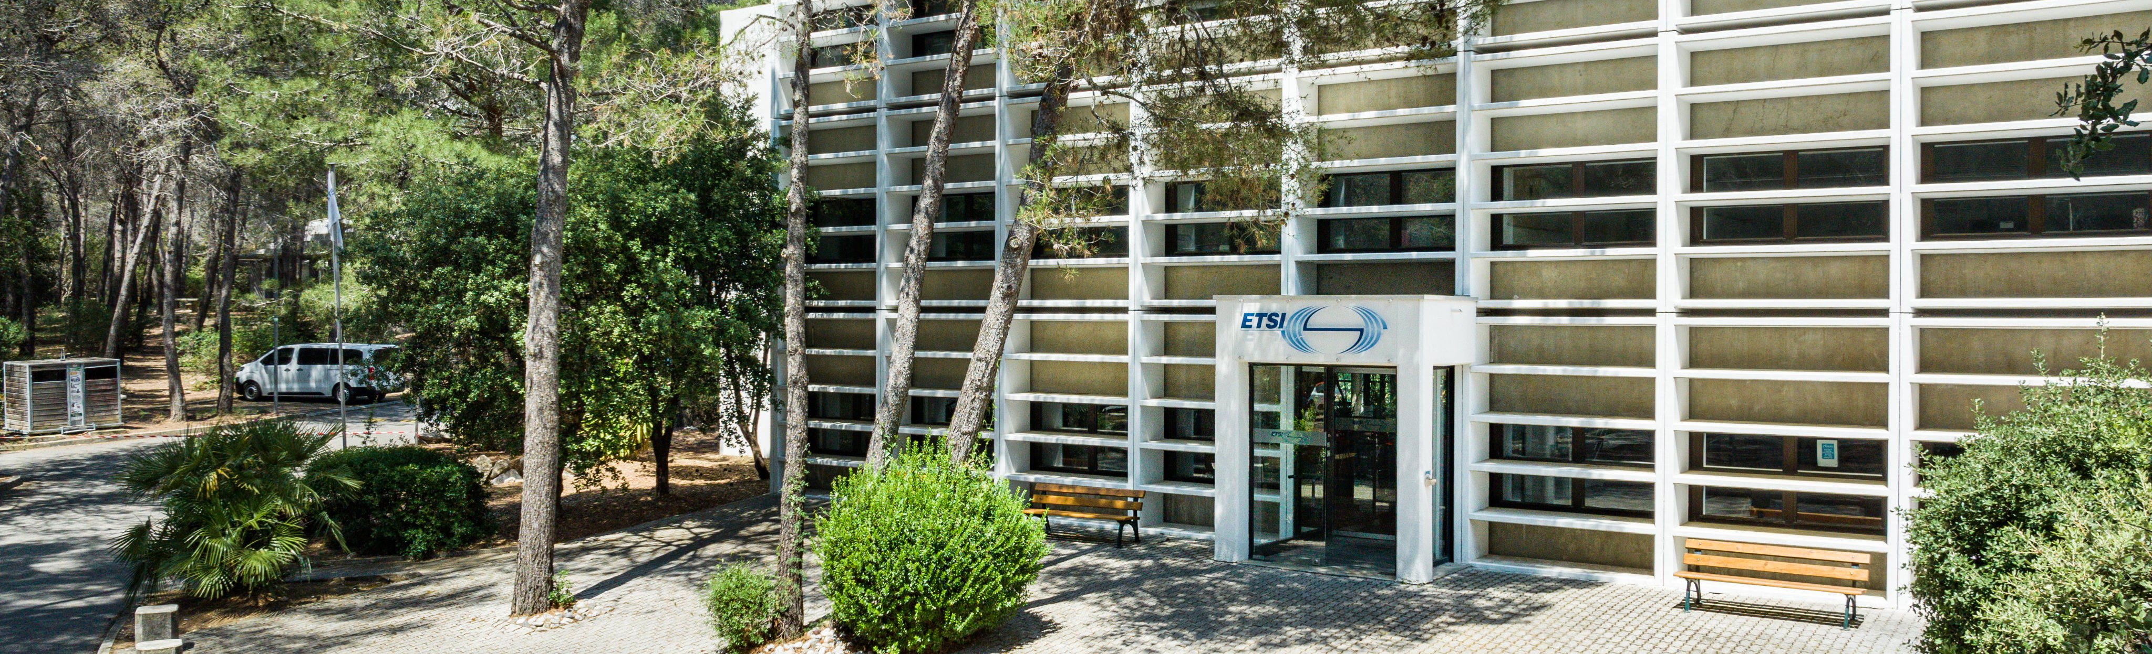


The guide for a smooth
3GPP SA5#159
in ETSI premises (Sophia-Antipolis, France)

Slide 2
Outline
ETSI is happy to welcome you in Sophia Antipolis
The goal of this guide is to describe the architecture of this event: 3GPP SA5. Let’s zoom on the logistic to make your daily life in Sophia-Antipolis much easier.
This guide is dedicated to the 3GPP Delegates and Chairs.

Slide 3

Agenda
Welcome
General Information
Meeting Room Set-up
SA5 meeting rooms
Coffee breaks
Lunch
3GPP wireless
3GPP SA5 social event
Safety instructions
Survey
Summary

Slide 4
Welcome
Welcome from ETSI meeting support team
Meeting Support services
Meeting Support team: Yvette Pachoud
Tel: (+33) 04.92.94.42.50
E-mail: Meetings@etsi.org
Helpdesk for onsite IT support
Opening hours: 08:30 -12:30 and 13:30 -16:30
Tel: (+33) 04.92.94.49.00
E-mail: Helpdesk@etsi.org

Slide 5
General Information
Opening hours & access
The ETSI official opening hours are from 08:00 to 20:00 but 3GPP SA5 gets a special access to the ETSI main building from 07:30 but access is limited to the Lobby area until one of the Chairs or ETSI Staff/MCC is present in the meeting room.
Check-in
Check-in opens from 07:30 on Monday morning. Please anticipate arriving before the start of the meeting as this may take some time if everyone arrives at the same time.

Slide 6
General Information
Check-in process (1/2)
To ease the check-in process, please either prepare your QR code on your phone or print it out for the check in.
Please find below the steps when a delegate arrives in ETSI:
Upon registration for a meeting in face-to-face, the delegate receives a confirmation email that includes a QR code image. This code allows the delegate to do a self-check-in when arriving at ETSI.
The delegate scans the QR code either from a smartphone or from a print of your registration confirmation mail at one of the self-check-in stations. The badge will be printed and the attendance for the meeting is recorded automatically in our database.

Slide 7
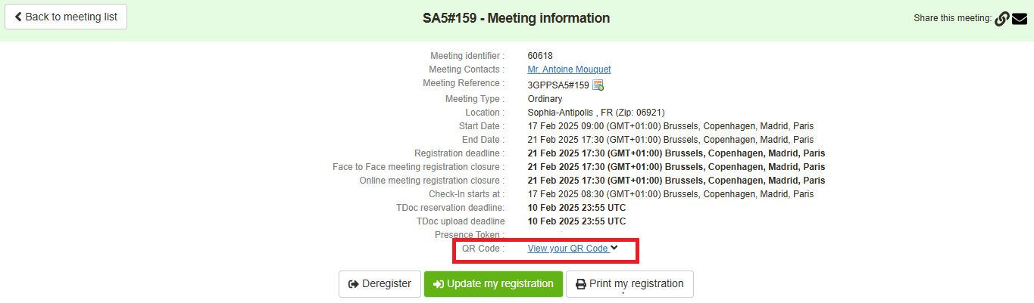
General Information
Check-in process (2/2)
  In case the delegate no longer has the confirmation email sent by noreply@3gpp.org with the following subject “3GPP Registration - 3GPPSA5#159 (Sophia-Antipolis - FRANCE)”, the QR code is easily accessible on 3GU (see example below where to view the QR Code).

Slide 8
General Information
Badges
Access to meeting rooms is NOT allowed without a badge.
Delegates are requested to always wear their badge visibly:
  to show they are eligible to access meeting rooms,
  for security/safety reasons so that delegates/visitors can be identified.
IMPORTANT: You need to print out your badge to record your attendance.
Taxi
  Please contact the ETSI reception

Slide 9
SA5 Meeting Rooms
---------------------------------------------------------
Room 1: AMPHI. ATHENA (SA5 Main, 244 pax)
On Monday morning and Friday
--------------------------------------------------
Room 2: AMPHI. IRIS (SA5 Main, 70 pax)
From Monday afternoon until Thursday evening (if there are enough seats, otherwise, we will need to stay in Amphi. Athena)
--------------------------------------------------
Room 3: IRIS G2AB (OAM breakout, 22 pax)
From Monday until Thursday evening
--------------------------------------------------
Room 4: IRIS G3AB (SWG Charging, 20 pax)
From Monday until Thursday evening

Slide 10
3GPP coffee break & water
3GPP coffee breaks (sponsored by E3MAG): 10:30-11:00 and 15:30-16:00
Where: In the Lobby area
Water
Water fountains to fill in the water jugs are in the main lobby behind the reception and in the jungle, in the corridor next to IRIS G4, in the corridor between IRIS B3 and IRIS B4, and in front of the Amphi. Athena and Amphi. Iris.
Please note that a few kettles will be at your disposal.
A vending machine is available in the lobby area. Cash and credit cards are accepted.

Slide 11
Lunch
Snacking
Walking distance from ETSI premises
“Le Kiosque” food truck The sandwich van is in the area between the two ETSI buildings, you should turn left when you get out from the ETSI Main building and walk 2-3 min.
A Sandwich/Salad is between 5€ and 8€ (credit cards are accepted).
To avoid some queue, it is recommended to grab your lunch before noon. What about at AM coffee break?
Rotisserie Les Lucioles The sandwich van is about 5-minute walk from the ETSI main building.
A Sandwich/Wrap/Hot-Dog is about 8-11€ (credit cards are accepted). Possibility to make an online order before 11:00 am.
Green is better The salad bar is about 5-minute walk from the ETSI main building.
A salad is between 10€ and 14€ (credit cards are accepted).
Possibility to make an online order.

Slide 12
Lunch
Restaurants
Walking distance from ETSI premises
Restaurants Place Sophie Lafitte Sophia Antipolis is about 5-minute walk from the ETSI main building. You should turn left when you get out from the ETSI Main building and once you reach the road, you should turn right.
La Dolce Vita Tel +33 4 83 15 52 83
Sushi For You Tel +33 4 93 67 83 16
KuiSiNe Tel +33 7 84 22 06 27
Ma Dame Nova Tel +33 6 16 66 17 21 (booking in advance is recommended especially if it is not possible to eat ouside)

Slide 13
Lunch (by car)
Restaurant La Boucherie (next to IBIS hotel) - 502 Rue Albert Caquot 06560 Valbonne - Tel +33 4 92 38 43 80 3 mins by car or around 15 minutes walking distance
HillSide Bar Lounge & Resto (Mercure Hotel) - Rue Albert Caquot, 06560 Valbonne - Tel +33 4 92 96 04 04
- 3 mins by car or around 15 minutes walking distance
Restaurant Mouratoglou Hotel - L’embleme (around 5 minutes by car) - 3550 Rte Dolines, 06410 Biot
And many more options in “Espace commercial St-Philippe” (200 Av. Roumanille, 06410 Biot), including a supermarket.

Slide 14

3GPP IT Settings
3GPPWIFI may not be visible and is accessible as a Hidden Network (name to be entered manually).
Wireless LAN
You should select “Hidden Network”
and then enter the following:
  SSID: 3GPPWIFI
  Password: 3GPP3GPPM (CAPITAL LETTERS!)
FTP Server:
  To get access to documents: ftp://172.28.11.2 or http://172.28.11.2
  There is no possibility to upload files outside the 3GPP/ETSI Wi-Fi.

Slide 15
Transportation
Bus (Envibus)
The main buses in Sophia-Antipolis/Antibes/Juan-Les-Pins are A and B.
The closest bus stop to ETSI premises is "Place Sophie Laffitte” (only deserved by Bus B and 09).
If you take bus A, you may want to change buses and take bus B in St-Philippe.
For more details, please have a look at: https://www.etsi.org/find-us

Slide 16
3GPP SA5 social event
Tuesday 18th evening
  Restaurant “L’Aliva" in Sophia Antipolis
  3-course dinner (starter, main and dessert), with drinks
  40€ to be paid at the restaurant

Slide 17
SA5 Group photo
When: Tuesday AM coffee break
Where: In front of the main entrance (if the weather allows it)

Slide 18
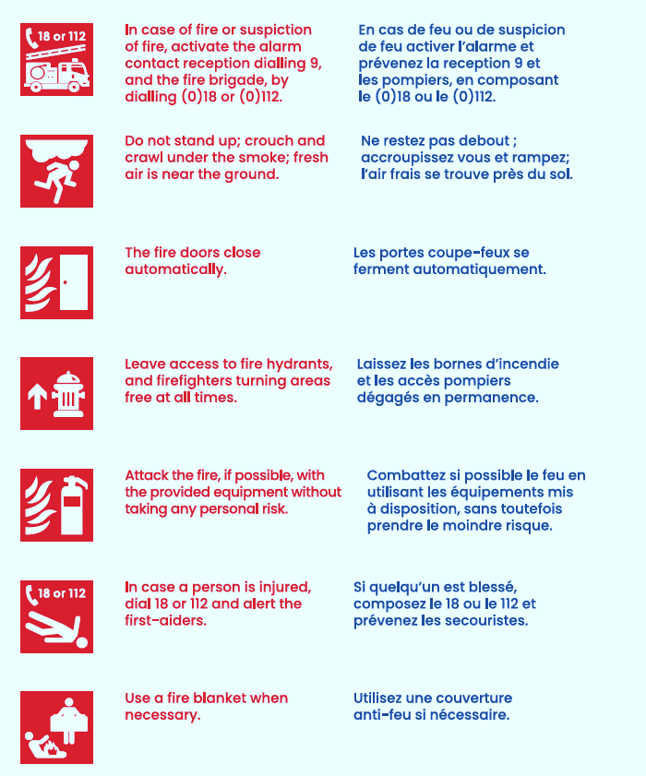
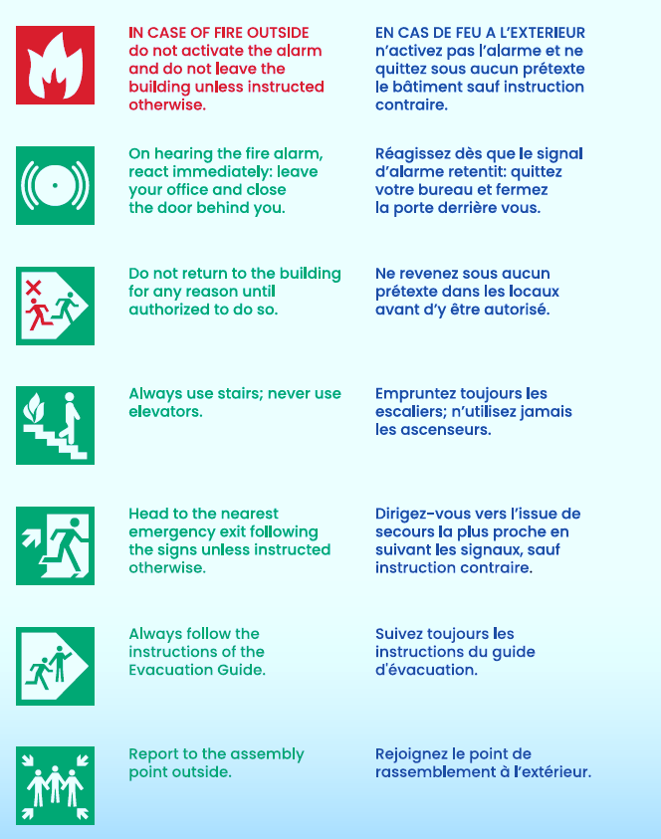
Safety Instructions / Consignes de Sécurité

Slide 19
Summary
ETSI premises is opened from 07:30 to 20:00
Please wear your badges
Coffee breaks at 10:30 and 15:30
If you need a taxi, please contact the ETSI reception Receptionist@etsi.org
IT support needed please contact HELPDESK ETSI Helpdesk@etsi.org
General support please contact ETSI_Meetings Meetings@etsi.org

Slide 20

Summary
Thank You for attending this F2F meeting within ETSI
Have a fruitful meeting in Sophia Antipolis
Take care, stay safe, and travel safe

Slide 21

Thank you for your attention
Follow us on:

