Slide 1
SA5 OAM&P Exec Report SA5#140e, 15 – 24 November, 2021 e-meeting
Zou Lan, SA5 Vice-Chair, HUAWEI
Thomas Tovinger, SA5 Chair, ERICSSON
Mirko Cano Soveri, MCC

Slide 2
Incoming LSs(1/2)
Tdoc | Title | Source | Decision | Reply In
S5-216013 | Resubmitted LS cc SA5 on Prioritized Vehicle to Cloud Technical Solutions | Automotive Edge Computing Consortium (AECC) | replied to | S5-216412
S5-216014 | Resubmitted LS on Guidelines on Port Allocation for New 3GPP Interfaces | C4-214848 | postponed
S5-216015 | Resubmitted LS on slicing management aspects in relation to SEAL | S6-210709 | postponed
S5-216016 | Resubmitted LS on the mapping between service types and slice at application | R3-212904 | replied to | S5-216414
S5-216017 | Resubmitted Reply LS on Inclusive language for ANR | R2-2108869 | replied to | S5-216197
S5-216018 | Resubmitted Reply LS on Inclusive Language for ANR | R3-214289 | noted
S5-216019 | Resubmitted Reply LS on QoE configuration and reporting related issues | R3-214471 | replied to | S5-216415
S5-216020 | Resubmitted LS on RAN3 agreements for NR QoE | R3-214477 | postponed
S5-216021 | Resubmitted LS on the Beam measurement reports for the MDT measurements | R3-214519 | replied to | S5-216628
S5-216022 | Resubmitted LS on Network slice information from OAM | S2-2106634 | replied to | S5-216416
S5-216023 | Resubmitted LS on TS 28.404/TS 28.405 Clarification | S4-211234 | postponed
S5-216024 | Resubmitted LS Reply on QoE report handling at QoE pause | S4-211290 | replied to | S5-216417
S5-216025 | Resubmitted Reply LS on Inclusive language review | SP-211140 | noted
S5-216026 | LS ccSA5 on updating the readme.md file in 3GPP Forge | C4-215475 | replied to | S5-216413
S5-216027 | LSccSA5 on updating the readme.md file in 3GPP Forge | C3-215408 | noted
S5-216028 | LS reply on UPF reporting for redundant transmission on transport layer | S2-2107862 | noted
S5-216029 | Reply LS on UPF reporting for redundant transmission on transport layer | C4-215505 | noted
S5-216030 | Reply LS on PSCELL ID availability in SGW CDR | ETSI TC LI | noted

Slide 3
Incoming LSs(2/2)
Tdoc | Title | Source | Decision | Reply In
S5-216031 | LIAISON STATEMENT TO 3GPP TSG SA AND SA6 (forwarded to SA5) - APT REPORT ON EMERGING CRITICAL APPLICATIONS & USE CASES OF IMT FOR INDUSTRIAL, SOCIETAL AND ENTERPRISE USERS | APT Wireless Group | postponed
S5-216032 | LSout to 3GPP SA5 about MANO performance measurements accuracy to estimate VNF energy consumption | ETSI ISG NFV | replied to | S5-216419
S5-216033 | LS on introducing NR RedCap Indication | S2-2107853 | postponed
S5-216034 | LS Reply ccSA5 on the offline charging only indication | S2-2107863 | noted
S5-216035 | LS on MINT functionality for Disaster Roaming | S2-2108172 | postponed
S5-216036 | LS on network slice management service consumption | S6-212460 | postponed
S5-216418 | Liaison Multi-SDO Autonomous Networks (AN) Formal Liaison: 22nd November 2021 Meeting Invitation, Agenda, Bridge, and Meeting Schedule Ref AN-SDO2021-13 | TMF | postponed

Slide 4
Outgoing LSs
Tdoc | Title | To | Cc | ReplyTo
S5-216628 | Reply to: LS on the Beam measurement reports for the MDT measurements | RAN3 | RAN2 | S5-216021
S5-216197 | Reply to: Resubmitted Reply LS on Inclusive language for ANR | RAN2 | RAN3, RAN, SA | S5-216017
S5-216412 | Reply to: Resubmitted LS cc SA5 on Prioritized Vehicle to Cloud Technical Solutions | Automotive Edge Computing Consortium (AECC) | 3GPP TSG SA，3GPP SA WG1, 3GPP SA WG2, 3GPP SA WG6 | S5-216013
S5-216413 | Reply to: LS ccSA5 on updating the readme.md file in 3GPP Forge | CT3, CT4 | SA, CT, CT1, SA4 | S5-216026
S5-216414 | Reply to: LS on the mapping between service types and slice at application | RAN3 | SA4, RAN2, SA2, CT1 | S5-216016
S5-216415 | Reply to: Reply LS on QoE configuration and reporting related issues | RAN3 | SA4,RAN2 | S5-216019
S5-216416 | Reply to: LS on Network slice information from OAM | SA2 | - | S5-216022
S5-216417 | Reply to: LS Reply on QoE report handling at QoE pause | SA4 | RAN2,SA3 | S5-216024
S5-216419 | Reply to: LSout to 3GPP SA5 about MANO performance measurements accuracy to estimate VNF energy consumption | ETSI ISG NFV | SA | S5-216032
S5-216423 | LS to RAN3 on model deployment and update from OAM to NG-RAN | RAN3 | SA2 | S5-215029

Slide 5
Agreed new or Revised Work Items / Study Items
Tdoc | Type | Release | Title | Source | Potential related groups
S5‑216424 | New SID | Rel-18 | New SID on new aspects of EE for 5G networks Phase 2 | Orange
S5‑216425 | New WID | Rel-18 | New WID on enhancements of EE for 5G phase 2 | Orange
S5‑216577 | New SID | Rel-18 | New Rel-18 WID on Enhanced intent driven management services for mobile network | Huawei, Ericsson, China Telecom, CATT, AsiaInfo, China Unicom, China Mobile, ZTE
S5‑216426 | New SID | Rel-18 | New SID on deterministic communication service assurance | Huawei, China Mobile, CATT, China Unicom
S5‑216427 | New SID | Rel-18 | New Rel-18 SID AI/ML management | Intel, NEC, Orange, Verizon, China Telecom, China Unicom, Samsung, CATT, ZTE, AT&T, Deutsche Telekom, Telefónica S.A., Lenovo, Motorola Mobility, China Mobile, US Cellular, AsiaInfo | RAN3， SA2
S5‑216549 | New WID | Rel-18 | New WID on network slicing provisioning rules | Ericsson Inc. | GSMA
S5‑216428 | New SID | Rel-18 | New SID on Network and Service Operations for Energy Verticals | EUTC, Samsung, BMWi, Vodafone, Orange, Novamint
S5‑216429 | New SID | Rel-18 | New SID on evaluation of autonomous network levels | China Mobile, Huawei, AsiaInfo, China Unicom, China Telecom, ZTE, CATT, Lenovo, Motorola Mobility, Intel
S5‑216430 | New SID | Rel-18 | New SID on enhancement of autonomous network levels | China Mobile, Huawei, AsiaInfo, China Unicom, China Telecom, ZTE, CATT, Lenovo, Motorola Mobility, Intel
S5‑216067 | Revised WID | Rel-17 | Revised SID New aspects of EE for 5G networks | Orange
S5‑216068 | Revised WID | Rel-17 | Revised WID Enhancements on EE for 5G networks | Orange
S5‑216348 | Revised WID | Rel-17 | Revised WID Enhancements of Management Data Analytics Service | Intel, NEC
S5‑216595 | Revised WID | Rel-17 | SID revised was SP-210136 SID on enhancement of service based management architecture | Huawei Technologies (Korea)

Slide 6
Work Items / Study Items which need more discussion
S5‑216132 New SID Study on Computing Power Management and Orchestration China Telecommunications
S5‑216182 New SID on alignment with GSMA OPG and ETSI MEC for Edge computing management Huawei, Samsung
S5‑216262 Discussion on digital twin for network management China Mobile
S5‑216264 New SID on Federated machine learning for mobile network management China Mobile
S5‑216306 New R18 SID on Conflict management and coordination Lenovo, Motorola Mobility
S5‑216371 New SID Study on measurement data collection to support RAN intelligence Intel, Verizon, AT&T, CMCC
S5‑216579 New SID on PaaS for Virtualized Network Functions China Mobile
S5‑216578 New SID on intent-driven network slicing management Ericsson

Slide 7
Documents endorsed by OA&M
TDoc | Title | Source | Potential related topics and related groups
S5‑216327 | Correct wording and header | Ericsson France S.A.S
S5‑216547 | Discussion on enhanced MIMO PRB Usage for cell | China Unicom
S5‑216401 | DP on YANG solution set for Inventory | Ericsson Hungary Ltd
S5‑216311 | Enhance Management Service to Support Access Control Procedures | Ericsson LM
S5‑216584 | Discussion Paper on exposure scenario | Alibaba Group, AsiaInfo
S5‑216551 | Discussion on structuring Rel-18 work in SA5 | Orange, Deutsche Telekom, Telefonica, Ericsson, Huawei

Slide 8
OAM General Topics
Working Progress
The following general topics are discussed and approved in the meeting:
S5‑216551 Discussion on structuring Rel-18 work in SA5 Orange, Deutsche Telekom, Telefonica, Ericsson, Huawei
Structure for Rel-18 is as follows:
1. Intelligence and Automation
// Will include functionalities or enablers such as e.g.:
ANL
SON // Will include topics such as e.g. Plug-and-Connect, etc.
Closed loop
Intent
MDA
AI/ML
2. Management Architecture and Mechanisms
SBMA
NRM
Provisioning
Fault Supervision
Performance Assurance
Other management capabilities
3. Support of New Services
5G management exposure
Non-Public Networks
Quality of Experience // Will include such topics as e.g. KQI, SLA, etc.
Business use cases // Will include such topics as e.g. Network and Service Operations for Energy Verticals. etc.
Management aspects of edge computing
Management aspects of network sharing

Slide 9
Overview of Rel-17 SA5 OAM ongoing WIs/SIs
31 ongoing WIs/SIs, 8 finished SIs, 3 finished WIs
20 ongoing WIs, 3 finished WIs, 1 WI wait for SA approval
4 ongoing SIs, 8 finished SIs
 | Rel-17 Operations, Administration, Maintenance and Provisioning (OAM&P)
1 | Additional NRM features | adNRM | 870026
2 | Enhancements of 5G performance measurements and KPIs | ePM_KPI_5G | 880025
3 | Management of MDT enhancement in 5G | e_5GMDT | 870025
4 | Enhancement of QoE Measurement Collection | eQoE | 870027
5 | Management Aspects of 5G Network Sharing | MANS | 900021
6 | File Management | FIMA | 910030
7 | Access control on management service | MSAC | 930010
8 | Enhancement of service-based management architecture | NSA_SBMA | 930009
9 | (finished) Autonomous network levels | ANL | 880027
10 | Intent driven management service for mobile networks | IDMS_MN | 810027
11 | Enhanced Closed loop SLS Assurance | eCOSLA | 870030
12 | (finished) Network policy management for 5G mobile networks | NPM | 860024
13 | Enhancements of Management Data Analytics Service | eMDAS | 850028
14 | Enhancements of Self-Organizing Networks (SON) for 5G networks | eSON_5G | 870028
15 | Generic Plug and connect | PACMAN | 910029
16 | Enhancement of Handover Optimization | E_HOO | 880029
17 | (finished) Enhancements on EE for 5G networks | EE5GPLUS | 870022
18 | Discovery of management services in 5G | 5GDMS | 820035
19 | Management data collection control and discovery | MADCOL | 880028
20 | Management of non-public networks | OAM_NPN | 870023
21 | Enhancement on Management Aspects of 5G Service-Level Agreement | EMA5SLA | 870024
22 | Management of the enhanced tenant concept | eMEMTANE | 880026
23 | Edge Computing Management | ECM | 920019
24 | network slice provisioning enhancement | eNETSLICE_PRO | Wait for SA approval
 | Rel-17 OAM&P Studies
1 | Study on YANG PUSH | FS_YANG | 890017
2 | Study on continuous integration continuous delivery support for 3GPP NFs | FS_CICDNS | 910028
3 | Study on enhancement of service based management architecture | FS_eSBMA | 910031
4 | Study on management aspects of network slice management capability exposure | FS_NSCE | 910026
5 | (finished) Study on autonomous network levels | FS_ANL | 850032
6 | (finished) Study on management and orchestration aspects with integrated satellite components in a 5G network | FS_5GSAT_MO | 830025
7 | (finished) Study on enhancement of Management Data Analytics Service (finished) | FS_eMDAS | 850028
8 | (finished) Study on enhancements of edge computing management | FS_eEDGE_Mgt | 870029
9 | (finished) Study on access control for management service | FS_MNSAC | 890016
10 | (finished) Study on new aspects of EE for 5G networks | FS_EE5G | 870021
11 | (finished) Study on Management Aspects of 5G Network Sharing | FS_MANS | 920018
12 | (finished) Study on network slice management enhancements | FS_NSMEN | 860022

Slide 10
Overview of Rel-18 SA5 OAM ongoing WIs/SIs
14 Rel-18 WIs/SIs waiting for SA approval
 | Rel-18 OAM&P Studies
Intelligence and Automation
1 | New SID on enhancement of autonomous network levels | China Mobile, Huawei | FS_eANL | Wait for SA approval
2 | New SID on evaluation of autonomous network levels | China Mobile, Huawei | FS_ANLEVA | Wait for SA approval
3 | New Rel-18 SID on Enhanced intent driven management services for mobile network | Huawei, Ericsson | FS_eIDMS_MN | Wait for SA approval
4 | New Rel-18 SID AI/ML management | Intel, NEC | FS_AIML_MGMT | Wait for SA approval
5 | Study on Enhancement of the management aspects related to NWDAF | China Telecom | FS_MANWDAF | Wait for SA approval
Management Architecture and Mechanisms
6 | New SID on Fault Supervision Evolution | Huawei,China Mobile | FS_FSEV | Wait for SA approval
Support of New Services
7 | New SID on enhancement on management of NPN | Huawei | FS_OAM_eNPN | Wait for SA approval
8 | New SID on new aspects of EE for 5G networks Phase 2 | Orange | FS_EE5G_Ph2 | Wait for SA approval
9 | New SID on Network and Service Operations for Energy Verticals | Samsung | FS_NSOEV | Wait for SA approval
10 | New SID on Key Quality Indicators(KQIs)for 5G service experience | Huawei | KQI_5G | Wait for SA approval
11 | New SID on deterministic communication service assurance | Huawei | FS_DCSA | Wait for SA approval
 | Rel-18 Operations, Administration, Maintenance and Provisioning (OAM&P)
Intelligence and Automation
1 | New WID on Self-Configuration of RAN Nes | China Mobile, Huawei | RANSC | Wait for SA approval
Management Architecture and Mechanisms
2 | New WID on network slicing provisioning rules | Ericsson | NSRULE | Wait for SA approval
Support of New Services
3 | New WID on enhancements of EE for 5G phase 2 | Orange | EE5GPLUS_Ph2 | Wait for SA approval

Slide 11
Rel-16/Rel-17 CRs
Working Progress
The following topics are discussed in the meeting.
TS 28.310:
[SA5#140e], 6.3-MAINT, GROUP#1(S5-216054/S5-216055) Update energy saving solutions
TS 28.313:
[SA5#140e], 6.3-MAINT, GROUP#2(S5-216323/S5-216324) Correct handover trigger
TS 28.405:
[SA5#140e], 6.3-MAINT, S5-216122 Rel-16 CR TS 28.405 Correct the description of QoE reference and PLMN target
TS 28.532:
[SA5#140e], 6.3-MAINT, S5-216352 Rel-16 CR 28.532 Correct spelling of notifyAlarmListRebuilt
TS 28.533:
[SA5#140e], 6.3-MAINT, GROUP#3(S5-216215/S5-216216) CR TS 28.533 Fix editorial issues
TS 28.535:
[SA5#140e], 6.3-MAINT, GROUP#4(S5-216393/S5-216395) Clarify business requirement and correct punctuation
[SA5#140e], 6.3-MAINT, GROUP#5(S5-216394/S5-216396) Clarify communication service in requirement CSA-CON-06
TS 28.541:
[SA5#140e], 6.3-MAINT, GROUP#6(S5-216207/S5-216208) CR TS 28.541 Correct the wrong reference for TS 32.160
[SA5#140e], 6.3-MAINT, GROUP#7(S5-216244/S5-216245) Fix stage3 definition for plmnId
[SA5#140e], 6.3-MAINT, GROUP#8(S5-216325/S5-216326) Correct maximumDeviationHoTrigger
[SA5#140e], 6.3-MAINT, GROUP#9(S5-216389/S5-216402) Correct spelling of Attribute properties
[SA5#140e], 6.3-MAINT, S5-216039 Rel-17 CR 28.541 Correction of YANG Solution set
[SA5#140e], 6.3-MAINT, S5-216066 Rel-17 CR 28.541 Update 5GC NRM for 5G_DDNMF reference point
[SA5#140e], 6.3-MAINT, S5-216198 Rel-17 CR TS 28.541 Update inclusive language modification for TS 28.541
[SA5#140e], 6.3-MAINT, S5-216246 Rel-17 network slice isolation
[SA5#140e], 6.3-MAINT, S5-216247 network slice protection on N6 interface
[SA5#140e], 6.3-MAINT, S5-216248 network slice specific authentication
TS 28.622:
[SA5#140e], 6.3-MAINT, GROUP#10(S5-216209/S5-216210) CR TS 28.622 Update the scope to be applicable for SBMA
[SA5#140e], 6.3-MAINT, S5-216287 Rel-16 CR 28.622 Add missing definitions of common data types
[SA5#140e], 6.3-MAINT, S5-216347 Rel-16 CR 28.622 Clarify behavior of NtfSubscriptionControl
TS 28.623:
[SA5#140e], 6.3-MAINT, S5-216037 Add new common types for YANG
TS 28.658:
[SA5#140e], 6.3-MAINT, GROUP#11(S5-216211/S5-216212) CR TS 28.658 Update EUTRAN NRM to be applicable for SBMA
TS 28.662:
[SA5#140e], 6.3-MAINT, GROUP#12(S5-216213/S5-216214) Update Generic RAN NRM to be applicable for SBMA
TS 28.552:
[SA5#140e], 6.3-MAINT, GROUP#13(S5-216307/S5-216310) CR 28.552 Correct definition of Distribution of UL UE throughput in gNB
[SA5#140e], 6.3-MAINT, S5-216327 Rel-17 CR 28.552 Correct wording and header
TS 32.160:
[SA5#140e], 6.3-MAINT, S5-216288,Rel-17 CR 28.160 Amend stage 2 NRM specification template
TS 32.422:
[SA5#140e], 6.3-MAINT, GROUP#14(S5-216331/S5-216333) CR 32.422 Update to include Trace Failure admin messages
[SA5#140e], 6.3-MAINT, GROUP#15(S5-216337/S5-216339) CR 32.422 Correction of IP Address of Trace Collection Entity
TS 32.421&TS 32.422& TS 32.423& TS28.623
[SA5#140e], 6.3-MAINT, GROUP#16(S5-216100/S5-216101/S5-216102/S5-216103/S5-216104/S5-216105/S5-216106) Introduce missing interfaces of HSS

Slide 12
Rel-17 WI MADCOL/ePM_KPI_5G/e_5GMDT/eQoE
WI code | WI Title | Completion rate | TS/TR | Tdoc reference | Target date | Rapporteur | Related groups | Related topic
MADCOL | Management data collection control and discovery | 35%->40%->40% | TS28.533/28.532/28.622/ 28.623 | SP-200465 | SA#95 (Mar. 2022) | Nokia | SA2/RAN2/RAN3
ePM_KPI_5G | Enhancements of 5G performance measurements and KPIs | 50%->60%->70%->80% | TS28.552/32.425/28.554/32.426/32.450/32.451/32.455 | SP-200462 | SA#95 (Mar. 2022) | Intel | SA2/RAN2/RAN3
e_5GMDT | Management of MDT enhancement in 5G | 85%->88%->95% | TS32.421/32.422/32.423/28.622/28.623/28.523 | SP-200191 | SA#94 (Dec. 2021) ->SA#95 (Mar. 2022) | Ericsson | SA2/RAN2/RAN3
eQoE | Enhancement of QoE Measurement Collection | 15%->20%->40%->60% | TS28.307/28.308/28.309/28.404/28.405/28.406/28.622/28.623/28.533 | SP-200193 | SA#95 (Mar. 2022) | Ericsson | RAN2/RAN3/SA4
Working Progress
MADCOL:
Discussions on the controversial topics continued. No agreements we made.
eQoE: The following topics are discussed and agreed
Adding Signalling Based Activation for UTRAN and LTE.
Adding Management Based Activation and Temporary stop and restart during RAN overload in NR.
e_5GMDT: The WI e_5GMDT has made the following contributions during this e-meeting:
Add requirement for beam level configuration
Add new parameter for beam level configuration
Update to include trace failure admin messages
Correction of IP Address of Trace Collection Entity
Introduce missing interfaces of HSS
ePM_KPI_5G: Group agreed the measurements related to:
enhanced MIMO PRB Usage for cell
subscriber data management for UDM
parameter provision for UDM
Handover failures per beam related to MRO for intra-system mobility

Slide 13
Rel-17 WI adNRM/MANS/FIMA/ECM/NSA_SBMA
WI code | WI Title | Completion rate | TS/TR | Tdoc reference | Target date | Rapporteur | Related groups | Related topic
adNRM | Additional NRM features | 50%->75%->80% | TS28.540/28.541/28.622/ 28.623 | SP-200192 | SA#94 (Dec. 2021) ->SA#95 (Mar. 2022) | Nokia | SA2/RAN3
MANS | Management Aspects of 5G Network Sharing | 30%->40%->60% | TS 28.541/28.552/32.130 | SP-201080 | SA#95 (Mar. 2022) | China Unicom | RAN2/RAN3
FIMA | New WID on File Management | 60%->65%->75% | TS 28.537/28.622/28.623/28.532 | SP-210135 | SA#94 (Dec 2021) ->SA#95 (Mar. 2022) | Nokia
ECM | Edge Computing Management | 0%->10%->25%->50% | TS 28.538 | SP-210388 | SA#95 (Mar 2022) | Samsung | SA2/SA6/NFV
NSA_SBMA | Improved support for NSA in the service-based management architecture | 0%->10%->20% | TS 28.622/28.623/28.659/28.663 | SP-210858 | SA#95 (Mar. 2022) | Huawei/Ericsson
Working Progress
adNRM: several CRs for NR, 5GC and IMS NRM enhancement were agreed. A few CRs related to association between NRCellDU and Beam, IMS mapping to YANG/YAML, IMA N70/71 stage3 and condition information for threshold monitoring were discussed but were noted or Not pursued.
FIMA: The file retrieval NRM fragment was almost finalized. Good progress was made for the file download NRM fragment.
MANS: the following topic is discussed and agreed:Rel-17 CR TS 32.130 Update RAN sharing scenarios to cover 5G RAN sharing; Rel-17 CR TS 32.130 Update requirments for NG-RAN MOCN network sharing scenarios.
ECM: We agreed to Performance Assurance, ECS and EAS termination and transport view EAS. The target is to complete the work in next meeting. The following topics are approved.
28.538 Import attribute tAI to for Edge NRM.
28.552 Add EAS data volume measurements.
28.538 add MnS information for EAS performance assurance
28.538 add ECS termination procedure
28.538 updating EAS termination procedure
28.538 add Provisioning MnS for Edge Computing
28.538 add transport view for EAS
NSA_SBMA: All proposals for updating the IRP specifications that are used in SBMA were objected.
A discussion paper on YANG solution set for Inventory specifications was endorsed.
A proposal for SBMA supporting management of 5G SA and NSA scenarios was agreed.

Slide 14
Rel-17 WI ANL/IDMS_MN/NPM/eCOSLA/eMDAS
WI code | WI Title | Completion rate | TS/TR | Tdoc reference | Target date | Rapporteur | Related groups | Related topic
ANL | Autonomous network levels | 71%->85%->100% | TS 28.100 | SP-200464 | SA#94 (Dec. 2021) | CMCC | TMF/SA2/RAN3/ZSM | Autonomous network
IDMS_MN | Intent driven management service for mobile networks | 70%->75%->85% | TR28.812/TS 28.312 | SP-180899 | SA#94 (Dec. 2021) ->SA#95 (Mar. 2022) | Huawei | SA2/RAN3/ZSM | Intent
NPM | Network policy management for 5G mobile networks based on NFV scenarios | 78%->85%->100% | TS 28.555/28.556 | SP-191211 | SA#95 (Mar. 2022) | CMCC | SA2/RAN2/RAN3 | Policy
eCOSLA | Enhanced Closed loop SLS Assurance | 60%->70%->80% | TS28.535/28.536/28.533/28.541/28.546/28.552/28.553 | SP-200196 | SA#95 (Mar. 2022) | Ericsson | ZSM/SA2/RAN3 | Closed loop interaction
eMDAS | Enhancements of Management Data Analytics Service | 0%->10%->25%->45% | TS 28.104/ and another new TS (being requested by the revised WID) | SP-210132 -> Revised WID in S5 216348 | SA#94 (Dec. 2021) ->SA#95 (Mar. 2022) | Intel,NEC | SA2/RAN3 | Data analytics
Working Progress
ANL:
Based on Draft TS 28.100-070 EditHelp review version, scope (S5-216256), workflow, tasks, generic autonomous network level description (S5-216257) and Annex A (S5-216217) are updated, all editor's notes are addressed and cleaned up (S5-216258).
The proposal of TS 28.100 2.0.0 presentation to TSG for information and approval (S5-216259) is approved by SA5.
eMDAS: Group agreed the UCs and requirements related to:
Replacement of alarm incident by alarm information
software management
paging optimization
HO optimization
Alignment of terminology
coverage problem analysis
MDA assisted Energy Saving
MDA Request and Control
obtaining MDA output
E2E latency analysis
network slice load analysis
inter-gNB beam selection optimization
slice coverage analysis
Consumer requested ML model training
Producer initiated ML model training
Group also agreed the stage 2 definitions related to:
structure for TS 28.104
MDA capability for coverage problem analysis
NRM for MDA request
IDMS_MN:.
The group discussed several contributions to align the intent concepts and use cases with intent definition (focus on what without how);
The description for Intent Life Cycle Management is rephrased;
The group discussed a package of contributions related to intent model from several companies, and reach an agreement on a generic intent model (mainly for intent Expectation) and an example of Intent Expectation for Radio Network, which are under email approval process;
There is one proposal for introducing TM Forum RDFS Intent model in 3GPP, which is discussed and haven’t reach an agreement, which need further discussion
NPM: Several contributions regarding Stage 2 updates and Stage 3 definiton have been approved/endorsed:
pCR 28.556 Add notificaition definition
pCR 28.556 Change stage 2 information attribute definition
pCR 28.556 update Policy activation and deactivation procedure
pCR 28.556 Add stage 3 definition
pCR 28.556 update PolicyContent definition
eCOSLA: The group has been working on use cases, requirements and solutions. A discussion paper on composite management services was presented. Main topics under discussion are pause-point and reporting. During the meeting good progress was made for the reporting solution.

Slide 15
Rel-17 WI eSON_5G/PACMAN/E_HOO/EE5GPLUS/5GDMS
WI code | WI Title | Completion rate | TS/TR | Tdoc reference | Target date | Rapporteur | Related groups | Related topic
eSON_5G | Enhancements of Self-Organizing Networks (SON) for 5G networks | 70%->85%->90% | TS 28.313/28.552/28.541/28.545 | SP-200194 | SA#94 (Dec. 2021) ->SA#95 (Mar. 2022) | Intel | RAN3 | SON
PACMAN | Generic Plug and connect | 20%->60%->70% | TS 28.313/28.314/28.315/28.316 | SP-210260 | SA#96 (June 2022) ->SA#95 (Mar. 2022) | Ericsson
E_HOO | Enhancement of Handover Optimization | 30%->40%->90% | TS28.552/28.313/28.541 | SP-200466 | SA#95 (Mar. 2022) | Ericsson | RAN3 | SON
EE5GPLUS | Enhancements on EE for 5G networks | 70%->90%->100% | TS28.310/28.552/28.554/28.541 | SP-200188 | SA#94 (Dec. 2021) | Orange | SA2/RAN2/RAN3/ETSI EE/ITU-T/GSMA | Energy saving
5GDMS | Discovery of management services in 5G | 80%->90%->95% | TS 28.533/28.532/531 | SP-181072 | SA#95 (Mar. 2022) | Huawei |  | Service based discovery
Working Progress
eSON_5G: The group agreed CRs to add C-SON CCO control information and beam specific handover counters to MRO, and the conversion of draft CR for LBO SON function to CR. The main issue remain open has to do with how to notify consumers for actions taken by SON functions.
EE5GPLUS:
A Rel-17 CR (Energy Efficiency of the 5GC based on the useful output of 5GC user plane) to TS 28.554 has been agreed
The WID has been revised to reflect what has really been achieved during Rel-17
PACMAN: the following contributions were approved.
Both TS 28.314 and TS 28.315 are completed.
PnC Concepts and Requirements, procedure minor updates
28.316 PnC Data formats - DHCP Request
E_HOO:
Most of Stage 1 is agreed, only two clauses not agreed this meeting. They need to be contributed to next meeting, which is the last for the WI.
Stage 1 is collected in a Draft CR, which needs to be converted to a proper CR for next meeting.
Stage 2 and 3 finished.
Measurements finished.
5GDMS:
Error in YANG solution set is corrected.
A solution for discovery of managed entities was discussed, but agreement could not be reached.

Slide 16
Rel-17 WI OAM_NPN/EMA5SLA/eMEMTANE/eNETSLICE_PRO
WI code | WI Title | Completion rate | TS/TR | Tdoc reference | Target date | Rapporteur | Related groups | Related topic
OAM_NPN | Management of non-public networks | 70%->80%->85% | TS28.557/28.541/28.531/28.533/28.552/28.554 | SP-200189 | SA#94 (Dec. 2021) ->SA#95 (Mar. 2022) | Huawei | SA2/RAN3 | NPN
EMA5SLA | Enhancement on Management Aspects of 5G Service-Level Agreement | 70%->75%->85% | TS28.531/28.541 | SP-200190 | SA#94 (Dec. 2021) ->SA#95 (Mar.2022) | China Mobile | SA2/RAN3 | SLA
eMEMTANE | Management of the enhanced tenant concept | 20%->40%->45% | TS28.531/28.532/28.533/28.541 | SP-200463 | SA#94 (Dec. 2021) ->SA#95 (Mar.2022) | Huawei | SA2 | Tenant
MSAC | Access control for management service | 0%->10%->50% | TS28.533/28.622/28.623/28.532 | SP-210859 | SA#94 (Dec. 2021) ->SA#95 (Mar.2022) | Nokia | SA3
eNETSLICE_PRO | Network slice provisioning enhancement | 0%->0% | TS 28.531/28.541 | S5-215497 | SA#95 (Mar. 2022) | Samsung |  | Slicing
Working Progress
OAM_NPN:
The group agreed the update of NPN management aspects and mode names.
The group needs further discussion on the solutions for SNPN and exposure of management capabilities of PNI-NPN
eMEMTANE: Three CRs and one discussion paper are submitted and discussed. The CRs are not pursued, the discussion paper is noted.
EMA5SLA: Correction of existed stage 2 work, add new features of SLA requirement modification and specific authentication.
MSAC: Made good progress in this meeting. The contributions of stage 1 changes for architecture and management services, workflows and NRM requirements were agreed. However stage 2 and 3 are still missing. Need 1 or 2 more meetings to complete.
eNETSLICE_PRO: The following topics are discussed, but no progress are made in this meeting.
Fixing NetworkSlice and NetworkSliceSubnet Allocation and Deallocation
feasibility check
Asynchronous design

Slide 17
Rel-17 SI FS_EE5G/FS_YANG/FS_CICDNS/FS_eEDGE_Mgt/FS_MANS
WI code | WI Title | Completion rate | TS/TR | Tdoc reference | Target date | Rapporteur | Related groups | Related topic
FS_EE5G | Study on new aspects of EE for 5G networks | 70%->75%->80%->90%->100% | TR 28.813 | SP-200188 | SA#94 (Dec. 2021) | Orange | SA2/EE | Energy saving
FS_YANG | Study on YANG PUSH | 5%->10%->10%->10% | TR 28.818 | SP-200765 | SA#94 (Dec. 2021) ->SA#95 (Mar. 2022) | Ericsson | ONAP | YANG
FS_CICDNS | continuous integration continuous delivery support for 3GPP NFs | 0%->15%->30%->50%->75% | TR 28.819 | SP-210133 | SA#94 (Dec. 2021) ->SA#95 (Mar.2022) | Lenovo, China Mobile | ETSI NFV
FS_eEDGE_Mgt | Study on management aspects of edge computing | 75%->90%->100% | TR 28.814 | SP-200195 | SA#93 (Sep. 2021) | Intel | SA6 | edge
FS_MANS | Study on Management Aspects of 5G Network Sharing | 5%->90%->100% | TR 28.825 | SP-210387 | SA#94(Dec2021) | China Unicom | RAN3
Working Progress
FS_CICDNS:
Most solutions and initial recommendation of the TR were approved after some discussions. Finalization work needs to be done on certain concepts particularly the overall procedure of testing.
FS_MANS: the following topic is discussed and agreed:
four pCRs for TR 28.825 Add concepts and overview, conclusions and recommendations, references and abbreviation.
FS_EE5G: the following pCRs have been approved:
TR 28.813 has received final updates (Add conclusion to Key Issue #3, Update solution of Key Issue 6, Update impact on normative work of Key Issue 4)
A pCR to introduce an EE KPI definition for URLLC network slice based on reliability was discussed but could not be approved
The SID has been revised to reflect what has really been achieved during Rel-17
TR 28.813 is sent to SA for approval
FS_YANG: No progress for FS_YANG this meeting.

Slide 18
Rel-17 SI FS_NSMEN/FS_eSBMA/FS_MNSAC/FS_NSCE
WI code | WI Title | Completion rate | TS/TR | Tdoc reference | Target date | Rapporteur | Related groups | Related topic
FS_NSMEN | Study on network slice management enhancements | 90%->95%->100% | TR 28.811 | SP-191192 | SA#94 (Dec. 2021) | Huawei, Nokia | SA2/RAN3 | SLA
FS_eSBMA | Enhancement of service based management architecture | 10%->15%->35% | TR 28.925 | SP-210136 | SA#94 (Dec. 2021) ->SA#95(Mar.2022) | Huawei, Ericsson | ETSI ZSM | architecture
FS_MNSAC | Study on access control for management service | 35%->80%->100% | TR 28.817 | SP-200853 | SA#93 (Sep. 2021) | Nokia | SA3 | security
FS_NSCE | Study on network slice management capability exposure | 25%->40%->65% | TR 28.824 | SP-210131 | SA#94 (Dec. 2021) ->SA#95(Mar.2022) | Alibaba | SA3, SA, RAN | exposure
Working Progress
FS_NSMEN:
Solution for national roaming was agreed.
Minor editorial cleanup was agreed.
To be presented to SA#94e for approval.
FS_eSBMA: Following agreements were made:
Modelling of MnFs,
Conclusion and proposed solution for SBMA supporting management architecture and frameworks in other SDOs that nothing more needs to be done.
Adding problem description and potential solution for modelling of MnF.
FS_MNSAC:
Several CRs and a discussion paper were discussed in the meeting. Although all CRs were noted but agreement was made on discussion paper regarding general access control services and workflow, which should be applicable for both OpenAPI and Netconf solutions.
FS_NSCE: Several contributions regarding use cases, requirements and general concepts have been approved/endorsed:
S5-216583 Clarifications on clause 4 overview
S5-216584 Discussion paper on exposure scenario
S5-216616 Add Use Case for exposure without going through BSS
S5-216617 Exposure of network slice as a service
S5-216624 Consolidate potential requirements of use cases for eMnS discovery service
S5-216585 Add procedures related to product onboarding
S5-216586 Clarification on clause 5 use cases
S5-216385 Clarification on clause 7 solutions
Several contributions regarding are still under email approval:
S5-216582 Concept definition for Exposed Management Service
S5-216623 Exposure to SA6 application or middleware
S5-216625 Add text to procedures related to management capability exposure

Slide 19
List of latest DraftCRs
Tdoc# | Title | Source Company | Rapporteur | Agenda
S5-213674-> S5-215622 | DraftCR for eCOSLA - TS 28.535 | Ericsson | Jan Groenendijk | 6.4.12
S5-215550->S5-216596(email approval) | DraftCR for eCOSLA - TS 28.536 | Ericsson | Jan Groenendijk | 6.4.12
S5-211487->S5-215651->NA | DraftCR for eSON_5G – TS 28.313 | Intel | Joey | 6.4.13
S5-214653-> S5-216621 (email approval) | DraftCR for E-HOO - TS 28.313 | Ericsson | Per Elmdahl | 6.4.14
S5-214654->S5-215055->NA | DraftCR for 5GDMS - TS 28.533 updated to version 17.0.0 | Huawei | Brendan | 6.4.16
NA | DraftCR for 5GDMS - TS 28.537 | Huawei | Brendan | 6.4.16
S5-214655->S5-215056->NA | DraftCR for 5GDMS - TS 28.622 updated to version 16.9.0 | Huawei | Brendan | 6.4.16
S5-214656->S5-215057->NA S5-216090 | DraftCR for 5GDMS - TS 28.623 updated to version 16.9.0 | Huawei | Brendan | 6.4.16
S5-214759 | DraftCR for eQoE - TS 28.405 | Ericsson | Robert Petersen | 6.4.5
S5-215364 | DraftCR for MADCOL TS 28.622 | Nokia | Olaf Pollakowski | 6.4.8
S5-215492 | DraftCR for MADCOL TS 28.537 | Nokia | Olaf Pollakowski | 6.4.8
S5-214592 | DraftCR for FIMA TS 28.537 | Nokia | Olaf Pollakowski | 6.4.20
S5-214758->S5-216597(email approval) | DraftCR for FIMA TS 28.622 | Nokia | Olaf Pollakowski | 6.4.20

Slide 20
Rapporteur calls (draft plan after SA5#140e)
Rapporteur calls | Date Time | Potential Topics
#140e.1 | Dec.2nd 14:00 CET~16:00 CET | Generic asynch mechanism (SA5-216252rev1_BL) (Robert) All Rel-17 Rapporteurs check Rel-17 WI work progress 5G spec structure(6240)
#140e.2 | Dec.9th 14:00 CET~16:00 CET | NSA_SBMA (6164/6165/6392/6580/6581/6618/6619) (Xu Ruiyue, Olaf) MADCOL (Olaf) digital twin study item proposal(S5-216262/S5-216263) (Xiaowen Sun)
#140e.3 | Dec.16th 14:00 CET~16:00 CET | eCOSLA (6406) (Ishan, Jan) MSAC (Ping Jing) Conflict management study proposal (6306) (Ishan)
#140e.4 | Jan.13th 14:00 CET~16:00 CET | Open for topics
Latest update on the rapporteur call agenda in : https://www.3gpp.org/ftp/Email_Discussions/SA5/OAM%20rapporteur%20calls/Rapporteur%20call%20%23140e

Slide 21
TRs / TSs to be sent to SA#94-e
Tdoc | Title | Source | Sent for
S5-216607 | TR 28.811 Study on network slice management enhancement | Huawei | Approval
S5-216606 | TR 28.813 Study on new aspects of Energy Efficiency (EE) for 5G | Orange | Approval
S5-216611 | TR 28.825 Study on management aspects of 5G network sharing | China Unicom | Approval
S5-216599 | TS 28.100 Management and orchestration; Levels of autonomous network | China Mobile | Approval

Slide 22
Exception to be sent to SA#94-e
Tdoc | Title | Source

Slide 23
TRs / TSs to be sent to Edithelp
Title | Source
TR 28.811 Study on network slice management enhancement | Huawei
TR 28.813 Study on new aspects of Energy Efficiency (EE) for 5G | Orange
TR 28.825 Study on management aspects of 5G network sharing | China Unicom
TS 28.100 Management and orchestration; Levels of autonomous network | China Mobile

Slide 24
New action items from this meeting
Item | Description | Rel. | Owner | Status | Target

Slide 25
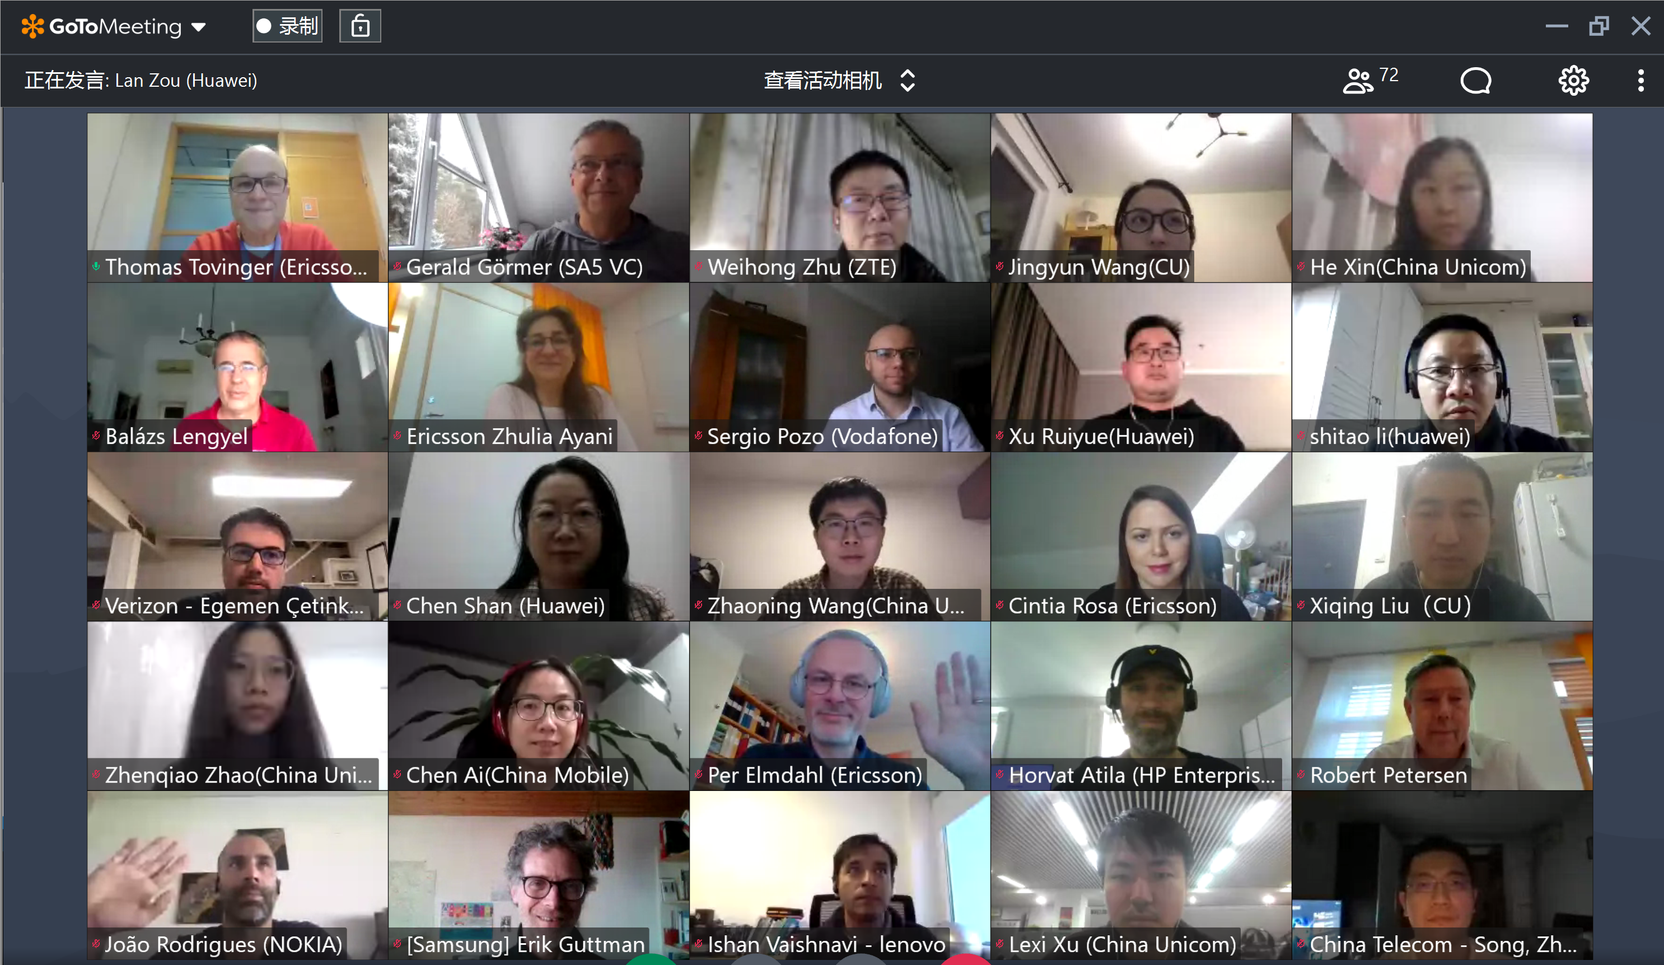
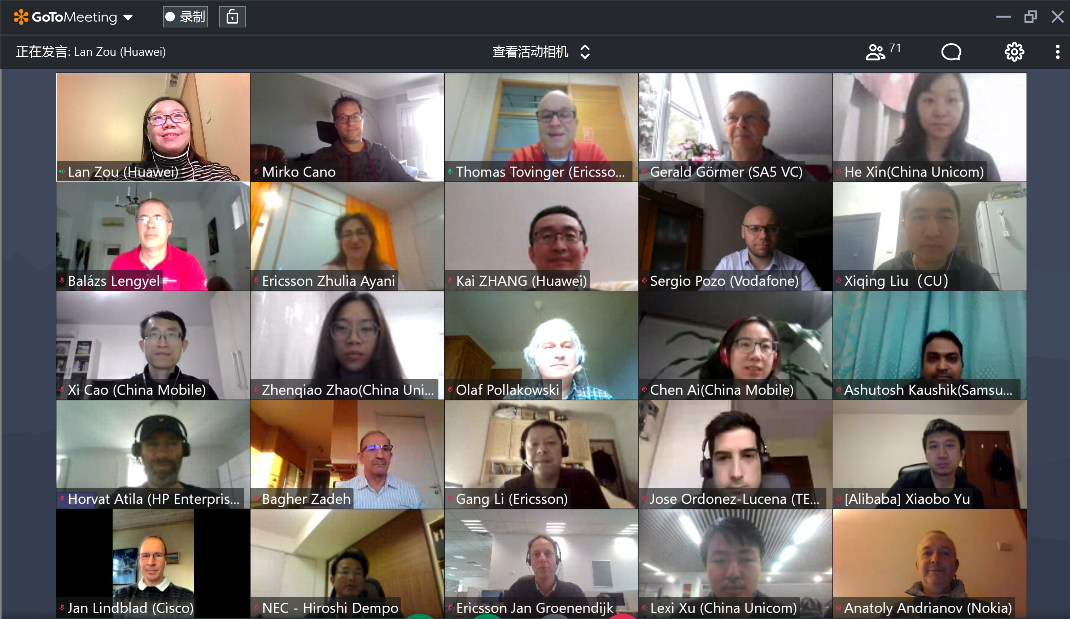
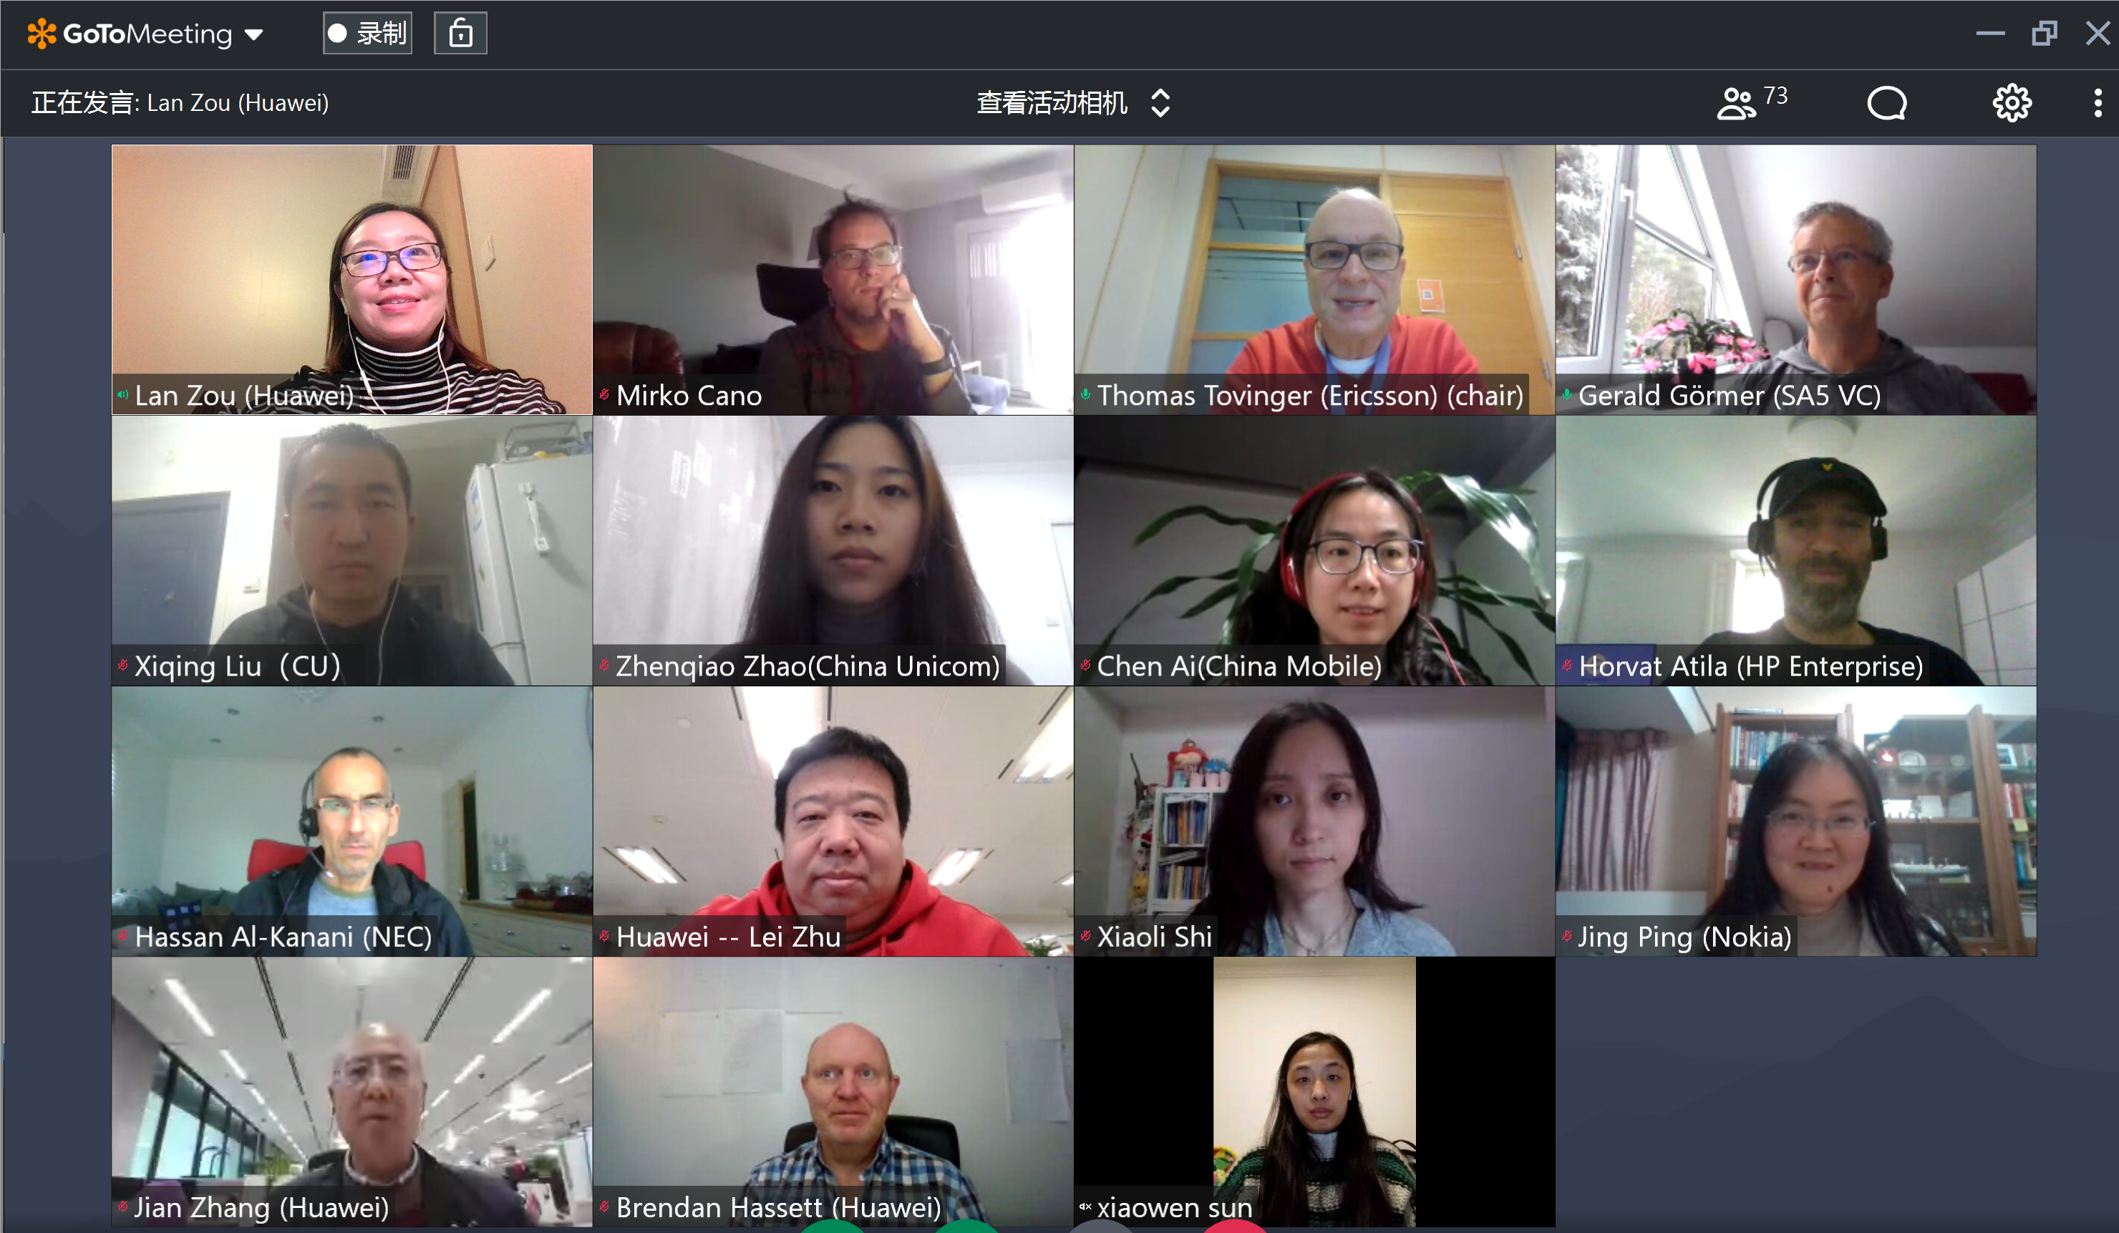
Thank you!

