Slide 1
SA5 OAM&P Exec Report
SA5#138e, 23 – 31 August, 2021 e-meeting
Zou Lan, SA5 Vice-Chair, HUAWEI
Thomas Tovinger, SA5 Chair, ERICSSON
Mirko Cano Soveri, MCC

Slide 2
Incoming LSs(1/2)
Tdoc | Title | Source | Decision | Reply In
S5-214015 | Reply 3GPP LS S5-213444 to TM Forum on Multi-SDO Autonomous Networks | TMF | Noted
S5-214016 | Multi-SDO Autonomous Networks (AN) Formal Liaison: Request for review of Letter of Intent and report on the 21st of June Formal meeting Ref AN-SDO2021-08 | TMF | replied to | S5-214514
S5-214044 | LiaisonMulti-SDO Autonomous Networks (AN) Formal Liaison:21st June 2021 Meeting Invitation, agenda, Bridge, andMeeting Schedule Ref AN-SDO2021-07 | TMF | Noted
S5-214508 | Liaison Multi-SDO Autonomous Networks (AN) Formal Liaison: 16th Aug 2021 Meeting Invitation, agenda, Bridge, and Meeting Schedule Ref AN-SDO2021-08 | TMF | Noted
S5-214511 | Liaison Multi-SDO Autonomous Networks (AN) Formal Liaison: Minutes and Actions 16th Aug 2021 Meeting #9 Ref AN-SDO2021-09 | TMF | Noted
S5-214513 | SDO Matrix update | WG Vice Chair (Huawei) | Endorsed
S5-214514 | Reply to Multi-SDO Autonomous Networks (AN) Formal Liaison: Request for review of Letter of Intent and report | WG Chair | Noted
S5-214013 | Reply 3GPP LS S5-213522 to TM Forum on Intent Management | TMF | Postponed
S5-214024 | LS ccSA5 on 5G capabilities exposure for factories of the future | S2-2104794 | Noted
S5-214025 | LS ccSA5 on 5G capabilities exposure for factories of the future | S6-211497 | Noted
S5-214023 | Reply LS to GSMA Operator Platform Group ccSA5 on edge computing definition and integration | SP-210583 | Noted
S5-214029 | LS reply to SA ccSA5 on GSMA 3GPP Edge Computing coordination | S2-2105034 | Noted
S5-214022 | LS/r on methodology harmonization and REST-based network management framework (reply to 3GPP TSG SA5-S5-213454) | ITU-T SG2 | Postponed
S5-214031 | Reply LS ccSA5 on Clarification on the API design principles | C4-213451 | Noted
S5-214019 | Resubmitted LS on slicing management aspects in relation to SEAL | S6-210709 | Postponed
S5-214045 | LS on initiation of a new work item M.il-AITOM “Intelligence Levels of AI enhanced Telecom Operation and Management” | ITU-T SG2 | Noted
S5-214047 | LS on the new work item on “Requirements and framework of NGNe orchestration enhancements for support computing power network” (Y.NGNe-O-CPN-reqts) | ITU-T SG11 | Noted
S5-214510 | LS on New Whitepaper: “E2E Network Slicing Architecture" | GSMA | Postponed
S5-214021 | Resubmitted LS reply to 3GPP SA5 on Network Slice EE KPIs | GSMA | replied to | S5-214535
S5-214028 | LS on (de)activation and failure handling of NR QMC | R3-212975 | replied to | S5-214186

Slide 3
Incoming LSs(2/2)
Tdoc | Title | Source | Decision | Reply In
S5-214046 | LS/r on Network slice EE KPIs (reply to 3GPP TSG SA5-S5-2063446) | ITU-T SG5 | Noted
S5-214026 | Answer to liaison from 3GPP SA5 EEPS(21)059002 | ETSI TC EE | Noted
S5-214017 | Resubmitted Reply LS on QoE Measurement Collection for LTE | RP-210922 | Noted
S5-214020 | Resubmitted Reply LS to SA5 on network sharing with multiple SSBs in a carrier | R2-2104606 | Noted
S5-214030 | LS ccSA5 on the area handling for QoE during mobility | R3-212976 | Noted
S5-214032 | LS on QoE report handling at QoE pause | R2-2106775 | replied to | S5-214519
S5-214033 | LS on QoE configuration and reporting related issues | R2-2106776 | replied to | S5-214520
S5-214034 | LS on Report Amount for M4, M5, M6, M7 measurements | R3-212961 | replied to | S5-214523
S5-214517 | Reply LS on Report Amount for M4, M5, M6, M7 measurements | R2-2108966 | Noted
S5-214516 | Reply LS on using SA5 Performance Measurements and Trace for centralised PCI management | R2-2108967 | Noted
S5-214035 | LS ccSA5 on requirement for configuration changes of ongoing QMC sessions | R3-212953 | Noted
S5-214036 | LS on the mapping between service types and slice at application | R3-212904 | Postponed
S5-214037 | Reply LS on LS Reply on QoS Monitoring for URLLC | R3-212937 | Noted
S5-214038 | Reply LS ccSA5 to CT4 on Information on the port number allocation solutions | R3-212800 | Noted
S5-214039 | Reply LS ccSA5 on SA WG2 assumptions from conclusion of study on architecture aspects for using satellite access in 5G | R3-212916 | Noted
S5-214040 | Response LS on Handover terminology | R3-212907 | Noted
S5-214041 | Reply LS on the clarification of HO and/or reselection parameters ranges required by MLB | R3-212840 | Noted

Slide 4
Outgoing LSs
Tdoc | Title | Source | To | Cc | Reply To
S5-214514 | Reply to Multi-SDO Autonomous Networks (AN) Formal Liaison: Request for review of Letter of Intent and report | WG Chair | TM Forum, ETSI, GSMA, ONAP, NGMN, CCSA, IEEE, IETF, ITU-T | SA | S5-214016
S5-214535 | LS reply to LS reply to 3GPP SA5 on Network Slice EE KPIs | Orange | GSMA 5GJA | SA | S5-214021
S5-214186 | Reply LS on (de)activation and failure handling of NR QMC | ZTE Corporation | 3GPP TSG RAN3 | SA2 | S5-214028
S5-214519 | Reply LS on QoE report handling at QoE pause | Huawei | RAN2, SA4 | SA3 | R2-2106775
S5-214520 | Reply LS on QoE configuration and reporting related issues | Huawei | RAN2 | SA4, RAN3 | S5-214033
S5-214523 | Reply LS on Report Amount for M4, M5, M6, M7 measurements (reply to 4034) | Nokia | RAN3 | RAN2 | S5-214034
S5-214607 | LS to ETSI NFV on MANO performance measurements accuracy to estimate VNF energy consumption | Orange | NFV | SA | new
S5-214467 | LS to SA3 for progress of security related work in SA5 | Nokia, Nokia Shanghai Bell | SA3 |  | new
S5-214652 | LS to RAN3 on the F1 interface for MOCN network sharing for multiple Cell Identity broadcast scenario | HUAWEI Technologies Japan K.K. | RAN3 |  | new

Slide 5
New or Revised Work Items / Study Items
Tdoc | Type | Release | Title | Source | Potential related groups
S5-214533 | New WID | Rel-17 | new WI proposal for access control on management service | Nokia, Nokia Shanghai Bell
S5-214532 | New WID | Rel-17 | new WID Enhancement of service-based management architecture | Huawei Technologies (Korea), China Telecom, Ericsson
S5-214489 | WID revised | Rel-17 | WID Update Enhancement on Management Aspects of 5G Service-Level Agreement | Ericsson GmbH, Eurolab

Slide 6
Documents endorsed by OA&M
TDoc | Title | Source | Potential related topics and related groups
S5-214526 | SA5 presentation for SA Rel-18 workshop | WG Vice Chair (Huawei) SA5 Chair, WG Vice Chair (Nokia) | SA
S5-214513 | SDO Matrix update | WG Vice Chair (Huawei) | TM Forum
S5-214484 | SA5 working procedures stage2 stage3 alignment | SA5 Vice Chair, SA5 Chair
S5-214051 | Motivations for a potential Rel-18 work item on Energy Efficiency of 5G | Orange | RAN3
S5-214394 | DP on Rel-18 topic for enhance edge computing management | Samsung Electronics Benelux BV | MEC/GSMA
S5-214194 | Discussion on the observations of the issues caused by the updated NetworkSliceSubnet inheritence relationship | Huawei
S5-214225 | Living document of review of GSMA GST SA5#138e | Huawei, China Mobile | GSMA
S5-214754 | R17 DP Way forward for ANL WI | Ericsson Inc.
S5-214365 | Discussion on Requirements, use cases and services for C-PCI | Ericsson France S.A.S
S5-214242 | Discussion paper on the generic principle for EE KPI definition for 5GC | China Telecom Corporation Ltd.
S5-214503 | Discussion paper on acquiring virtual compute resource information | China Telecom Corporation Ltd.
S5-214077 | Discussion paper on 5G exposure | Orange, Ericsson, Huawei, AT&T, Telefonica | TM Forum

Slide 7
OAM General Topics
Working Progress
The following general topics are discussed in the meeting:
S5-214301 Collection of useful endorsed document and external communication documents
S5-214446 R17 CR 32160-h20 Add motivation to requirements
S5-214497 Discussion paper on documentation of UML code
S5-214534 SA5 working procedures stage2 stage3 alignment

Slide 8
Overview of Rel-17 SA5 OAM ongoing WIs/SIs
30 ongoing WIs/SIs, 3 finished SI, 2 WIs for SA approval
21 ongoing WIs, 2 WIs wait for SA approval
9 ongoing SIs, 3 finished SI
 | Rel-17 Operations, Administration, Maintenance and Provisioning (OAM&P)
1 | Additional NRM features | adNRM | 870026
2 | Enhancements of 5G performance measurements and KPIs | ePM_KPI_5G | 880025
3 | Management of MDT enhancement in 5G | e_5GMDT | 870025
4 | Enhancement of QoE Measurement Collection | eQoE | 870027
5 | Management data collection control and discovery | MADCOL | 880028
6 | Management Aspects of 5G Network Sharing | MANS | 900021
7 | File Management | FIMA | 910030
8 | Autonomous network levels | ANL | 880027
9 | Intent driven management service for mobile networks | IDMS_MN | 810027
10 | Network policy management for 5G mobile networks | NPM | 860024
11 | Enhanced Closed loop SLS Assurance | eCOSLA | 870030
12 | Enhancements of Management Data Analytics Service | eMDAS | 850028
13 | Enhancements of Self-Organizing Networks (SON) for 5G networks | eSON_5G | 870028
14 | Generic Plug and connect | PACMAN | 910029
15 | Enhancement of Handover Optimization | E_HOO | 880029
16 | Enhancements on EE for 5G networks | EE5GPLUS | 870022
17 | Discovery of management services in 5G | 5GDMS | 820035
18 | Management of non-public networks | OAM_NPN | 870023
19 | Enhancement on Management Aspects of 5G Service-Level Agreement | EMA5SLA | 870024
20 | Management of the enhanced tenant concept | eMEMTANE | 880026
21 | Edge Computing Management | ECM | 920019
New | new WI proposal for access control on management service | MNSAC | Wait for SA approval
New | new WID Enhancement of service-based management architecture | eSBMA-INSA | Wait for SA approval
 | Rel-17 OAM&P Studies
1 | Study on new aspects of EE for 5G networks | FS_EE5G | 870021
2 | Study on YANG PUSH | FS_YANG | 890017
3 | Study on continuous integration continuous delivery support for 3GPP NFs | FS_CICDNS | 910028
4 | Study on enhancements of edge computing management | FS_eEDGE_Mgt | 870029
5 | Study on network slice management enhancements | FS_NSMEN | 860022
6 | Study on enhancement of service based management architecture | FS_eSBMA | 910031
7 | Study on access control for management service | FS_MNSAC | 890016
8 | Study on management aspects of network slice management capability exposure | FS_NSCE | 910026
9 | Study on Management Aspects of 5G Network Sharing | FS_MANS | 920018
10 | Study on autonomous network levels (finished) | FS_ANL | 850032
11 | Study on management and orchestration aspects with integrated satellite components in a 5G network | FS_5GSAT_MO | 830025
12 | Study on enhancement of Management Data Analytics Service | FS_eMDAS | 850028

Slide 9
Rel-16/Rel-17 CRs
Working Progress
The following topics are discussed and agreed related CRs in the meeting.
TS 28.531:
correction_of_network_slice_subnet_configuration
updating NSSI deallocation
Removing network slice capacity planning
updating NSSI deactivation
Removing Notify Network Slice Subnet Capability Information
updating NSSI allocation
TS 28.532
Remove last occurrences of “-Type” in data type names
Correct definition of the “timeTick” parameter in the File MnS
Alignment the description for streaming data reporting MnS producer
Add missing reference for TS 32.404 and RFC 6901
TS 28.541:
  YANG NR-NRM model structure repair and cleanup
  Deprecate Top-Attr and use Top instead
  Fix incorrect attributes inheritance description
  Remove the attribute definition which is not used
  correction for attribute desrciption of servAttrCom
  Correction of YAML references
  Remove isINEF attribute from NEFFunction IOC
  YANG updates to correct YANG merging problems
  Fix inconsistent clauses and attributes used in TS 38.211 and TS 28.541
  Correction of YANG Solution set for TS 28.541
  Revise description of NextHopInfo and qosProfileRefList attribute in EP_transport IOC
  Moving RIM monitoring related attributes to NRCellDU
  TS 28.541&28.622
  issue caused by the updated NetworkSliceSubnet inheritence relationship
  TS 28.550
  Correction of OpenAPI
  TS 28.552
  Replace Editor's notes with references
  Revise the calculation for average round-trip packet delay between PSA UPF and NG-RAN
  TS 28.622
  Correction for vnfParametersList
  Add missing MnsAgent to class and inheritance diagrams
  Add missing notification type “notifyClearedAlarm” to the attribute “notificationTypes”
  TS 28.623
  YANG Solution set for TS 28.623
  Replace local data type definition for notificationFilter by common filter definition
  Clarify resource id is required and nullable (OpenAPI definitions)
  TS 28.622&28.623
  Correction and clarification of reporting in TraceJob
  Adaptation and cleanup of Trace/MDT related parameters
  TS 32.158
  Correct definitions of resource update
  Clarify query parameters for filtering
  TS 32.160
  Align different (abbreviated) names for support qualifier to “S”
  Change format for NRM stage 3 definition rules from JSON to YAML
  32160-h20 Add motivation to requirements
  TS 32.422
  Introduce missing parameter descriptions related to reporting of Trace/MDT
  Correction and cleanup of Trace/MDT related parameters and procedures

Slide 10
Rel-17 WI MADCOL/ePM_KPI_5G/e_5GMDT/eQoE
WI code | WI Title | Completion rate | TS/TR | Tdoc reference | Target date | Rapporteur | Related groups | Related topic
MADCOL | Management data collection control and discovery | 25%->30%->35% | TS28.533/28.532/28.622/ 28.623 | SP-200465 | SA#93 (Sep. 2021) ->SA#95 (Mar. 2022) | Nokia | SA2/RAN2/RAN3
ePM_KPI_5G | Enhancements of 5G performance measurements and KPIs | 40%->50%->60% | TS28.552/32.425/28.554/32.426/32.450/32.451/32.455 | SP-200462 | SA#93 (Sep. 2021) ->SA#95 (Mar. 2022) | Intel | SA2/RAN2/RAN3
e_5GMDT | Management of MDT enhancement in 5G | 70%->75%->85% | TS32.421/32.422/32.423/28.622/28.623/28.523 | SP-200191 | SA#94 (Dec. 2021) | Ericsson | SA2/RAN2/RAN3
eQoE | Enhancement of QoE Measurement Collection | 15%->20%->40% | TS28.307/28.308/28.309/28.404/28.405/28.406/28.622/28.623/28.533 | SP-200193 | SA#95 (Mar. 2022) | Ericsson | RAN2/RAN3/SA4
Working Progress
MADCOL: The following topic is agreed.
Add requirements for data management
eQoE: The following topics are discussed and agreed
The signalling based activation for UTRAN and LTE is finished.
Proposed to change Rapporteur to Bagher Zadeh
ePM_KPI_5G: Group discussed and agreed the following performance measurements:
measurements related to AF session with QoS for NEF;
measurements related to applying policy for NEF;
measurements related to UCMF provisoning for NEF;
Add PLMN granularity to PDCP SDU data volume measurement per interface for split gNB deployment scenario;
Mean&Maximum CM-Connected subscribers of network slice through AMF;
PFCP session established success rate of one network and one network slice.
e_5GMDT: The following topic is agreed.
Align RAN specification for MDT Event Threshold for SINR

Slide 11
Rel-17 WI adNRM/MANS/FIMA/ECM
WI code | WI Title | Completion rate | TS/TR | Tdoc reference | Target date | Rapporteur | Related groups | Related topic
adNRM | Additional NRM features | 15%->30%->50% | TS28.540/28.541/28.622/ 28.623 | SP-200192 | SA#94 (Dec. 2021) | Nokia | SA2/RAN3
MANS | Management Aspects of 5G Network Sharing | 20%->25%->30% | TS 28.541/28.552/32.130 | SP-201080 | Sep 2021 (SA#93) ->SA#95 (Mar. 2022) | China Unicom | RAN2/RAN3
FIMA | New WID on File Management | 0%->25%->60% | TS 28.537/28.622/28.623/28.532 | SP-210135 | SA#94 (Dec 2021) | Nokia
ECM | Edge Computing Management | 0%->10% | TS 28.538 | SP-210388 | SA#95 (Mar 2022) | Samsung | SA2/SA6/NFV
Working Progress
adNRM: several CRs for 5GC and NR NRM enhancement were agreed, CRs for network slice NRM enhancement were discussed but most of them were noted.
FIMA: Add requirements for file management and Add File control NRM fragment are approved.
MANS: Add NG-RAN sharing individual management use case and requirements is agreed.
ECM: Agreed contributions includes: TS Structure, EAS Lifecycle Management use case, Edge NRM, Scope. Group decided to postpone the EAC LSM procedure for next meeting, Group endorsed on the need of a Rel-18 WID working on fulfilling GSMA OPG requirements.

Slide 12
Rel-17 WI ANL/IDMS_MN/NPM/eCOSLA/eMDAS
WI code | WI Title | Completion rate | TS/TR | Tdoc reference | Target date | Rapporteur | Related groups | Related topic
ANL | Autonomous network levels | 50%->70%->71% | TS 28.100 | SP-200464 | SA#92 (Jun. 2021) -> SA#94 (Dec. 2021) | CMCC | TMF/SA2/RAN3/ZSM | Autonomous network
IDMS_MN | Intent driven management service for mobile networks | 65%->70%->70% | TR28.812/TS 28.312 | SP-180899 | SA#93 (Sep. 2021) -> SA#94 (Dec. 2021) | Huawei | SA2/RAN3/ZSM | Intent
NPM | Network policy management for 5G mobile networks based on NFV scenarios | 65%->78% | TS 28.555/28.556 | SP-191211 | SA#95 (Mar. 2022) | CMCC | SA2/RAN2/RAN3 | Policy
eCOSLA | Enhanced Closed loop SLS Assurance | 30%->50%->60% | TS28.535/28.536/28.533/28.541/28.546/28.552/28.553 | SP-200196 | SA#93 (Sep. 2021)->SA#95 (Mar. 2022) | Ericsson | ZSM/SA2/RAN3 | Closed loop interaction
eMDAS | Enhancements of Management Data Analytics Service | 0%->0%->10% | TS 28.104 | SP-210132 | SA#94 (Dec. 2021) | Intel,NEC | SA2/RAN3 | Data analytics
Working Progress
ANL: Several pCRs regarding ANL use case, generic requirements and some of the corresponding solutions are approved
28.100 Update autonomous network level for fault management
28.100 Update autonomous network level for network optimization with generic requirements, use case and solutions
28.100 Update generic requirements for autonomous network level with some solutions
28.100 Clean-up for some Editor's Notes been addressed
NPM: The following CR topics are discussed and agreed.
pCR 28.556 add policy activation management procedure
pCR 28.556 add policy deactivation management procedure
eMDAS: The following topics are discussed.
The proposals on scope, MDA overview, MDA in management loop, MDA functionality and service framework were agreed.
No agreement was reached on the TS structure, which resulted in many stage 1 and stage 2 contributions could not be agreed.
IDMS_MN: No progress in this meeting due to the discussion on relation with TM Forum.
Key Issue:
During the discussion in SA5, there are two solutions proposed by different companies for intent driven management:
Option#1: Intent driven management can be implemented by CRUD operations/notifications (as MnS component type A) with 3GPP specific intent IOCs (as MnS component type B).
Option#2: Intent driven management can be implemented by the Intent Handling API including set, update, remove, report and probe referring to TM Forum IG1253 (as MnS component type A) with 3GPP specific intent IOC (as MnS component type B).
eCOSLA: The group has been working on new use cases, requirements and solutions, including enhancement of the Rel-16 descriptions. Main topics under discussion are use cases for loop co-ordination, location, reporting and policy in TS 28.535. During the meeting a deeper understanding of the use cases, requirements and solutions has been reached however more work is needed.

Slide 13
Rel-17 WI eSON_5G/PACMAN/E_HOO/EE5GPLUS/5GDMS
WI code | WI Title | Completion rate | TS/TR | Tdoc reference | Target date | Rapporteur | Related groups | Related topic
eSON_5G | Enhancements of Self-Organizing Networks (SON) for 5G networks | 15%->35%->70% | TS 28.313/28.552/28.541/28.545 | SP-200194 | SA#94 (Dec. 2021) | Intel | RAN3 | SON
PACMAN | Generic Plug and connect | 0%->10%->20% | TS 28.313/28.314/28.315/28.316 | SP-210260 | SA#96 (June 2022) | Ericsson
E_HOO | Enhancement of Handover Optimization | 10%->30%->40% | TS28.552/28.313/28.541 | SP-200466 | SA#95 (Mar. 2022) | Ericsson | RAN3 | SON
EE5GPLUS | Enhancements on EE for 5G networks | 30%->55%->70% | TS28.310/28.552/28.554/28.541 | SP-200188 | SA#94 (Dec. 2021) | Orange | SA2/RAN2/RAN3/ETSI EE/ITU-T/GSMA | Energy saving
5GDMS | Discovery of management services in 5G | 70%->80%->90% | TS 28.533/28.532/531 | SP-181072 | SA#93 (Sep-2021) ->SA#95 (Mar. 2022) | Huawei |  | Service based discovery
Working Progress
eSON_5G: The group agreed the following topics:
Add RRM related measurements
Requirements, use cases and services for C-PCI
Add CCO use cases, requirements, information, and procedure.
Correction for the Number of Active Ues measurements
EE5GPLUS: The following topics are discussed and agreed in this meeting
New Energy Consumption KPIs
Update on the solutions for energy efficiency
Update the EE KPI for the URLLC network slice
PACMAN:.
PnC Concepts and Requirements - ConceptAndBackground are agreed.
PnC Procedure, plug and connect procedure, PnC Concepts and Requirements - Specification Requirements need more discussion.
E_HOO: The following topic is agreed.
Two contributions containing input to the draft CR for 28.313 were agreed. The contributions contained Use Cases and Requirements for CHO and DAPS HO.
5GDMS: The following topics are agreed.
Good progress on 28.533 and 28.537, work on these specifications is complete.
28.622 is almost complete, but there is an open issue regarding MnS types.
OpenAPI and YANG solutions sets were added to 28.623.

Slide 14
Rel-17 WI OAM_NPN/EMA5SLA/eMEMTANE
WI code | WI Title | Completion rate | TS/TR | Tdoc reference | Target date | Rapporteur | Related groups | Related topic
OAM_NPN | Management of non-public networks | 35%->50%->70% | TS28.557/28.541/28.531/28.533/28.552/28.554 | SP-200189 | SA#94 (Dec. 2021) | Huawei | SA2/RAN3 | NPN
EMA5SLA | Enhancement on Management Aspects of 5G Service-Level Agreement | 60%->65%->70% | TS28.531/28.541 | SP-200190 | SA#92 (Jun. 2021) ->SA#94 (Dec. 2021) | China Mobile | SA2/RAN3 | SLA
eMEMTANE | Management of the enhanced tenant concept | 15%->15%->20% | TS28.531/28.532/28.533/28.541 | SP-200463 | SA#94 (Dec. 2021) | Huawei | SA2 | Tenant
Working Progress
OAM_NPN: The following topics are discussed and agreed
Requirements of NPN management for 5GC
NRM solution supporting for NPN Identity on NR cell
Requirements for management of SNPN/PNI-NPN
eMEMTANE: No progress in this meeting.
EMA5SLA: several CRs has been agreed and approved
Use of TopSliceSubnetProfile
Remove obsolete coverageArea attribute in TopSliceSubnetProfile
Add survival time to CNSliceProfile
Add radio spectrum support in slicing profiles
Update maxPktSize and determinComm to support UL and DL requirements

Slide 15
Rel-17 SI FS_EE5G/FS_YANG/FS_CICDNS/FS_eEDGE_Mgt/FS_MANS
WI code | WI Title | Completion rate | TS/TR | Tdoc reference | Target date | Rapporteur | Related groups | Related topic
FS_EE5G | Study on new aspects of EE for 5G networks | 70%->75%->80% | TR 28.813 | SP-200188 | SA#94 (Dec. 2021) | Orange | SA2/EE | Energy saving
FS_YANG | Study on YANG PUSH | 5%->10%->10% | TR 28.818 | SP-200765 | SA#93 (Sep. 2021) -> SA#94 (Dec. 2021) | Ericsson | ONAP | YANG
FS_CICDNS | continuous integration continuous delivery support for 3GPP NFs | 0%->15%->30% | TR 28.819 | SP-210133 | SA#93 (Sep. 2021) -> SA#94 (Dec. 2021) | Lenovo, China Mobile | ETSI NFV
FS_eEDGE_Mgt | Study on management aspects of edge computing | 75%->90%->100% | TR 28.814 | SP-200195 | SA#93 (Sep. 2021) | Intel | SA6 | edge
FS_MANS | Study on Management Aspects of 5G Network Sharing | 0%->5% | TR 28.825 | SP-210387 | SA#94(Dec2021) | China Unicom | RAN3
Working Progress
FS_EE5G: The following topics are discussed and agreed in this meeting:
Discussion paper on the generic principle for EE KPI definition for 5GC
introducing the generic 5GC EE KPI
Add conclusion to Key Issue No. 10
Update conclusion of Key Issue No. 4
Conclusion for Key Issue #6
Conclusion and enhanced solution for Key Issue #7
Discussion paper on acquiring virtual compute resource information
FS_eEDGE_Mgt: The group agreed the following topics and agree send TR for approval
Add reference and abbreviation for 5GS enhancements for Edge Computing
Add concept and scenarios for 5GS enhancements for Edge Computing
Add management aspect for 5GS enhancements for Edge Computing
Add Use cases and potential requirements for 5GS enhancements for Edge Computing
Add potential solutions for 5GS enhancements for Edge Computing
FS_YANG: The following topic is agreed.
Analysis on the solution set for management service
FS_CICDNS:
A comprehensive list of use cases for CI-CD support for 3GPP NFs were accepted and we had a good discussion on an initial solution. The next meeting will primarily focus on solutions for most of the existing scenarios and a final set of new scenarios.
FS_MANS: The following topics are agreed.
Skeleton and structure
add NR Cell relation configuration

Slide 16
Rel-17 SI FS_NSMEN/FS_eSBMA/FS_MNSAC/FS_NSCE
WI code | WI Title | Completion rate | TS/TR | Tdoc reference | Target date | Rapporteur | Related groups | Related topic
FS_NSMEN | Study on network slice management enhancements | 40%->80%->90% | TR 28.811 | SP-191192 | SA#93 (Sep. 2021) -> SA#94 (Dec. 2021) | Huawei, Nokia | SA2/RAN3 | SLA
FS_eSBMA | Enhancement of service based management architecture | 0%->10%->15% | TR 28.925 | SP-210136 | SA#94 (Dec. 2021) | Huawei, Ericsson | ETSI ZSM | architecture
FS_MNSAC | Study on access control for management service | 35%->80%->100% | TR 28.817 | SP-200853 | SA#93 (Sep. 2021) | Nokia | SA3 | security
FS_NSCE | Study on network slice management capability exposure | 0%->5%->25% | TR 28.824 | SP-210131 | SA#94 (Dec. 2021) | Alibaba | SA3, SA, RAN | exposure
Working Progress
FS_NSMEN: The following topics are discussed and agreed
To support management data isolation for different NSCs, usecases, potential requirements, and possible solution were added.
To support network slice protection on N6 interface, a possible solution was added.
References and requirement labels were tidied up.
After discussing contributions related to management of a RAN sharing scenario, we were unable to reach agreement.
FS_eSBMA: The following topics are discussed and agreed.
Add conclusion and recommendation for Issue#4
First conclusions agreed for NSA management support and corrections for 28.533.
FS_MNSAC:
solutions, conclusion and recommendation for the study were agreed and plan to finish the study item in this meeting. Presentation sheet for approval of TR 28.817 was submitted to the meeting. In addition, new Rel17 WI proposal based on conclusion of the study was agreed.
FS_NSCE: Several pCRs regarding TR skeleton, concepts, and use case are approved:
28.824 Use case - eMnS discovery service
28.824 eMNs discovery by other systems
28.824 Improve description of roles

Slide 17
List of latest DraftCRs
Tdoc# | Title | Source Company | Rapporteur | Agenda
S5-213674 | DraftCR for eCOSLA - TS 28.535 | Ericsson | Jan Groenendijk | 6.4.12
NA | DraftCR for eCOSLA - TS 28.536 | Ericsson | Jan Groenendijk | 6.4.12
S5-211487 | DraftCR for eSON_5G – TS 28.313 | Intel | Joey | 6.4.13
S5-214653 | DraftCR for E-HOO - TS 28.313 | Ericsson | Per Elmdahl | 6.4.14
S5-213661-> S5-214654 | DraftCR for 5GDMS - TS 28.533 | Huawei | Brendan | 6.4.16
S5-213659->NA | DraftCR for 5GDMS - TS 28.537 | Huawei | Brendan | 6.4.16
S5-213537-> S5-214655 | DraftCR for 5GDMS - TS 28.622 | Huawei | Lei Zhu | 6.4.16
S5-213538-> S5-214656 | DraftCR for 5GDMS - TS 28.623 | Huawei | Lei Zhu | 6.4.16
S5-213660-> S5-214759 | DraftCR for eQoE - TS 28.405 | Ericsson | Robert Petersen | 6.4.5
NA | DraftCR for MADCOL TS 28.622 | Nokia | Olaf Pollakowski | 6.4.8
S5-213673 (to be update to NA if 4525 is agreed) | DraftCR for MADCOL TS 28.537 | Nokia | Olaf Pollakowski | 6.4.8
S5-213451-> S5-214592 | DraftCR for FIMA TS 28.537 | Nokia | Olaf Pollakowski | 6.4.20
S5-214758 | DraftCR for FIMA TS 28.622 | Nokia | Olaf Pollakowski | 6.4.20

Slide 18
Rapporteur calls (draft plan after SA5#137e)
Rapporteur calls | Date Time | Potential Topics
#138e.1 | Sep 16th 15:00 CEST~17:00 CEST | 1. Rel-18 WID/SID discussion
#138e.2 | Sep 23th 15:00 CEST~17:00 CEST | Open

Slide 19
TRs / TSs to be sent to SA#93e
Tdoc | Title | Source | Sent for
S5-214177 | Presentation sheet of TS 28.557 for SA Information | Huawei | Information
S5-214591 | Presentation of TR 28.814 for approval | Intel Corporation (UK) Ltd | Approval
S5-214465 | Presentation sheet for approval of TR 28.817 | Nokia, Nokia Shanghai Bell | Approval

Slide 20
Exception to be sent to SA#91e
Tdoc | Title | Source

Slide 21
TRs / TSs to be sent to Edithelp
Title | Source
TR 28.814 Study on enhancements of edge computing management | Intel Corporation (UK) Ltd
TR 28.817 Study on the access control for management services | Nokia, Nokia Shanghai Bell

Slide 22
New action items from this meeting
Item | Description | Rel. | Owner | Status | Target
138e.1 | CRs (S5-213100/S5-213480) for TS 32.160 are cat-F but they are missing the mirrors in Release 17. | Rel-17 | Olaf | Closed. (S5-214099/S5-214095 are agreed in SA5#138e) | SA5#138e
138e.2 | AP for Ericsson to propose and discuss update of endorsed tdoc in S5-213134.(S5-214218) | Rel-17 | Jan | Open | SA5#139e

Slide 23
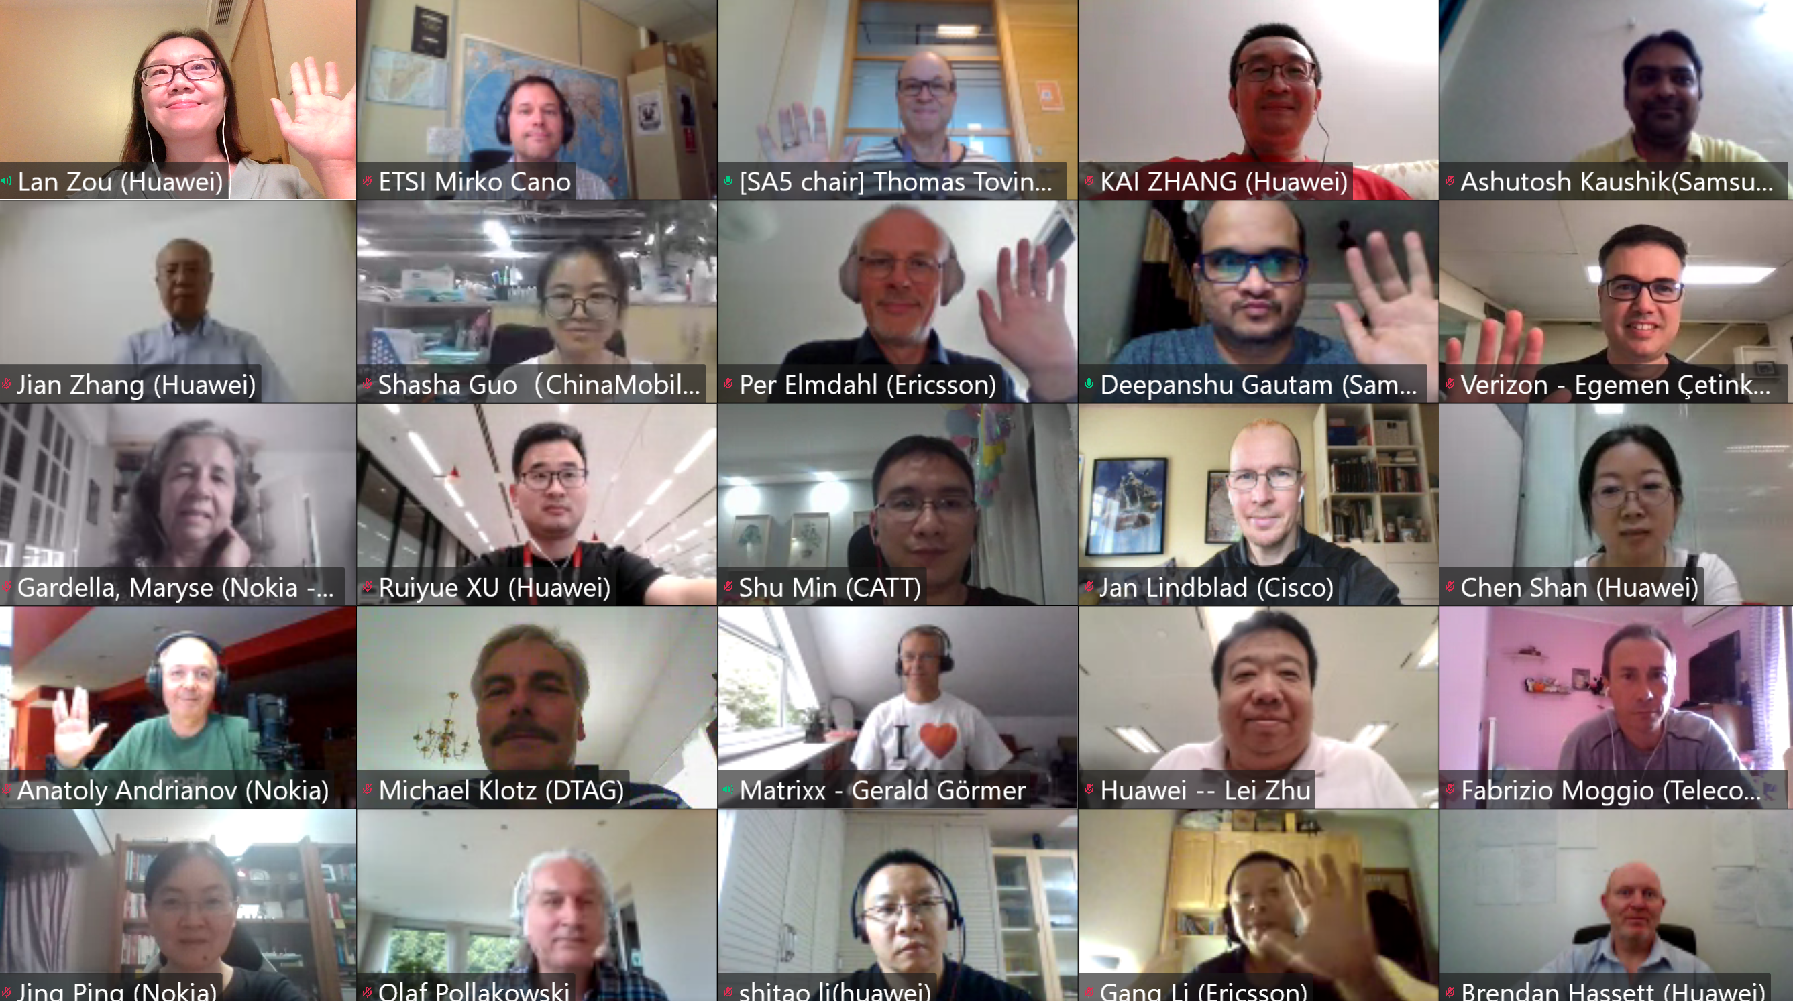
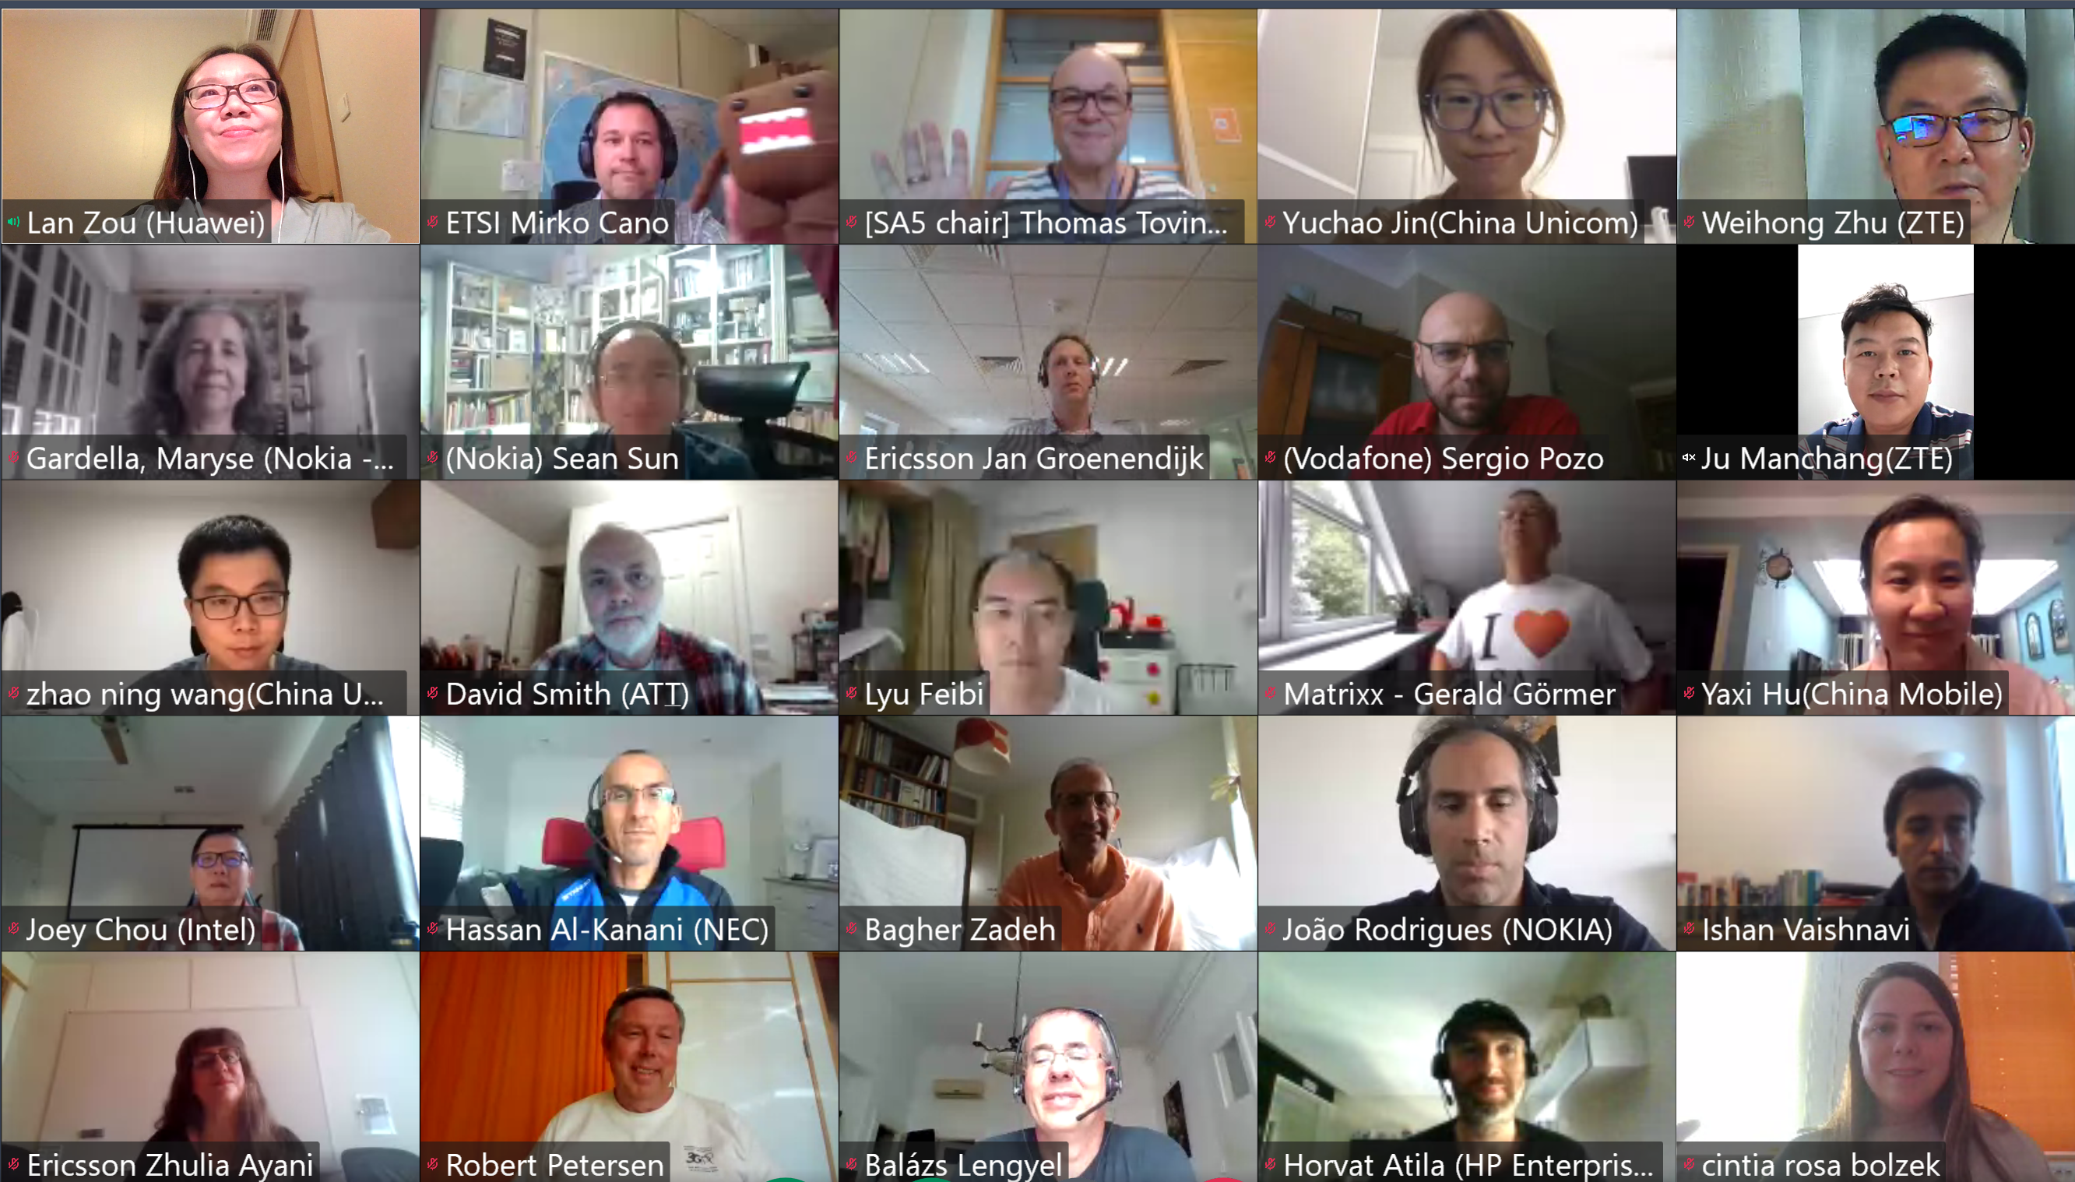
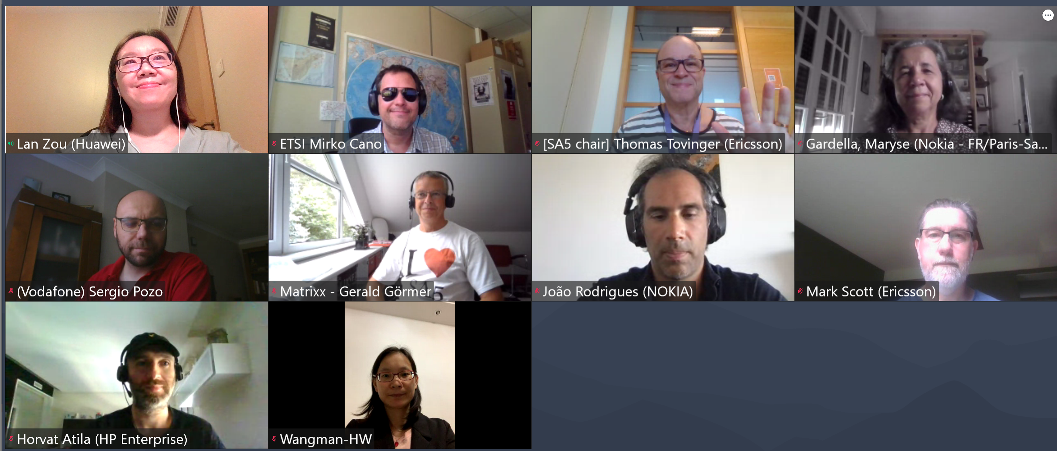
Thank you!

