Slide 1
Release-17 Time Plan Proposal for OAM
SA5#136e, 1 – 9 March, 2021
Zou Lan, SA5 Vice-Chair, HUAWEI
Thomas Tovinger, 3GPP SA5 Chair (Ericsson)

Slide 2
Background
Rel-17 release schedule was discussed in SA and RAN plenary in Dec. 2020 , Rel-17 release schedule were updated in SA#90E (Dec.2020).
We need to align the SA5 work plan with the overall 3GPP release schedule.
This tdoc uses the following references:
  SA#90e: 3GPP Work Plan review at Plenary #90e (SP-201146)
  SA#86 3GPP Newcomer Orientation.pdf
Comments to the time plan proposal are welcome before SA5#136e.

Slide 3
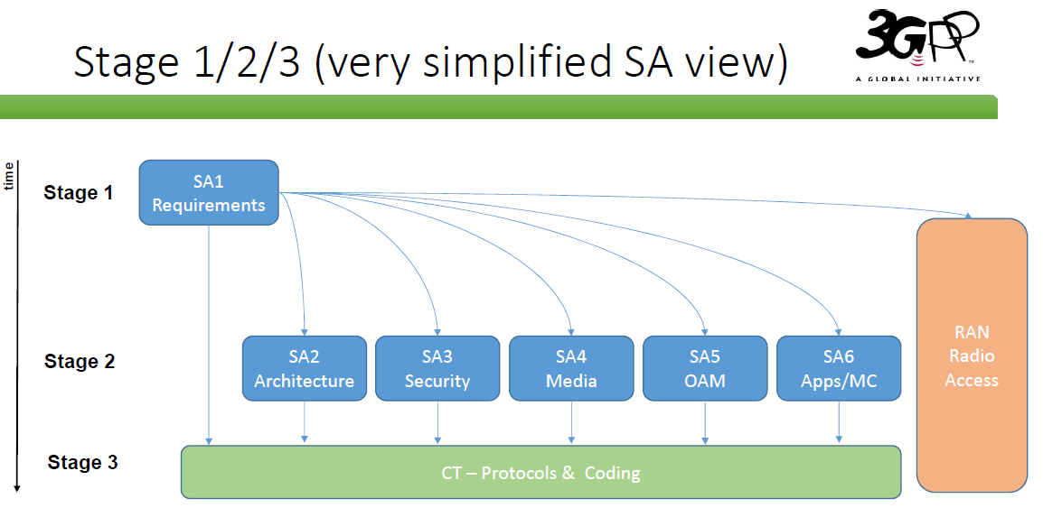
Ref: SA#86 3GPP Newcomer Orientation.pdf

Slide 4

Detailed view of SA5 OAM relation with other groups
GSMA GST
ETSI ZSM
time
SA1
Requirements
1
2
1. SA1 Management requirements refer to SA5 specifications.
2. Take GSMA GST deliverables as input
3. Align the MnS with ZSM
4. ONAP reuses SA5 MnS
5. Collaboration with SA2 on architecture and CN management
6. Collaboration with SA4 on QoE
7. O-RAN reuse SA5 MnS
8. Provide inputs to CT
9. Collaboration with RAN on RAN management
Stage 1
3
SA5 OAM
Stage 1
9
RAN
Radio Access
5
6
SA5 OAM
Stage 2
ONAP
O-RAN
8
4
7
Stage 2
SA2
Architecture
SA3
Security
SA4
Media
SA5 OAM
Stage 3
SA6
Apps/MC
Stage 3
CT – Protocols & Coding

Slide 5
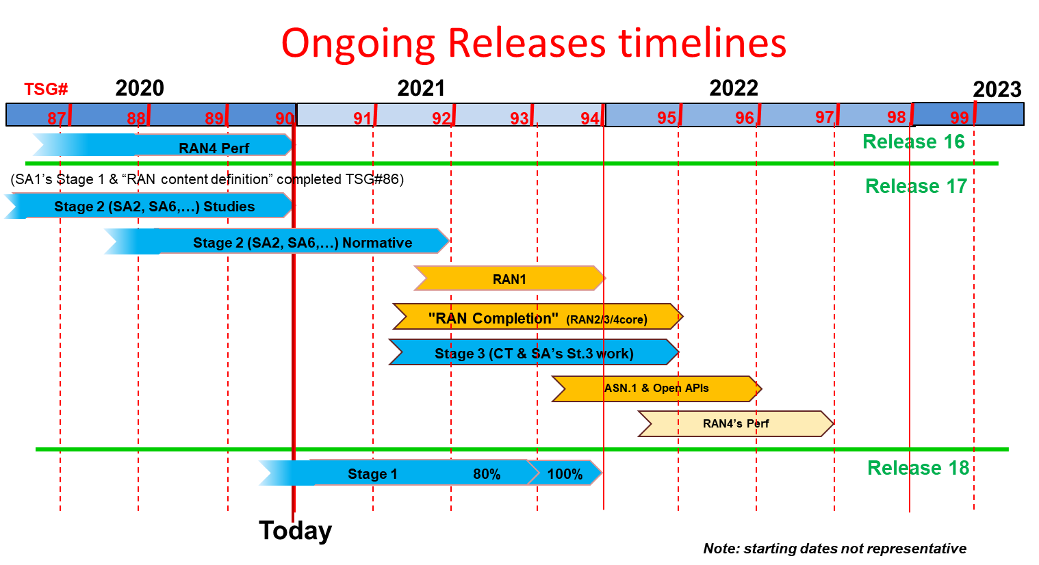
Latest timelines from SA#90e
Ref: SA#90e SP-201146

Slide 6
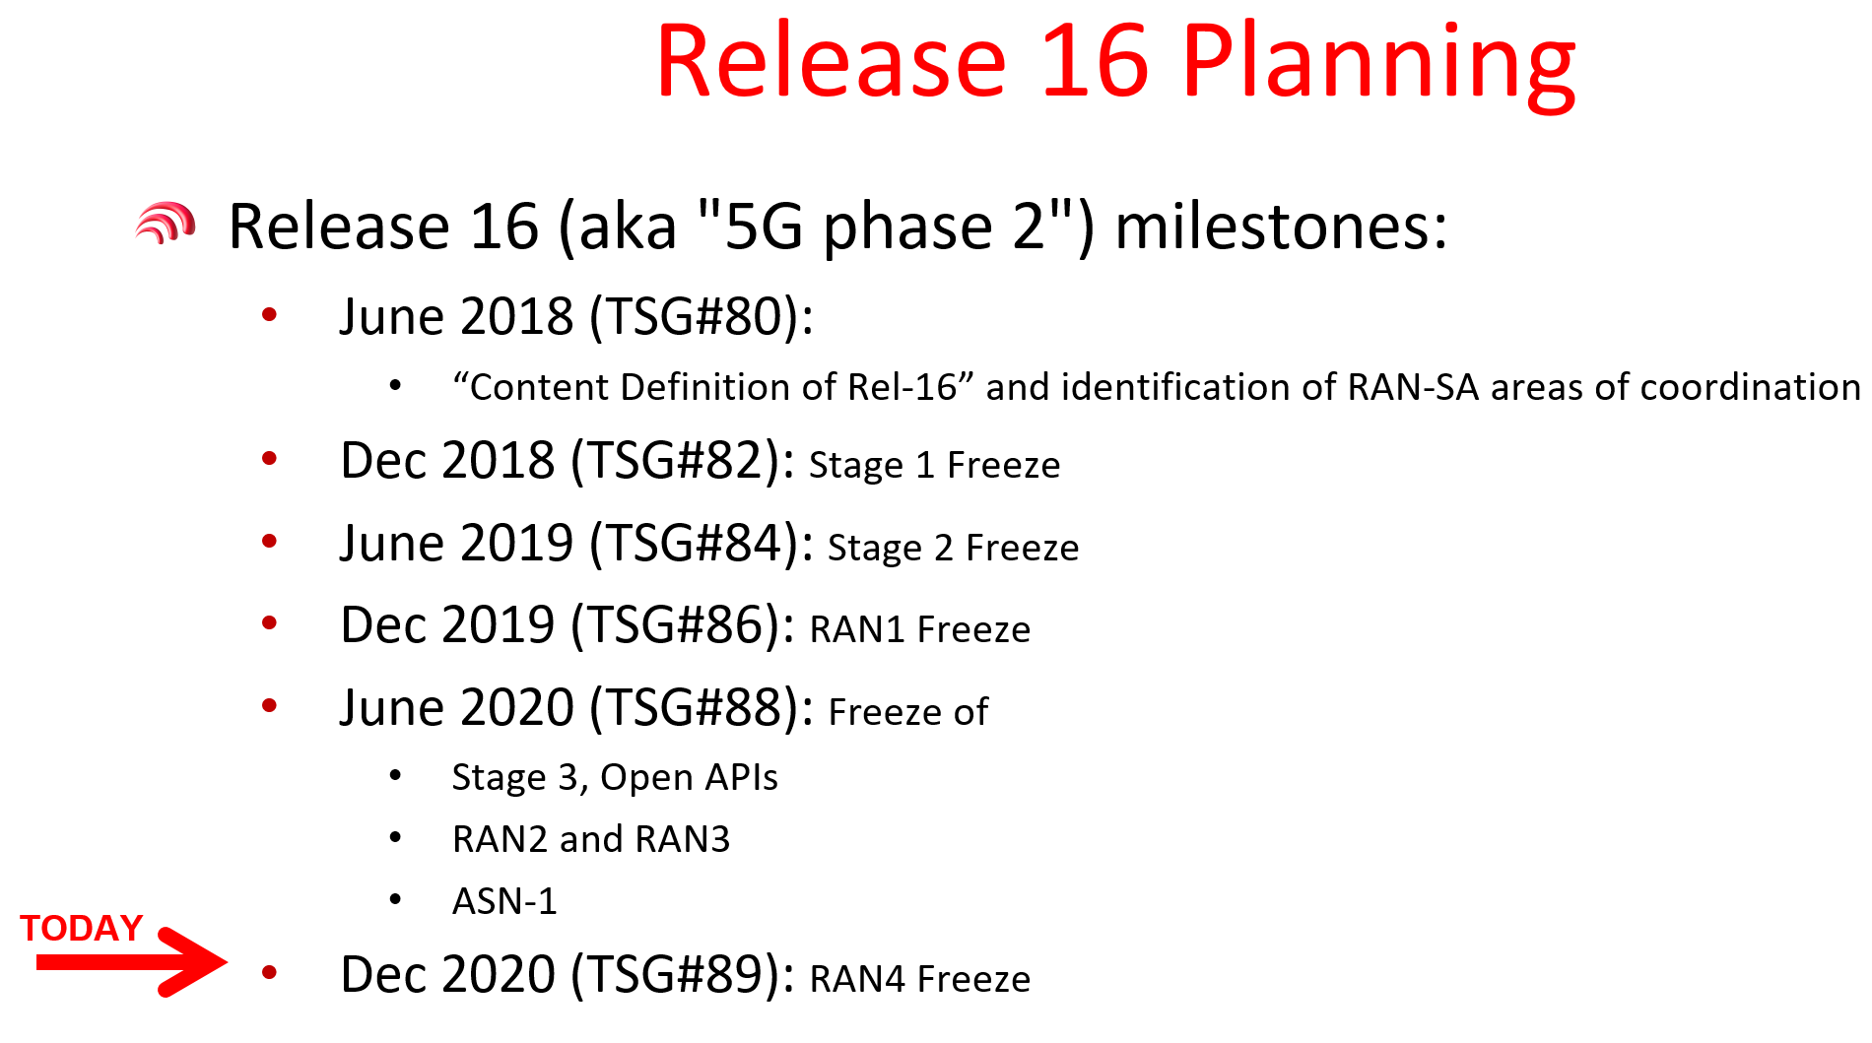
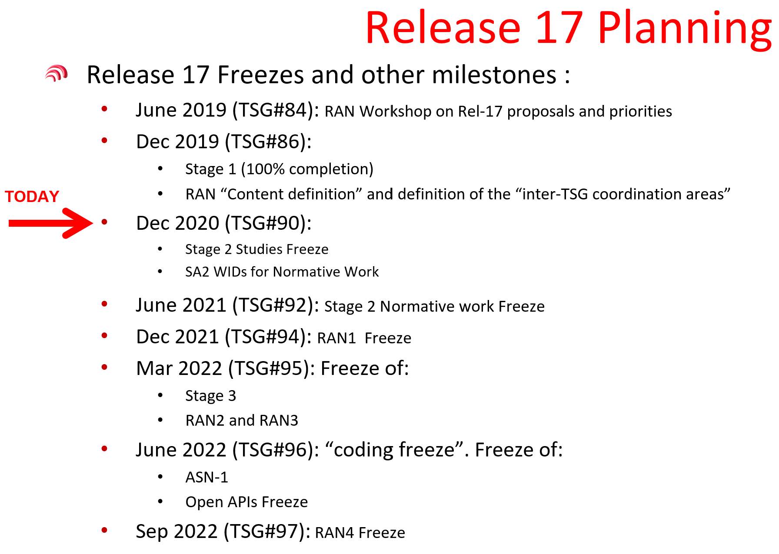
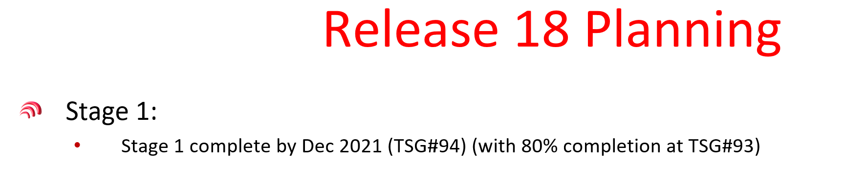
Latest timelines from SA#90e
Ref: SA#90e SP-201146

Slide 7
Consideration on SA5 OAM time planning
1. We should strictly follow the 3GPP release timelines (especially to align the stage 3 freeze date).
2. For the CT related features, we need to provide inputs to CT as early as possible.
3. Management aspects which have no Core/RAN dependency should be addressed as early as possible.
4. Avoid exception requests as much as possible, in case the work could not be completed according to the time plan, either narrow down the scope of the work, or postpone the work to next release.

Slide 8


OAM Release planning with relation to SA/CT/RAN
SA5 OAM Rel-17 plan
  Closure of WI/SI proposal: no new Rel-17 WI/SI is recommended after SA5 #136e.
  Stage 1 freeze: Sep.2021 (9 months later than SA/CT Rel-17 plan)
  Stage 2 freeze: Dec.2021 (6 months later than SA/CT Rel-17 plan)
  Stage 3 freeze: Mar.2022
SA5 Rel-18 plan
  Start of WI/SI proposal: new Rel-18 WI/SI is recommended from SA5 #139e.
  Stage 1 freeze: Jun.2022
SA/CT Rel-17 plan:
Stage 1 and content definition (already completed for a while)
Rel-17 stage 2 freeze (relevant for SA/CT) – June 2021 (TSGs#92)
Rel-17 stage 3 freeze – March 2022 (TSGs#95)
Rel-17 protocol coding freeze (ASN.1, OpenAPI, …) – June 2022 (TSGs#96)
RAN Rel-17 plan:
  RAN1 freeze: Dec.2021
  Stage 3 freeze: Mar.2022
  ASN.1 freeze:
  Jun.2022

Slide 9
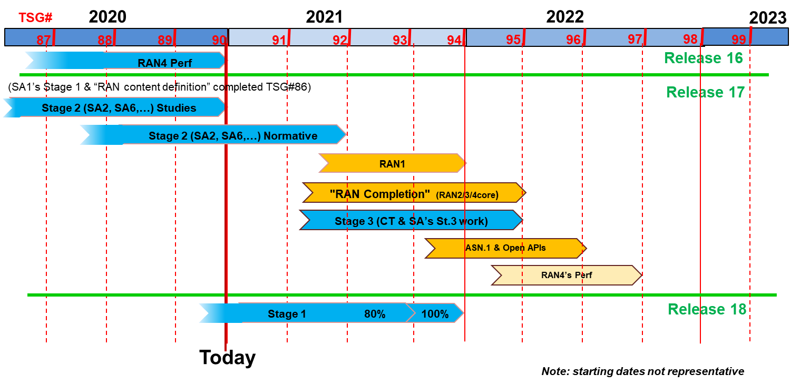
OAM Release planning in accordance with 3GPP releases timelines
SA5 OAM time plan
#135e
#136e
#137e
#138
#139
#140
#141
#142
#143
Rel-17
Schedule
No new R17 WI/SI
R17 stage 1
R17 stage 2
R17 stage 3
Rel-18
Schedule
(preliminary)
R18 stage 1
Start new R18 WI/SI

Slide 10
Leaders’ recommendation for SA5 OAM time planning for endorsement
SA5 OAM Release 17 Freezes and other milestones :
Closure of WI/SI proposal: No new Rel-17 WID/SID proposals to be submitted after SA5 #136e, except for new WIDs which have a corresponding (existing) Rel-17 study item.
Sep.2021 (SA5# 138e): Stage 1 freeze except requirements which supporting other groups
Dec.2021 (SA5# 139e/TSG#94): Stage 2 freeze
Mar.2022 (SA5# 141e/TSG#95): Stage 3 freeze
SA5 OAM Release 18 planning：
Dec.2021 (SA5# 139e/TSG#94): New Rel-18 WID/SID proposals are recommended to start from SA5 #139e.
Jun.2022 (SA5# 142e/TSG#96): Rel-18 Stage 1 freeze
Note:
SA5 stage 1 is currently planned 9 month behind 3GPP Rel-17 stage1 timelines, due to the nature of dependency with Core/RAN progress. The management aspects which have no Core/RAN dependency should be addressed as early as possible.
SA5 stage 2 work is 6 months behind 3GPP Rel-17 stage2 timelines, due to the nature of dependency with Core/RAN progress. The management aspects which have no Core/RAN dependency should be addressed as early as possible.
SA5 stage 3 time plan is aligned with 3GPP overall Rel-17 stage 3 time plan.
Management aspects that need alignment with other WGs should be finalized with the other WGs latest in Dec. 2021.

Slide 11
Thank you!

Slide 12
Change History
SA5 #129e | S5-201349 SA5 Rel-17 time plan proposal for OAM
SA5# 131e | S5-203021 Rel-17 time plan proposal for OAM
SA5# 135e | S5-211081 Rel-17 time plan proposal for OAM
SA5# 136e | S5-212061 Rel-17 time plan proposal for OAM

