Slide 1
SA5 Status Report to SA#87-e
Charging Management (CH)
Operation, Administration, Maintenance & Provisioning (OAM&P)
Thomas TOVINGER, SA5 Chair, Ericsson
Zou Lan, SA5 Vice Chair, Huawei
Maryse Gardella SA5 Vice Chair, Nokia
Mirko CANO SOVERI, SA5 Secretary, ETSI MCC

Slide 2
SA5 leadership
SA5
Thomas Tovinger (Ericsson) Chair since 08/2015
Zou Lan (Huawei) VC since 08/2019
Maryse Gardella (Nokia) VC since 08/2019
  Charging Sub-Working Group (SWG)
Maryse Gardella (Nokia) Chair since 08/2013
Chen Shan (Huawei) VC since 05/2016

Slide 3
2020 meeting calendar
Meeting | Date | City | Country | Host | Co-location
SA5#129e | 24 Feb – 4 Mar 2020 | (f2f Hyderabad cancelled) E-meeting | - | -
SA5#130 | 20-24 Apr 2020 | (f2f Sophia Antipolis cancelled) E-meeting TBD | - | -
SA5#131 | 25-29 May 2020 | (f2f Vilnius cancelled) E-meeting TBD | - | -
SA5#132 | 24-28 Aug 2020 | N.Am. (city TBD) | N.Am. | NAF3
SA5#133 | 12-16 Oct 2020 | N.Am. (city TBD) | N.Am. | NAF3
SA5#134 | 16-20 Nov 2020 | China (city TBD) | China | CF3

Slide 4
Experience of this first e-meeting (1)
General experience
  Quite good progress given the hard conditions of many busy parallel email exchanges (totally about 2000 emails) requiring extra effort compared to f2f meetings: possible thanks to strong involvement of delegates and a well prepared and agreed process.
  About 50% of the ~325 contributions agreed
  Conference calls: Limited in duration to accommodate time zone differences (15-17.00 CET)
CH e-meeting organization & experience
  5 days (24 February – 28 February)
  Reduced Agenda (i.e. limited to critical maintenance CRs and sub-set of Rel-16 WIDs)
  Assigned day for starting Agenda Items threads
  3 Daily conference calls and final CH Closing conference call on Friday (with Webex)
  Conference calls: Used for process clarification, and to decide on WI exception sheets. Allowed one topic to progress based on submitted Discussion paper.
  Phasing start of Agenda Items allowed smoothing emails flood
  Not always easy to finalize conclusions by deadlines for emails.

Slide 5
Experience of this first e-meeting (2)
OAM e-meeting organization & experience
  8 days (24 February – 4 March)
  Reduced Agenda (focus on Rel-16 but a few Rel-17 cross-WG topics and new WIDs included)
  6 Daily conference calls (with GotoWebinar) (used to discuss and progress open issues) and final Closing Plenary conference call the 4th March – to confirm all conclusions and agree on email approvals after the meeting (updated draft TS/TRs, exception sheets and 2 technical issues)
  Found an efficient way to finalize conclusions by deadlines for emails – delegates had to state explicit objections for every not acceptable contribution.
  Still very stressful for the leadership to continuously monitor the status, adjust the process to the reality and to finalise all conclusions the last day due to the amount of emails and contributions.
  We clearly need to reduce the scope in future e-meetings.

Slide 6
Charging (CH) WIs/SIs

Slide 7
Summary of ongoing CH WIs/SIs
WI code | WI Title | Completion rate | Target date
5GSIMSCH | IMS Charging in 5G System Architecture | 30%->30% | Postponed to Rel-17
ETSUN | Charging aspects of Enhancing Topology of SMF and UPF in 5G | 70%->100% | SA#87 (03/2020)
5GS_NSPACH | Network Slice Performance and Analytics Charging in 5G System | 15%->30% | SA#87 (03/2020) => Rel-16 E.R (Exception request)
5GS_NSMCH | Network Slice Management Charging in 5G System | 5%->5% | SA#87 (03/2020) => Rel-16 E.R
ATSSS | Charging Access Traffic Steering, Switching and Splitting in 5G system architecture | 0%-> 15% | SA#87 (03/2020) => Rel-16 E.R
5WWC | Charging Aspect for 5WWC | 0%-> 35% | SA#87 (03/2020) => Rel-16 E.R
CHFCQM | CHF-controlled quota management | 0%-> 50% | SA#87 (03/2020) => Rel-16 E.R

Slide 8
Charging TSs & TRs
Number | Title | For
- | -

Slide 9
Charging WIDs
Number | Title
- | -

Slide 10
Charging Exception requests
Number | Title
SP-200204 | Rel-16 WI Exception for Network Slice performance and Analytics Charging in 5GS
SP-200200 | Rel-16 WI Exception for Network Slice Management Charging in 5GS
SP-200202 | Rel-16 WI Exception for Charging Access Traffic Steering, Switching and Splitting in 5G system architecture
SP-200203 | Rel-16 WI Exception for Charging Aspect for 5WWC
SP-200214 | Rel-16 WI Exception for CHF-controlled quota management

Slide 11
5GSIMSCH
WI code | WI Title | Completion rate | TS/TR | Tdoc reference | Target date | Rapporteur | Related groups | Related topic
5GSIMSCH | IMS Charging in 5G System Architecture | 30%-> 30% | TS 32.240, TS 32.260, TS 32.275, TS 32.281, TS 32.290, TS 32.291, TS 32.298, TS 32.297 | SP-190367 | SA#87 (03/2020) | T-Mobile US | - | -
Working Progress
(Not included in the e-meeting Agenda )

Slide 12
ETSUN
WI code | WI Title | Completion rate | TS/TR | Tdoc reference | Target date | Rapporteur | Related groups | Related topic
ETSUN | Charging aspects of Enhancing Topology of SMF and UPF in 5G | 70%-> 100% | TS 32.255, TS 32.291, TS 32.298 | SP-190880 | SA#87 (03/2020) | China Mobile | - | -
Working Progress
CRs were agreed to TS 32.255 on:
  Introduction of V-SMF change in Roaming HR – principles and flows
  Introduction of additional message flows on:
    Addition of Branching Point or UL CL controlled by I-SMF
    Adding/removal/change of PSA2 and UL CL or BP controlled by I-SMF
    5GS to EPS handover using N26 interface with I-SMF
    EPS to 5GS handover using N26 interface with I-SMF

Slide 13
5GS_NSPACH
WI code | WI Title | Completion rate | TS/TR | Tdoc reference | Target date | Rapporteur | Related groups | Related topic
5GS_NSPACH | Network Slice Performance and Analytics Charging in 5G System | 15%-> 30% | TS 32.240, TS 32.290, TS 32.291, TS 32.298, TS 32.297, TS 28.201 (New) | SP-190780 | SA#87 (03/2020) | Huawei | - | -
Working Progress
pCRs were approved for draft TS 28.201 with:
  Additional information to address performance in charging (Service Experience for a Network Slice, load information both defined in TS 23.288..)
  Introduction of the Bnspa Reference point to the Billing system.
  Introduction of charging principles for charging data collection by the new Entity from MnS Producer and NWDAF, and interaction with CHF.
  Introduction of flow between the new Entity and CHF in Post Event Charging.
  Introduction of preliminary triggers.

Slide 14
5GS_NSMCH
WI code | WI Title | Completion rate | TS/TR | Tdoc reference | Target date | Rapporteur | Related groups | Related topic
5GS_NSMCH | Network Slice Management Charging in 5G System | 5%-> 5% | TS 32.240, TS 32.290, TS 32.291, TS 32.298, TS 32.297, TS 28.202 (New) | SP-190788 | SA#87 (03/2020) | Nokia | - | -
Working Progress
(Not included in the e-meeting Agenda )

Slide 15
ATSSS
WI code | WI Title | Completion rate | TS/TR | Tdoc reference | Target date | Rapporteur | Related groups | Related topic
ATSSS | Charging Access Traffic Steering, Switching and Splitting in 5G system architecture | 0%-> 15% | TS 32.255, TS 32.290, TS 32.291, TS 32.298 | SP-191187 | SA#87 (03/2020) | Nokia | - | -
Working Progress
CRs were agreed to TS 32.255 on:
  Introduction of ATSSS architecture reference and charging requirements
  Introduction of MA PDU session and PCC Rules description
  Introduction of ATSSS flows on Multi-Access PDU session establishment by the UE and by the Network

Slide 16
5WWC
WI code | WI Title | Completion rate | TS/TR | Tdoc reference | Target date | Rapporteur | Related groups | Related topic
5WWC | Charging Aspect for 5WWC | 0%-> 35% | TS 32.240, TS 32.255, TS 32.291, TS 32.298 | SP-191188 | SA#87 (03/2020) | Huawei | - | -
Working Progress
CRs were agreed to TS 32.255 on:
  Introduction of architecture references for charging: trusted non-3GPP access and Wireline (5G-RG with W-5GAN and NG RAN, FN-RG with W-5GAN).
  Introduction of flows for PDU Session Establishment requested by 5G-RG via W-5GAN, and requested by FN-RG via W-5GAN
  Introduction of “SUPI” as the subscriber identifier via wireline access for charging

Slide 17
CHFCQM
WI code | WI Title | Completion rate | TS/TR | Tdoc reference | Target date | Rapporteur | Related groups | Related topic
CHFCQM | CHF-controlled quota management | 0%-> 50% | TS 32.255, TS 32.290, TS 32.291 | SP-191189 | SA#87 (03/2020) | Amdocs | - | -
Working Progress
CR agreed to TS 32.255 introducing the description of the mechanism used by CHF during interaction with NF consumer to suspend and resume the quota on a per rating group basis, without affecting the usage reporting.

Slide 18
Charging CRs
Number | Title
SP-200167 | Rel-15 CR on Service Based Interface for 5G Charging
SP-200170 | Rel-16 CRs on Charging aspects of ETSUN
SP-200179 | Rel-16 CRs on Charging aspects of ATSSS
SP-200164 | Rel-16 CRs on Charging aspects of 5WWC
SP-200182 | Rel-16 CR on CHF-controlled quota management

Slide 19
TEI CRs (Charging & OAM)
Number | Title
SP-200165 | Rel-15 CRs on TEI
SP-200166 | Rel-16 CRs on TEI

Slide 20
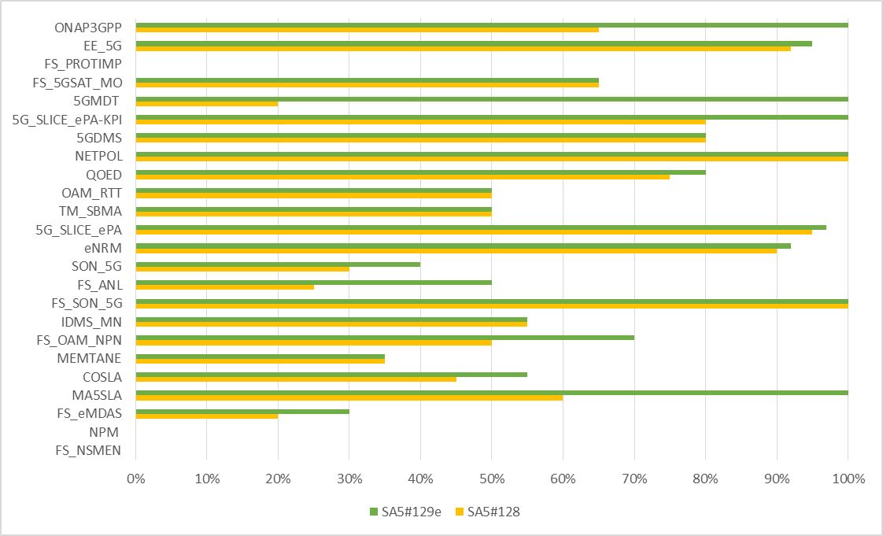
Overview of SA5 OAM ongoing WIs/SIs progress
Rel-16: (28)
14 ongoing WIs/SIs
12 finished WIs/Sis
Rel-17:(14)
2 ongoing SI
1 ongoing WI
11 new WIDs wait for SA approval
Rel-16
Rel-17

Slide 21
OAM - New or Revised WID/SIDs
Tdoc | Release | Title | Source | Potential related groups
SP-200185 | R16 | Revised WID for MA5SLA | China Mobile | GSMA
SP-200187 | R17 | New SID New areas on EE for 5G networks | Orange | RAN3/SA2/EE/ITU-T
SP-200188 | R17 | New WID Enhancements on EE for 5G networks | Orange | RAN3/SA2/EE/ITU-T
SP-200189 | R17 | New WI on management of non-public networks | Huawei | RAN3/SA2/SA1
SP-200190 | R17 | New WID Enhancement on Management Aspects of 5G Service-Level Agreement | China Mobile | GSMA
SP-200191 | R17 | New WID on management of MDT enhancement in 5G | Ericsson | RAN2/RAN3
SP-200192 | R17 | New WID on Additional NRM features | Nokia | RAN2/RAN3/SA2
SP-200193 | R17 | New WID on QoE Measurement Collection in 5G and Signalling Based Activation for UMTS and LTE | Ericsson | RAN2/RAN3
SP-200194 | R17 | New WID on Self-Organizing Networks (SON) for 5G networks | Intel | RAN3/SA2
SP-200195 | R17 | New SID on edge computing management | Intel | SA2/SA6/NFV
SP-200196 | R17 | Revised WID on Enhanced Closed loop SLS assurance | Ericsson | SA2/RAN3/ETSI ZSM

Slide 22
OAM - TS/TRs
Tdoc | Title | Sent for
SP-200197 | Presentation of TS 28.537 | Information and Approval
SP-200198 | Presentation of TS 28.310 | Approval
SP-200199 | Presentation of TR 28.807 | Information

Slide 23
OAM - Rel-16 WI Exception requests
Tdoc | Title
SP-200201 | WI Exception request Closed loop SLS Assurance
SP-200204 | WI exception request Network Slice performance and Analytics Charging in 5GS
SP-200205 | WI exception request Energy efficiency of 5G
SP-200206 | WI exception request Trace Management in the context of Services Based Management Architecture
SP-200207 | WI exception request Streaming trace reporting
SP-200208 | WI exception request Enhancement of 3GPP management system for multiple tenant environment support
SP-200209 | WI exception request Enhancement of performance assurance for 5G networks including network slicing
SP-200210 | WI exception request Discovery of management services in 5G
SP-200211 | WI exception request Self-Organizing Networks (SON) for 5G networks
SP-200212 | WI exception request NRM enhancements
SP-200213 | WI exception request Management of QoE measurement collection

Slide 24
MA5SLA/COSLA/MEMTANE/FS_OAM_NPN
WI code | WI Title | Completion rate | TS/TR | Tdoc reference | Target date | Rapporteur | Related groups | Related topic
MA5SLA | Management aspects of 5G Service-Level Agreement | 20%->60%->100% | TS 28.541 | SP-190789 | SA#87 (03/2020) | CMCC | GSMA, ETSI ZSM | Tbd
COSLA | Closed loop SLS assurance | 20%->45%->55% (E.R. (Exception request)) | TS 28.535/28.536 | SP-190781 | SA#87 (03/2020) | Ericsson | SA2, RAN3, ETSI ZSM | NWDAF, RAN intelligence automation
MEMTANE | Enhancement of 3GPP management system for multiple tenant environnent support | 20%->35%->35% (E.R.) | TS 28.531/28.532/28.533/28.541/28.552/28.554 | SP-190786 | SA#87 (03/2020) | Huawei | ETSI ZSM, SA2(potentially) | Tbd
FS_OAM_NPN | Study on non-public networks management | 20%->50%->70% | TR 28.807 | SP-190137 | SA#87 (03/2020) -> SA#88 (06/2020) | Huawei | SA1, SA2, RAN3, 5G-ACIA | NPN
Working Progress
MA5SLA: The group discussed and agreed the following topics:
Update on slice NRM and solution sets
The GST work item should be continued to Rel-17 and should use version 3.0 (when available)
Parameters that are already supported by SA5 TS in other objects than serviceProfile in the NetworkSlice IOC, SA2 TS or RAN TS shall remain in Rel-16 serviceProfile.
Revised WID scope -> Rel-16 completed.
MEMTANE: The group discussed the contribution related to the following topics but no conclusion was made:
Add tenant concept associated to CSI consumer
Add clarifications to concept description
tenant information to support multi-tenancy environment
COSLA: The following topics discussed and agreed in the meeting.
Management control loops overviews, control loops including open control loops and closed control loops, management control loops in different layers are agreed.
Update of management service deployment based on ZSM framework
A UC on NWDAF assisted CSI SLS Assurance
FS_OAM_NPN: the TR was agreed to be sent for information.
Network Slice as a Service in the management of PNI-NPN.
Solutions and conclusion for mgmt of PNI-NPN
Solutions and conclusion for mgmt of SNPN

Slide 25
IDMS_MN/FS_ANL
WI code | WI Title | Completion rate | TS/TR | Tdoc reference | Target date | Rapporteur | Related groups | Related topic
IDMS_MN | Intent driven management services for mobile network | 50%->55%->55% | TR 28.812/ TS 28.312 | SP-180899 | SA#87 (3/2020) -> SA#91 (03/2021) | Huawei | RAN3, SA2 (potentially) | Realization of intent on RAN or CN side
FS_ANL | Study on levels of autonomous network | 5%->25%->50% | TR 28.810 | SP-190928 | SA#87 (03/2020) -> SA#88 (06/2020) | CMCC,Huawei | ETSI ZSM, SA2, RAN3, RAN2 | Tbd
Working Progress
IDMS_MN:The work item was agreed to move to Rel-17
Rapporteur cleanup.
Update the recommendation and conclusion for the study work.
FS_ANL：The following aspects are discussed and agreed
Update Potential dimension for classification of network autonomy
Fault RCA and recovery scenario example for network autonomy level
Add Resource optimization scenario for classification of network autonomy levels
Update NE deployment scenario example for classification of network autonomy levels

Slide 26
SON_5G
WI code | WI Title | Completion rate | TS/TR | Tdoc reference | Target date | Rapporteur | Related groups | Related topic
SON_5G | Self-Organizing Networks (SON) for 5G networks | 15%->30%->40% (E.R.) | TS 28.313/28.544 | SP-190785 | SA#87 (03/2020) | Intel | RAN3, RAN2, SA2 | Tbd
Working Progress
SON_5G：The group discussed and agreed contributions related to the following topics:
  Changes to MRO Management service
  Changes to RACH optimization
  CR to add Random Access Preambles measurements

Slide 27
FS_eMDAS
WI code | WI Title | Completion rate | TS/TR | Tdoc reference | Target date | Rapporteur | Related groups | Related topic
FS_eMDAS | Study on Management Data Analytics Service | 5%->20% ->30% | TR 28.809 | SP-190930 | SA#89 (09/2020) | Intel,NEC | SA2, RAN3 | NWDAF, RAN intelligence, automation
Working Progress
FS_eMDAS: the following topics are agreed.
Modification on Management Interaction with NWDAF.
Add the use cases related to SLA assurance.
addition of resource utilization analysis solution.
Use case and potential solutions of MDA assisted EE.

Slide 28
eNRM/5G_SLICE_ePA/TM_SBMA/QOED/5GDMS/5G_SLICE_ePA_KPI/OAM_RTT/FS_5GSAT_MO/FS_PROTIMP (1/3)
WI code | WI Title | Completion rate | TS/TR | reference | Target date | Rapporteur | Related groups | Related topic
eNRM | NRM enhancements | 80%->90%->92% (E.R.) | TS 28.541 | SP-190140 | SA#87 (03/2020) | Nokia | SA2, RAN3, ORAN (potentially) | NR, 5GC modelling
5G_SLICE_ePA | Enhancement of performance assurance for 5G networks including network slicing | 90%->97% (E.R.) | TS 28.552/28.554 | SP-190247 | SA#86 (12/2019) | Intel,CMCC | SA2, RAN2 | PM
TM_SBMA | Trace Management in the context of Services Based Management Architecture | 10%->50%->50% (E.R.) | TS 32.421/ 32.422/ 28.530/ 28.532/28.533/ 28.540/28.541 | SP-181073 | SA#87 (03/2020) | Nokia | RAN3, RAN2, SA2 | Trace
OAM_RTT | Streaming trace reporting | 25%->25% ->25% (E.R.) | 32.421/32.422/32.423/28.532/28.533 | SP-190782 | SA#87 (3/2020) | Nokia | RAN3, RAN2, SA2 | Trace
QOED | Management of QoE measurement collection | 75%->75%->80% (E.R.) | TS 28.404/28.405/28.406/28.307/28.308/28.309 | SP-181069 | SA#87 (3/2020) | Ericsson | SA4, CT1, RAN2, RAN3,CT4 | QoE
5GDMS | Discovery of management services in 5G | 70%->80%->80% (E.R.) | TS 28.533/28.532/531 | SP-181072 | SA#87 (3/2020) | Huawei |  | Service based discovery
5G_SLICE_ePA-KPI | KPI reporting | 15%->60% ->100% | TS 28.550/28.554 28.622/28.532 | SP-190881 | SA#87 (3/2020) | ZTE | -- | KPI
5GMDT | Management of MDT in 5G | 0%->20%->100% | TS 32.421/32.422/ 32.423/ 28.532/28.533 | SP-191190 | SA#87 (3/2020) | Ericsson | RAN3, RAN2, SA2 | MDT
FS_5GSAT_MO | Study on management and orchestration aspects with integrated satellite components in a 5G network | 45%->60%->60% | TR 28.808 | SP-190138 | SA#87 (3/2020) -> SA#88 (06/2020) | Thales | SA2,RAN3, RAN1, RAN2 | Satellite modelling
FS_PROTIMP | Study on protocol enhancement for real time communication | 0%->0%->0% | TR 28.823 | SP-180597 | SA#87 (3/2020) -> SA#88 (06/2020) | Nokia | -- | --

Slide 29
eNRM/5G_SLICE_ePA/TM_SBMA/QOED/5GDMS/5G_SLICE_ePA_KPI/OAM_RTT/FS_5GSAT_MO/FS_PROTIMP (2/3)
Working Progress
eNRM：The following topics are agreed:
RIM parameters of mapping relations for remote interference management
Add configurable FM
Some correction the NRM.
JSON with YAML in NRM，Use YAML instead of JSON in the OpenAPI definitions of the REST SS are endorsed.
OpenAPI definitions required by the ProvMnS were agreed to be added to 28.623 and 28.541.
Update the NR NRM to align with NG-RAN overview architecture
YANG Guidelines Update
YANG_Netconf CRUD Operations.
  The following topics needs to be further discussed:
RRMPolicy models.
Support of Netconf
5G_SLICE_ePA: The group discussed the following measurements and use cases:
    measurements on DL delay between PSA UPF and UE
    measurements on UL delay between PSA UPF and UE
    measurement Average delay UL on over-the-air interface
    measurements on DL delay between PSA UPF and NG-RAN
    measurements on UL delay between PSA UPF and NG-RAN
    measurements on RTT delay between PSA UPF and NG-RAN
    measurements related to DRB Setup via Initial Context Setup
    measurements for SSB beam handover
    RSRP measurements
    Number of Active UEs measurements
    Add new use case related to Monitor of QoS flow release
    Correction of UE throughput measurements, Packet Drop Rate measurements, Packet Loss Rate measurements, QoS flows

Slide 30
eNRM/5G_SLICE_ePA/TM_SBMA/QOED/5GDMS/5G_SLICE_ePA_KPI/OAM_RTT/FS_5GSAT_MO/FS_PROTIMP (3/3)
Working Progress
QOED:
  Remove SBA
  Removing Signalling Based Activation.
5G_SLICE_ePA-KPI:
  The group agreed on configurable KPI control NRM.
  Update KPI definitions to align with the new template.
5GMDT : The following topics are agreed.
  Reply to RAN2 LS S5-201165 to SA5 on trace related configurations for NR MDT.
  Add MDT trace record for NR measurements
  Add MDT user consent handling for 5G
  MDT activation and deactivation mechanisms for 5G
  For area based MDT, Alignment with RAN2, Add anonymization of MDT data for 5G, Add MDT specific configuration parameters for 5G
  MDT requirements for NR
  MDT trace recording session start and stop mechanism for 5G
FS_5GSAT_MO:
  No contribution for this meeting.
TM_SBMA:
  No contribution for this meeting.
OAM_RTT:
  No contribution for this meeting.
5GDMS:
  No contribution for this meeting.

Slide 31
EE_5G
WI code | WI Title | Completion rate | TS/TR | Tdoc reference | Target date | Rapporteur | Related groups | Related topic
EE_5G | Energy efficiency of 5G | 90%->92%->95% (E.R.) | TS 28.310 | SP-180819 | SA#87 (03/2020) | Orange | RAN3, ETSI EE, ITU-T SG5 | Energy saving, EE measurements
Working Progress
Reply LS on analytics support for energy saving to SA and SA2 was agreed.
Add solution for distributed energy saving management
Add solution for centralized energy saving management
Requirement on energy saving reactivation
TS 28.310 is agreed for approval to SA#87

Slide 32
ONAP3GPP
WI code | WI Title | Completion rate | TS/TR | Tdoc reference | Target date | Rapporteur | Related groups | Related topic
ONAP3GPP | Integration of ONAP and 3GPP 5G management framework | 40% ->65%->100% | TS 28.540/28.622/28.623/28.532 | SP-190139 | SA#87 (03/2020) | Orange, AT&T | ONAP, ETSI ZSM | 3GPP-ONAP Integration
Working Progress
Correction of MnS Stage 3 SSs for integration with ONAP VES is agreed.

Slide 33
NPM/FS_NSMEN
WI code | WI Title | Completion rate | TS/TR | Tdoc reference | Target date | Rapporteur | Related groups | Related topic
NPM | Network policy management for 5G mobile networks | 0% | TS 28.555/28.556 | SP-191211 | SA#90 (12/2020) | China Mobile | ETSI NFV | Management Services
FS_NSMEN | Study on network slice management enhancement | 0% | TR 28.811 | SP-191338 | SA#92 (06/2021) | Huawei | GSMA 5GJA ETSI ZSM | Slice management
Working Progress
NPM:
  Not yet started.
FS_NSMEN:
  Not yet started.

Slide 34
OAM CRs
Tdoc | Title
SP-200162 | Rel-16 CRs on Enhancement of performance assurance for 5G networks including network slicing
SP-200163 | Rel-16 CRs on Enhancement of performance assurance for 5G networks including network slicing-KPI reporting
SP-200169 | Rel-16 CRs on NRM enhancements
SP-200172 | Rel-16 CRs on Methodology for 5G management specifications
SP-200173 | Rel-16 CRs on Management of MDT in 5G
SP-200174 | Rel-15 CRs on Provisioning of network slicing for 5G networks and services
SP-200175 | Rel-16 CRs on Streaming trace reporting
SP-200176 | Rel-16 CRs on Integration of ONAP and 3GPP 5G management framework
SP-200177 | Rel-16 CRs on Management of QoE measurement collection
SP-200178 | Rel-16 CRs on Self-Organizing Networks (SON) for 5G networks
SP-200180 | Rel-16 CRs on Closed loop SLS Assurance
SP-200181 | Rel-15 CRs on Performance Assurance for 5G networks including network slicing
SP-200183 | Rel-15 CRs on REST Solution Sets (normative work)
SP-200227 | Rel-15 CRs on NETSLICe

Slide 35
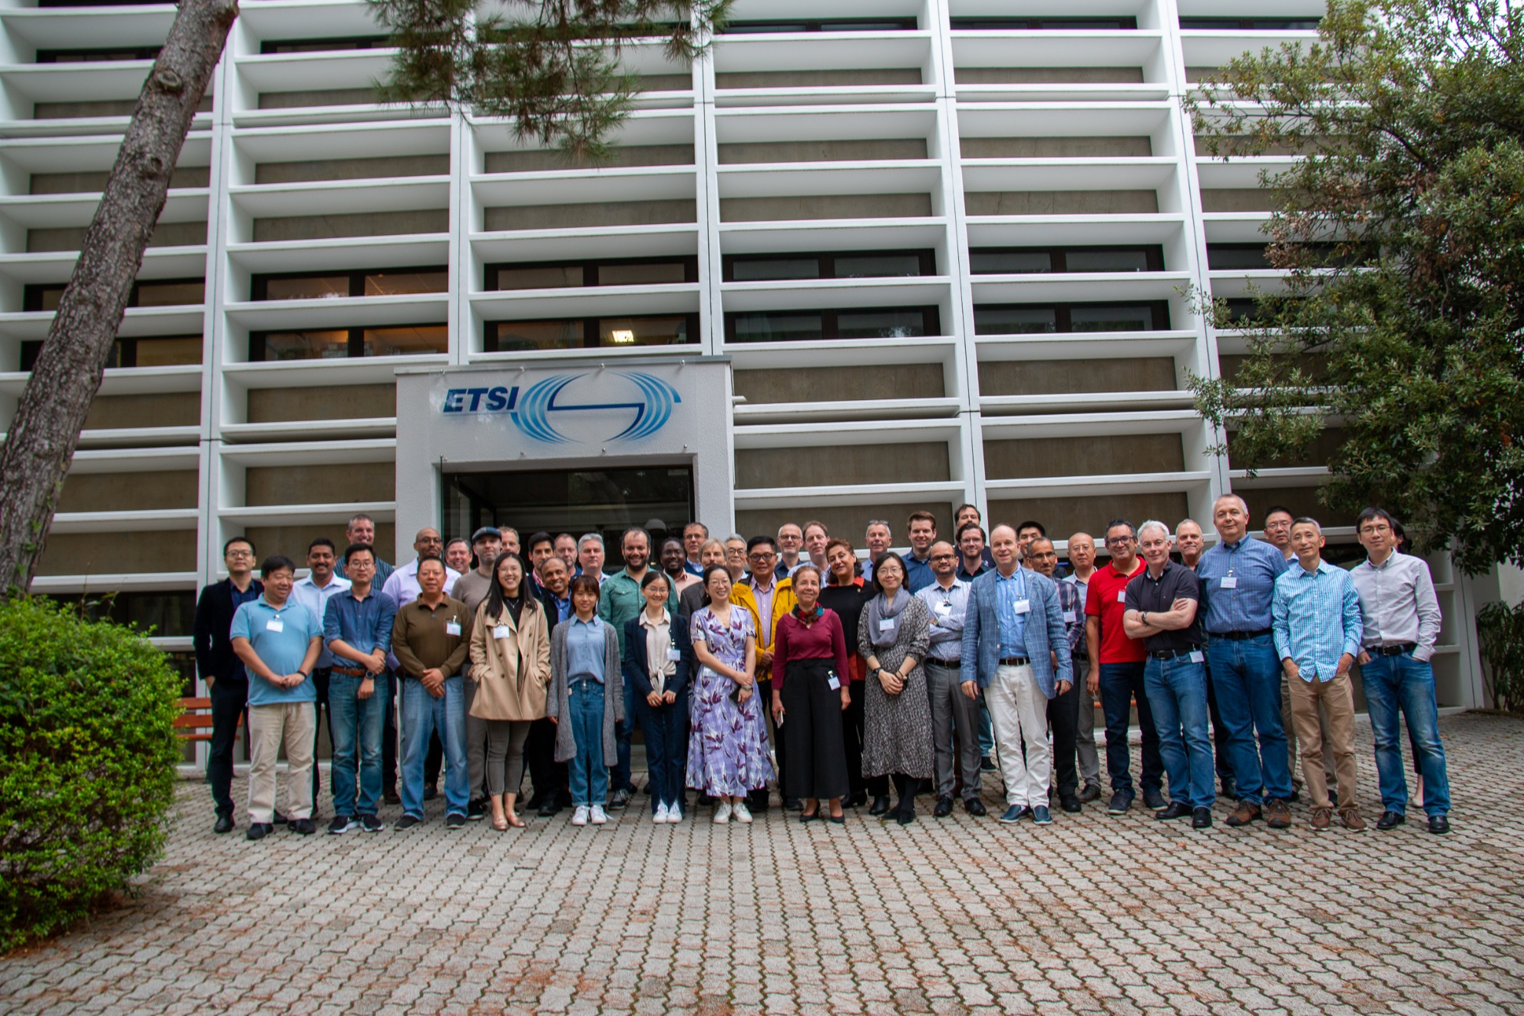
Thank you!

