Slide 1
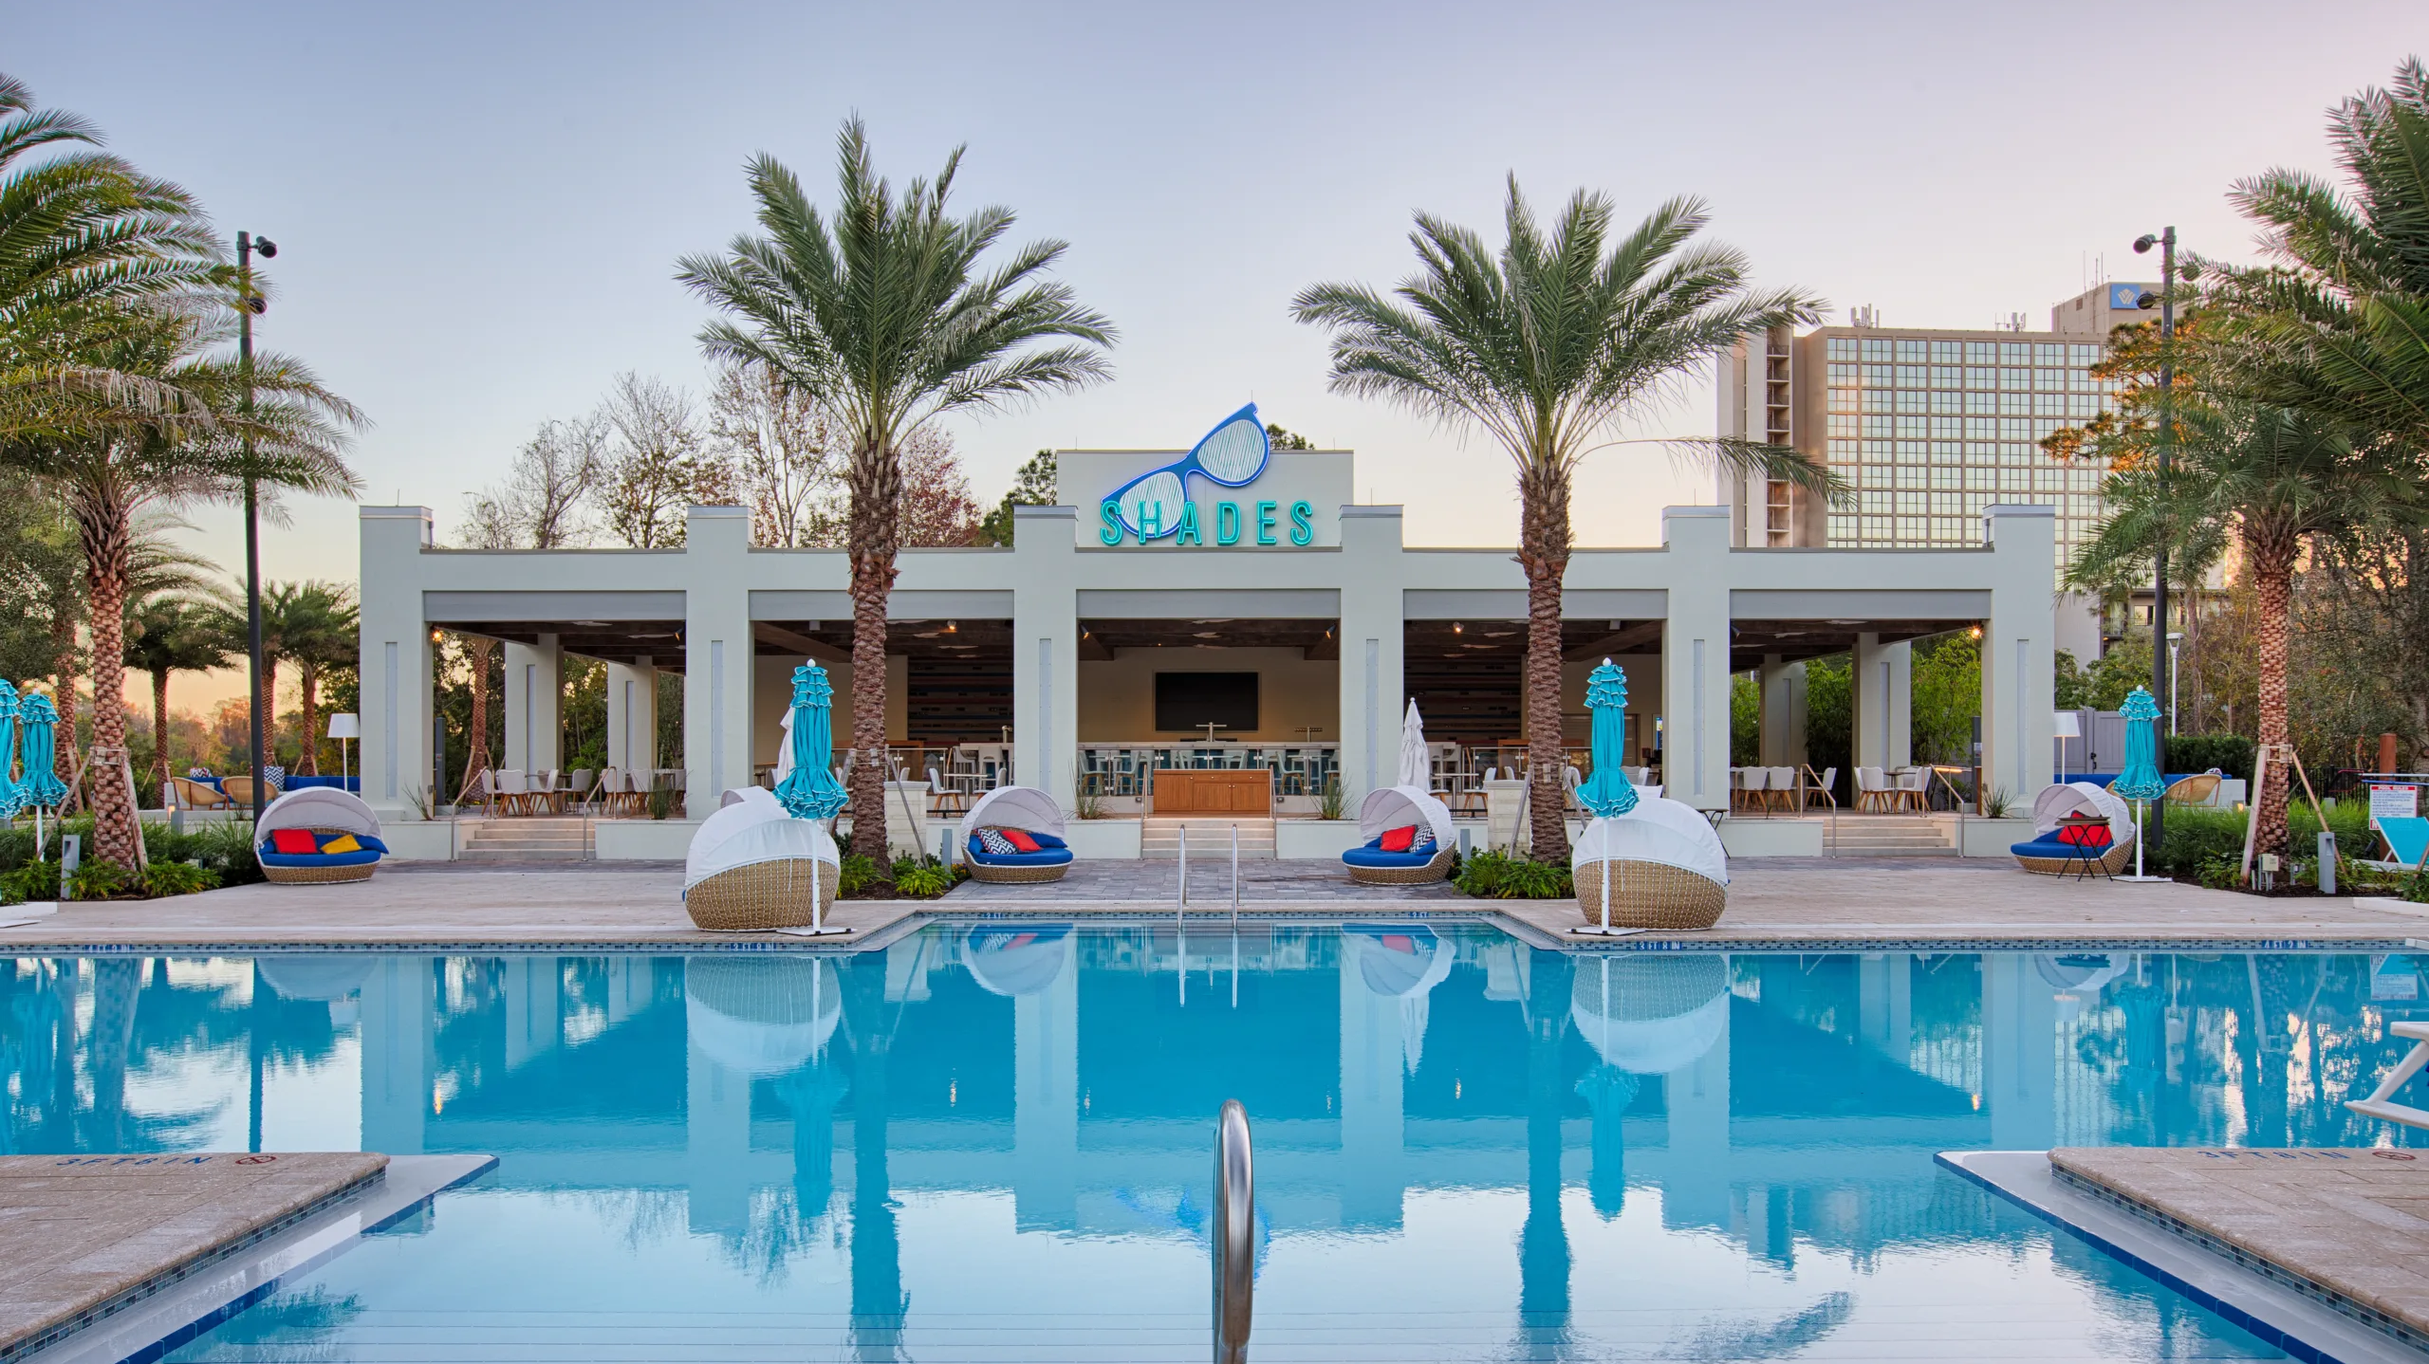
Informational SA4 Social Gathering at Hilton Pool Bar
Thursday, November 21 2024 at 1900

Slide 2
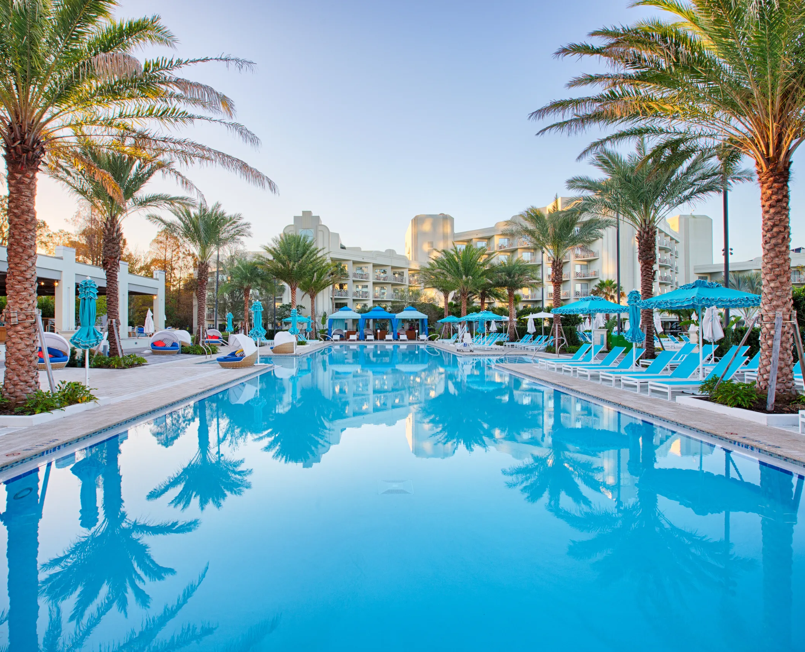
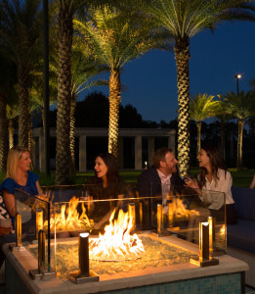
Details
After checking different options, decided to make it simple. A good advice in general
Plan:
  can just go there and have drinks for 1 hour, then people can head off for dinner.
  Everyone is invited
  Everything will be self-paid at the Poolbar – serve beer and drinks, also in baskets of 5 pay 4 beer. Snacks as well
  There is a playground next door to do some games, but as it is at the pool, you may also bring your swimming clothes and jump into the water

