Slide 1
[FS_AMD] WT3a: Multiple Service Locations in 5G Media Streaming
3GPP TSG SA WG4 #130
Orlando, TL, US, 18-22 November, 2024
S4-241889
Source: Qualcomm Germany
Agenda Item: 8.6

Slide 2
5G Media Streaming architecture
As defined in TS 26.501

Slide 3
What is "multi-CDN"?
Multi-CDN generally provides content in a redundant manner on locations that can be differentiated by the client.
The locations typically differentiate in one or multiple Quality-of-Service criteria, for example the access bandwidth is different, the reliability of the end points is different, the costs for the service provider are different, the outage probabilities are different and so on.
While referred to as multi-CDN, the concept is more general and may preferably be named as multiple service locations. CDN is more the commercial implementation.
We use the term multi-CDN and multiple service locations synomously in the following
Content may be offered fully redundant on multiple CDNs, or content may be offered as subsets on one or the other CDN or coded redundant versions may be generated.
Decisions on which location to use at which time may be done by the client only, by instruction from the network or service provider, or by a combination of the two.
Multi-CDN approaches may also be considered in broadcast/multicast/unicast scenarios

Slide 4
What would multi-CDN mean in context of 5GMSd AS?
MPEG-DASH defines service locations in clause 5.6.6
A service location defines a collection of network resources that share commonalities and can be referred to by a common label.
Several elements in the MPD of type xs:anyURI may have associated a @serviceLocation attribute which provides the label for a Service Location. If two resources share the same value for this attribute , (i.e., they are assigned to the same Service Location), then these URLs are likely to have their URLs resolve to services at a common network location, for example a common Content Delivery Network.
If the element does not include a @serviceLocation attribute, no relationship to any resource in the MPD is known.
The string value of @serviceLocation should only contain characters from the set [a..z], [A..Z], [0..9], '.', '-', and '_'.
A client may for example use such information in order to correlate network statistics from the collected statistics when resolving to a URL at the same service location to predict the behaviour when resolving for another resource at the same service location.
Service locations may for example be used to annotate redundant content offerings. In this case, for example a content steering operation as defined in Annex K.3.6 may use the values of service locations to steer the client towards a specific version of the redundant content offering.

Slide 5
Examples for multi-CDN are
See attached paper for some more background
Multi-CDN delivery with DNS-based client-side switching
Multi-CDN delivery with DASH-based client-side switching
  The usage of multiple BaseURL and consistent resolution is for example described in the 3GPP DASH profile clause 8.6 in 3GPP TS 26.247.
Multi-CDN delivery with DASH-based client-side switching and priorities
  See for example the definition in ETSI TS 103 285 (DVB-DASH)
Multi-CDN delivery with Content Steering
  See for example HLS and DASH, with DASH being defined in ETSI TS 103 998
Multi-CDN delivery using SAND4M
  3GPP DASH in TS 26.247, clause 13.10 defines the SAND functionality for enabling SAND for Multi-Network support (SAND4M).
Common Multi-source Media Format (CMMF) as defined in ETSI TS 103 973
  This functionality permits the creation of complementary copies – more details later

Slide 6
Multi-CDN is either ...
... A feature of the 5GMS AS or it is a feature of the Application Provider
Multi-CDN Client
Multi-CDN
Multi-CDN Client
Multi-CDN

Slide 7
Examples
Option 1: 5GMSd AS does active multi-CDN operation
  DASH content is provided to the 5GMSd AS
  5GMSd AS initiates multi-CDN AS
  Note that 5GMSd AS can be in trusted or non-trusted network
  Examples for multi-CDN
    Multi-CDN hosting and client decision ➔ add multiple service locations to MPD
    Content Steering ➔ Add multiple service locations and content steering server
    Multi-CDN as defined in TS 26.247 ➔ Add multiple service locations to MPD and use SAND for switching
    CMMF ➔ create new content from the DASH content and host it on different CDNs
Option 2: 5GMSd AS is an edge cache
  In this case the multi-CDN operation is done by the App
  The App may instruct to select the 5GMS AS as the serving CDN or maybe an external CDN.
  There may be two or multiple "5GMSd ASes", for example the 5GMS AS for each operator may be different.
  In this case the 5GMSd AS may only host a subset of the content

Slide 8
Option 1: Implementation of AS with multi-CDN
Media Player+
5GMSd AS
Multi-CDN
Controller
Media Player
DASH/HLS
/CMAF
Multi-CDN Client
M4
CDN/Service Location 1
Multi-CDN
Processor
Multi-CDN
Client
CDN/Service Location 2
For 5GMS multi-CDN, either
an extension to the player and player manifest is needed or
a new module in player is added that is initiated with use plane information and interfaces with the media player through well defined APIs.

Slide 9
Option 1: Implementation of AS with multi-CDN
M5
Provisioning M1
MSH
5GMSd AF
M10
M3
Media Player+
5GMSd AS
Multi-CDN
Controller
Media Player
DASH/HLS
/CMAF M2
Multi-CDN Client
M4
CDN/Service Location 1
Multi-CDN
Processor
Multi-CDN
Client
CDN/Service Location 2

Slide 10
Implementation of AS with as one of multiple CDNs
5GMS application provider
5GMS-aware application
Multi-CDN
Controller
Multi-CDN
Client Manager
M8
DASH/HLS
/CMAF
CDN/Service Location 1
Multi-CDN
Processor
M7d
M2
Media Player+
5GMSd AS
Media Player
CDN/Service Location 2
M4d
Multi-CDN Client
For 5GMS being one service location, most of the control exchange happens via M8d, but the player is instructed by M7d to change the behaviour, for example switch to the new service location

Slide 11
Implementation of AS with as one of multiple CDNs
5GMS application provider
5GMS-aware application
Multi-CDN
Controller
Multi-CDN
Client Manager
M8
DASH/HLS
/CMAF
CDN/Service Location 1
Multi-CDN
Processor
M6d
M1
M5
MSH
5GMSd AF
M7d
M2
M10
M3
Media Player+
5GMSd AS
Media Player
M4d
CDN/Service Location 2
Multi-CDN Client

Slide 12
Call flow for Option 1a: No Content Modification
A detailed call flow is under preparation
Content is ingested into the AS
The 5GMSd prepares the content for multi-CDN delivery
  Updates the MPD to provide multiple service locations, possibly priorities
  Publishes the content at multiple service locations
  Potentially establishes a processor the manages the multi-CDN content (e.g. Steering server, MPD rewriter, SANDer)
The MPD is published and the media player uses the multi-CDN information
The Media Player may contact the Content Steering or SAND server for information and acts accordingly.
The Media Player downloads the content typically from one of the service locations
This information may be updated based on dynamic information from MPD updates, SAND information or from the Content Steering Server

Slide 13
Call flow for Option 1b: Content Modification
A detailed call flow is under preparation
Content is ingested into the AS
The 5GMSd prepares the content for multi-CDN delivery
  Creates a configuration information to provide information to Multi-CDN client
  Includes the Player entry point to the Manifest
  Creates multiple copies of each segments (e.g. CMMF encoding)
  Maps the redundant copies to a label that can be associated to MPD URLs (something like an FDT in MBMS/MBS)
  Uploads the redundant copies to the service location
The AS Provides the configuration information to the CMMF module in the client
The CMMF client requests the redundant objects (for example on demand or proactively)
The CMMF client reconstructs the original segments and makes them available to the Media Player

Slide 14
Option 2: No Content modification – AS just hosts
A detailed call flow is under preparation
The application provider prepares content to be distributed via multiple service location
The application provider provisions 5GMS via M1 to host a subset of the content
The AF configures the AS accordingly.
The subset of content is ingest into the 5GMS AS via M2 (e.g. selected Representations, CMMF stripe)
The AS acts as one service location for the application service provider
A player may be 5GMS aware, but it will get content partially via M4 (managed) and partially via M8. The player configuration and choices are provided by the application
The AF may be involved, but only to manage the the M4 delivery.

Slide 15
Multi-Service Locations and 5GMS
New considerations

Slide 16
Architecture updates – Option 1
M5
Provisioning M1
5GMSd AF
M3
5GMSd AS
Multi-SL
Controller
Service Location 1
DASH/HLS
/CMAF M2
M4
Multi-SL
Processor
Service Location N

Slide 17
Provisioning Call flow - updates
The provisioning in TS 26.501, clause 5.3.2 applies
Core updates for multi-service locations are
  New provisioning parameters
Provisioning parameters include
  Request for using multiple service locations
  Parameters for the multi service location processing
    A detailed Content Preparation template is provided to the AS (see clause 7.2 of TS 26.501)
  Exact feature:
    multi-SL and client selection
    Multi-SL and content steering
    Multi-SL and SAND4M
    CMMF with detailed configuration parameters
  The number of service locations and parameters for each service location
    Each service location may be assigned with different QoS parameters
    Each service location may be a different slice
    Other differentiating aspects to be added to service locations may be considered.
  In a variant, the AS may also be informed about existing service locations
  that are outside of the 5GMS and may provide policies on how to use.

Slide 18
Distribution Call flow - updates
The updates to the call flow are based on clause 5.7.4 of TS 26.501
Updates in bold (right) for multi-service locations (MSL)
  Media Player entry includes information
  about multiple service locations
  The multiple service location data is processed by player
  The player get service location information from AS
  The information may be used when establishing transport session
  When accessing Segments, the selected service locations
  are used
  When accessing Segments and Media entries, new information
  may be provided (this could also come from an update in the
  Media Player Entry)
  Service location information may be exchanged with the Media
  Session handler, for example to address the selection of
  Service locations
The call flow is generic to address
  multi-SL and client selection
  Multi-SL and content steering
  Multi-SL and SAND4M

Slide 19
Combining Content Steering and 5GMS

Slide 20
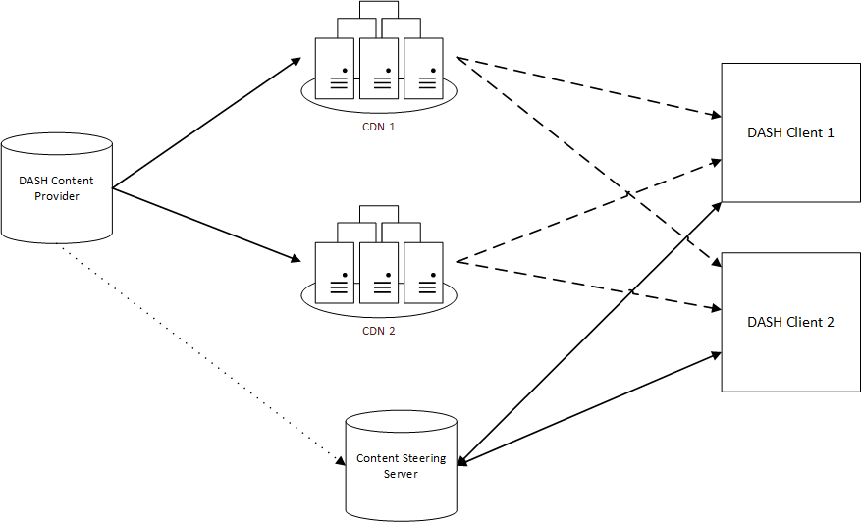
What is Content Steering?
Background: Published as ETSI TS 103 998 – Content Steering – and also included in HLS specification

Slide 21
Provisioning Call flow – updates for CS
The provisioning in TS 26.501, clause 5.3.2 applies
Core updates for multi-service locations are
  New provisioning parameters
Provisioning parameters include
  Request for using multiple service locations
    Distribution of resources (copy, selected content on service locations, etc.)
    MPD hosting
  Request for adding a content steering server with parameters
    Update frequency
  The number of service locations and parameters for each service location
    Each service location may be assigned with different QoS parameters
    Each service location may be a different slice
    Other differentiating aspects to be added to service locations may be considered.
  In a variant, the AS may also be informed about existing service locations
  that are outside of the 5GMS and may provide policies on how to use.
  Information on how the content steering server may be used
  In another embodiment, also Content Steering for DASH and HLS may
  be provided

Slide 22
Distribution Call flow - updates
The updates to the call flow are based on clause 5.7.4 of TS 26.501
Updates in bold (right) for multi-service locations
with content steering
  Media Player entry includes information
  about multiple service locations and Content Steering Server
  The content steering and multiple service location data
  is processed by player
  The information may be used when establishing transport session
  When accessing Segments, the selected service locations
  are used
  When accessing Segments and Media entries, new information
  may be provided (updates to Media Player Entry)
  Updated Content steering information may be provided from AS
  The information is used by the media player when requesting
  Segments available on different content locations.

Slide 23
Multi-CDN - CMMF Background and basics of CDP Instantation

Slide 24
Background
ETSI TS 103 973 defines a Content Delivery based Instantation in Annex D
CMMF is considered as a Content Delivery Protocol (CDP) as defined in clause of 8 of [RFC5052].
Annex D provides a mapping of CMMF to the RFC 5052 principles and vice versa
This instantiation also permits to re-use existing FEC Code including Raptor (the 3GPP MBMS code) as defined in RFC 5053 and RaptorQ as defined in RFC 6330.
The protocol also makes use of 3GPP familiar concepts such as the File Delivery Table in FLUTE and used in MBMS and MBS

Slide 25
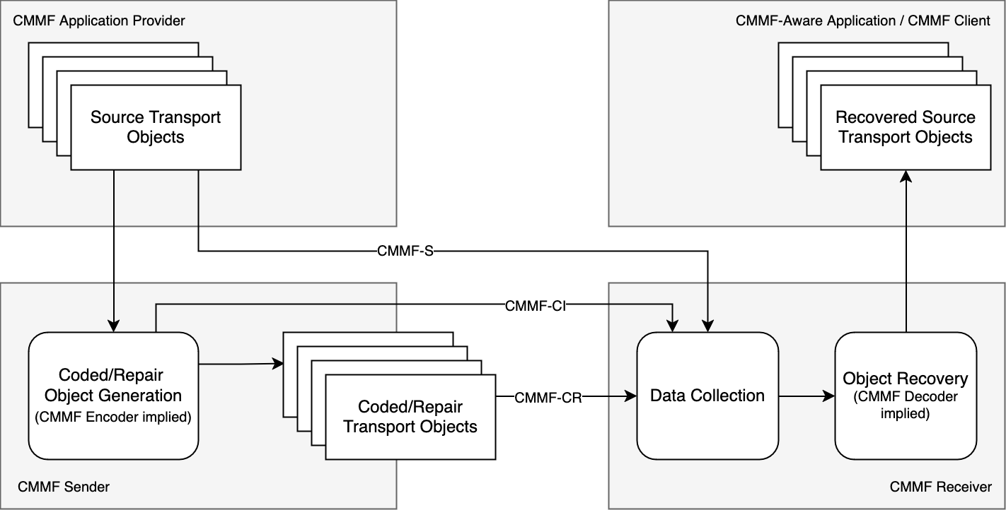
CMMF Architecture
Simplified Architecture as developed by Qualcomm during CMMF specification development

Slide 26
Defined Reference Points
CMMF-CI: This reference point provides Configuration Information describing the location and relationship of the source and coded/repair objects, may be provided to a CMMF receiver.
CMMF-S: This reference point provides the source transport objects. For CMMF, these objects are unmodified from original data. Parts of these objects may be used by Object Recovery to recover source objects.
CMMF-CR: This reference point provides the coded/repair transport objects. Details on the formats on this reference point are provided in clause.
Not explicitly mentioned in the diagram are the following reference points:
  The server-side configuration of the CMMF sender
  The client-side API to have an API between the CMMF receiver and the application
Note also that the application is completely independent of any manifest and so on

Slide 27
Call flow for FLUTE-based CMMF CDP instantation (Figure D.1)

Slide 28
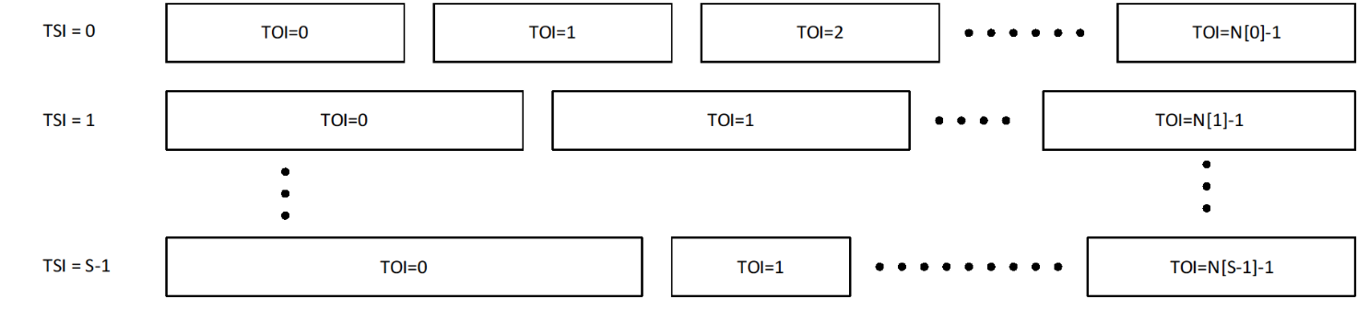
CMMF Transport Objects and Transport Sessions
Source and Repair objects are assigned to TSI and TOI
Information is provided to receiver through configuration information, describing
  Each logical flow that is operated
  Each object, metadata of the object and other information
  The type of the object as well encoding parameters

Slide 29
Configuration Parameters
Parameter |  |  |  | Usage | Definition
Complete |  |  |  | OD | Indicates whether the Configuration Information is complete.
Location |  |  |  | O | Provides information where the Configuration Information can be accessed in carried externally.
Expires |  |  |  | M | Provides information when this Configuration Information is no longer valid and an update is needed, for example using a reload from Location.
Source Flow |  |  |  | 1 … S | Provides 1 … S source flows.
 | TSI |  |  | M | Identifier of the source flow.
 |  | Object |  | 1 … N | Provides 1 … N objects in the source flow.
 |  |  | TOI | M | Transport object identifier (TOI) value that represents the source object.
 |  |  | Size | M | Size of the transmission object in bytes.
 |  |  | Content-Type |  | Describes media type of file.
 |  |  | Encoding |  | Describes encoding of file .
 |  |  | Message Digest |  | Message digest of file.
 |  |  | Associated URI |  | Name, Identification, and Location of file (specified by the URI).
 |  |  | Access URL |  | The URL where the source object can be accessed. If the field is not present, then the source flow is not directly accessible.
 |  |  | availabilityStartTime |  | Provides a wall-clock time when the resource is accessible.
 |  |  | availabilityStartTime |  | Provides a wall-clock time when the resource ceases to be available.
 |  |  | <Additional metadata> |  | May include cache or E-Tag metadata.
 |  | Representation |  |  | Refers to a DASH Representation in an MPD or a Track in an HLS manifest.
Coded/Repair Flow |  |  |  | 1 … R | Provides 1 … R coded/repair flows.
 | TSI |  |  | M | Identifier of the coded/repair flow.
 |  | Object |  | 1 … N | Provides 1 … N objects in the coded/repair flow.
 |  |  | TOI | M | Transport object identifier (TOI) value that represents the coded/repair object.
 |  |  | FEC-OTI |  | If object is coded using a scheme based on [RFC5052], FEC Object transmission information including the FEC Encoding ID and, if relevant, the FEC Instance ID.
 |  |  | includedSourceTOI | M | List of (TSI, TOI pairs) of the included source transport objects forming super objects . Typically, only a single pair is provided.
 |  |  | Content-Type |  | Media Mime Type of the file.
 |  |  | completeObject | OD FALSE | Indicates whether the transport object includes sufficient information to recover all files included in this coded/repair object.
 |  |  | symbolArrangement |  | Provide this symbol arrangement in the object according to Table 78. If not present, the symbol Arrangement is unknown and only present in the bitstream.
 |  |  | sAParameters |  | may be present if the symbolArrangement is present. If present, it provides the parameters assigned to the symbol arrangement as defined in Table 36. For arrangement 2 and 3, this is a comma-separated list of: Index difference, Symbol group, Index in symbol group
 |  |  | Access URLs |  | The URLs where the coded/repair object can be accessed.
 |  |  | availabilityStartTime |  | Provides a wall-clock time, when the resource is accessible.
 |  |  | availabilityEndTime |  | Provides a wall-clock time, when the resource ceases to be available.
 |  |  | <Additional metadata >
The Configuration Information allows the CMMF client to map an application request to CMMF receiver operations.
Table D.1.5-1 provides examples of possible Configuration Information that can be used where source and coded/repair transport objects are described.
Some use cases may require additional information or only a subset of this information, and a simpler version of this parameter set may be used.
Updates of the CI information may happen

Slide 30
Encoding Options in Annex D
Source Object with Kt=29
SBN=0
(30 source symbols)
Encoding Symbols with ESI 30 to 119
CMMF Receiver can recover source object from any 30 symbols (including byte ranges)
Encoding Symbols
Repair Object 1
ESI 30 to 59
Repair Object 2
ESI 60 to 89
Repair Object 3
ESI 90 to 119

Slide 31
Source Object with Kt=29 symbols
block=0
block_num_symbols =10
block=1
block_num_symbols =10
block=2
block_num_symbols =9
Encoding Symbols with ESI 0 to 29
Encoding Symbols with ESI 0 to 29
Encoding Symbols with ESI 0 to 26
Encoded Symbols
mbpg_first_symbol_index=0
0
0
0
3
3
3
24
24
24
27
27
mbpg_num_symbols=25
mbpg_difference=3
mbpg_first_symbol_index=1
1
1
1
4
4
4
25
25
25
28
28
mbpg_num_symbols=25
mbpg_first_symbol_index=2
2
2
2
5
5
5
26
26
26
29
29
mbpg_num_symbols=25
mbpg_symbol_group_subset_index =4

Slide 32
Source Object with Kt=29 symbols
block=0 (ESI 0-9)
block_num_symbols =10
block=1 (ESI 0-9)
block_num_symbols =10
block=2 (ESI 0-8)
block_num_symbols =9
FEC with ESI 10 to 30
FEC with ESI 10 to 30
FEC with ESI 9 to 30
Source Symbols
Repair Symbols
mbpg_first_symbol_index=0
0
3
6
9
2
5
8
1
4
7
10
10
9
25
25
24
28
28
27
mbpg_num_symbols=30
mbpg_difference=3
mbpg_first_symbol_index=1
1
4
7
0
3
6
9
2
5
8
11
11
10
26
26
25
29
29
28
mbpg_num_symbols=30
mbpg_first_symbol_index=2
2
5
8
1
4
7
0
3
6
12
12
11
27
27
26
30
30
29
mbpg_num_symbols=29
mbpg_symbol_group_subset_index=0

Slide 33
One Implementation of CI – Extended FDT
Multiple Files –
Self-contained objects including source symbols
Aligned with File Delivery Table from FLUTE with extensions
<FDTInstance xmlns:xsi="http://www.w3.org/2001/XMLSchema-instance" xmlns="urn:ETSI:CMMF:2023:FDT" xsi:schemaLocation="urn:ETSI:CMMF:2023:FDT extendedFDT.xsd" Expires="2024-05-30T09:30:10Z" Complete="true" FEC-OTI-FEC-Encoding-ID="6" FEC-OTI-Encoding-Symbol-Length="64"> <File ContentLocation="https://example.com/efd1-video.mp4" ContentType="video/mp4 codecs='avc1.42c01e' profiles='iso8'" TOI="0" Content-Length="64000"> <EncodedObjects type="self-contained" interleavingType="spread" independentObject="true" includedSymbols="1001,3,1,0,0,0">https://example.com/part1-video.cmf</EncodedObjects> <EncodedObjects type="self-contained" interleavingType="spread" independentObject="true" includedSymbols="1001,3,1,0,0,1">https://example.com/part2-video.cmf</EncodedObjects> <EncodedObjects type="self-contained" interleavingType="spread" independentObject="true" includedSymbols="1001,3,1,0,0,2">https://example.com/part3-video.cmf</EncodedObjects> </File> <File ContentLocation="https://example.com/efd1-audio.mp4" ContentType="audio/mp4 codecs='mp4a.40.29' profiles='iso8'" TOI="1" Content-Length="4800"> <EncodedObjects type="self-contained" interleavingType="spread" independentObject="true" includedSymbols="80,3,1,0,0,0">https://example.com/part1-audio.cmf</EncodedObjects> <EncodedObjects type="self-contained" interleavingType="spread" independentObject="true" includedSymbols="80,3,1,0,0,1">https://example.com/part2-audio.cmf</EncodedObjects> <EncodedObjects type="self-contained" interleavingType="spread" independentObject="true" includedSymbols="80,3,1,0,0,2">https://example.com/part3-audio.cmf</EncodedObjects> </File> </FDTInstance>
Single File –
Source and Partial Encoding Object
<?xml version="1.0" encoding="UTF-8"?> <FDTInstance xmlns:xsi="http://www.w3.org/2001/XMLSchema-instance" xmlns="urn:ETSI:CMMF:2023:FDT" xsi:schemaLocation="urn:ETSI:CMMF:2023:FDT extendedFDT.xsd" Expires="2024-05-30T09:30:10Z" Complete="true" ContentType="video/mp4 codecs='avc1.42c01e,mp4a.40.29' profiles='iso8'" FEC-Encoding-ID="6" FEC-Encoding-Symbol-Length="64"> <File ContentLocation="https://example.com/efd1.mp4" TOI="0" Content-Length="64000"> <EncodedObjects type="source" independentObject="true">https://example.com/efd1.mp4</EncodedObjects> <EncodedObjects type="partial" interleavingType="sequential-sbn" includedSymbols="500,0,1001">https://example.com/part1.cmf</EncodedObjects> <EncodedObjects type="partial" interleavingType="sequential-sbn" includedSymbols="500,0,1501">https://example.com/part2.cmf</EncodedObjects> <EncodedObjects type="partial" interleavingType="sequential-sbn" includedSymbols="500,0,2001">https://example.com/part3.cmf</EncodedObjects> </File> </FDTInstance>

Slide 34
Combining CDP-based CMMF and 5G Media Streaming

Slide 35
Architecture Extensions for CMMF
M5
Provisioning M1
MSH
5GMSd AF
M10
M3
Media Player+
5GMSd AS
CMMF Configuration Information
Media Player
Service Location 1
DASH/HLS
/CMAF M2
M4
CMMF Coded Object Generator
MX
CMMF Receiver
with "5GMS AS"-like server
Service Location N

Slide 36
Provisioning Call flow – updates for CMMF
The provisioning in TS 26.501, clause 5.3.2 applies
Core updates for multi-service locations are
  New provisioning parameters
Provisioning parameters include
  Request for CMMF processing with configuration parameters
  Parameters for CMMF processing
    Number of service locations
    Formation of source and repair objects – (spreading, size)
    Usage of FEC code with code parameters
    Distribution of Media Player Entry
  The number of service locations and parameters for each service location
    Each service location may be assigned with different QoS parameters
    Each service location may be a different slice
    Other differentiating aspects to be added to service locations may be considered.

Slide 37
Distribution Call flow - CMMF
Updates to call flow based on clause 5.7.4 of TS 26.501
Updates in bold (right) for CMMF
  Service announcement includes CMMF configuration information URL and MIME Type
  Media Session handler starts CMMF part of extended media player
  CMMF Configuration information collected
  CMMF Receiver identifies MPD and starts Media Player
  Media Player identifies segments to be requested and asks CMMF receiver
  CMMF Receiver based on continuous updates collected the associated encoded objects, recovers the source objects and provides the media segments
Variants:
  Parts of the information may go directly to Media Player
  Configuration information may be static (for example a template information is used)

Slide 38
Proposal

Slide 39
It is proposed to
Take into account the architecture updates on slide 16, as well as the call flows in slide 17 and 18 for provisioning and distribution into account for WT#3a
To consider content steering as introduced in slide 20, as well as well as the call flows in slide 21 and 22 for provisioning and distribution into account for WT#3a
To consider Annex D of ETSI TS 103 973 as an option for multi-service location and further align the work with existing 3GPP specification related to MBMS, FLUTE and 3GPP FEC.
To consider CMMF as introduced in slide 35, as well as well as the call flows in slide 36 and 37 for provisioning and distribution into account for WT#3a
Update the CR with the relevant information – this will be done after the submission deadline
Agree stage-2 work at this meeting without details on the solution
Identify the relevant stage-3 solutions until SA4#131

