Slide 1
On iRTCW
April 2022

Slide 2
Two scenarios for iRTCW
(Immersive Real Time Communication for WebRTC)
Type 1) OTT is a primary service provider.
  WebRTC is one of the OTT’s services.
  MNO supports and assists OTT’s services indirectly.
    MNO doesn’t touch on WebRTC.
    MNO gets basic information (e.g., 5 tuples and QoS parameters) from UE and provides QoS enhancements.
  By providing an enabler, MNO is an actor behind an OTT.
  Simple scenario.
Type 2) MNO is a primary service provider.
  WebRTC is an MNO’s service.
  OTT and MNO can jointly provide the service.
  MNO plays the leading role.
  Advanced scenario.

Slide 3
General view of WebRTC
Control-plane is up to a provider.
An intermediary is usually used.
UE-A
Intermediary
UE-B
APP
APP/SigServ/ICE/MCU/SFU
APP
Media
Control
Control
Media
Control
Media

Slide 4
Two scenarios for WebRTC
MNO
Tyep 1) Simple scenario: MNO provides access to basic NW control.
UE-A
Intermediary
UE-B
APP
APP/SigServ/ICE/MCU/SFU
APP
Media
Control
Control
Media
Control
Media
X
AF
X
X is embedded as an NW control entry point.
Features by X are primitive (not full SDP level).
PCF/NEF
Type 2) Advanced scenario: MNO provides entire session control.
UE-A
Intermediary
UE-B
APP
APP/SigServ/ICE/MCU/SFU
APP
Media
Control
Control
Media
Control
Media
Traditional C-plane, but WebRTC-based
PCF

Slide 5
Conclusion
Two scenarios (at least) should be investigated.
Architecture, call flows, and protocol stacks should be described.
iRTCW (normative work) and FS_eiRTCW (study)
  Type 1 can be the main focus of iRTCW.
  Type 2 is the main focus of FS_eiRTCW.
Issues:
  Relationship with 5G_AREA.

Slide 6
backup

Slide 7
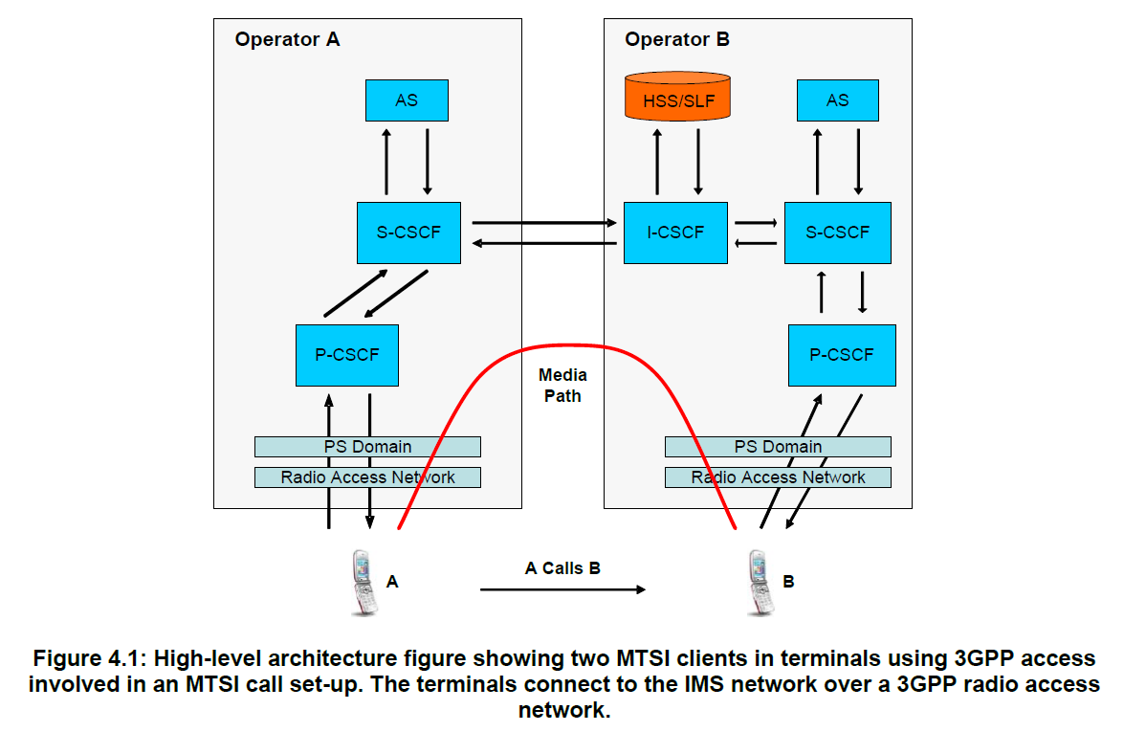
TS 26.114

Slide 8
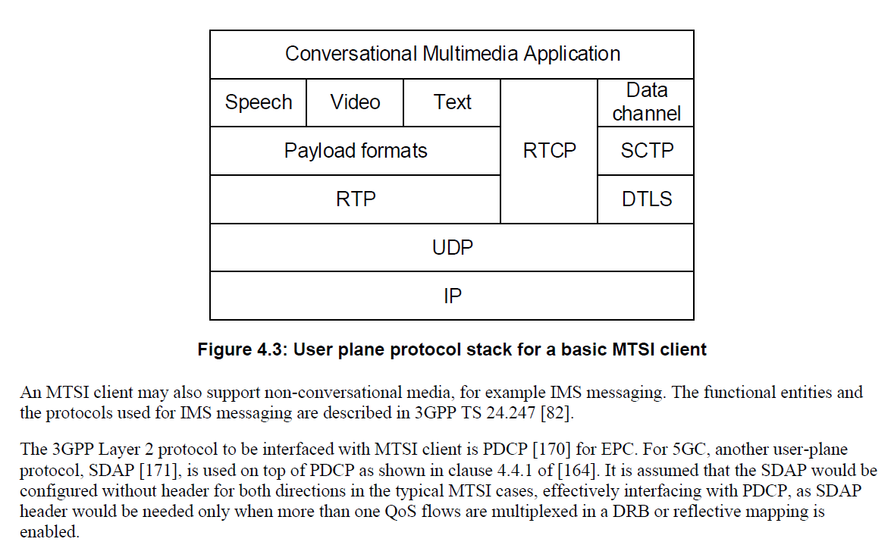
TS 26.114

Slide 9
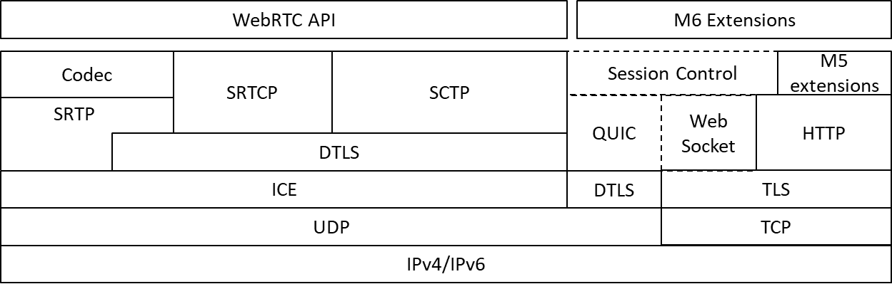
Proposal in 377

Slide 10
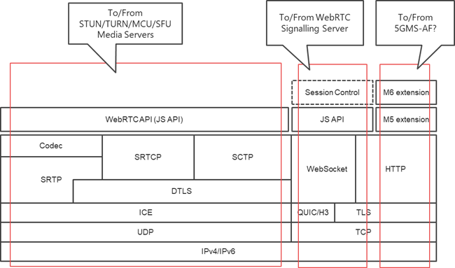
NTT’s idea

Slide 11
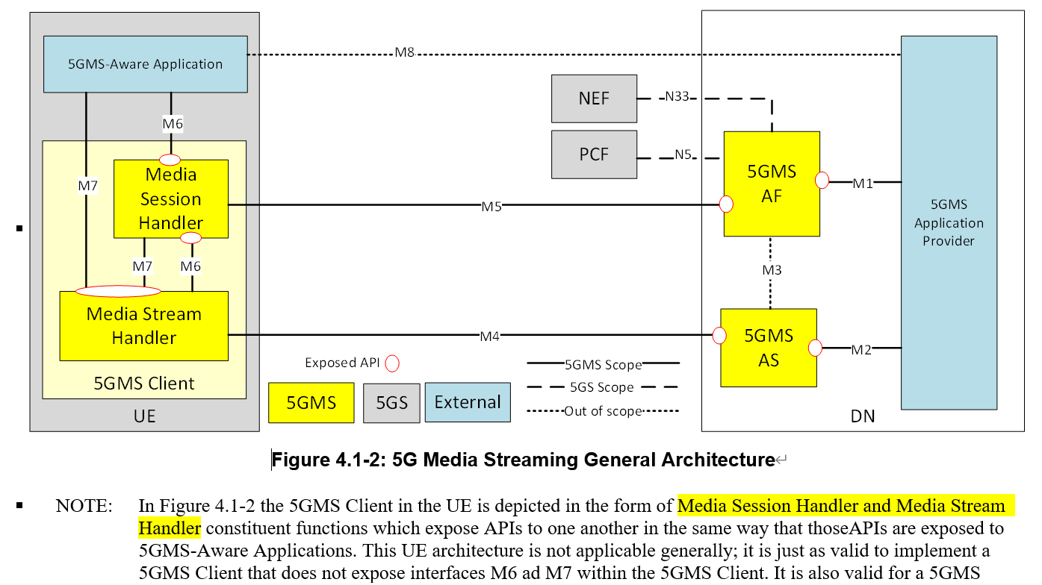
26.501

Slide 12
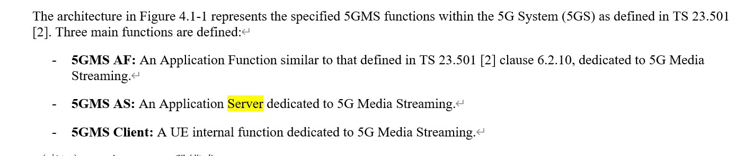

Slide 13
Different Models between RTC Work Items
To be updated
With specified C-plane, Operator-Assistance will provide interoperability
as IMS-based model while involving OTT-related elements.
OTT-related elements
iRTCW
(WebRTC-based
OTT model)
FS_eiRTCW
(WebRTC-based
Carrier Assistance model)
IBACS Expectation
(IMS model)
To be checked..
OTT-Data NW
Operator NW
OTT App
Operator NW
WebRTC
Signalling
Server
MCU/SFU
with ICE
WebRTC
Signalling
Server
AS
QoS
Control
(NBI?)
ISC
Mr’
OTT
C-Plane
U-Plane
QoS
Control
S-CSCF
MRFC
Operator
NW
NEF
Mw
Mp
PCF
OTT App
QoS
Control
PCF
Npcf
N7,
N4
N7,
N4
PCF
new WebRTC
C-Plane
MCU/SFU
with ICE
P-CSCF
MRFP
QoS
Tunnel
N7,N4
(R)AN / UPF
(R)AN / UPF
U-Plane
(R)AN
C-Plane
U-Plane
OTT proprietary
Client
OTT proprietary
Client
Various
Client
Various
Client
IMS Client
IMS Client

