Slide 1

JCCP: Joint Content Conformance Project
ATSC | CTA | DASH-IF | DVB | HbbTV
…with support from Apple

Slide 2
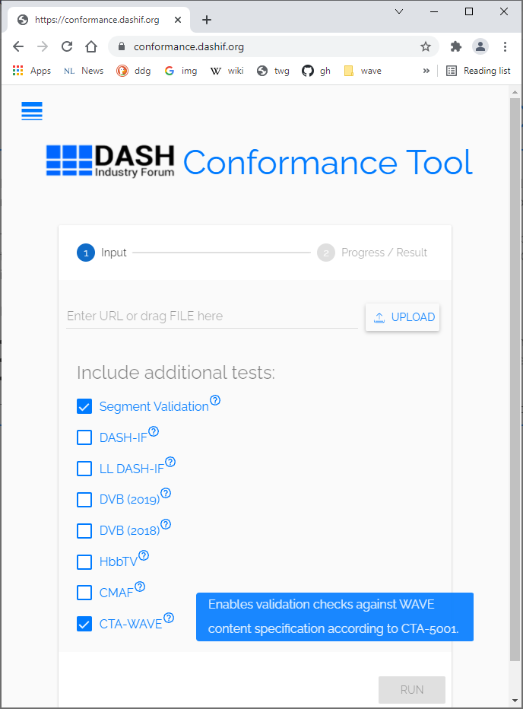
About the Joint Content Conformance Project
DASH-IF maintains an open-source software tool at conformance.dashif.org
  Currently used by multiple SDO’s
Tool capabilities
  Validates the MPD vs. ISO/IEC 23009-1 DASH MPD & Segment Formats
  Validates applicable profiles
  (Optional) Segment Validation
  (Optional) CTA WAVE / DASH-IF / DVB / HbbTV / MPEG-CMAF
But
  Code has been developed and maintained for >10 years
  Code uses multiple languages and tools
  It’s difficult to maintain, hard to extend

Slide 3
Project Status
“Conformance Partners” getting into contract
  Letter of Intent signed by ATSC | CTA | DASH-IF | DVB | HbbTV
  Cost-sharing Agreement in drafting
  Can consider additional participants
Phase 1, requirements & structure – Completed (study funded by DASH-IF)
Phase 2
  RFP out now (see https://dashif.org/news/jscsp/)
  Anticipate a 12-month project
SDOs potentially get:
  ISOBMFF segment validator (shared jointly w/ other parties)
  SDO-specific module

Slide 4
Strategies and Goals
Refactor in fewer languages/tools
Make additional (selected) improvements
Eliminate JVM in runtime
Define unified API across modules
Create distinct ISOSegmentValidator
12-month project, starting late 2021/early 2022
Easier maintenance/accuracy/extensions
Support for: CMAF, DASH, DVB, HbbTV, HLS, WAVE Content and DASH-HLS, Service Validation

Slide 5
Questions?

