Slide 1

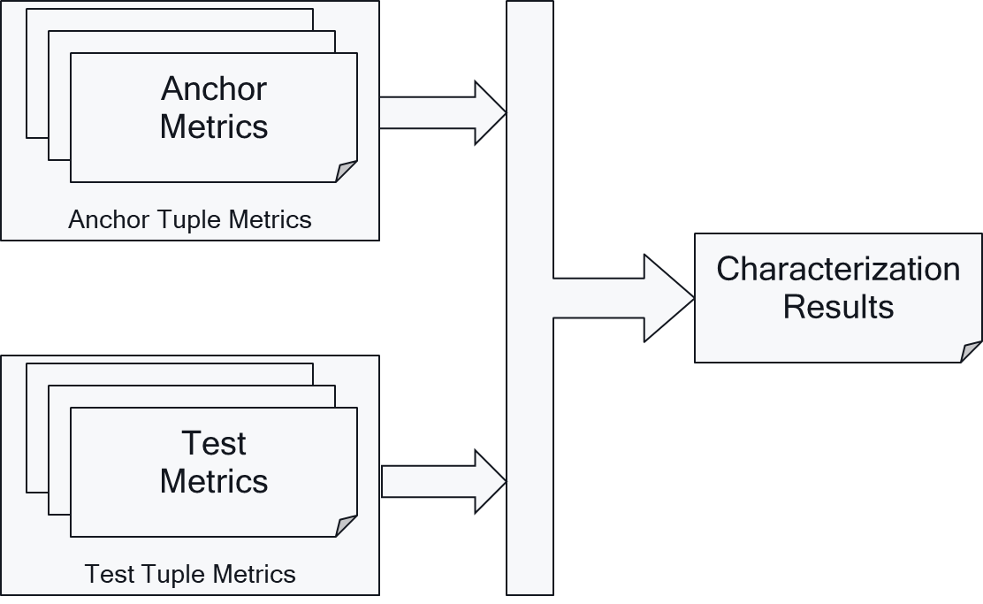




3GPP 5G Video Characterization
Feasibility Study in Rel-17
Thomas Stockhammer
Qualcomm Incorporated
TM-AVC1230

Slide 2
Scope
Approved in by SA plenary #87 in SP-200052.
High-Level Objectives
  identify relevant interoperability requirements, performance characteristics and implementation constraints of video codecs in 5G services,
  characterize existing 3GPP video codecs, in particular H.264/AVC and H.265/HEVC as benchmark for the addition of potential future video codecs.
The concrete objectives are as follows:
  Collect a subset of relevant scenarios for video codecs in 5G-based services and applications, including video formats (resolution, frame rates, color space, etc.), encoding and decoding requirements, adaptive streaming requirements, predominantly based on scenarios defined for 5G media streaming as well as for TR 26.925 and TR 26.928.
  Collect relevant and exemplary test conditions and material for such scenarios, including test sequences.
  Define performance metrics for such scenarios with focus on objective performance metrics.
  Collect relevant interoperability functionalities and enabling elements for video codecs in different 5G services such as MTSI and Telepresence (i.e. RTP based conversational communications), or 5G media streaming (e.g. based on DASH/CMAF) supporting the identified scenarios.
  Collect relevant criteria and key performance indicators for the integration of video codecs in 5G processing platforms, taking into account factors such as encoding and decoding complexity in the context of the defined scenarios.
  Characterize the existing codecs H.264/AVC and H.265/HEVC in the context of the above scenarios and document the findings in a consistent manner.
  Identify gaps and deficiencies of existing codecs in such use cases and derive requirements for potential new codecs.
  Collect initial information on how new codecs under development in ISO/IEC SC29 WG11 (MPEG)/JVET (in particular including VVC and EVC) may meet the above criteria based on the characterization results provided for example by ISO/IEC SC29 WG11 (MPEG)/JVET.

Slide 3
Status after SA4#114-e
The latest version of TR26.955 is available in S4-210871 in version 1.2.0. This document collects the status of the work and identifies the open points.
Also note that the work item has been updated in S4-210956 which will be sent to SA for approval (adds AV1)
The time plan is available in S4-210741 (Completion Dec 2021)
A status update as well as tracking open issues is provided in S4-210872

Slide 4
Scenarios
Scenarios are defined
  to identify how video codecs are typically used in 5G type of services
  To define reference sequences (types and formats), decoding & encoding constraints
Defined Scenarios
  Scenario 1: Full HD Streaming
  Scenario 2: 4K-TV
  Scenario 3: Screen Content Scenario
  Scenario 4: Messaging and Social Sharing
  Scenario 5: Online Gaming
Note: New scenario will be added for 8K based on new work item

Slide 5
Anchor Generation for each Scenario
Anchor
Configuration
Reference Sequence
Reference
Software
Encoder
Anchor Bitstream
Conforming
Decoder
Anchor Sequence
Metrics Computation
Anchor
Metrics

Slide 6
Reference Sequences: Example 4K-TV
Key | Name | Reference | Resolution | Frame rate | Colour Gamut | Number of Frames | Scene Cut
S2-R1 | Brest-Sedof | Annex C.3.1.3.1 | 3840 x 2160 | 60 | BT.709 | 300 | 0
S2-R2 | Rain Fruits | Annex C.3.1.3.2 | 3840 x 2160 | 50 | BT.709 | 500 | 0
S2-R3 | Park Joy | Annex C.3.1.3.3 | 3840 x 2160 | 50 | BT.709 | 500 | 0
S2-R4 | Soccer | Annex C.3.1.3.4 | 3840 x 2160 | 23.98 | BT.709 | 385 | 4
S2-R5 | Tunnel Flag | Annex C.3.1.3.5 | 4096 x 2160 | 59.94 | BT.709 | 600 | 0
S2-R6 | Boat | Annex C.3.1.3.6 | 4096 x 2160 | 59.94 | BT.709 | 300 | 0
S2-R7 | Fountain | Annex C.3.1.3.7 | 4096 x 2160 | 59.94 | BT.709 | 600 | 0
S2-R8 | Riverbank | Annex C.3.1.3.8 | 3840 x 2160 | 50 | BT.709 | 600 | 0
Key | Name | Reference | Resolution | Frame rate | Colour Gamut | Number of Frames | Scene Cut
S2-R11 | Life-Untouched | Annex C.3.2.3.1 | 4096 x 2160 | 59.94 | BT.2020 | 450 | 0
S2-R12 | Meridian | Annex C.3.2.3.2 | 3840 x 2160 | 59.94 | BT.2020 | 327 | 0
S2-R13 | Sol-Levante | Annex C.3.2.3.3 | 3840 x 2160 | 24 | BT.2020 | 145 | 0
S2-R14 | Cosmos | Annex C.3.2.3.4 | 3840 x 2160 | 24 | BT.2020 | 182 | 0
S2-R15 | Elevator | Annex C.3.2.3.5 | 4096 x 2160 | 59.94 | BT.2020 | 432 | 0
S2-R16 | Sparks | Annex C.3.2.3.6 | 4096 x 2160 | 59.94 | BT.2020 | 261 | 0
S2-R17 | Nocturne | Annex C.3.2.3.7 | 3840 x 2160 | 60 | BT.2020 | 370 | 0
All sequences are available here
https://dash-large-files.akamaized.net/WAVE/3GPP/5GVideo/ReferenceSequences/
Example annotation
https://dash-large-files.akamaized.net/WAVE/3GPP/5GVideo/ReferenceSequences/Brest-Sedof/Brest-Sedof.json

Slide 7
Metrics
SDR & HDR
Name | Type | Semantics
parameter | BIGINT | the associated variation parameter as defined for the anchor, for example the QP
bitrate | DOUBLEPRECISION | The size of the file divided by the duration of the reference sequence in bit/s as defined in clause 5.5.1 with 2 decimal digits accuracy.
y_psnr | DOUBLEPRECISION | Peak signal to noise ratio for Y planes in dB as defined in clause 5.5.2 with 2 decimal digits accuracy.
u_psnr | DOUBLEPRECISION | Peak signal to noise ratio for U planes in dB as defined in clause 5.5.2 with 2 decimal digits accuracy.
v_psnr | DOUBLEPRECISION | Peak signal to noise ratio for V planes in dB as defined in clause 5.5.2 with 2 decimal digits accuracy.
ms_ssim | DOUBLEPRECISION | structural similarity between frames as defined in clause 5.5.2 with 4 decimal digits accuracy.
vmaf | DOUBLEPRECISION | Video Multimethod Assessment Fusion (VMAF) as defined in clause 5.5.2 with 2 decimal digits accuracy.
bitrate_log | DOUBLEPRECISION | The bitrate as documented by the encoder log. If not known, it is set to 0.
encode_time | DOUBLEPRECISION | Total time spent to encode the sequence with reference encoder in seconds. If not known, it is set to 0.
decode_time | DOUBLEPRECISION | Total time spent to decode the sequence with reference decoder in seconds. If not known, it is set to 0.
Name | Type | Semantics
Parameter | BIGINT | the associated variation parameter as defined for the anchor, for example the QP
Bitrate | DOUBLEPRECISION | The size of the file divided by the duration of the reference sequence in bit/s as defined in clause 5.5.1.
y_psnr | DOUBLEPRECISION | Peak signal to noise ratio for Y planes in dB as defined in clause 5.5.2.
u_psnr | DOUBLEPRECISION | Peak signal to noise ratio for U planes in dB as defined in clause 5.5.2.
v_psnr | DOUBLEPRECISION | Peak signal to noise ratio for V planes in dB as defined in clause 5.5.2.
Wpsnr | DOUBLEPRECISION | Weighted peak signal to noise ratio for Y, U and V planes in dB as defined in clause 5.5.3.
psnrl100 | DOUBLEPRECISION | PSNRL100 as defined in clause 5.5.3
de100 | DOUBLEPRECISION | DE100 as defined in clause 5.5.3.
bitrate_log | DOUBLEPRECISION | The bitrate as documented by the encoder log. If not known, it is set to 0.
encode_time | DOUBLEPRECISION | Total time spent to encode the sequence with reference encoder in seconds. If not known, it is set to 0.

Slide 8
Metrics Details
Anchor
Configuration
Reference Sequence
json
Reference
Software
Encoder
Anchor Bitstream
json
Conforming
Decoder
Anchor Sequence
json
Metrics Computation
Anchor
Metrics

Slide 9
Tools
Unix command for file size
Reference Encoders
Reference Decoders
HDRTools
  HDRConvert (bitdepth, YUV/RGB for HDR)
  HDRMetrics
vmafossexec
Others?

Slide 10
Open Questions and Proposal for SDR Metrics
We need definitions for each of the metrics that can be implemented
Bitrate Options
  Bitstream
    File size (AVC, AV1)
    File size – frames*sizeSEI*flag
    General processing model
    Per codec processing model (file size w/o hash SEI for HEVC, VVC, EVC?)
    Per codec/cfg processing model
  Encoder log (expect identical with above)
  File size is only tracked for debugging
PSNR
  10 bit basis for all sequences (max 1020)
  We need algorithm for
    I: 8 bit -> O: 8 bit (AVC)
    I: 8 bit -> O: 10 bit (HEVC)
    I: 10 bit -> O: 10 bit (HEVC)
  8 bit to 10 bit convert by adding 2 '0‘s
    One step preferred
    Two step is currently done
MS-SSIM
  10 bit basis
  Needs conversion of 8 bit to 10 bit in two steps
  Use MPEG definition (unless someone complains)
  in dB
VMAF
  10 bit only (unclear internally)
  Needs conversion of 8 bit to 10 bit in two steps

Slide 11
Open Questions and Proposal for HDR Metrics
Bitrate same as SDR
PSNR – same as SDR (all 10 bit)
HDR Specific Metrics
  Wpsnr
  psnrl100
  De100
Process 10 bit yuv => 4:2:0 => 4:4:4 => RGB floating point => compute HDR metrics
  Desirable is a one step
  Currently a two-step approach: HDRConvert + HDRMetrics
    If used we would apply single precision for EXR
  Alexis will check if one step is doable, otherwise we go with two-step

Slide 12
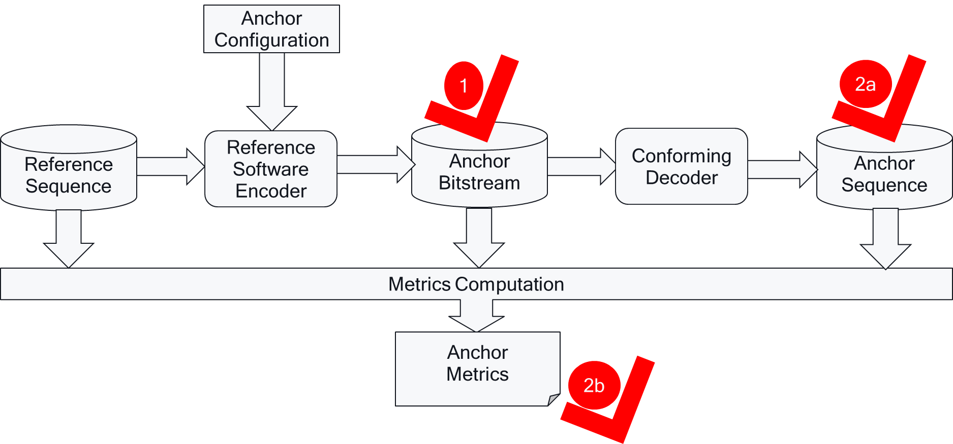
Verification
Anchor bitstream verification: Anchor bitstreams are correct. By using a defined reference sequence, an anchor configuration as well as a reference encoder, two different executions of this process results in the same anchor bitstream.
Anchor reconstruction is correct. By using a verified anchor bitstream, a reference decoder in two different implementations results
  in the same anchor sequence,
  in the same quality metrics.

Slide 13
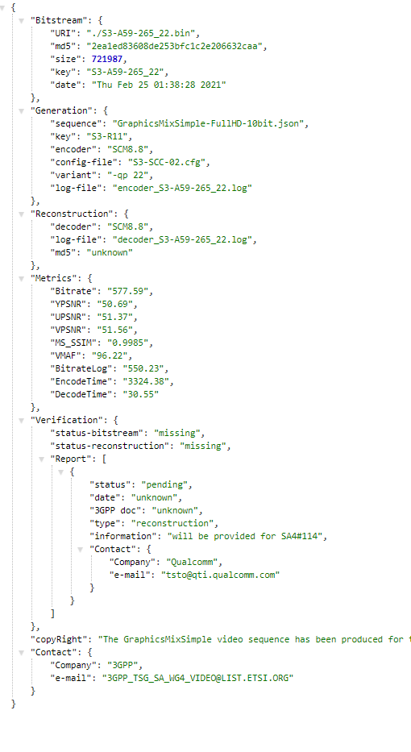
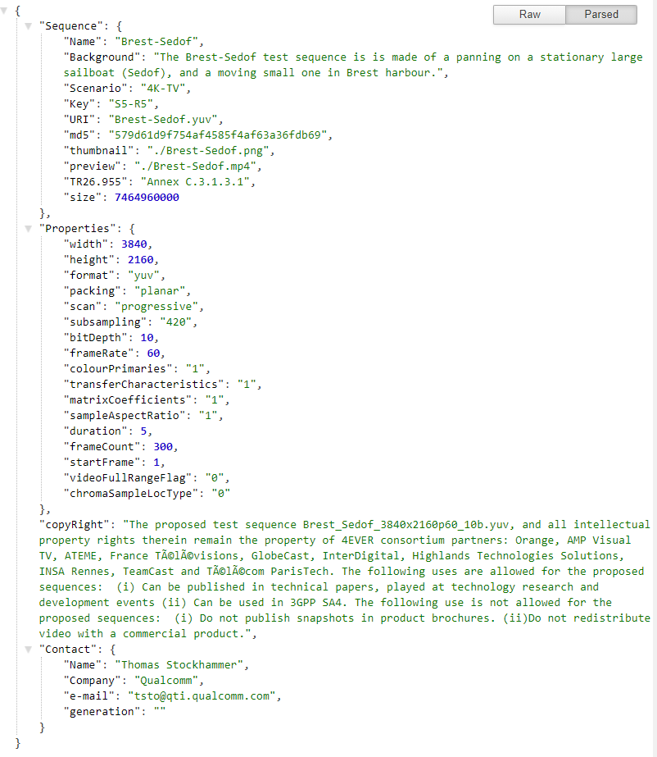
Annotation

Slide 14
Characterization
Characterization is the comparison of a codec under test with an anchor based on the framework introduced in this clause. Characterization in this report is based on Bjöntegard-Delta (BD)-rate.
A full characterization of a codec for a scenario against a 3GPP codec shall provide at least the following metrics
  The BD-rate gain for each defined anchor tuple and each required metric
  The average BD-rate gain across all anchors of the scenario for each required metric.

Slide 15

Tools and Repositories
All sequences are available here https://dash-large-files.akamaized.net/WAVE/3GPP/5GVideo/ReferenceSequences/
All metrics, anchors and tests are available here: https://dash-large-files.akamaized.net/WAVE/3GPP/5GVideo/Bitstreams/
Scripts for running anchor and test generation, metrics generation as well as verification is provided here: https://github.com/haudiobe/5GVideo/

