Slide 1
Report from SA#94-e on SA3 topics
Suresh Nair, SA3 Chair, Nokia

Slide 2
Outline
General information
Outcome of SA3 submissions
Approved related WID/SIDs
SA3 Exception Requests
Report on specific topics
LS to SA3

Slide 3
General information
Input
  The SA#94-e documents: https://www.3gpp.org/ftp/tsg_sa/TSG_SA/TSGS_94E_Electronic_2021_12/Docs
  The RAN#94-e documents: https://www.3gpp.org/ftp/TSG_RAN/TSG_RAN/TSGR_94e/Docs
  The CT#94-e documents: https://www.3gpp.org/ftp/tsg_ct/tsg_ct/TSGC_94e/Docs
Reports
  SA#94-e report: https://www.3gpp.org/ftp/tsg_sa/TSG_SA/TSGS_94E_Electronic_2021_12/Report
  SP-211545 is SA3 status report to TSG SA.

Slide 4
Outcome of SA3 submissions
All SA3-LI contributions were approved as submitted.
All SA3 contributions were approved except, 33.501 CR1218R1(S3-214498 ) and 33.501 CR1219R1(S3-214499) sent back to SA WG3.

Slide 5
Approved SA3 WID/SIDs
SP-211362 | New WID on Security Assurance Specification for Management Function (MnF)
SP-211363 | New WID on Mission critical security enhancements phase 3
SP-211365 | New WID on SECAM and SCAS for 3GPP virtualized network products
SP-211364 | New SID on privacy of identifiers over radio access
SP-211368 | Revised Study on enhanced Security Aspects of the 5G Service Based Architecture
SP-211358 | New WID on Security aspects of Non-Seamless WLAN offload in 5GS
SP-211360 | New WID on Authentication enhancements in 5GS
SP-211361 | New WID on enhanced security for Phase 2 network slicing
SP-211366 | New WID on Security enhancement of SEAL
SP-211357 | Revised WID on Enhancements of 3GPP profiles for cryptographic algorithms and security protocols

Slide 6
SA3 Exception Requests
Three exceptions were granted for SA3 to complete the work on security aspects for
Edge Computing (SP-211354),
Proximity based Services (SP-211355),
Uncrewed Aerial Systems (UAS) (SP-211356).

Slide 7
Report on specific topics
Work plan was not discussed
  Because of the Rel-18 content finalization discussions, no work plan was discussed. However, there were questions on SA3 Rel-17 completion and remaining work !
Queries on Rel-18 Security workshop
  Many queries on Security work for Rel-18 and plans for a workshop. Subsequently an SA3 workshop for Rel-18 was conducted on Jan 13, 20, 2022.
F2F Meetings
  All meetings until end of May confirmed as Electronic. F2F meetings to start from TSG meetings in June (to be confirmed in Quarterly decision meeting).

Slide 8
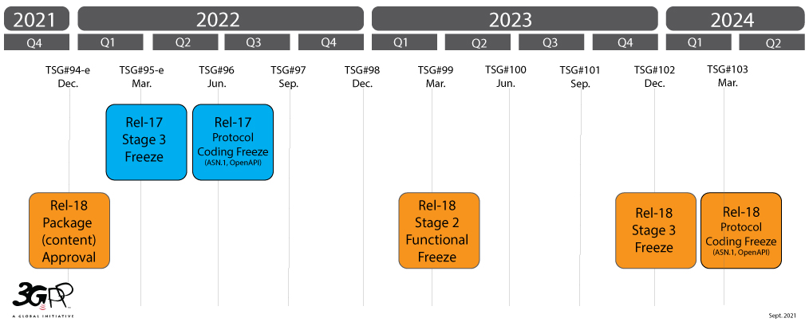
Rel-18 Timeline for SA3
Rel-18 Freeze for SA3

Slide 9
SA3 Upcoming meetings in 2022
SA3#106-e-Bis 2022-04-04 2022-04-08 Online
SA3#107-Bis 2022-06-27 2022-07-01 Bath, GB ➔ Need to confirm in this meeting
SA3#108 2022-08-22 2022-08-26 Gothenberg, Sweden
SA3#108 Bis 2022-10-10 2022-10-14 China, CN
SA3#109 2022-11-14 2022-11-18 USA

Slide 10
LSs to SA3
SP-211621 | LS on Energy Efficiency as guiding principle for new solutions

Slide 11

Thank You!
Suresh Nair
3GPP SA3 Chairman
mail: suresh.p.nair@nokia.com
phone: +1 973 978 9038

