Slide 1
R19 Energysys-Solutions proposed in TR and in August meeting
China Mobile
2024 August
Updated by Ericsson & Huawei

Slide 2
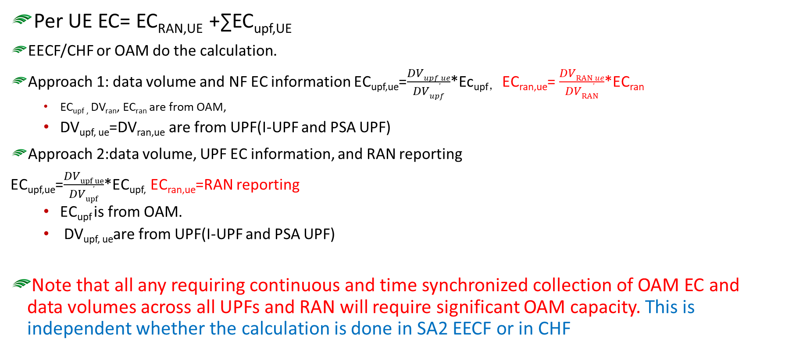

Summary of solutions- General on calculations
Per UE EC= EC_{RAN,UE} +∑EC_{upf,UE}
EECF/CHF or OAM do the calculation.
Approach 1: data volume and NF EC information EC_{upf,ue}=$\frac{DVupf,ue}{DVupf}$*Ec_{upf，} EC_{ran,ue}= $\frac{DVRAN,ue}{DVRAN}$*EC_{ran}
  EC_{upf ,} DV_{ran}, EC_{ran} are from OAM,
  DV_{upf, ue}=DV_{ran,ue} are from UPF(I-UPF and PSA UPF)
  Approach 2:data volume, UPF EC information, and RAN reporting
  EC_{upf,ue}=$\frac{DVupf,ue}{DVupf}$*EC_{upf,} EC_{ran,ue}=RAN reporting
  EC_{upf} is from OAM.
  DV_{upf, ue}are from UPF(I-UPF and PSA UPF)
Note that all any requiring continuous and time synchronized collection of OAM EC and data volumes across all UPFs and RAN will require significant OAM capacity. This is independent whether the calculation is done in SA2 EECF or in CHF

Slide 3
Summary of solutions- 5GC functionality
UE
AF
New NF EECF
New NEF exposure services
EECF do the calculation.
  The NF ID is provided from UDM to EECF (UPF/I-UPF?).
  RAN ID is provided from AMF to EECF.
  DV_{upf, ue}=DV_{ran,ue} are from UPF(I-UPF and PSA UPF)
  New NEF exposure services
  Significant OAM capacity needed to provide EC_{upf} and EC_{ran} (approach 1) measurement/estimations
    Same for all solution in these slides
  For roaming, the V-EECF may report the per UE EC of VPLMN to H-EECF, on a new roaming interface.
UE
5GCNF
NEF
UE
New EC exposure services
UE
OAM
UDM
UE
UE
EECF
UE
AMF
UE
SMF
UE
UE
UE
UE
UE
I-UPF
PSA-UPF
RAN
Architecture of 5GC supporting EnergySys

Slide 4
Summary of solutions- OAM based solution-determined by SA5
UE
AF
Per UE EC= EC_{RAN,UE} +∑EC_{upf,UE}
OAM do the calculation.
Formula the same as the slide 2 approach 1, except the CHF provides the DV_{upf,UE}=DV_{ran,ue}
SBMA to support per UE EC information exposure to NEF/5GC NF.
Observation:
One problem: CHF does not have I-UPF information. Therefore the OAM cannot generate the I-UPF EC of the UE.
How to support roaming is not clear.
Currently, the OAM manage object focus on NF or NS, not per UE.
UE
5GCNF
NEF
UE
UE
OAM
Not updated
UE
AMF
UE
SMF
UE
CHF
UE
UE
UE
UE
UE
I-UPF
PSA-UPF
RAN
How to calculate the I-UPF EC of UE is FFS

Slide 5
Summary of solutions- CHF based solution
UE
No new NF, enhancements to existing NFs
CHF to calculate the EC information per UE
  The CHF provides the DV_{upf,UE}=DV_{ran,ue}
  OAM provides EC_{upf}, EC_{ran,} DV_{upf,} DV_{ran}
  SMF provides UPF/I-UPF IDs to CHF
  ULI reporting is used to provide RAN IDs
Significant OAM capacity needed to provide EC_{upf} and EC_{ran} (approach 1) measurement/estimations
  Same for all solution in these slides
For roaming, the V-CHF may report the per UE EC of VPLMN to H-CHF by enhancing the existing roaming interface.
CHF is enhanced to support to UE EC exposure to NEF/NF.
AF
UE
5GCNF
NEF
UE
CHF expose the EC of UE to NEF/NF
UE
UE
AMF
UE
OAM
SMF
UE
CHF
UE
UE
UE
UE
UE
I-UPF
PSA-UPF
RAN

Slide 6
Summary
Solution# | Per UE EC calculation | Evaluation
5GC New functionality | Approach 1 RAN, I-UPF, PSA-UPF Node level EC from OAM; RAN node level DV from OAM DV_{upf,ue}=DV_{ran,ue} Approach 2 EC_{ran,ue} reporting from RAN (via?) | EC, DV_{ran} from OAM New NF New exposure services from new NF New Exposure service from NEF usable in conjunction with existing framework New roaming interface (e.g. between new NFs in VPLMN & HPLMN) Enhance existing NFs e.g. AMF, SMF CN internal decision making and reaction possible (e.g. AM, SM, UE policy decision); Reporting from RAN requires RAN decision
OAM | Formula the same as the Sol#1 approach 1, except the CHF provides the DVupf,UE=DVran,ue SBMA to support per UE EC information exposure to NEF/5GC NF. DV from CHF but without I-UPF related information | Specification enhancement in SA5 is needed to support the I-UPF EC information calculation. How to support roaming is not clear, and OAM do not support roaming. Currently, the OAM manage object focus on NF or NS, not per UE. OAM does not have SUPI information to identify the traffic of a specific UE. OAM does not have information of serving node of a specific UE Decided by SA5.
CHF | CHF provides the DVupf,UE=DVran,ue CHF get the ECupf, ECran, DVupf, DVran from OAM Approach 2 EC_{ran,ue} reporting from RAN (via SMF) | EC, DV_{ran} from OAM DVupf are collected from SMF, serving node are collected from charging information from AMF, SMF, Enhance CHF New exposure services from CHF towards NEF and other CN’s NF increased frequency of interaction between Charging System and 5GC to enable 5GC reaction e.g. (AM, SM UE policy decision) time effective Enhance existing roaming interface Enhance existing NFs e.g. SMF
OAM row updated by Hua

