Slide 1
R19 Energysys-Solutions proposed in TR and in August meeting
China Mobile
2024 August

Slide 2
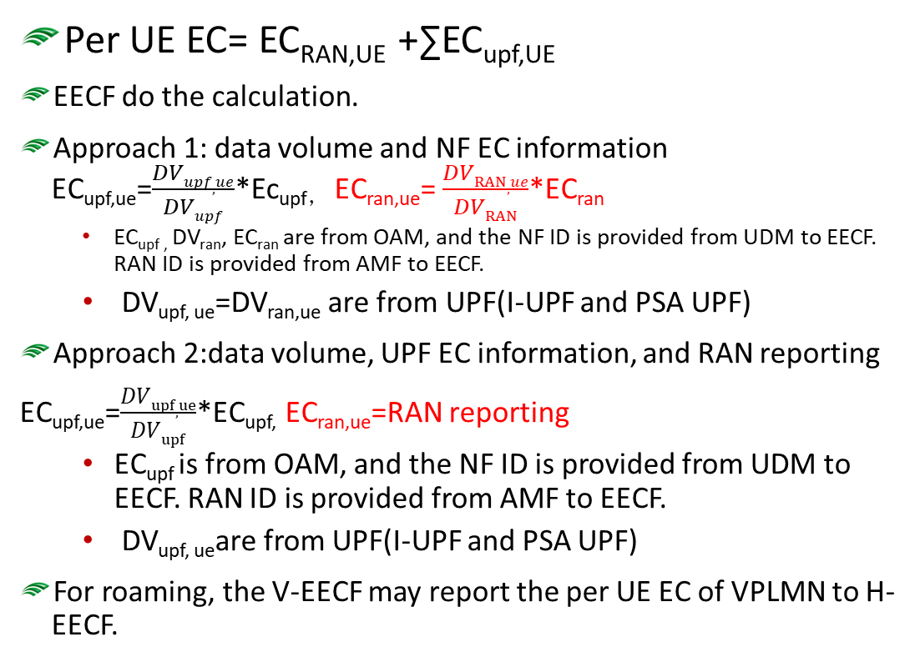

Summary of solutions- 5GC functionality-determined by SA2
UE
AF
Per UE EC= EC_{RAN,UE} +∑EC_{upf,UE}
EECF do the calculation.
Approach 1: data volume and NF EC information EC_{upf,ue}=$\frac{DVupf,ue}{DVupf}$*Ec_{upf，} EC_{ran,ue}= $\frac{DVRAN,ue}{DVRAN}$*EC_{ran}
  EC_{upf ,} DV_{ran}, EC_{ran} are from OAM, and the NF ID is provided from UDM to EECF. RAN ID is provided from AMF to EECF.
  DV_{upf, ue}=DV_{ran,ue} are from UPF(I-UPF and PSA UPF)
  Approach 2:data volume, UPF EC information, and RAN reporting
  EC_{upf,ue}=$\frac{DVupf,ue}{DVupf}$*EC_{upf,} EC_{ran,ue}=RAN reporting
  EC_{upf} is from OAM, and the NF ID is provided from UDM to EECF. RAN ID is provided from AMF to EECF.
  DV_{upf, ue}are from UPF(I-UPF and PSA UPF)
  For roaming, the V-EECF may report the per UE EC of VPLMN to H-EECF.
UE
5GCNF
NEF
UE
UE
OAM
UDM
UE
UE
EECF
UE
AMF
UE
SMF
UE
UE
UE
UE
UE
I-UPF
PSA-UPF
RAN
Architecture of 5GC supporting EnergySys

Slide 3
Summary of solutions- OAM based solution-determined by SA5
UE
AF
Per UE EC= EC_{RAN,UE} +∑EC_{upf,UE}
OAM do the calculation.
Formula the same as the slide 2 approach 1, except the CHF provides the DV_{upf,UE}=DV_{ran,ue}
SBMA to support per UE EC information exposure to NEF/5GC NF.
Observation:
One problem: CHF does not have I-UPF information. Therefore the OAM cannot generate the I-UPF EC of the UE.
How to support roaming is not clear.
Currently, the OAM manage object focus on NF or NS, not per UE.
UE
5GCNF
NEF
UE
UE
OAM
UE
AMF
UE
SMF
UE
CHF
UE
UE
UE
UE
UE
I-UPF
PSA-UPF
RAN
How to calculate the I-UPF EC of UE is FFS

Slide 4
Summary of solutions- CHF based solution-determined by SA5
UE
Per UE EC= EC_{RAN,UE} +∑EC_{upf,UE}
Formula the same as the slide 2 approach 1, except the CHF provides the DV_{upf,UE}=DV_{ran,ue}
CHF needs to get the EC_{upf}, EC_{ran,} DV_{upf,} DV_{ran} from OAM
Observation:
Functionality enhancement for CHF to calculate the EC information per UE.
Problem: CHF does not have I-UPF information. Therefore the CHF cannot generate the I-UPF EC of the UE.
How to support roaming is not clear.
How the CHF support to expose EC information to NEF/5GC NF is not clear.
AF
UE
5GCNF
NEF
UE
How to expose the EC of UE is FFS
UE
UE
AMF
UE
OAM
SMF
UE
CHF
Node level EC, DV of RAN and UPF, provided from OAM to CHF
UE
UE
UE
UE
UE
I-UPF
PSA-UPF
RAN
How to calculate the I-UPF EC of UE is FFS

Slide 5
Summary
Solution# | Per UE EC calculation | Evaluation
5GC New functionality | Approach 1 RAN, I-UPF, PSA-UPF Node level EC from OAM; RAN node level DV from OAM DV_{upf,ue}=DV_{ran,ue} Approach 2 EC_{ran,ue} reporting from RAN | Node level EC, DV_{ran} from OAM Decided by SA2.
OAM | Formula the same as the Sol#1 approach 1, except the CHF provides the DVupf,UE=DVran,ue SBMA to support per UE EC information exposure to NEF/5GC NF. DV from CHF but without I-UPF related information | Specification enhancement in SA5 is needed to support the I-UPF EC information calculation. How to support roaming is not clear, and OAM do not support roaming. Currently, the OAM manage object focus on NF or NS, not per UE. Decided by SA5.
CHF | Formula the same as the Sol#1 approach 1, except the CHF provides the DVupf,UE=DVran,ue CHF needs to get the ECupf, ECran, DVupf, DVran from OAM DV from CHF but without I-UPF related information How to expose is not clear | Specification enhancement in SA5 to support the I-UPF EC information calculation, and the CHF information exposure Interface between CHF and OAM to support CHF getting the ECupf, ECran, DVupf, DVran from OAM Decided by SA5.

