Slide 1
5GS Assistance for Federated Learning Member
Selection
Jingran Chen

Slide 2
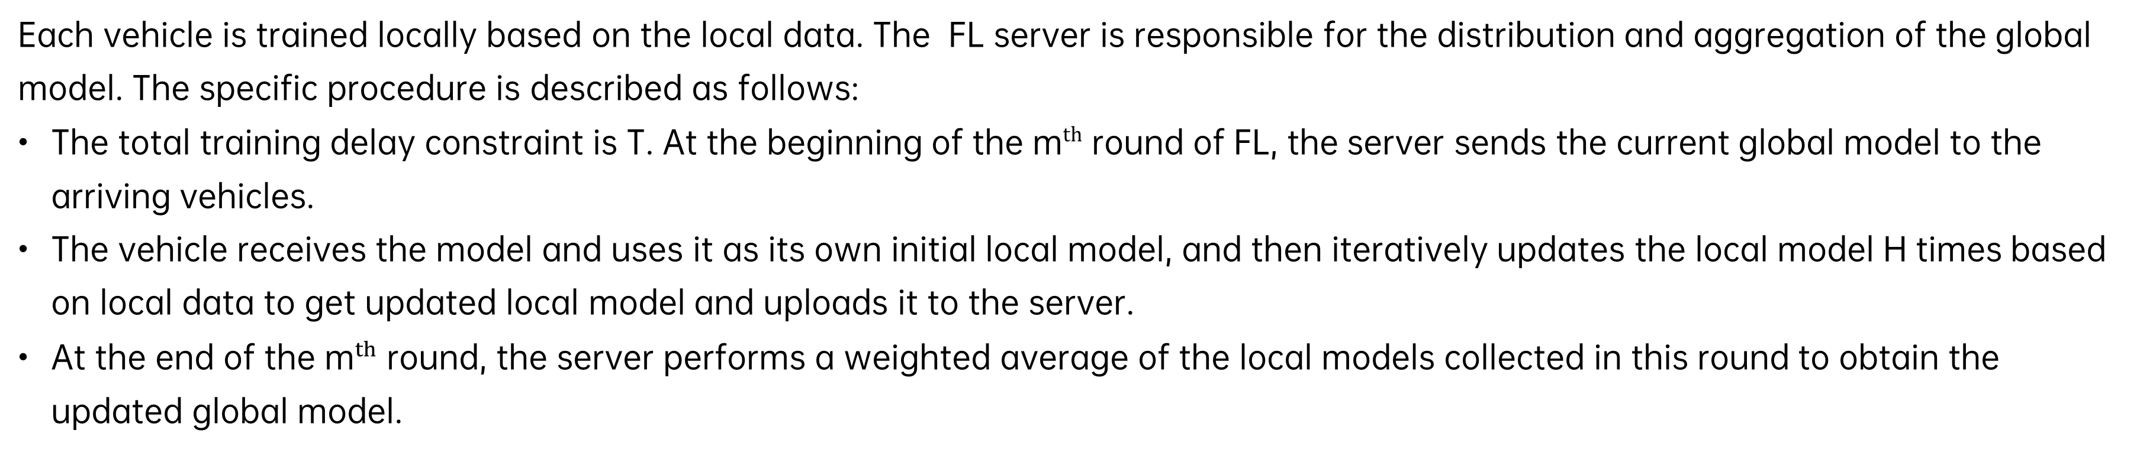
Federated learning based trajectory prediction-Application scenarios description
Each vehicle is trained locally based on the local data. The FL server is responsible for the distribution and aggregation of the global model. The specific procedure is described as follows:
The total training delay constraint is T. At the beginning of the ${\text{m}}^{th}$ round of FL, the server sends the current global model to the arriving vehicles.
The vehicle receives the model and uses it as its own initial local model, and then iteratively updates the local model H times based on local data to get updated local model and uploads it to the server.
At the end of the ${\text{m}}^{th}$ round, the server performs a weighted average of the local models collected in this round to obtain the updated global model.

Slide 3
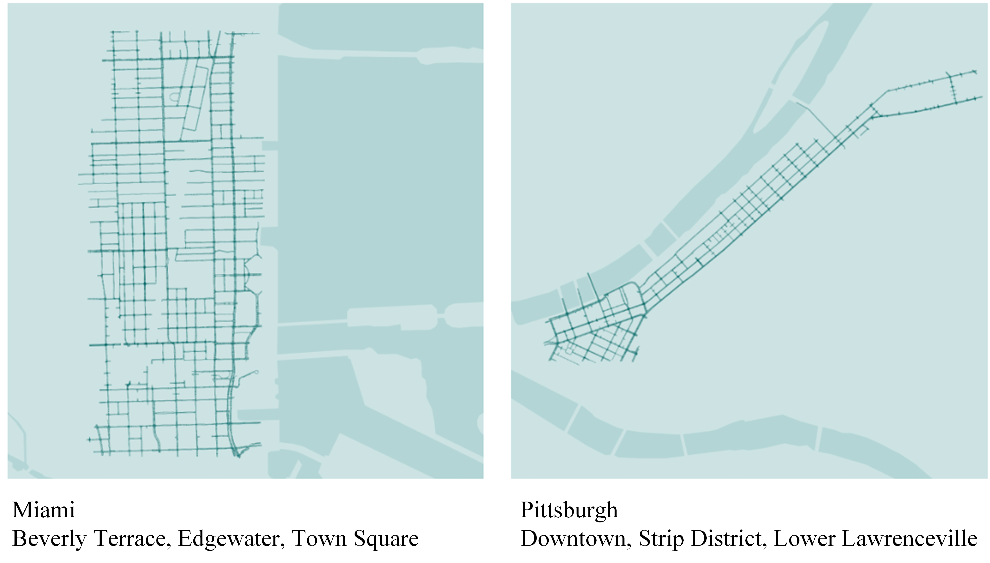
Simulation analysis- Dataset
Miami (MIA) dataset: historical trajectory data collected from the vehicles in Miami;
Pittsburgh (PIT) dataset: historical trajectory data collected from the vehicles in Pittsburgh.

Slide 4
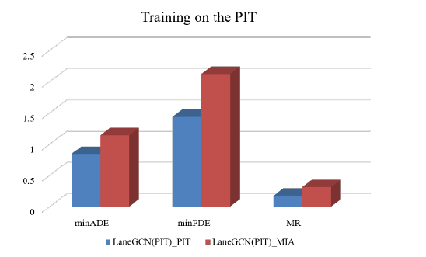
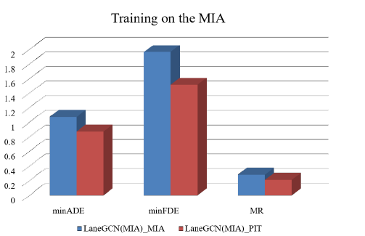
Simulation analysis
Model trained on the MIA dataset achieved good results on the PIT validation dataset.
The result shows that model training on a more diverse dataset with more geographic location features can effectively improve the model generalization and expand the applicable area of the model.

Slide 5
5GS assisted FL member selection- Criteria: UE current and historical location
Definition
Information exchanges
FL Coverage Area: The coverage area that the specific FL server applies the training.
Model’s Applicable Area: The area that the FL trained model can apply.
Historical Nomadic Period: The historical nomadic period is referred to the minimum duration that the UE was roving within the visited AoI.
Target Area of Interest (AoI): The target AoI which is beyond the FL coverage area but is within the model’s applicable area.
AF to 5GS:
Target AoI,
FL Coverage Area,
Historical nomadic period for the given target AoI.
5GS to AF:
5GS selects the in-coverage UEs coming from the target AoI and have been roving there over historical nomadic period.

Slide 6
Assistance information for federated learning
The data set of a single UE generally cannot represent the characteristics of the applicable area for model training. With assistance from 5GS, Federated Learning can collect multiple representative UE data sets to form a integral data set for model training in the applicable area
Candidate UE selection based on certain filtering criteria from 3rd party
Unsuitably collected multiple UEs’ dataset
Effective UEs’ dataset representing model applicable area
Model’s applicable area
Model’s applicable area

Slide 7
Criteria: UE Direction and separation distance
Vehicles can only move on the road which makes that geographically close vehicles tend to have similar data sets from in-vehicle cameras or sensors.
To avoid to select these nodes with similar data sets for FL training, 5GC needs to ensure that the distance between each candidate UE provided to the FL server is adequately apart.
As shown in the figure, car1 and car2 are running at different direction on the road and may have different data sets from in-vehicle camera. For location based FL member selection, this situation need to be considered

Slide 8
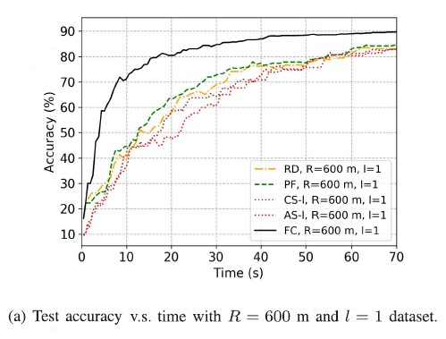
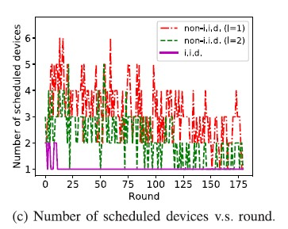
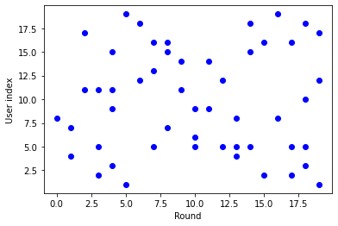
Criteria: UE latency performance
The left picture shows the training convergence with different FL scheduling strategy (potentially with 5GS assistance)
  FC: An efficient scheduling algorism with a good tradeoff between the latency per round and the number of rounds.
PF: Schedules N=3 devices with the best instantaneous channel conditions out of all M devices
To achieve the best FL performance (i.e. FC), the right picture shows a intermediate training result per round regarding UE number, selected UE ids)
(Reference: TWC-2021 Joint Device Scheduling and Resource Allocation for Latency Constrained Wireless Federated Learning)
Dynamic UE scheduling helps to accelerate FL training a lot;
UE selection based on real-time network resource measuring helps for FL member determination;

Slide 9
Specific procedure for the 5GC assistance to Member selection

