Slide 1
Welcome to TSG#101 @
Bangalore (Bengaluru)!
11th – 15th September 2023

Slide 2
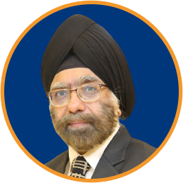
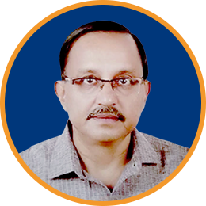
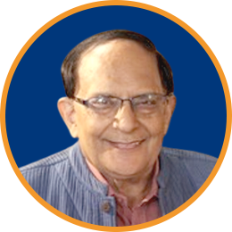
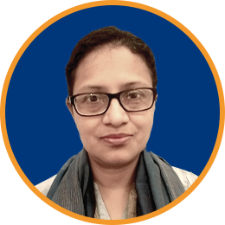
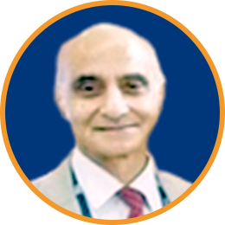
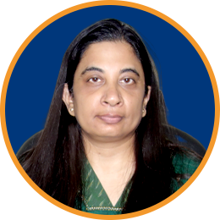
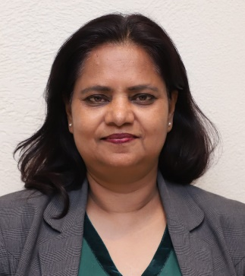
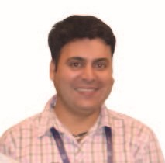
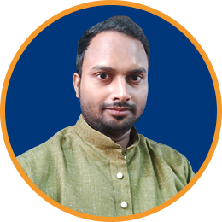
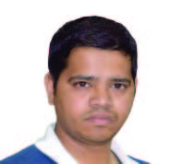
Thank You!
TSDSI Secretariat
Kuljit Singh
AK Mittal
Vijay Madan
Bindoo Srivastava
PK Jaswal
Shefali Sinha
Anupam Sinha
Harsh Arora
Asif Iqbal
Rajesh Vasudev
Administrative Ministries of Government of India – DoT, MEA & MHA

Slide 3
Bangalore (Bengaluru) - History
Bengaluru is the capital and largest city of the southern Indian state of Karnataka. It has a population of more than 8 million and a metropolitan population of around 11 million, making it India's third most populous city.
References suggest that a city existed here dates to around 517 CE (Based on temple inscriptions and early references)
To give a sense of how old the city is:
Chokkanatha Swamy temple in Bangalore dates to 1200 CE.
The Nageshvara temple goes back to 1200 years.
Roman silver coins have been found in Bengaluru and some 163 coins included bearing the faces of Augustus, Tiberius and Claudius (discovered near the HAL Airport). The Roman empire fell in 476 CE, so imagine finding 1700-year-old coins in the heart of Bangalore.
All lakes in Bangalore are man made, Bellandur lake is around 2000-year-old, as are Begur and Hebbal lakes (Based on the idols and inscriptions that have been found near the lake) Ulsoor and Sankey tank are the youngest lakes (Post 1537)
Medieval Bangalore:
In 1537, Kempe Gowda, a feudal ruler under the Vijayanagar Empire (1336-1646), established a mud fort (called Banglaore Fort), around what is now considered modern Bangalore.
Interested in the history of Bangalore? https://www.youtube.com/watch?v=HKzE-PfovXA

Slide 4
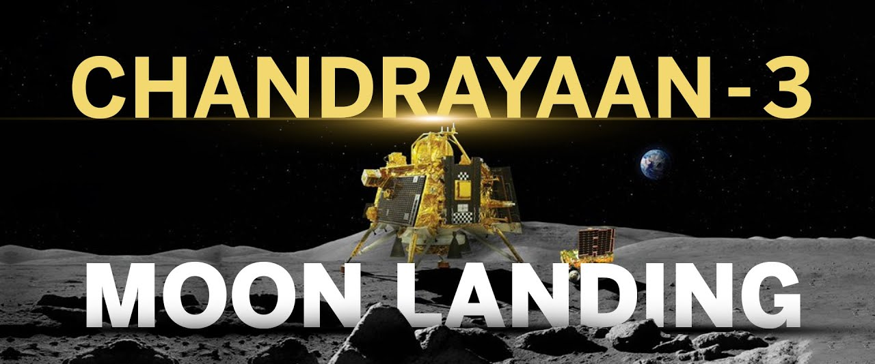
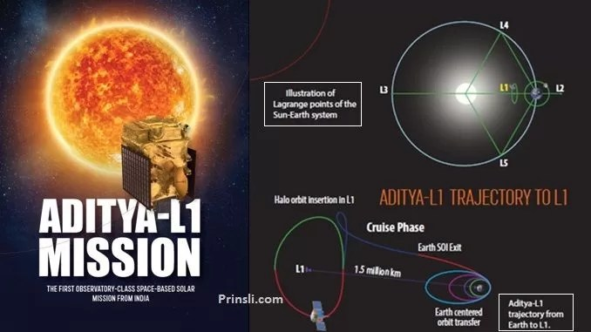
Today’s Bangalore!
The city is widely regarded as the "Silicon Valley of India", as the largest IT hub of the country, and the “Start-up city” of India, with 5,062 Tech startups since 2021.
Bangalore contributes to 38% of India's total IT exports, and home to 400 of the Fortune-500 companies.
The Indian Space Research Organization (ISRO) is headquartered in Bangalore.
Chandrayaan-3 successfully landed on the South Pole of the moon (world’s first!)
Interesting Fact: Cost of Chandrayaan 3 was $75 million, less than Interstellar's budget of $165 million
Aditya-L1 mission launched on 2nd September on its way to an orbit close to the Sun

Slide 5
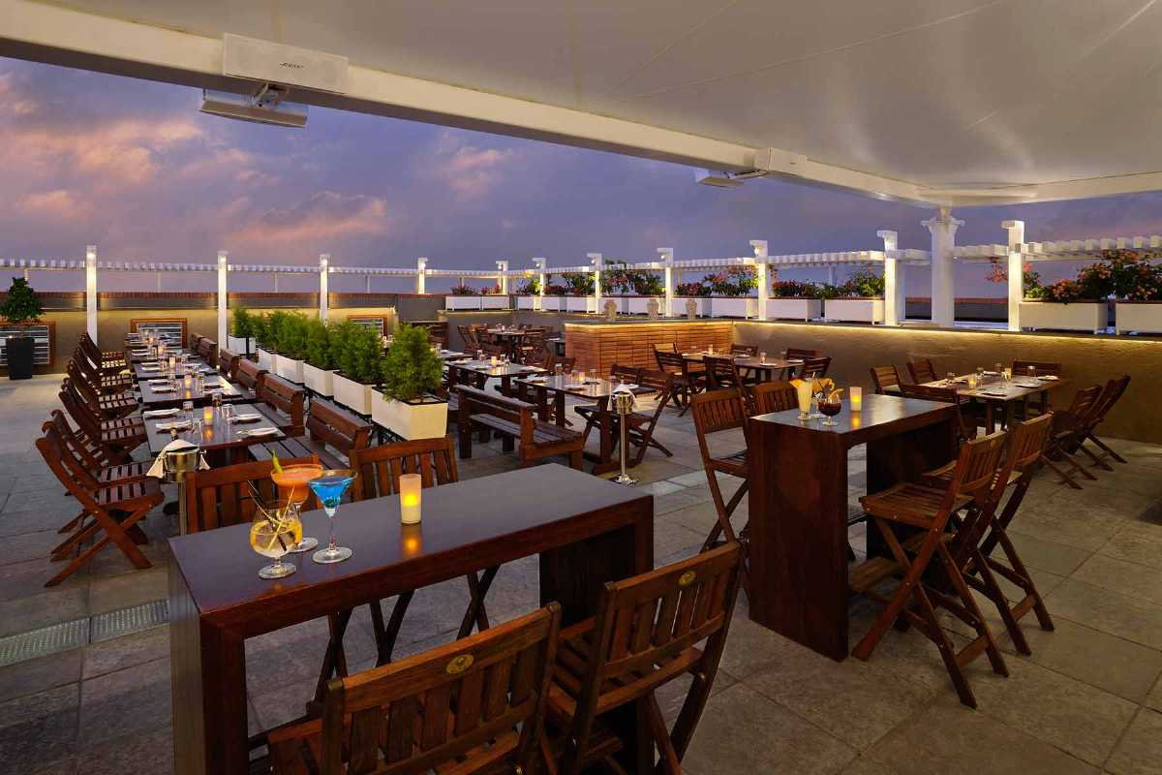
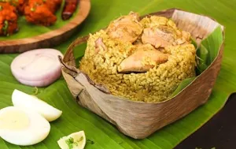
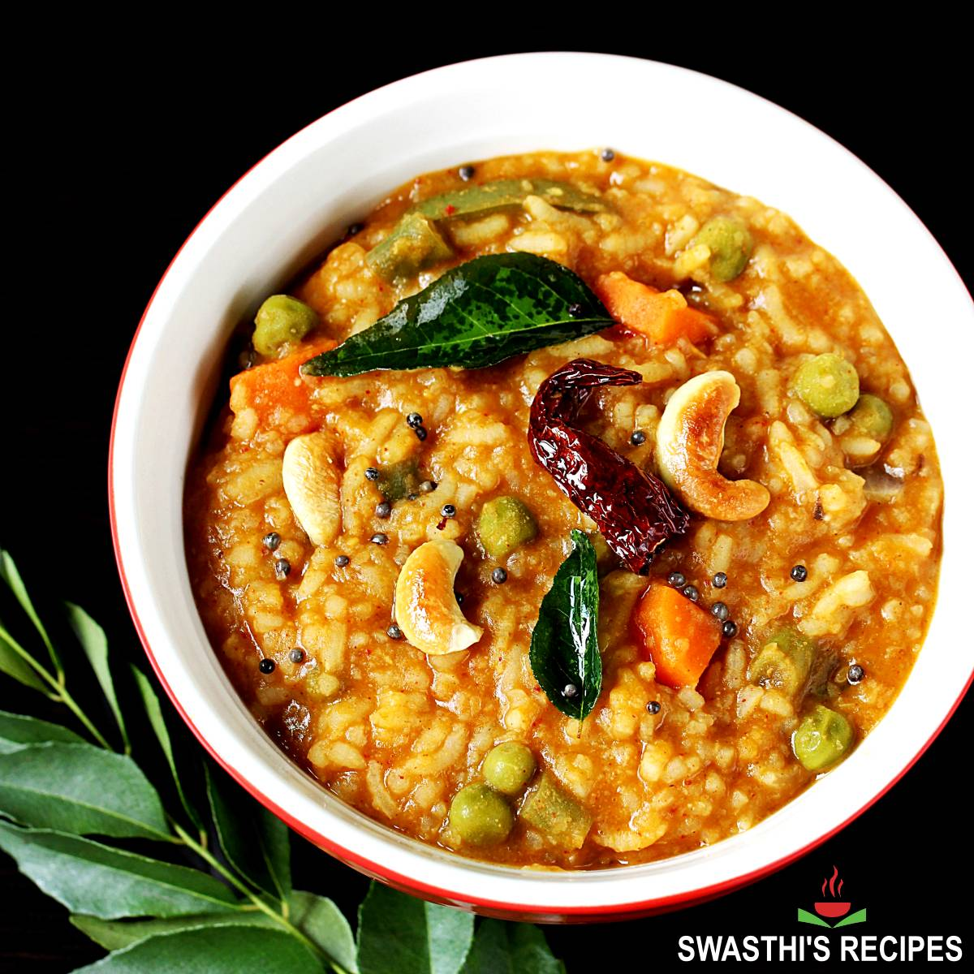
Bangalore – Food / Beer
Bangalore is considered as the brewery capital of India with around 80 breweries (all brewing their own beer)
Top breweries in Bangalore:
https://www.holidify.com/pages/breweries-in-bangalore-2986.html
Windmills Craftworks (Whitefield)
ABSOLUTE LOCAL FOOD - MUST TRY
Donne Biryani (Meat and Rice cooked in spices and served in a teak leaf bowl or a banana leaf bowl)
Bisi bele bhath is a spicy, rice-based dish with origins in the state of Karnataka
Ancient Cookbook
Pakadarpanam (Sanskrit: पाकदर्पण) written by Nala more than 5000 years back is considered as the first cookbook on planet earth – Some preserved parts of the original Sanskrit text is translated and is available in English. (https://www.amazon.in/PAKADARPAN-NALA-Dr-Madhulika/dp/8176372412 )

Slide 6
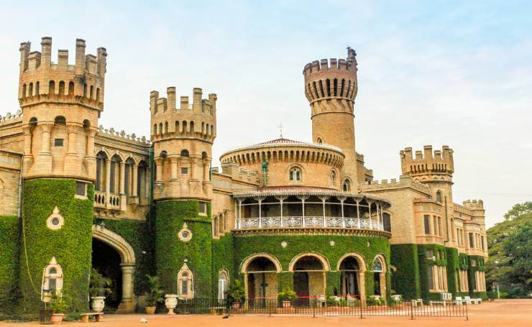
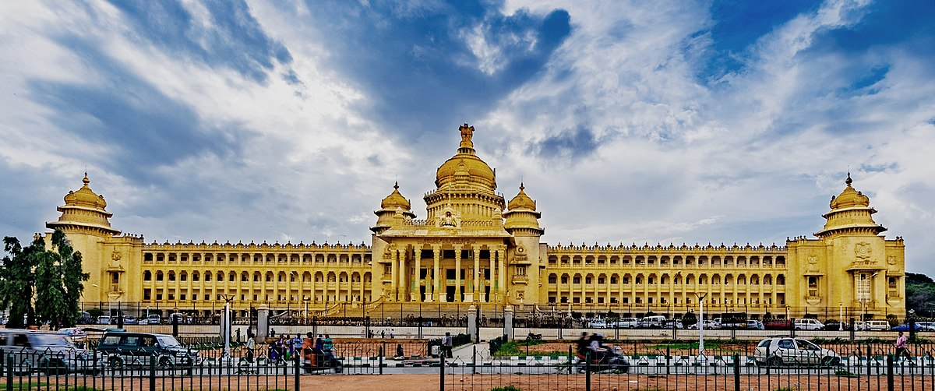
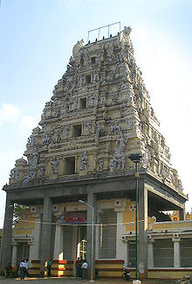
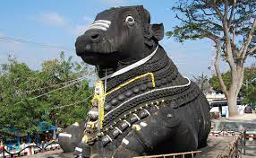
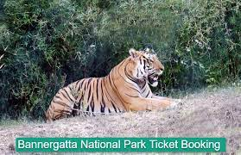
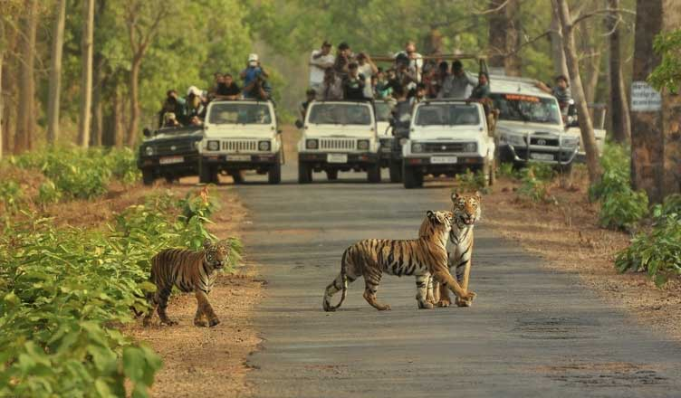
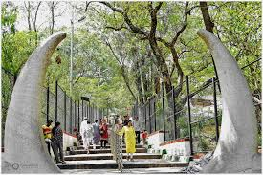
Bangalore – Places to see
You will find advice on Google
for other places to visit in
Bangalore
BUT
The absolute MUST visit Places
Vidhana Soudha
(Karnataka State Assembly)
The Bangalore Place
(Modelled after Windsor Castle)
Bannerghatta National Park and the Tiger Safari
The Bull Temple

Slide 7
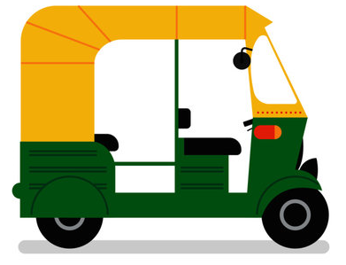
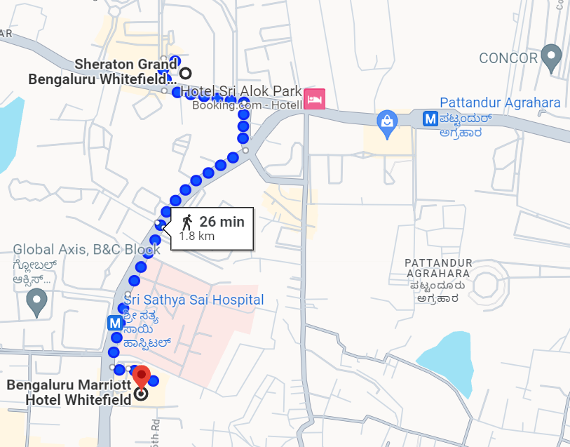
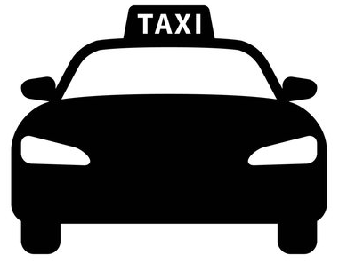
Local Commute - Whitefield
PURPLE LINE
Sri Sathya Sai Hospital Metro Station
Ticketing is in L1 floor. Fare is INR 10 to Pattandur Agrahara Metro Station
Platforms are in L2 level. Take Platform 1 towards Pattandur Agrahara Metro Station (Refer map)
Take Exit point B to exit into the side of Sri Sathya Sai Hospital (which is in the side of BMHW)
Pattandur Agrahara Metro Station
Ticketing is in L1 floor. Fare is INR 10 to Sri Sathya Sai Hospital Metro Station
Platforms are in L2 level. Take Platform 2 towards Sri Sathya Sai Hospital Metro Station (Refer map)
Take Exit point A (Thigalarapalya side) to exit into the side to walk towards SGBW
Take Exit point B (Pattandur Agrahara side) to reach the Park Square Mall
(SGBW)
“Auto”
“Rickshaw”
“Auto Rickshaw”
Pattandur Agrahara Metro Station
1.1Km (16 mins walk from SGBW)
3 mins journey
The Ticket media are:
Tokens (for single journey) – Pay by cash or Paytm/UPI at ticketing counter (Credit card not accepted)
Contactless Smart Cards (for multiple journeys)
QR code based Ticket (Chatbot service through WhatsApp: +918105556677) – Allows credit card payment
Sri Sathya Sai Hospital Metro Station
350m (5 mins walk from BMHW)
The best way to avail transport services of “Auto” and “Taxi” is to use the Apps – Uber or Ola.
(BMHW)

Slide 8
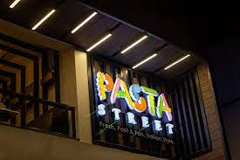
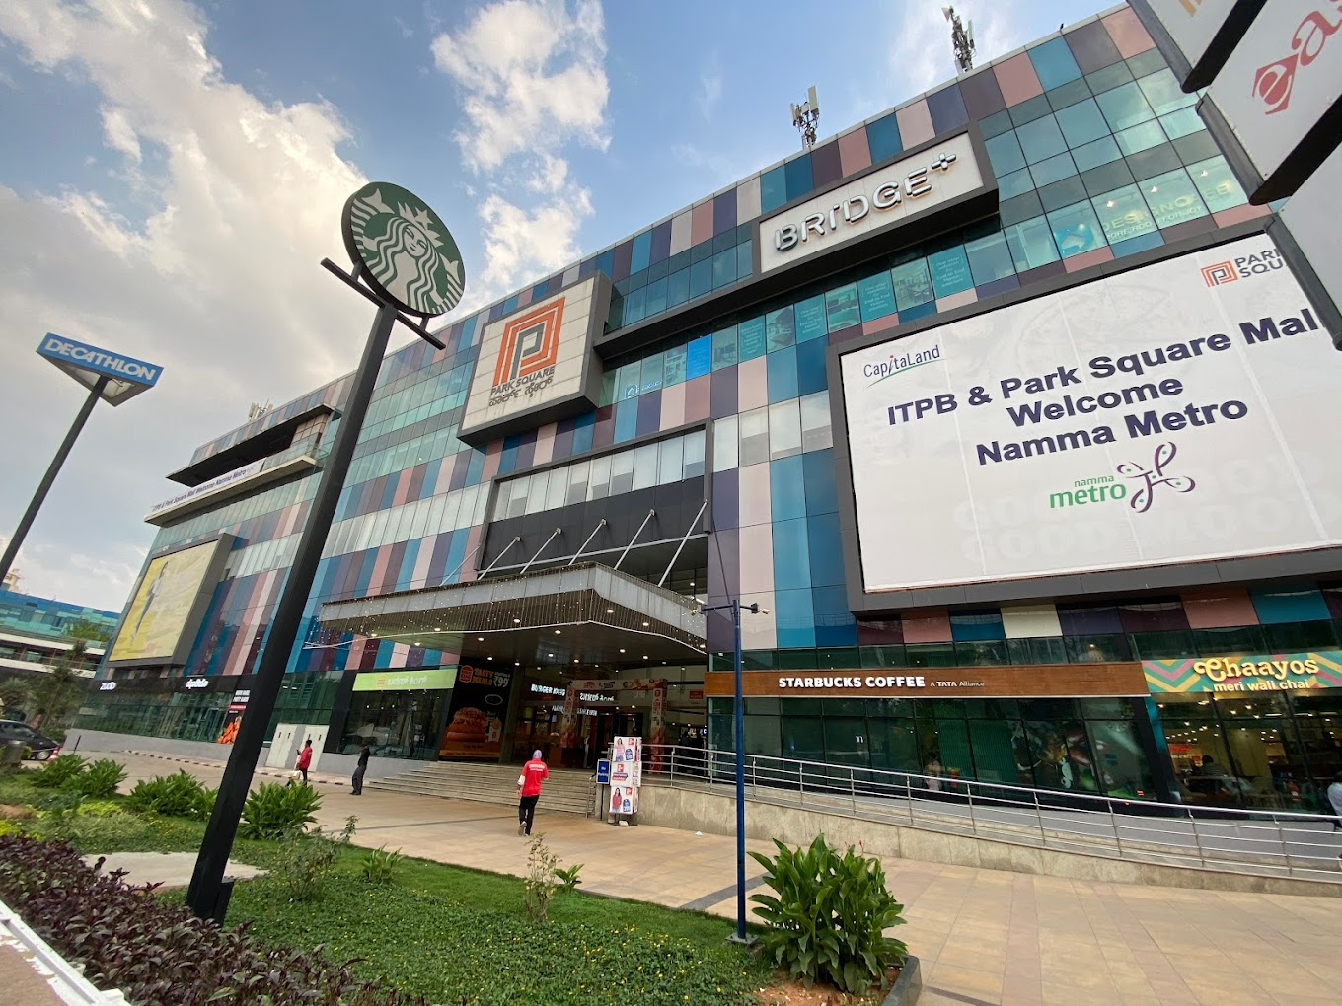
Places to Hangout!!
2
PASTA STREET
(Oppo. to Sheraton Grand Bengaluru)
(SGBW)
2
Pastas – Antipasti, Insalata, Soup
Pizzas – Veg and Non-Veg
Risotto
Wines – Wine based Cocktail
1
1
PARK SQUARE MALL
(Oppo. to Pattandur Agrahara Metro Station – one stop from Marriott)
Barbeque Nation – Indian Grill & Buffet
Hard Rock Café – American restaurant
Amoeba Sports Bar – Bowling and Buffet
Fast Food - McDonald’s, KFC, Burger King, Pizza Hut, Dominos Pizza

Slide 9
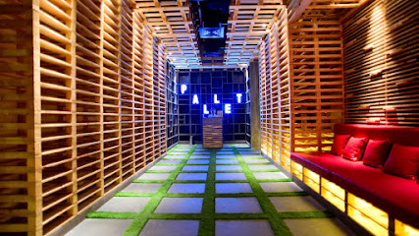
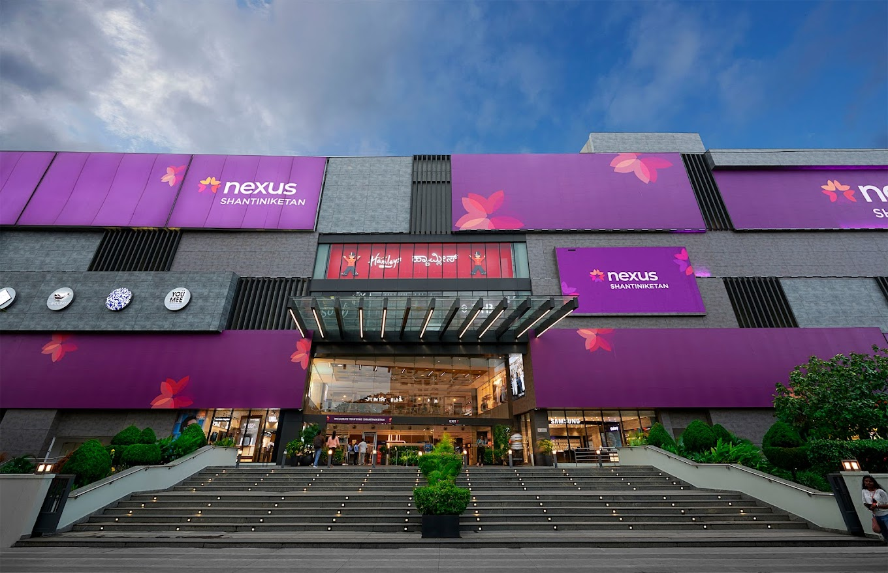
Places to Hangout!!
4
4
THE PALLET
Brewhouse and Kitchen
(12 mins walk Sheraton Grand Bengaluru)
3
(SGBW)
American, Oriental, Indian cuisines
Beverages!!
3
NEXUS SHANTINIKETAN MALL
(Beside Sheraton Grand Bengaluru)
Punjab Grill (Upper GF) – Indian Grilled food & Buffet
TOSCANO (Upper GF) – Italian restaurant
YouMee (Upper GF) – Pan Asian restaurant
Food Court (3rd Floor) - KFC, Burger King, Pizza Hut, Dominos

Slide 10
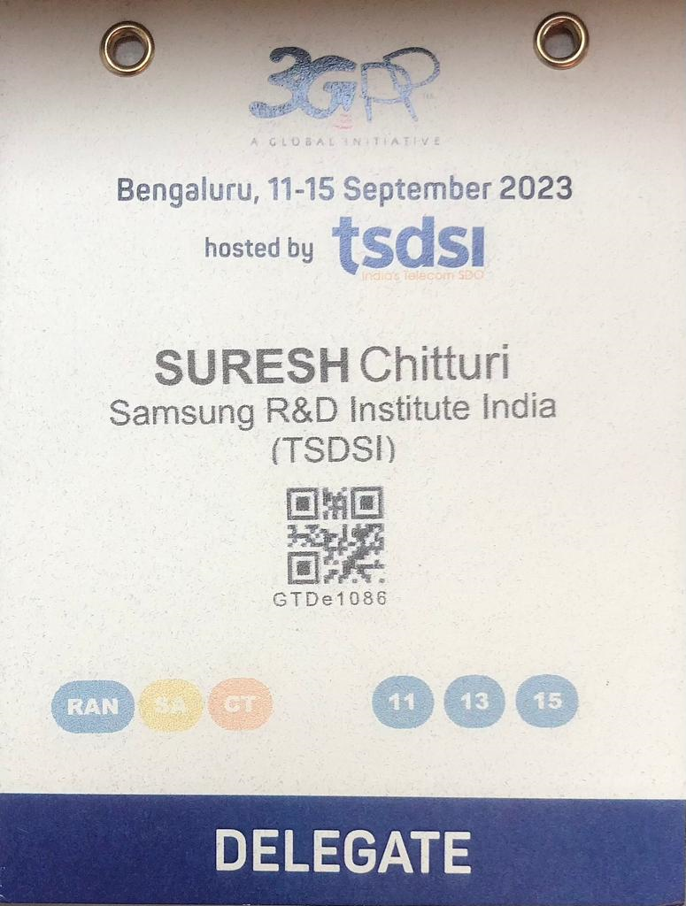
Meeting Logistics
Eco-friendly Badge
Coffee Breaks (morning and afternoon)
10:30 to 11:00 am
3:30 to 4:00 pm (SA/CT) and 4:00 to 4:30pm (RAN)
Lunch (12:30 to 2:00pm)
Social Dinners + Culture programme!
Monday (SA/CT – Marriott) from 7pm onwards
Wednesday (RAN – Sheraton) from 7:30pm onwards
TSDSI Outreach Workshop – Friday (open to all)
Friday (at Sheraton) from 4:30 to 6:00pm
Networking Reception from 6:00pm onwards
NOTE 1: Badge QR codes will be scanned at the meetings, lunch and dinner events
NOTE 2: Social Dinners and Networking Reception only based on prior registration
PLEASE RETURN YOUR LANYARDS AT THE REGISTRATION DESK AT THE END OF THE MEETING

Slide 11
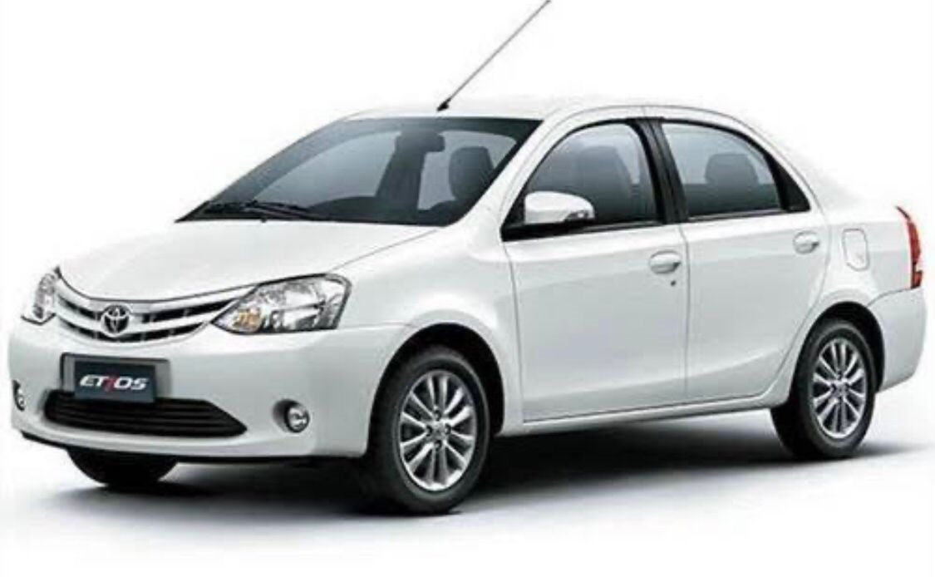
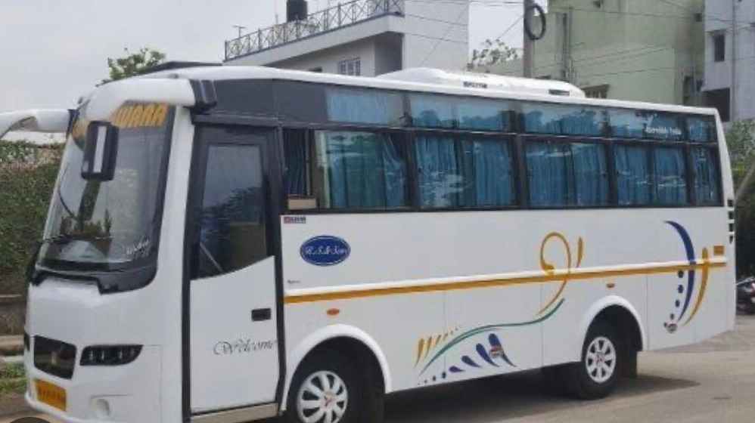
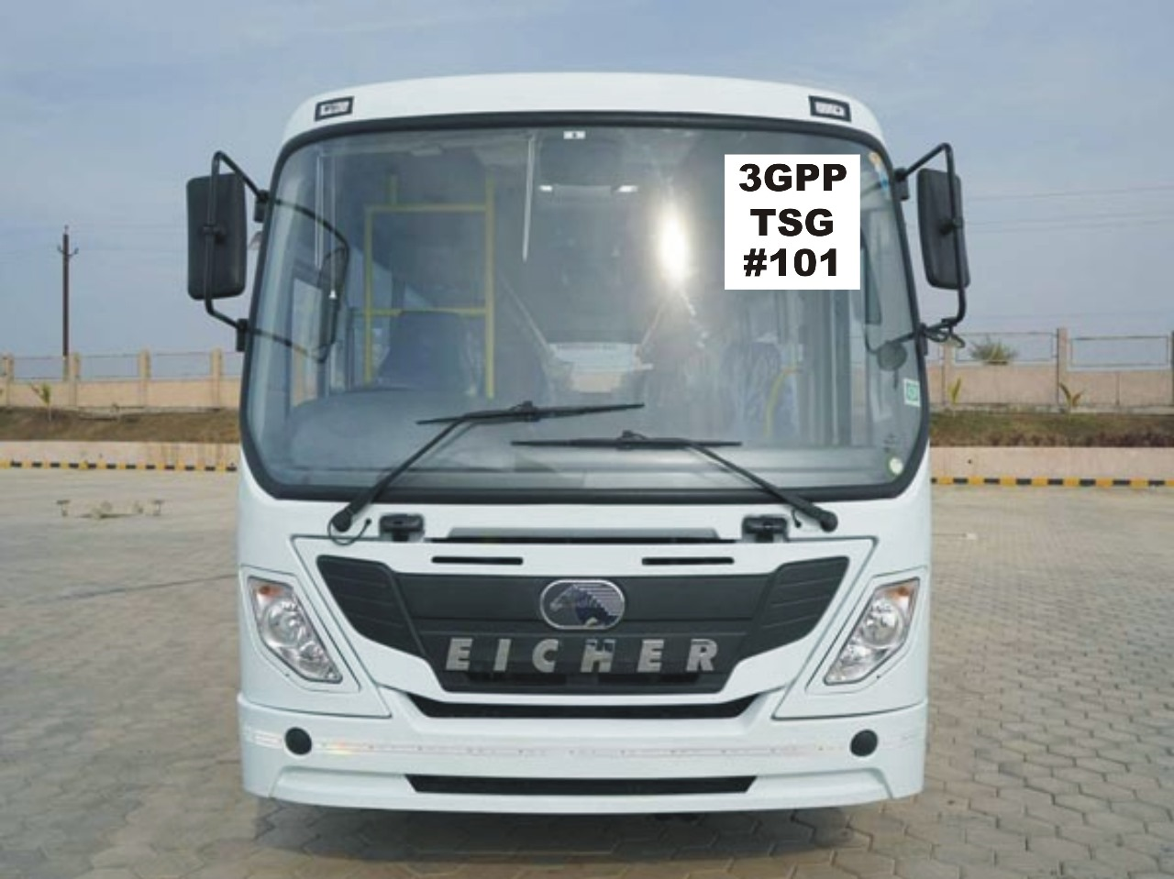
Shuttle Service
Free shuttle service between the meeting hotels throughout the day from 8am to 7pm
Shuttle service can be used for all 3GPP delegates (regardless of your hotel stay)
Sedan
MPV (3-6 seater)
Minibus (21 seater)

Slide 12
Thank You For further help/information please visit the 3GPP registration desks at the respective hotels

