Slide 1
RAN5#96-e RF FR2_PCC_SCC_Prio Session
Flores Fernández Moderator

Slide 2
Agenda
R5-224078: Discussion on message type for Power limit test functions
R5-224079 : Rel-16 Pcell power limit test function proposal including unequal bandwidth case
R5-225191: New method for preventing SCell drop in RAN5 FR2 UL CA test cases
R5-225122: On the feasibility of the PHR method

Slide 3
Tohru detailss
3GPP TOHRU hand raising tool: - https://tohru.3gpp.org/
TOHRU id: RAN5#96e FR2_PCC_SCC_Prio

Slide 4
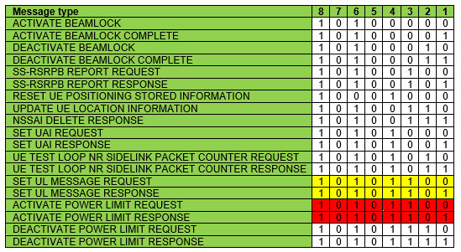
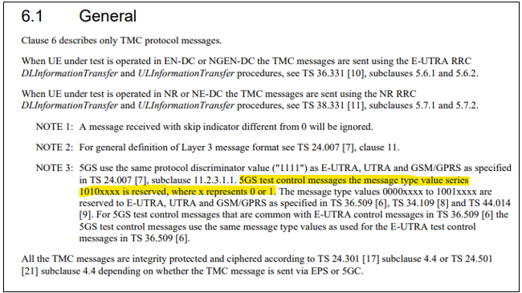
R5-224078: Discussion on message type for Power limit test functions
Problem 1 statement (38.509): Conflicting message types

Slide 5
R5-224078: Discussion on message type for Power limit test functions
Problem 2 statement (38.509): Running short of message type codes for 5GS

Slide 6
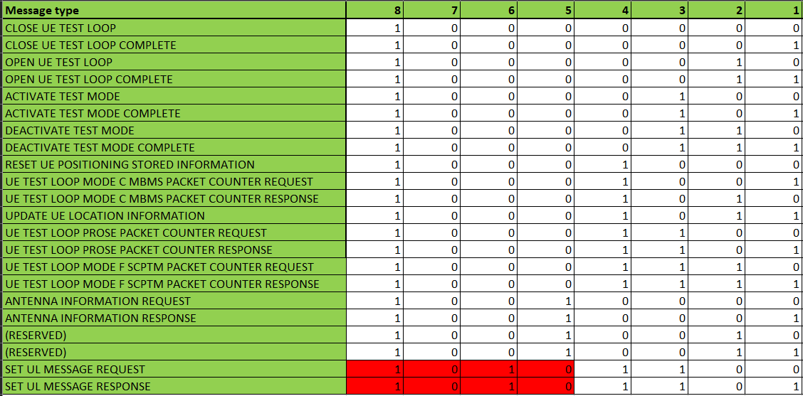
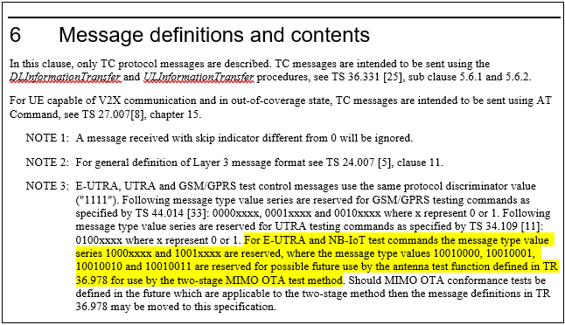
R5-224078: Discussion on message type for Power limit test functions
Problem 3 statement (36.509): SET UL MESSAGE messages type not complying with message types reserved for E-UTRA and NB-IoT
There are already UE implementations in the market using current message type values for SET UL MESSAGE REQUEST and SET UL MESSAGE RESPONSE defined in TS 36.509 as RACS NR test case 8.1.5.9.1 was already verified by ETSI back in March 2022

Slide 7
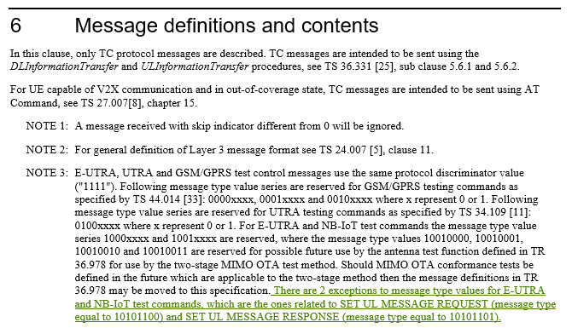
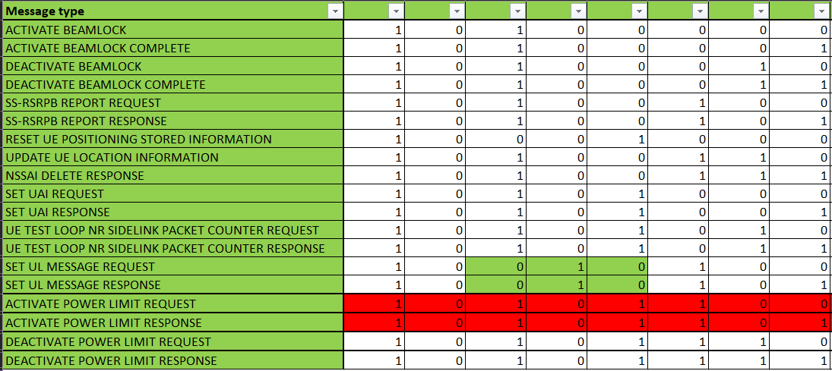
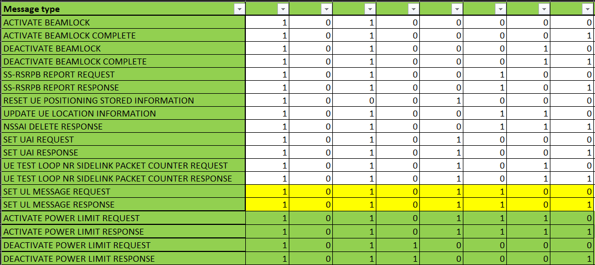
R5-224078: Discussion on message type for Power limit test functions
Option 1 solution: Correcting TS 36.509 SET UL MESSAGES
36.509:
38.509:
Option 2 solution: Keeping TS 36.509 SET UL MESSAGES as they are and accommodating new message types in TS 38.509
36.509:
38.509
Comments:
Option 1:
Option 2:

Slide 8
R5-224078: Discussion on message type for Power limit test functions
5GS message extension: Compatible with option 1 and option 2
Comments:
Agreeable:
Not agreeable:

Slide 9
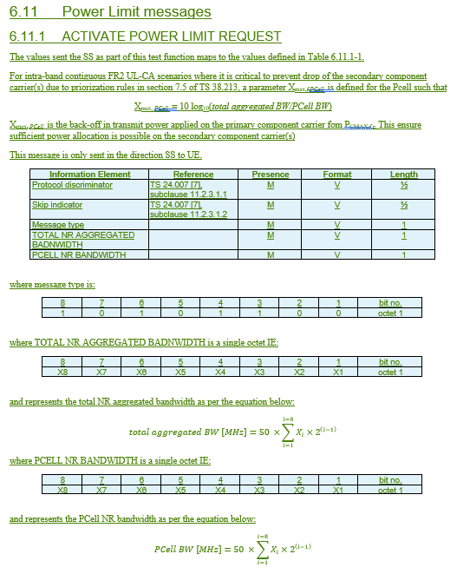
R5-224079: Pcell power limit test function including unequal BW case
Main changes in ACTIVATE POWER LIMIT REQUEST
Other UPLF messages are also needed
Current CRs are for Option 1 but could be merged with whichever outcome of discussions for R5-224078

Slide 10
R5-224079: Pcell power limit test function including unequal BW case
Comments:
Agreeable
Not agreeable

Slide 11
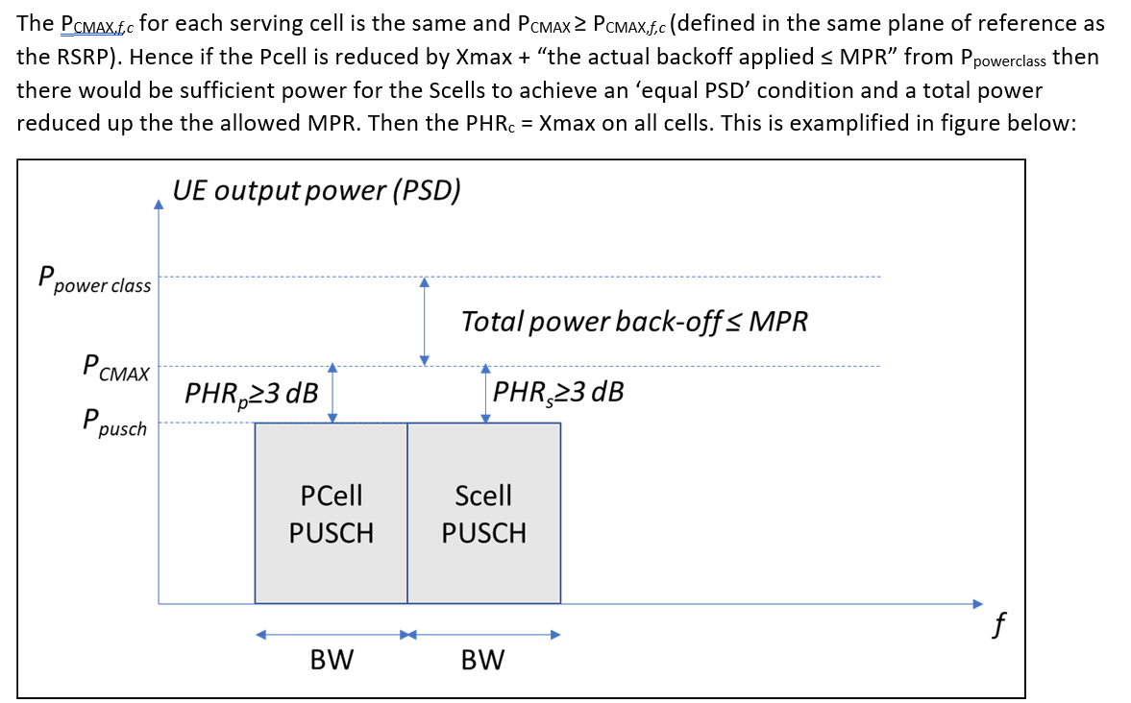
R5-225191: New method for preventing SCell drop in FR2 UL CA test cases

Slide 12
R5-225191: New method for preventing SCell drop in FR2 UL CA test cases
Solution from Rel-15
It can co-exist with ULPF, and even be a short-term solution until test mode solution is in place
Benefits with option 1C (PHR):
Test result is more relevant since conformance test is performed in the same mode of operation as in the field.
No UE impact and can be used from Rel-15
Equal PSD for unequal channel BW is achievable by using carrier specific Xmax
Benefits with option 2 (Test mode):
Even simpler and potentially more stable procedure
Ensure testing at max power (although some UE power control functionality may be disabled)

Slide 13
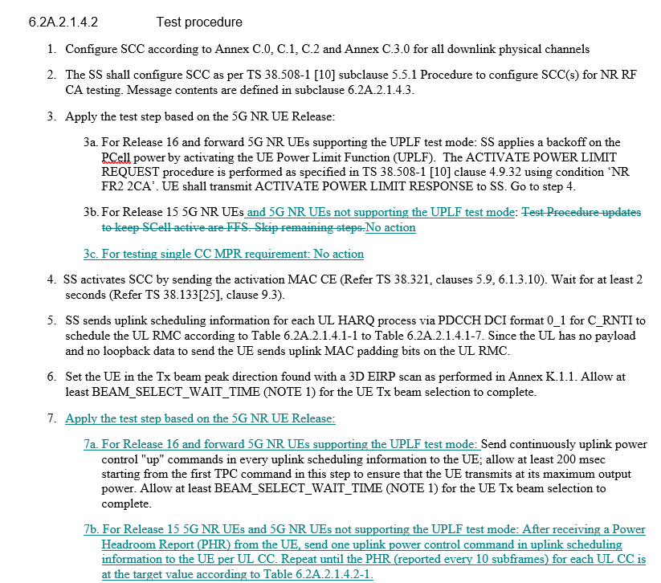
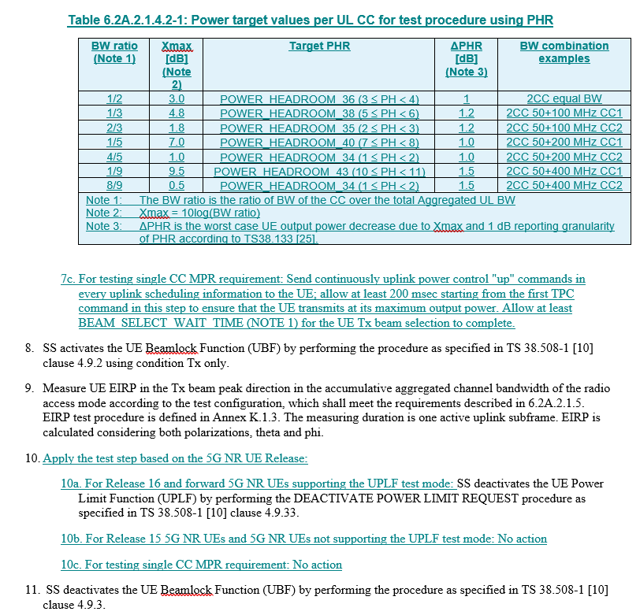
R5-225192: New method for preventing SCell drop in FR2 UL CA test cases

Slide 14
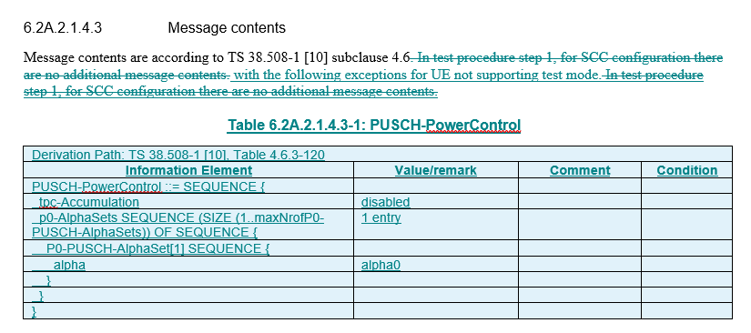
R5-225192: New method for preventing SCell drop in FR2 UL CA test cases

Slide 15
R5-225192: New method for preventing SCell drop in FR2 UL CA test cases

Slide 16
R5-225191: New method for preventing SCell drop in FR2 UL CA test cases
Comments:
Agreeable
Not agreeable

Slide 17
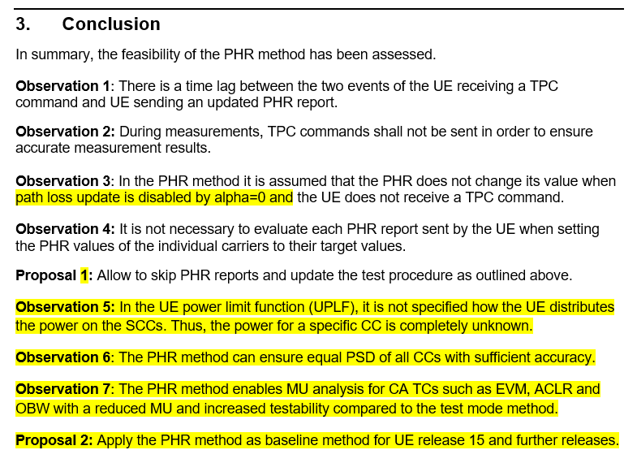
R5-225122: On the feasibility of the PHR method
8/17 FR2 MU GTM#1:
KS: We have a similar view on the first part and the feasibility needs to be explored. In principle, we agree to P1.
Apple: No strong view on P1. The additions in r1 creates a link to the E/// paper and as such the other proposals should be discussed with that paper on tomorrow's session.
Anritsu: Agree that P1 is good for test case implementation. Does P2 mean that PHR is to be used for all CA test cases and will UPLF be deleted? Our understanding is that the total power does not drop with UPLF approach. Is the concern about the power imbalance?
KS: On the r1, we agree with Anritsu that this has not been demonstrated for UPLF. CRs were agreed to the UPLF changes at the last meeting. Maybe both alternatives could be valid. Can't agree to P2 at this time.
E///: P1 looks reasonable and the test procedure update can be made in a revision.
R&S: On Apple's comment, we are fine to have the discussion on the GTM tomorrow. Baseline would be MOP so only the test cases affected by the SCell dropping issue. Alternatively, UPLF could be used and would not have to be deleted. Can further discuss tomorrow. The testability issue is dependent on the specific test case and the EVM of the particular carrier. The power imbalance issue is more applicable to the OBW test case.
Apple: Not OK to endorse P1 yet until the method is agreed.

Slide 18
R5-225122: On the feasibility of the PHR method
Comments:
Agreeable
Not agreeable

Slide 19
Thank You !

