Slide 1
Discussion on n39 A-MPR PC2 Test Case
3GPP TSG-RAN5 Meeting #96-e R5-22XXXX
Electronic Meeting, Aug 15 – 26, 2022
CMCC, Huawei, Hisilicon

Slide 2
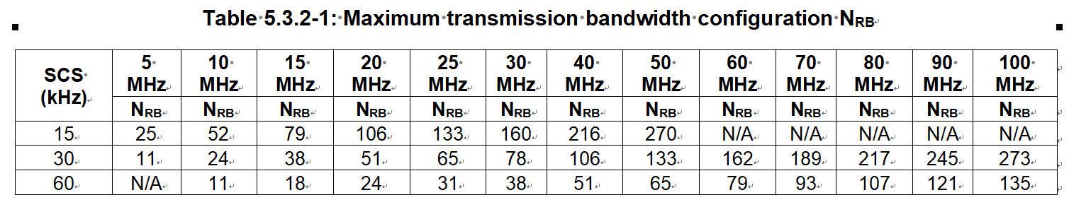
Minimum Conformance Requirements for n39 A-MPR PC2@CBW=10MHz & SCS=60KHz
Observation 1: As per Table 5.3.2-1, for CBW=10MHz & SCS=60KHz, the Maximum Transmission Bandwidth is N_{RB}*12*SCS = 11*12*60(kHz) = 7.920(MHz)
Table 6.2.3.3.19-3: A-MPR regions for NS_50 (Power Class 2)
TS 38.521-1 (h50)
Channel Bandwidth (MHz) | RB_{start}*12*SCS (MHz) | L_{CRB}*12*SCS (MHz) | A-MPR
10 MHz | ≤ 1.44 | < 1.44 | A5
 | ≤ 1.8 | ≥ 2.7+2* RBstart*12*SCS | A4
 | >1.8 | ≥ 8.1- RBstart*12*SCS | A4
Observation 2: As per Table 6.2.3.3.19-3, for CBW=10MHz & SCS=60KHz, the Transmission Bandwidth is (L_{CRB} + RB_{start})*12*SCS ≥ 8.1(MHz). The Transmission Bandwidth is “larger” than the Maximum Transmission Bandwidth, which is unreasonable.

Slide 3
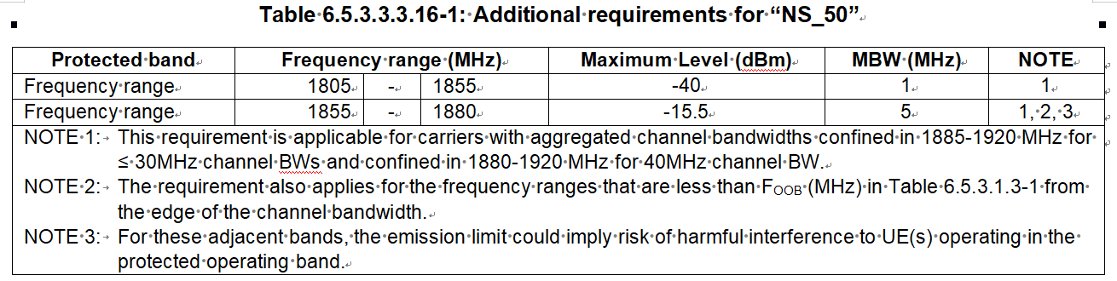
Minimum Conformance Requirements for n39 A-MPR PC2@CBW=15MHz & SCS=60KHz
Observation 3: As per Table 6.5.3.3.3.16-1, the Protected band is lower than n39. So the possible smallest RB_{start} and biggest L_{CRB} should be chosen for most “critical” scenario.
Table 6.2.3.3.19-3: A-MPR regions for NS_50 (Power Class 2)
TS 38.521-1 (h50)
Channel Bandwidth (MHz) | RB_{start}*12*SCS (MHz) | L_{CRB}*12*SCS (MHz) | A-MPR
15 MHz | ≤ 2.88 | < 2.7 | A5
 | ≤ 3.24 | ≥ 2.7+2* RBstart*12*SCS | A3
 | >3.24 | ≥ 12.42- RBstart*12*SCS | A4
Observation 4: As per Table 6.2.3.3.19-3, RB_{start} should be >4.5, and RB_{start}=5 is chosen. So L_{CRB} should be ≥12.25. For CP-OFDM, the possible biggest L_{CRB} =18-5=13. For DFT-s-OFDM, the possible biggest L_{CRB} =12, which contradict L_{CRB}≥12.25.

Slide 4
Minimum Conformance Requirements for n39 A-MPR PC2@CBW=20MHz & SCS=60KHz
Observation 5: As per Table 5.3.2-1, for CBW=20MHz & SCS=60KHz, the Maximum Transmission Bandwidth is N_{RB}*12*SCS = 24*12*60(kHz) = 17.28(MHz)
Table 6.2.3.3.19-3: A-MPR regions for NS_50 (Power Class 2)
TS 38.521-1 (h50)
Channel Bandwidth (MHz) | RB_{start}*12*SCS (MHz) | L_{CRB}*12*SCS (MHz) | A-MPR
20 MHz | ≤ 4.32 | < 3.6 | A5
 | ≤ 4.5 | ≥ 3.6+2* RBstart*12*SCS | A3
 | >4.5 | ≥ 17.1- RBstart*12*SCS | A4
Observation 6: As per Table 6.2.3.3.19-3, RB_{start} should be >6.25, and RB_{start}=7 is chosen. So L_{CRB} should be ≥16.75. For CP-OFDM, the possible biggest L_{CRB} =24-7=17. For DFT-s-OFDM, the possible biggest L_{CRB} =16, which contradict L_{CRB}≥16.75.

Slide 5
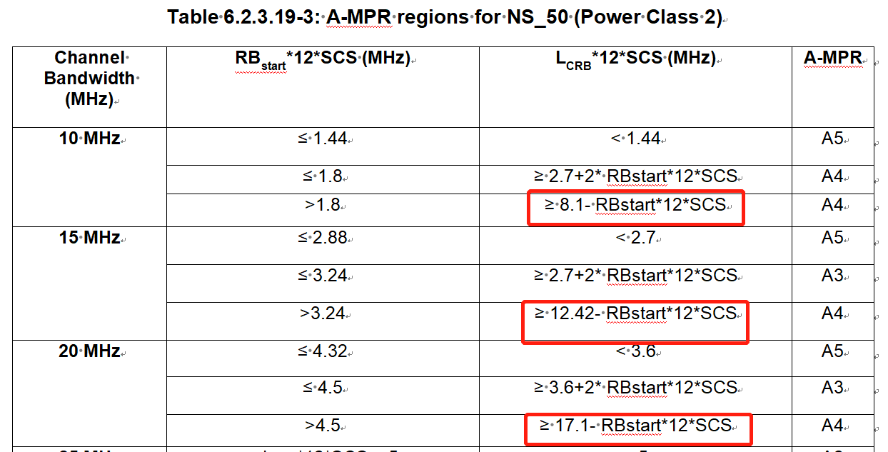
Proposals
There might be more contradictions to be identified from Table 6.2.3.3.19-3 of TS 38.521-1.
Proposal 1: To send LS to request RAN4 to review Table 6.2.3.19-3 of TS 38.101-1, from which RAN5 derives “Table 6.2.3.3.19-3: A-MPR regions for NS_50 (Power Class 2)”.
TS 38.101-1 (h60)

Slide 6
Thank you!

