Slide 1
Discussion on spurious emission for UE co-existence limits in RAN5
3GPP TSG-RAN5 Meeting #96-e R5-224956r1 Electronic Meeting, August 15th– 26th, 2022
ZTE Corporation

Slide 2
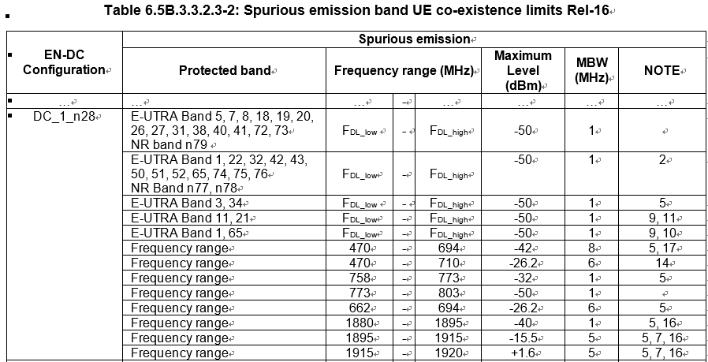
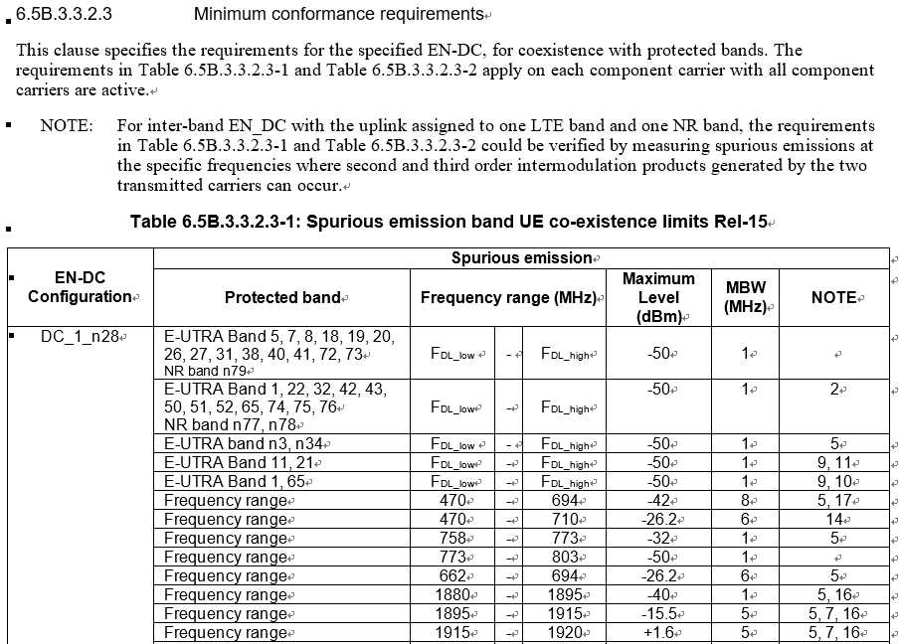
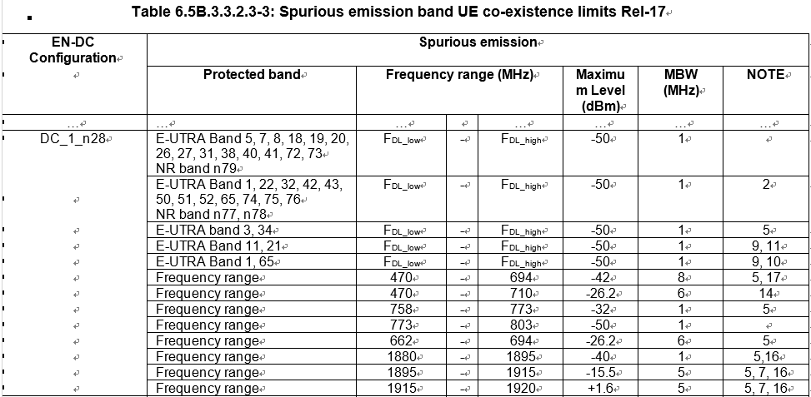
Spurious emissions for EN-DC in TS 38.521-3
Observation 1: The minimum conformance requirements for the EN-DC configurations for UE co-existence with protected bands are specified in different tables in accordance with different releases respectively.

Slide 3
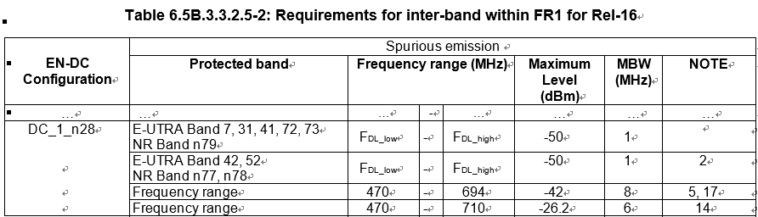
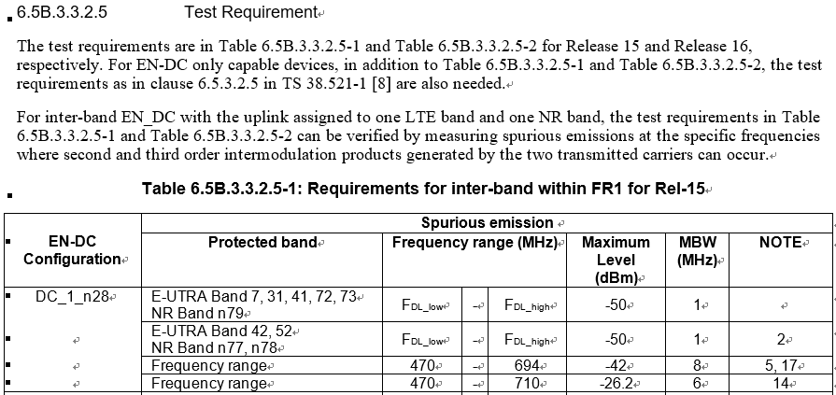
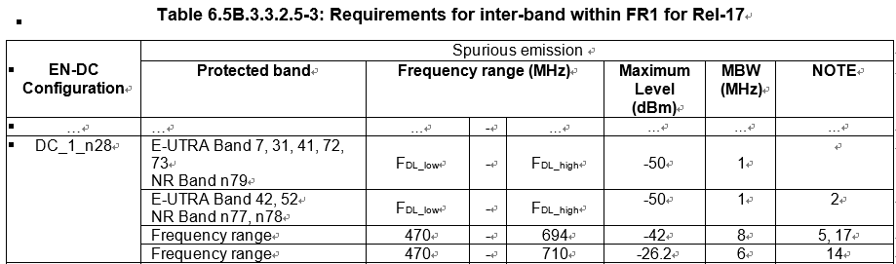
Spurious emissions for EN-DC in TS 38.521-3
Observation 2: The test requirements for the EN-DC configurations for UE co-existence with protected bands are specified in different tables in accordance with different releases respectively.
Observation 3: For most of the EN-DC configurations in the earlier release, the minimum conformance requirements and test requirements for UE co-existence with protected bands are the same and redundant in the later releases with different requirement tables.

Slide 4
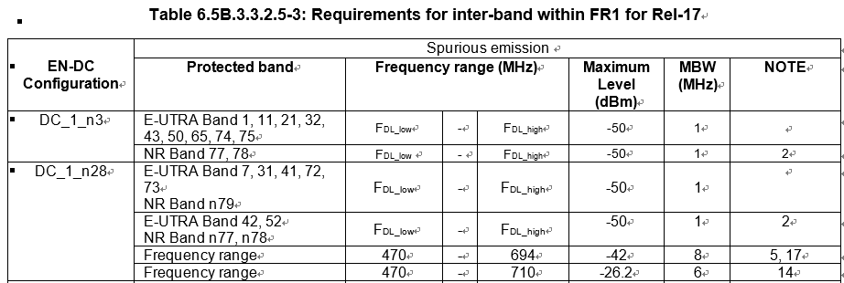
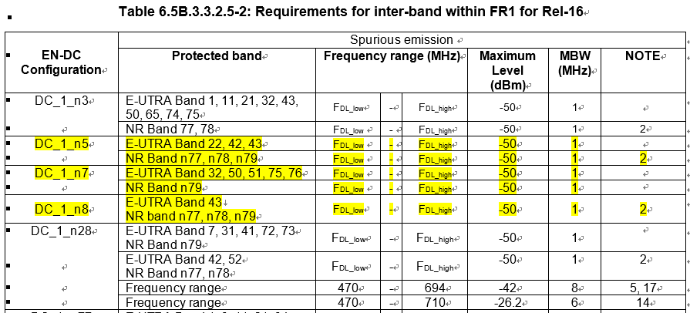
Spurious emissions for EN-DC in TS 38.521-3
Observation 4: For some EN-DC configurations, the redundancy among the tables not only leads to poor readability, but also increases the risk of inconsistency in the spec.
The test requirements of the configurations are missing in Rel-17！
Observation 5: The situation of redundancies among different tables will be more serious in the future considering that more configurations and more new releases are to be introduced.

Slide 5
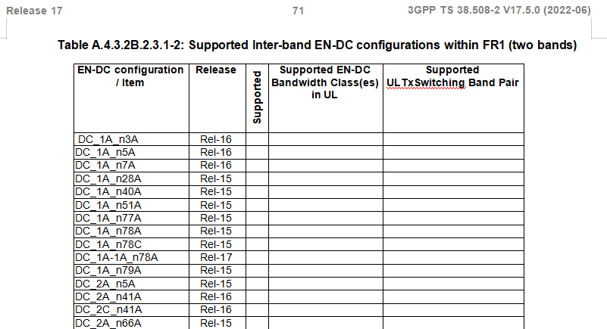
Spurious emissions for EN-DC in TS 38.521-3
Observation 6: For EN-DC configurations in other RAN5 spec, such as in TS 38.508-2 the supported EN-DC configurations are specified in one table with different releases.
Proposal 1: For EN-DC spurious emissions in TS 38.521-3, considering that the minimum requirements come from RAN4 spec and to avoid table chaos if merged together with different releases, it is suggested to keep the minimum requirement table as it is now so as to align with RAN4.

Slide 6
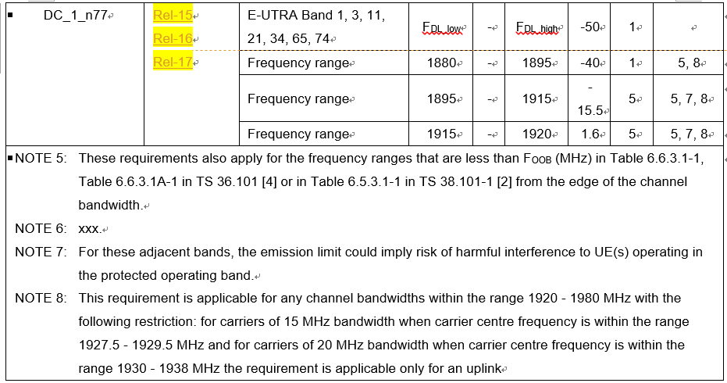
Spurious emissions for EN-DC in TS 38.521-3
Proposal 12: It is proposed to merge the tables of minimum test conformance requirements for EN-DC configurations for UE co-existence with protected bands with all the releases in one table and add a column “Release” in the table to indicate from which release the configuration supports. The same approach is proposed to be applied to the tables of test requirements for EN-DC configurations for UE co-existence.
  If the requirements for a specified configuration have not changed since an early release, the column of “Release” should be noted as the early release, which is the starting release all the supported releases in one row. Otherwise, a new row in the table for the later release with new requirements for the specified configuration should be added.
  If the Note number in the table is different among releases, a subscript for release should be applied, such as
  NOTE X_{R15}, NOTE X_{R16}, etc.
Example 1: Common requirements among different Releases

Slide 7
Spurious emissions for inter-band CA in TS 38.521-1
Observation 7: The minimum conformance requirements and test requirements for the inter-band CA configurations for UE co-existence with protected bands in TS 38.521-1 are similar to the cases for EN-DC in TS 38.521-3 which are specified in different tables in accordance with different releases respectively.
Proposal 23: It is proposed to merge the tables of minimum conformance requirements and the tables of test requirements for inter-band CA configurations for UE co-existence with protected bands in TS 38.521-1 respectively. A new column of “Release” in the merged table to indicate the starting release all the supported releases is suggested. If the requirements for a certain combo are different among releases, the combo should be added in the table separately.

Slide 8
Spurious emissions for NR band in TS 38.521-1
Observation 8: The minimum conformance test requirements for the specified single NR band for UE co-existence with protected bands in TS 38.521-1 are similar to the cases for EN-DC in TS 38.521-3 which are specified in different tables in accordance with different releases respectively.
Proposal 34: It is proposed to merge the tables of minimum conformance test requirements for the specified single NR band for UE co-existence with protected bands in TS 38.521-1. A new column of “Release” in the merged table to indicate the starting release is suggested.

Slide 9
Thank you!

