Slide 1
Way Forward on NR-U PUCCH demodulation requirements
3GPP TSG-RAN WG4 Meeting #97-e
Electronic Meeting, 2 - 13 November 2020
Agenda: 7.1.8.3
R4-2017467
Document for: Approval
Ericsson

Slide 2
Background
R4-2012542, Email discussion summary for [96e][328] NR_unlic_Demod
R4-2012611, Way Forward on NR-U BS demodulation requirements, Ericsson

Slide 3
General test configurations
PUCCH formats
Define the performance requirements for Rel-16 PF 0/1/2/3 with interlace resource allocation
Number of interlaces
1 interlace for PF 0/1/2/3
Antenna configuration
1Tx2Rx
Bandwidth
Define the NR-U PUCCH requirements with 20MHz bandwidth
Frequency hopping
Not configure frequency hopping
SCS
Option 1: 30kHz
Option 2: 15 kHz and 30 kHz
Propagation conditions
Option 1: TDLA30-10
Option 2: TDLC300-100

Slide 4
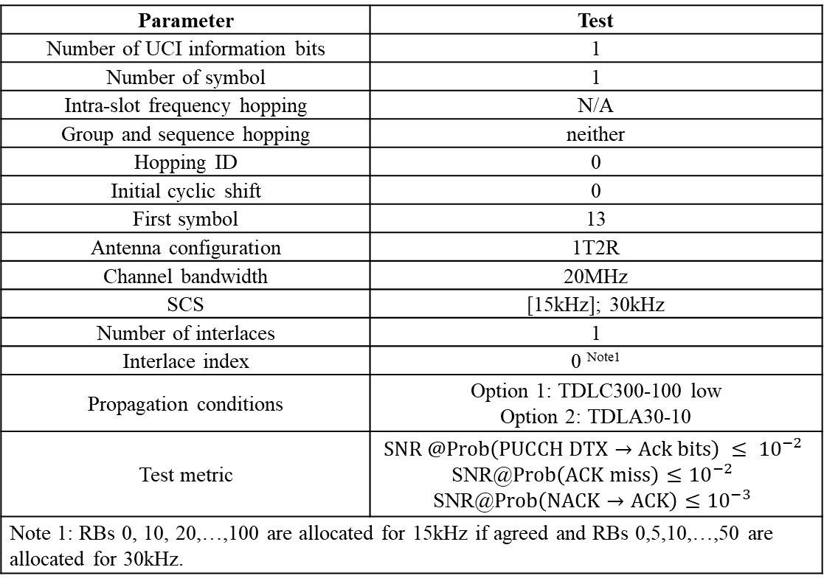
PUCCH format 0
Parameter | Test
Number of UCI information bits | 1
Number of symbol | 1
Intra-slot frequency hopping | N/A
Group and sequence hopping | neither
Hopping ID | 0
Initial cyclic shift | 0
First symbol | 13
Antenna configuration | 1T2R
Channel bandwidth | 20MHz
SCS | [15kHz]; 30kHz
Number of interlaces | 1
Interlace index | 0 ^{Note1}
Propagation conditions | Option 1: TDLC300-100 low Option 2: TDLA30-10
Test metric | $$SNR @Prob\left(PUCCH DTX→Ack bits\right) ≤ {10}^{−2}$$ SNR@$Prob\left(ACK miss\right)≤{10}^{−2}$ SNR@$Prob\left(NACK→ACK\right)≤{10}^{−3}$
Note 1: RBs 0, 10, 20,…,100 are allocated for 15kHz if agreed and RBs 0,5,10,…,50 are allocated for 30kHz.
Number of symbols
Only test 1 OFDM symbol for PF0
Test metric
Option 1: Only Rel-15 PF0 test metric will be used
Option 2: 3 test metrics will be used
SNR @Prob(PUCCH DTX→Ack bits) ≤ 10^(−2)
SNR@Prob(ACK miss)≤10^(−2)
SNR@Prob(NACK→ACK)≤10^(−3)

Slide 5
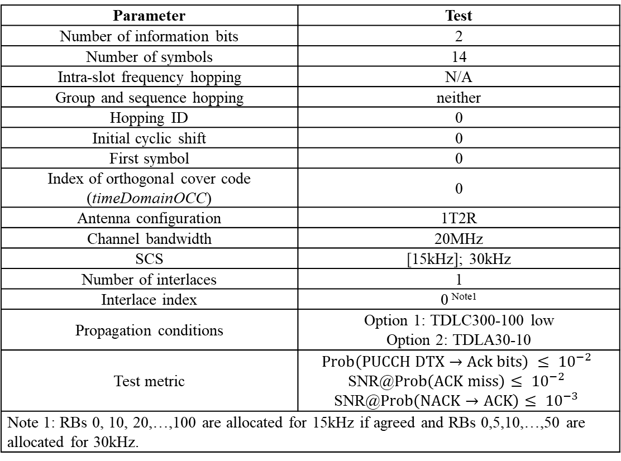
PUCCH format 1
Parameter | Test
Number of information bits | 2
Number of symbols | 14
Intra-slot frequency hopping | N/A
Group and sequence hopping | neither
Hopping ID | 0
Initial cyclic shift | 0
First symbol | 0
Index of orthogonal cover code (timeDomainOCC) | 0
Antenna configuration | 1T2R
Channel bandwidth | 20MHz
SCS | [15kHz]; 30kHz
Number of interlaces | 1
Interlace index | 0 ^{Note1}
Propagation conditions | Option 1: TDLC300-100 low Option 2: TDLA30-10
Test metric | $$Prob\left(PUCCH DTX→Ack bits\right) ≤ {10}^{−2}$$ SNR@$Prob\left(ACK miss\right)≤ {10}^{−2}$ SNR@$Prob\left(NACK→ACK\right)≤ {10}^{−3}$
Note 1: RBs 0, 10, 20,…,100 are allocated for 15kHz if agreed and RBs 0,5,10,…,50 are allocated for 30kHz.

Slide 6
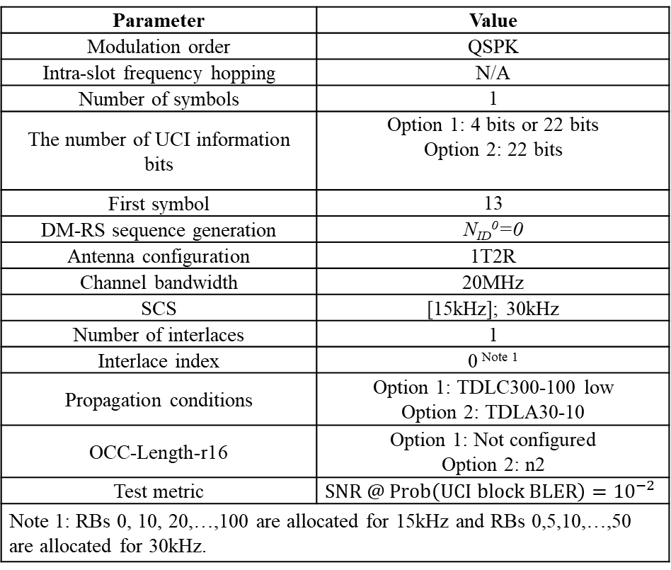
PUCCH format 2
Parameter | Value
Modulation order | QSPK
Intra-slot frequency hopping | N/A
Number of symbols | 1
The number of UCI information bits | Option 1: 4 bits or 22 bits Option 2: 22 bits
First symbol | 13
DM-RS sequence generation | N_{ID}⁰=0
Antenna configuration | 1T2R
Channel bandwidth | 20MHz
SCS | [15kHz]; 30kHz
Number of interlaces | 1
Interlace index | 0 ^{Note 1}
Propagation conditions | Option 1: TDLC300-100 low Option 2: TDLA30-10
OCC-Length-r16 | Option 1: Not configured Option 2: n2
Test metric | $$SNR @ Prob\left(UCI block BLER\right)={10}^{−2}$$
Note 1: RBs 0, 10, 20,…,100 are allocated for 15kHz and RBs 0,5,10,…,50 are allocated for 30kHz.
Number of interlaces
One interlace
Number of OFDM symbols
One OFDM symbol
Information bits
Option 1: 4 bits or 22 bits
Option 2: 22 bits
OCC configuration
Option 1: Not configure
Option 2: OCC length n2

Slide 7
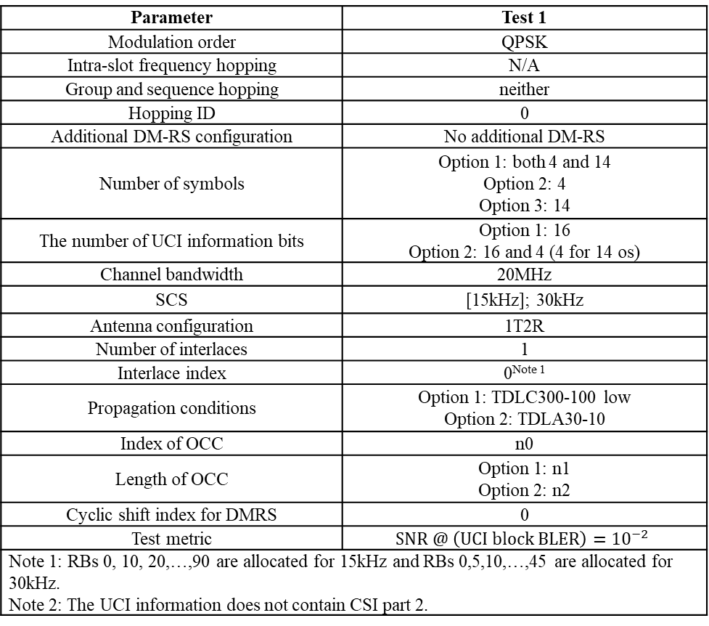
PUCCH format 3
Parameter | Test 1
Modulation order | QPSK
Intra-slot frequency hopping | N/A
Group and sequence hopping | neither
Hopping ID | 0
Additional DM-RS configuration | No additional DM-RS
Number of symbols | Option 1: both 4 and 14 Option 2: 4 Option 3: 14
The number of UCI information bits | Option 1: 16 Option 2: 16 and 4 (4 for 14 os)
Channel bandwidth | 20MHz
SCS | [15kHz]; 30kHz
Antenna configuration | 1T2R
Number of interlaces | 1
Interlace index | 0^{Note 1}
Propagation conditions | Option 1: TDLC300-100 low Option 2: TDLA30-10
Index of OCC | n0
Length of OCC | Option 1: n1 Option 2: n2
Cyclic shift index for DMRS | 0
Test metric | $$SNR @ \left(UCI block BLER\right)={10}^{−2}$$
Note 1: RBs 0, 10, 20,…,90 are allocated for 15kHz and RBs 0,5,10,…,45 are allocated for 30kHz. Note 2: The UCI information does not contain CSI part 2.
Number of interlaces
One interlace
information bits
Option 1: 16
Option 2: 16 and 4 (4 for 14 os)
Number of OFDM symbols
Option 1: Both 4 and 14
Option 2: 4
Option 3: 14
OCC length
Option 1: n1
Option 2: n2
Other values are not precluded.

