Slide 1
WF on NR-U BS Tx and Rx remaining requirements for NR-U
3GPP TSG-RAN WG4 #96e
17th Aug - 28th Aug. 2020
R4-2012607
ZTE, …

Slide 2
Background
In RAN4#96e,open issues are identified for NR-U BS requirements which needs further discussion, open issues are listed as following:
1) How to reflect NR-U BS to support AAS BS type;
2) IBB/OOBB requirements for NR-U BS;
3) Δf_{OBUE} and Δf_{OOBB} for NR-U BS type 1-C and 1-H;
4) Frequency offset of interferer signal for RX ACS and IMD requirements;
5) LO leakage exception for NR-U BS Tx
Note : 1) and 4) has been resolved in the GTW meeting with following agreement:
Proposal 1: Prated,C,AC used in WF [4] and CR [3] should be updated as Prated,x;
Proposal 1: to use the following frequency offset for ACS interfering signal in Table 7.4.1.2-2a in R4-2010960;
Proposal 4: to use the following frequency offset for RX IMD interfering signal in Table 7.7.2-2a in R4-2010960;
Reference:
[1]R4-2010738, CR to TS 38.104: Introduction of NR-U into BS core specification,Nokia
[2]R4-2010743, Discussion on BS core specification drafting ,Nokia
[3]R4-2010959,NR-U BS Tx requirements, ZTE Corporation
[4]R4-2010960, NR-U BS Rx ACS, IBB, OOBB, IMD requirements, ZTE Corporation
[5]R4-2010495
[6] R4-1902505, WF on NR-U BS RF requirements, Nokia, Nokia Shanghai Bell

Slide 3
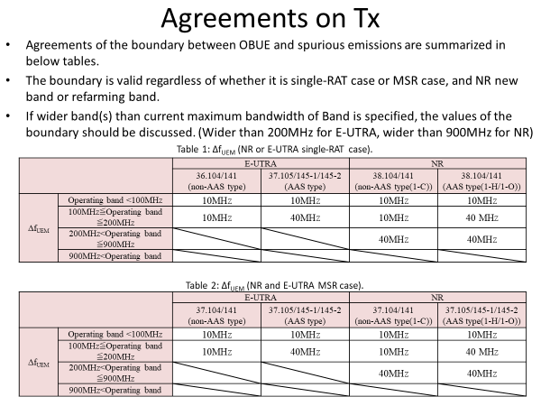
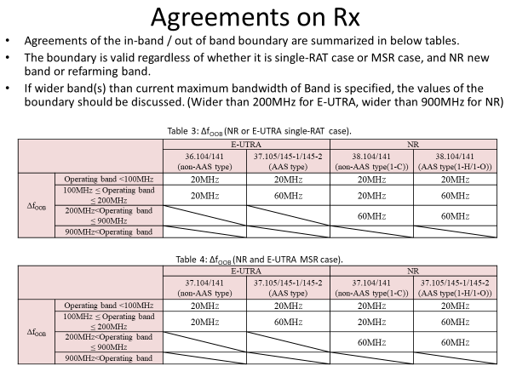
Background
As a reminder in-band and out-of-band boundary was discussed some time ago in RAN4 when AAS and NR was introducing and agreed in [1]. Main motivation to introduce wider boundary was that for antenna arrays in which antenna and radio are closely integrated and there are a potentially large number of transmitters, the amount of space for integrating filters is limited. It should be noted that that time boundary was discussed for all bands except Band 46. Also that time there was no NR-U.
From [1]:
[1] R4-1711779, WF on in-band and out-of-band boundary, NTT DOCOMO, INC., Nokia, Ericsson, Huawei, ZTE

Slide 4
WF for Δf_{OBUE} and Δf_{OOBB}
For NR-U BS type 1-C for n46
For NR-U BS type 1-H for n46 :
NR-BS Type 1-C | Δf_{OBUE} | Δf_{OOBB} | Supporting companies
Option 1 (legacy LTE/LAA values) | 10MHz | 20MHz | ZTE, Huawei
Option 2 (legacy NR values) | [40MHz ] | [60MHz] | Huawei, Nokia，Ericsson
Agreement: option 2 with [ ].
 | Δf_{OBUE} | Δf_{OOBB} | Supporting companies
Option 1 (legacy LTE/LAA values) | 10MHz | 20MHz
Option 2 (legacy NR values) | 40MHz | 60MHz | ZTE, Huawei, Nokia,Ericsson
Agreement: option 2
Notes:
E///: More proper to align with NR other than LTE.
Nokia: We believe same values can be applied for 6GHz since it’s band agnostic.
ZTE: we didn’t see the logic why we need to use NR either than LTE LAA since its same band. This may bring confusion from regulatory aspect.
Nokia: In NR, there is some refarming bands which applied new approach i.e. 3.5GHz band.
ZTE: is there any problem for product if we reuse LTE LAA requirements?
Nokia: Now we are in NR place, we have different SU compared to LTE.
ZTE: CHBW and SU not related to the boundary.
E///: With larger operating bandwidth, this is also adopted from LTE. This is the reason why we change the boundary.

Slide 5
WF for Δf_{OBUE} and Δf_{OOBB}
For NR-U BS type 1-C/1-H for n96
NR-BS Type 1-C/1-H | Δf_{OBUE} | Δf_{OOBB} | Supporting companies
Option1: | 40MHz | 60MHz | Nokia, E///, Qualcomm
Option 2: Further evaluation and analysis required with the associated assumption with band plan, channel arrangements ZTE, Huawei Tentative Agreement: Agree with option 1 with [ ]. Object by : Huawei and ZTE
Notes:
ZTE: we disagree with the proposed values. We didn’t any technical analysis for this part.
Huawei: Similar view as ZTE. The operating bandwidth >1GHz, which means current agreements applicable need to be further checked.
E///: Both band n46, and n96 with >200MHz operating bandwidth, we can further revise it.
Nokia: We already discussed n96 for several meetings, we didn’t see any analysis from companies. Any plan for that?
Huawei: We would Like to first agree some parameters i.e. channel arrangements, SU and so. We didn’t see any technical analysis for 6GHz band.
ZTE: Could you clarify which reference for this? Until this meeting, we only see Huawei paper.
Nokia: We already submit one paper on 6GHz 2010744. We didn’t see the issue.
ZTE: We didn’t see filter data, lack of enough evidence.
Huawei: Similar view as ZTE.
QC: We have concern on companies say want to further study but we faced to close the WI.
Huawei: Nokia proposed same OOB for same 1C and 1H; now Nokia change their position. Then how we can conclude with sudden views changes.
Nokia: We don’t change position, we are proposing alignment. We probably make misunderstanding on 10MHz but our intention is to have alignment among 1C and 1H.
Huawei: Even for 5GHz, we still have technical issues, we still need based on consensus and technical justification basis.

Slide 6
IBB and OOBB requirements
For NR-U BS type 1-C and 1-H for n46:
Note: for background for eLAA BS RX requirement could be found in the following R4-167192, R4-166293.
NR-BS Type 1-C | General blocking requirement | Supporting companies
Option 1 | To reuse LTE/LAA requirement | ZTE, Huawei
Option 2 | To reuse NR requirement | Nokia,E///,QC
Follow previous agreement in R4-1902505 proposal 6 (option2) .
NR-BS Type 1-H | General blocking requirement | Supporting companies
Option 1 | To reuse LTE/LAA requirement | ZTE
Option 2 | To reuse NR requirement | Nokia,Huawei, E///
Agreement: Option 2
Notes:
Huawei: We don’t 1-H for LTE LAA.
ZTE: Reusing the offset values.
E///:We already agreed reusing NR requirements in past meeting.
Nokia: we should be consistent to reuse legacy NR for both 1-C and 1-H, also OOBE. We design NR_U based on NR not based on LTE.
ZTE: I think that WF high levels, details still need to discuss. We need to further discuss and optimize and justify the difference.
E///: Why you prefer option 1?
Huawei: For Type 1-c, we will reuse same design for LAA and NR-U for type 1-C, better reuse this requirements.
ZTE: We have similar as Huawei.
QC: Make sense to use NR requirements considering NR difference compared LTE. We have wide CHBW.
Nokia: We also need to ensure other CHBW can be works well except 20MHz.

Slide 7
IBB and OOBB requirements
For NR-U BS type 1-C and 1-H for n96:
Note: for background for eLAA BS RX requirement could be found in the following R4-167192, R4-166293.
NR-BS Type 1-C/1H | General blocking requirement | Supporting companies
Option 1 | To reuse NR requirement | Nokia, E///, QC
Option 2: Further evaluation and analysis required with the associated assumption with band plan, channel arrangements ZTE, Huawei Tentative Agreement: Agree with option 1 with [ ]. Object by : Huawei and ZTE as they need time to further check and analyze.
Notes:
ZTE: We believe this requirements is band related.
Nokia：Why is band specific? What’s kind of analysis we needed ?
ZTE: We think as package with delta_FOOB.
Nokia: This band agonistic ,why we need treat as a package.

Slide 8
LO leakage for NR-U punctured channels (applied for both 5GHz and 6GHz)
An exception to the spectrum emission requirements for the non-transmitted 20 MHz channels allows a single 2 MHz bandwidth to extend to P_{rated,x}-28dB , or -20 dBm, whichever is the greatest.
Option 1: to define LO leakage exception
Nokia
Option 2: not to define LO leakage exception
ZTE, Huawei
Tentative Agreement：Option 2
Nokia : Object this tentative agreements.
Note :To define LO leakage exception will degrade the UE performance
Note: LO leakage exception is defined also in UE specification.
Notes:
Nokia: We already this in previous meeting for LO leakage, we are fine to Px modification. We are fine to work with such exception for some cases.
Huawei：We also mention to reuse BS requirements in previously agreed WF.
ZTE: Prated is typo, that’s not comprise.

Slide 9
Additional band n96 aspects
To define Local Are BS at RAN4#96e meeting and study further MR BS in the coming meeting.
The the following NF will be used to derive Rx requirements:
11dB for Medium Range BS
14dB for Local Area BS

