Slide 1
WF on NR-U BS Tx and Rx remaining requirements for NR-U
3GPP TSG-RAN WG4 #96e
17th Aug - 28th Aug. 2020
R4-2012607
ZTE, …

Slide 2
Background
In RAN4#90 meeting in the WF [6] it was agreed to reuse many legacy NR FR1 requirements (i.e. Tx intermodulation, IBB/OOBB etc.)
In RAN4#96e, in [3] and [4]lots of some proposals on the Tx and RX requirements were proposed for discussion i.e. open issues are identified for NR-U BS requirements which needs further discussion, open issues are listed as following:
1) How to reflect NR-U BS to support AAS BS type;
2) IBB/OOBB requirements for NR-U BS;
3) Δf_{OBUE} and Δf_{OOBB} for NR-U BS type 1-C and 1-H;
4) Frequency offset of interferer signal for RX ACS and IMD requirements;
5) LO leakage exception for NR-U BS Tx
Note : 1) and 4) has been resolved in the GTW meeting with following agreement:
Proposal 1: Prated,C,AC used in WF [4] and CR [3] should be updated as Prated,x;
Proposal 1: to use the following frequency offset for ACS interfering signal in Table 7.4.1.2-2a in R4-2010960;
Proposal 4: to use the following frequency offset for RX IMD interfering signal in Table 7.7.2-2a in R4-2010960;
Reference:
[1]R4-2010738, CR to TS 38.104: Introduction of NR-U into BS core specification,Nokia
[2]R4-2010743, Discussion on BS core specification drafting ,Nokia
[3]R4-2010959,NR-U BS Tx requirements, ZTE Corporation
[4]R4-2010960, NR-U BS Rx ACS, IBB, OOBB, IMD requirements, ZTE Corporation
[5]R4-2010495
[6] R4-1902505, WF on NR-U BS RF requirements, Nokia, Nokia Shanghai Bell

Slide 3
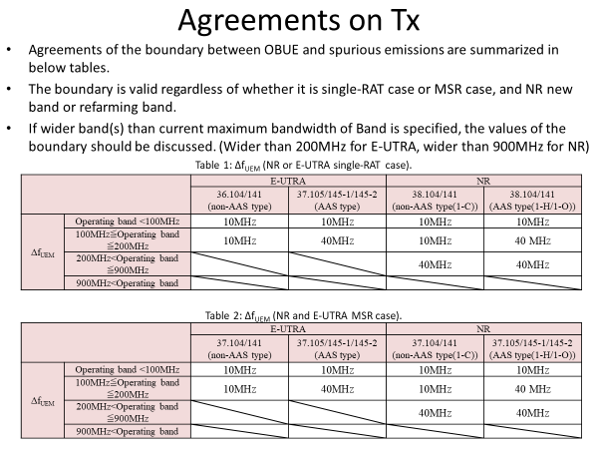
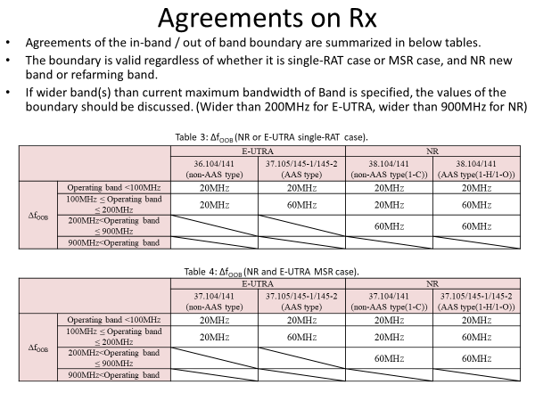
Background
As a reminder in-band and out-of-band boundary was discussed some time ago in RAN4 when AAS and NR was introducing and agreed in [1]. Main motivation to introduce wider boundary was that for antenna arrays in which antenna and radio are closely integrated and there are a potentially large number of transmitters, the amount of space for integrating filters is limited. It should be noted that that time boundary was discussed for all bands except Band 46. Also that time there was no NR-U.
From [1]:
[1] R4-1711779, WF on in-band and out-of-band boundary, NTT DOCOMO, INC., Nokia, Ericsson, Huawei, ZTE

Slide 4
WF for Δf_{OBUE} and Δf_{OOBB}
For NR-U BS type 1-C for n46NR-U:
For NR-U BS type 1-H for n46NR-U :
NR-BS Type 1-C | Δf_{OBUE} | Δf_{OOBB} | Supporting companies
Option 1 (legacy LTE/LAA values) | 10MHz | 20MHz | ZTE, Ericsson
Option 2 (legacy NR values) | 40MHz | 60MHz | Huawei, Nokia
Recommend Agreement: option 1
 | Δf_{OBUE} | Δf_{OOBB} | Supporting companies
Option 1 (legacy LTE/LAA values) | 10MHz | 20MHz
Option 2 (legacy NR values) | 40MHz | 60MHz | ZTE, Huawei, Nokia
Recommend Agreement: option 2

Slide 5
IBB and OOBB requirements
For NR-U BS type 1-C and 1-H for n46NR-U:
Note: for background for eLAA BS RX requirement could be found in the following R4-167192, R4-166293.
NR-BS Type 1-C | General blocking requirement | Supporting companies
Option 1 | To reuse LTE/LAA requirement | ZTE
Option 2 | To reuse NR requirement | Nokia
Recommend Agreement:
NR-BS Type 1-H | General blocking requirement | Supporting companies
Option 1 | To reuse LTE/LAA requirement
Option 2 | To reuse NR requirement | ZTE, Nokia
Recommend Agreement:

Slide 6
LO leakage for NR-U punctured channels
An exception to the spectrum emission requirements for the non-transmitted 20 MHz channels allows a single 2 MHz bandwidth to extend to P_{rated,x}-28dB , or -20 dBm, whichever is the greatest.
Option 1: to define LO leakage exception
Nokia, Huawei
Option 2: not to define LO leakage exception
ZTE
Note :To define LO leakage exception will degrade the UE performance as there are no LO indication to UE to do the calibration which is different from UE LO leakage where RAN1/2 signaling is supported.
Note: LO leakage exception is defined also in UE specification.

