Slide 1
WF on n13 A-MPR
­­­3GPP TSG-RAN WG4 Meeting # 96-e R4-2011801
Electronic Meeting, 17-28 Aug., 2020
Qualcomm, Huawei, [Apple], […]

Slide 2
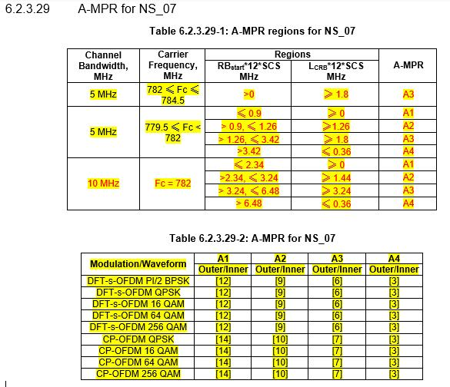
Background
Tentatively agreed A-MPR for NS_07 [1][2]

Slide 3
WF (1/2)
Simulations assumptions[3]:
No filter rejection for 769-775MHz
CIM3 = -60dBc,
Image and Carrier suppression at -28dBc
PA calibration point of 1dB MPR to meet general requirements for full allocated DFT-s-OFDM QPSK waveform.

Slide 4
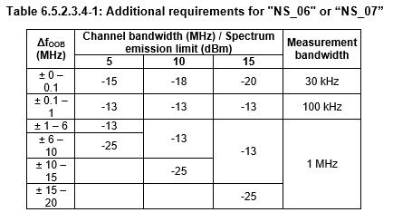
WF (2/2)
Other companies to provide simulations with following assumptions and requirements
Additional emission requirements [3]:

Slide 5
References
R4-2004464, “n13 Requirements”, Qualcomm Incorporated, 3GPP TSG-RAN WG4 #94bis-e
R4-2010490, “A-MPR for n13”,Huawei, HiSilicon, 3GPP TSG-RAN WG4 Meeting # 96-e
R4-2008209, “n13 AMPR”,Qualcomm Incorporated, 3GPP TSG-RAN WG4 #95-e

