Slide 1
WF on NR-U RRM (Part 1) all agreements in RAN4#95-e in email thread:
[95e][204] NR_unlic_RRM_1
3GPP TSG-RAN WG4 Meeting #95-e R4-2008552
Electronic Meeting, May 25 – June 5, 2020
Agenda Items: 6.1.5.1, 6.1.5.3, 6.1.5.4, 6.1.5.5, 6.1.5.6, 6.1.5.7
Ericsson

Slide 2
Agreements from the 1st round
Agreements from the GTW session
Agreements from the 2nd round

Slide 3
General
Remaining sections not covered by other technical CRs
  WF after the 1st round
    Analyse which clauses, if any, are anticipated to be without content 38.133 (and 36.133?) after the end of the first round, based on the outcome of first round discussions on the technical CRs
      Analysis for TS 38.133 – see R4-2008553 (rev. of R4-2004843)
      Analysis for TS 36.133 – see R4-2008554
    If missing clauses are anticipated between two clauses likely to be agreed, then introduce the clause titles with an additional CR
    If necessary, depending on the 1st round outcomes of technical CRs, revise R4-2004843 to add titles of any missing clauses
  Conclusions after the 2nd round
    For TS 38.133 – no CR with blank sections is needed
    For TS 36.133 – no CR with blank sections is needed

Slide 4
General
Further clarification on the terminology for occasions unavailable at the UE
  Use in the requirements a short term “X not available at the UE”, where X is:
    RLM-RS in RLM requirements,
    SMTC in measurement requirements other than RSSI requirements,
    SMTC in SCell activation, PSCell addition/release, TCI state switching requirements,
    SMTC in HO, RRC re-establishment, RRC release with redirection requirements, etc.
  “X not available at the UE” is further clarified in one place, for each X (e.g., where X is configured by the network, X may not be received at the UE during the corresponding period due to the absence of the necessary radio signals from the cell or DL CCA failure, etc.)
    FFS: whether/how to capture in this clarification the number of candidate resources to monitor
      Wait for RAN1 LS response on the number of monitored candidate resources
Further clarification on the terminology for missed transmissions
  The short term “Y unavailable for transmission” is used in the requirements and further clarified in one place (FFS: e.g., Y is configured by the network, UE is unable to transmit due to UL CCA failure, etc.), where the transmission is e.g. PRACH or HARQ feedback.

Slide 5
Handover
At least when the UE is not configured with both the UL BWP with PRACH occasion on the target cell and UL LBT failure detection/recovery, the handover interruption time considering the potential extensions caused by L₁, L₁´, L₂ and L₃ is limited only by the T304 timer
FFS: The impact of UL LBT failure detection/recovery on HO requirements for UE which is configured with both the UL BWP with PRACH occasion on the target cell and UL LBT failure detection/recovery
  For the case when the UE is configured with both the UL BWP with PRACH occasion on the target cell and UL LBT failure detection/recovery, do not specify the exact requirements, only clarify that that the interruption can be longer for such UE

Slide 6
RRC Re-Establishment
The impact of UL LBT failure detection procedure impact on RRC re-establishment requirements
  No new UE behavior needs to be defined due to consistent LBT failures under any stage of the RRC connection re-establishment procedure. The existing UE behaviour upon expiry of T311 defined in 38.331 shall apply under consistent LBT failures experienced by the UE over the RRC connection re-establishment delay
L_{*,max} values for RRC connection re-establishment
  Previous agreement from RAN4#94-e (in R4-2002336) related to RRC connection re-establishment requirements is still valid, i.e., K_{1,max}, K_{2i,max}, K_{SI,max} and K_{3,max} are not needed in the requirements

Slide 7
RRC Connection Release with Redirection
The need for L_{2,max} and clarification of the UE behaviour upon exceeding L_{2,max}
  RAN4 will not define L_{2,max}
  Existing UE behavior when exceeding preambleTransMax applies to RRC release with redirection

Slide 8
SCell Activation
Interruption window
  Interruption window length at SCell activation does not depend on LBT failures
    AGC issue is taken into account in the definition of the interruption window location for NR-U
  FFS: The interruption window location, considering the LBT impact on AGC and multiple interruption windows
Gain resetting upon delay of HARQ transmissions/retransmissions due to UL LBT failures and the need for compensation in SCell activation delay
  No consensus in RAN4 on this issue. No need to further discuss
Parameter setting in T_{activation}
  L_{3,1,max} = [2] if T_{SMTC_max} ≤ 40ms and L_{2,1,max} = [1] if T_{SMTC_max} > 40ms
  L_{3,2,max} = [2] if T_{rs} ≤ 40ms and L_{3,2,max} = [1] if T_{rs} > 40ms

Slide 9
SCell Activation (cont.)
FFS: The SCell activation requirements apply when SCell being activated is on a carrier frequency with CCA in
  Intra-band scenarios where all of the SCell being activated and all active serving cells are within the same band, or
  Inter-band scenarios where at least one of the SCell being activated and active serving cells is in a different band different than the band(s) of other active serving cells
T_{FirstSSB_MAX}
  Is the time to first configured SSB indicated by the SMTC after slot n + T_{HARQ}+3ms, when
    all active serving cells and SCells being activated or released have configured SSB bursts in the same slot, for intra-band scenario, or
    the SCell being activated has configured SSB burst, for inter-band scenario
Applicability of SCell activation requirements when sCellDeactivationTimer is not configured
  FFS: The SCell activation requirements for NR-U do not apply when the sCellDeactivationTimer is not configured

Slide 10
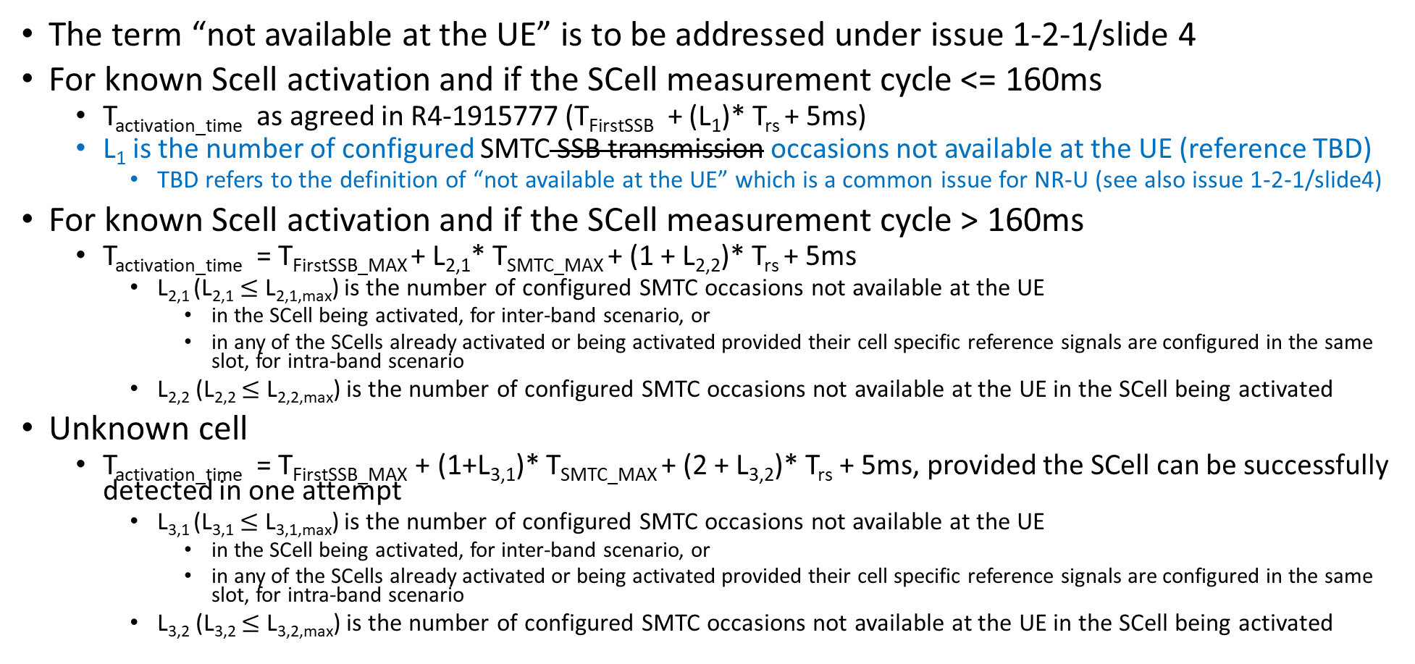
SCell Activation (cont.)
The term “not available at the UE” is to be addressed under issue 1-2-1/slide 4
For known Scell activation and if the SCell measurement cycle <= 160ms
  T_{activation_time} as agreed in R4-1915777 (T_{FirstSSB} + (L₁)* T_{rs} + 5ms)
  L₁ is the number of configured SMTC SSB transmission occasions not available at the UE (reference TBD)
    TBD refers to the definition of “not available at the UE” which is a common issue for NR-U (see also issue 1-2-1/slide4)
For known Scell activation and if the SCell measurement cycle > 160ms
  T_{activation_time} = T_{FirstSSB_MAX} + L_{2,1}* T_{SMTC_MAX} + (1 + L_{2,2})* T_{rs} + 5ms
    L_{2,1} (L_{2,1} $≤$ L_{2,1,max}) is the number of configured SMTC occasions not available at the UE
      in the SCell being activated, for inter-band scenario, or
      in any of the SCells already activated or being activated provided their cell specific reference signals are configured in the same slot, for intra-band scenario
    L_{2,2} (L_{2,2} $≤$ L_{2,2,max}) is the number of configured SMTC occasions not available at the UE in the SCell being activated
Unknown cell
  T_{activation_time} = T_{FirstSSB_MAX} + (1+L_{3,1})* T_{SMTC_MAX} + (2 + L_{3,2})* T_{rs} + 5ms, provided the SCell can be successfully detected in one attempt
    L_{3,1} (L_{3,1} $≤$ L_{3,1,max}) is the number of configured SMTC occasions not available at the UE
      in the SCell being activated, for inter-band scenario, or
      in any of the SCells already activated or being activated provided their cell specific reference signals are configured in the same slot, for intra-band scenario
    L_{3,2} (L_{3,2} $≤$ L_{3,2,max}) is the number of configured SMTC occasions not available at the UE in the SCell being activated

Slide 11
SCell Deactivation
Interruption window
  Interruption window length at SCell deactivation does not depend on LBT failures
  The starting point of deactivation interruption on PCell or PSCell or any activated SCell shall not occur before slot n+1+T_{HARQ}/NR_slot_length and not occur after slot n+1+(T_{HARQ} +3ms)/ NR_slot_length, where T_{HARQ} is as agreed in RAN4#94-e (R4-2002336)
Applicability of SCell deactivation requirements when sCellDeactivationTimer is not configured
  The SCell deactivation requirements for NR-U do not apply when the sCellDeactivationTimer is not configured

Slide 12
PSCell Addition/Release
UE behavior related to L_{1,max} and L_{2,max}
  Do not define L_{1,max} and L_{2,max} and the corresponding UE behavior
PRACH in other candidate UL BWPs
  Define requirements for UE which is not configured with both UL BWP with PRACH occasion on the target cell and UL LBT failure detection/recovery. When the UE is configured with both UL BWP with PRACH occasion on the target cell and UL LBT failure detection/recovery, clarify that the delay can be longer
Requirements applicability when UE is not provided with SMTC configuration or measurement object on this frequency
  If UE is not provided SMTC configuration or measurement object on this frequency: the requirement in this clause is applied with T_{rs} =5 ms assuming the SSB transmission periodicity is 5ms; there is no requirement if the SSB transmission periodicity is not 5ms

Slide 13
Active TCI State Switching
UE behavior
  RRC-based active TCI state switching
    FFS: UE declares beam failure upon exceeding L_{RRC,known,max} (for known state) and L1_{RRC,unknown,max} or L2_{RRC,unknown,max} (for unknown state)
      Wait for the response to RAN4 LS (R4-2005365)
  MAC-CE based active TCI state switching
    Confirm that the UE shall stay in the old state upon exceeding L_{MAC,known,max} (for known state) and upon exceeding L1_{MAC,unknown,max} or L2_{MAC,unknown,max} (for unknown state)
      Note 1: if Rel-15 behavior is modified then the agreement can be updated
      Note 2: the UE shall also stop the active TCI state switching procedure (as agreed in RAN4#93)
Definitions
  T_{first-SSB} is the time to the first SSB transmission occasion (“occasion” means the transmission is configured but may or may not come)

