Slide 1
3GPP TSG-RAN WG4 Meeting #94-e-Bis
Electronic Meeting, 20 – 30 Apr., 2020
draft R4-2005477
WF on IAB EMC
ZTE, …

Slide 2
Background
The IAB EMC has been extensively discussed and the first round discussion summary is in [1]
It is quite converged in [1] that IAB immunity requirement except Radiated immunity will reuse base station requirement.
For IAB radiated emission requirement, it has been agreed in [2] that:
“We will not define 2 sets of EMC requirement for DU and MT, but to define requirements per each enclosure and each port”.

Slide 3
Wayforward (Radiated emission)
The IAB EMC radiated emission requirements will be discussed as four cases listed below
  One enclosure case, TDM IAB
  One enclosure case, FDM/SDM IAB
  Different enclosure case, TDM IAB
  Different enclosure caes, FDM/SDM IAB
  This doesn't imply that requirement will be different in the above 4 cases. It is just to find a method to fully discuss the requirement. Final emission requirement after discussion can be merged.

Slide 4
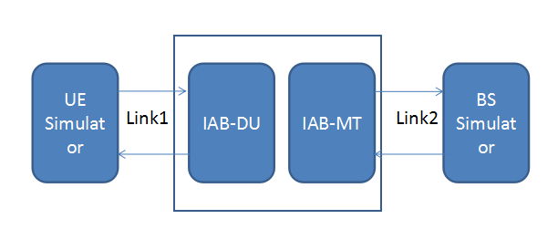
Wayforward (Radiated immunity)
This requirement will be discussed in two cases:
  Different enclosure:
    Option 1: BS and UE requirement apply to IAB-DU and IAB-MT enclosure separately
    Option 2: Apply BS requirement to each enclosure
  One enclosure:
  Some conformance issue has been listed in [2] but not fully discussed:
    Option 1: To test both links
    Option 2: To test each link at a time
  For core requirement:
  Test level:
    Option 1: To use base station requirement
    Option 2: To ues UE requirement
  Exclusion band:
    Option 1: A combined exclusion band to be discussed
    Option 2: To ues the exlusion band of BS and UE whichever is smaller
    Option 3: To ues the exlusion band of BS and UE whichever is larger

Slide 5
Wayforward (Capture the requirement)
How to capture the requirement:
  Option 1: A new TS is needed (ZTE, Huawei)
  Option 2: To capture in the BS spec TS 38.113 (Ericsson)

Slide 6
Reference
[1] R4-2005433 summary of RAN4#[94e Bis] [203] NR_EMC, ZTE
[2] R4-2002348 WF on IAB EMC core requirement, ZTE

