Slide 1
WF on BS demodulation requirements for 2-step RACH
3GPP TSG-RAN WG4 #94e Meeting
Electronic Meeting, Feb 24th – Mar 6th 2020
R4-2002389
ZTE

Slide 2
Agreements from 1st round discussion
Reusing preamble performance requirements and no additional preamble performance requirement for preamble is needed.
Leave performance requirements for interlaced PUSCH design and long preamble to NR-U WID.

Slide 3
Essential open issues
Application scenarios,
whether or not to consider only small cell case?
Whether 2 step RACH is only activated near to the centre of large cells ?
Timing offset (TO) issue:
Can BS assume the same or different timing offsets among UEs?
Potential impact on the performance of different TOs

Slide 4
Application scenarios agreements
RAN1 agreed to support all different preamble formats for 2-step RACH
It implies that there is no restricted application scenarios intended for 2-step RACH
Agreements
including small cell and none small cell scenarios
Applicable for all UEs, including cell centre users and cell edge users.

Slide 5
Application scenarios
If the timing offset between different UEs is large in comparison to the CP length, then some taps of the channel impulse response may fall outside of the CP and the msgA PUSCH from those UEs will not be orthogonal in the frequency domain and will not be orthogonal with regular PUSCH
If the timing offset between different UEs is large, larger than a CP , then the msgA PUSCH from those UEs will not be orthogonal in the frequency domain and will not be orthogonal with regular PUSCH
This may restrict the system capacity
RAN4 will not define requirements on multiple PUSCH
The fact that capacity is degraded for multiple PUSCH could mean that the application scenario of Ues beyond the ”centre” of a large cell is not useful
Definition of ”centre” depends on SCS etc

Slide 6
Impact to demodulation requirements
If the timing offset for an individual msgA PUSCH is larger than a CP then the receiver needs to adjust the reception timing for the PUSCH
During the discusisons in RAN4#94-e, companies expressed differing opions as to whether the RX timing adjustment is a functional or performace issue
If functional issue, no performance requirement needed
If performance issue and the TO values are seen as valid applications, performance requirement needed

Slide 7
Timing offsets (3): agreements
Due to lack of timing adjustment mechanism in 2-step RACH, timing offset of each UE may differ proportionally to the cell size, so BS cannot assume the same TO among UEs
Implementation limitation at BS side, e.g., multiple FFT is not intended, demodulation requirement of MsgA payload needs to be specified with the consideration of different TOs

Slide 8
Agreements
RAN4 should establish whether application scenarios in which the timing offset of the msgA PUSCH is large enough to merit a possible performance requirement are useful scenarios
If the answer to (1) by RAN4 is yes, then RAN4 should establish whether the impact to the receiver is functional or performance
If the answer to (2) is performance, RAN4 should establish the maximum expected timing offset,

Slide 9
Agreements
RAN4 should determine relevant application scenarios for MsgA performance evaluation
Including a request to all companies to contribute parameters needed for analysis, e.g., cell size of the use cases
RAN4 should study if new requirements for MsgA performance should be defined
FFS on whether the new requirements are functional or performance.

Slide 10
Work plan for BS demodulation requirements for 2-step RACH
If consensus is reached on specifying BS demodulation requirements for 2-step RACH, then the following work plan is advised:
RAN4#94-e:
Approve the workplan
RAN4#94bis:
Simulation configuration alignments for 2-step RACH MsgA payload
Simulation results collection and alignment
RAN4#95:
Final round of simulation results collection and alignment
CR for TS 38.104 Demodulation performance requirements for 2-step RACH Msg A payload
CR for TS 38.141-1 Conducted conformance tests for 2-step RACH Msg A payload
CR for TS 38.141-2 Radiated conformance tests for 2-step RACH Msg A payload

Slide 11
Reference
R4-2002387 Email discussion summary for RAN4#94e_#96_NR_2step_RACH_Demod, ZTE
R4-2000801 BS demodulation requirements for 2-step RACH, ZTE
R4-2000802 2-step RACH workplan, ZTE
R4-2000314 View on BS demodulation requirement for NR 2-step RACH, Samsung
R4-2001183 On 2 step RACH demodulation, Ericsson
R4-2001491 On 2-step RACH BS demodulation requirements, Nokia

Slide 12
Background information (not for agreement)

Slide 13
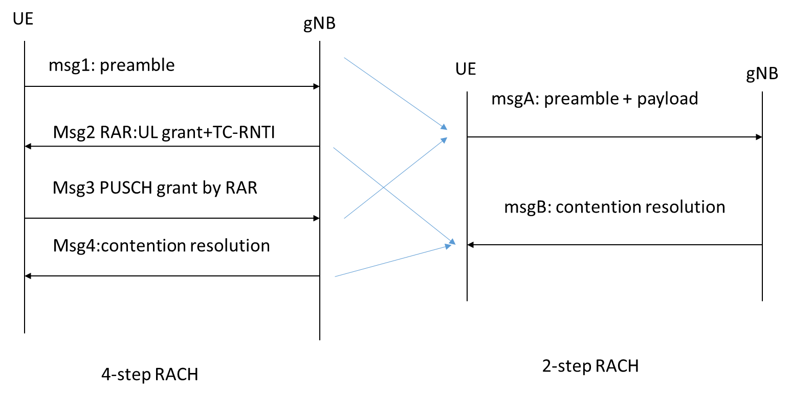
Timing Offsets (1): 2-step Vs 4-step RACH
Timing offset for each UE is estimated, and sent to the UE in Msg2
Lack of timing offsets adjustment
Timing adjusted
so all UEs preambles are received within one CP at BS side
Timing offsets among UEs are not guaranteed

Slide 14
Timing offsets (2): examples
Timing offset in the unit of CPs cause by round-trip delay
Fraction of CP due to round trip delay
Distance/SCS | 20 | 50 | 200 | 500 | 1732 | 25000 | Symbol length | CP length
15 kHz | 0.016344 | 0.04086 | 0.16344 | 0.408599 | 1.415387 | 20.42995 | 71.88 | 4.71
30 kHz | 0.032688 | 0.08172 | 0.326879 | 0.817198 | 2.830773 | 40.85989 | 35.94 | 2.355
60 kHz | 0.065376 | 0.16344 | 0.653758 | 1.634396 | 5.661547 | 81.71978 | 17.97 | 1.1775
120 kHz | 0.130752 | 0.326879 | 1.307517 | 3.268791 | 11.32309 | 163.4396 | 8.99 | 0.58875
To | 0.066667 | 0.166667 | 0.666667 | 1.666667 | 5.773333 | 83.33333
TO(us) | 0.07698 | 0.19245 | 0.7698 | 1.924501 | 6.666471 | 96.22504

