Slide 1
WF on MPR/A-MPR simulation assumptions for NR V2X PC2 UE
3GPP TSG-RAN WG4 Meeting #94-e R4-2002791
Electronic Meeting, Feb.24th – Mar.6th 2020
Agenda item: 8.4.4.1
Source: Huawei, HiSilicon

Slide 2
Background
In last RAN4 #93 meeting and e-mail discussion, we discussed the basic simulation assumption of the required MPR/AMPR levels for simultaneous PSFCH transmission and PSSCH/PSCCH transmission
In RAN4 #94e, companies provide the MPR simulation results about S-SSB.
In order to derive MPR/AMPR for NR V2X PC2 UE, simulation assumptions were proposed.

Slide 3
MPR/AMPR Assumption and parameters for PC2
parameter | Assumption
Center frequency | 5.9GHz
Maximum output power for all kinds of channel | 26 dBm
PA calibrationfor all kinds of channel | PA calibrated to deliver -31dBc ACLR for a fully RB allocated 20MHz QPSK DFT-s-OFDM waveform at 1dB MPR
Modulation for PSSCH | QPSK\16QAM\[64QAM]
PSSCH/PSCCH transmission | For other assumption, the sub-clause 8.1.2 from TR 38.886 can be referred to.
Simultaneous PSFCH transmission for multiple users | For other assumption, the WF (R4-2002758) on MPRA-MPR simulation assumptions and parameters for simultaneous PSFCH transmission can be referred to.

Slide 4
MPR/AMPR Assumption of S-SSB for NR V2X PC2 UE
parameter | Assumption
Bandwidth | 10/20/30/40MHz
numerology | 15 kHz/30kHz/60kHz
Modulation for PSBCH | QPSK
S-PSS | M-sequence
S-SSS | Golden-sequence
Waveform | CP-OFDM
Carrier leakage | 25dBc
IQ image | 25dBc
CIM3 | 45 or 60 dBc
RB allocation | RBstart: All the possible cases LCRB: 11 RB
S-SSB structure

Slide 5
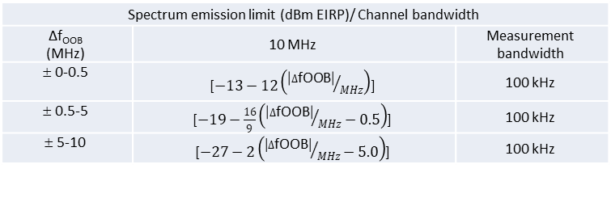
Additional requirements for AMPR
Need to add NS_34 and [NS_49] to comply ETSI regulation and FCC regulation
The A-SE will further discuss since EN302 571 will be revised to remove the UE coexistence requirements in page 6
Additional SEM requirements for 10MHz channel bandwidth in TS36.101
Spectrum emission limit (dBm EIRP)/ Channel bandwidth
Δf_{OOB} (MHz) | 10 MHz | Measurement bandwidth
± 0-0.5 | [$−13−12\left({\left|∆\text{fOOB}\right|}/{MHz}\right)$] | 100 kHz
± 0.5-5 | [$−19−\frac{16}{9}\left({\left|∆\text{fOOB}\right|}/{MHz}−0.5\right)$] | 100 kHz
± 5-10 | [$−27−2\left({\left|∆\text{fOOB}\right|}/{MHz}−5.0\right)$] | 100 kHz
Additional spectrum mask requirements for 40MHz channel bandwidth (fc = 5885MHz)
Δf_{OOB} (MHz) | Emission Limit (dBm) | Measurement Bandwidth
±0 - 2 | -32 | 100kHz
±2-10 | -36 | 100kHz
±10-20 | -38 | 100kHz
±20-40 | -43 | 100kHz
±40 - 100 | -50 | 100kHz

Slide 6
Additional requirements for AMPR
EN302 571 will be revised to remove the UE coexistence requirements.
However the formal EN302 571 is not release until now. Still captured the coexistence requirements in the official latest version.
47 | E-UTRA Band 1, 3, 5, 7, 8, 22, 26, 28, 34, 39, 40, 41, 42, 44, 45, 65, 68, 72, 73 NR band n77, n78 , n79 | FDL_low | - | FDL_high | -50 | 1
 | Frequency range | 5925 | - | 5950 | -30 EIRP | 1 | 38, 40, 43
 | Frequency range | 5815 | - | 5855 | -30 EIRP | 1 | 38, 43
NOTE 38: Applicable when NS_33 or NS_34 is configured by the pre-configured radio parameters. NOTE 40: In the frequency range x-5950MHz, SE requirement of -30dBm/MHz should be applied; where x = max (5925, fc + 15), where fc is the channel centre frequency. NOTE 43: The EIRP requirement is converted to conducted requirement depend on the supported post antenna connector gain G_{post connector} declared by the UE following the principle described in annex I.

Slide 7
Reference
R4-2001085 [V2X] TP on S-SSB MPR requirements for NR V2X in band n47, Huawei, HiSilicon
R4-1910707 LS to RAN4 on NR V2X S-SSB design, RAN1, CATT
R4-2001081 [V2X] MPR simulation results for PC2 NR V2X in band n47, Huawei, HiSilicon
R4-2001084 [V2X] TP on RF requirements for PC2 NR V2X UE in band n47, Huawei, HiSilicon
R4-2002032 draftCR for TS 38.101-1 PC2 RF requirements NR V2X, Huawei, HiSilicon
R4-2001215 Summary on E-mail discussion for NR V2X, LG Electronics
R4-2001214 TR update TR38.886 v0.5.0, LG Electronics

