Slide 1
RAN4#115 meeting schedule
3GPP TSG-RAN WG4 Meeting #115
Malta, Malta, 19th – 23rd May, 2025
Agenda Item: 2
RAN4 Chair: Yang Tang
Vice Chair: Gene Fong, Shan Yang

Slide 2
Monday
Venue Time | RAN4 Main | RAN4 RRM (RAN4 Breakout1) | RAN4 BDaT (RAN4 Breakout2 ) | Ad hoc room (RAN4 Breakout3)
9:00-9:20 | 1. Opening of the meeting 2. Approval of the agenda 3. Letters / reports from other groups / meetings 4. Awards for delegate excellence (2024) 5.Incoming LS TEI, essential CRs,
9:30-10:30 | Rel-19 Spectrum [108] HPUE_NR_bands (6) [110] HPUE_Basket_EN-DC (0) [111] HPUE_Basket_CADC_SUL (1) [112] LTE_NR_Other_basket (11) | Rel-19 [209] NR_IoT_NTN_req_test_enh (13) [205] NR_FR1_lessthan_5MHz_BW_Ph2 (12) | Rel-19 Demod [322] NR_demod_Ph5_Part1_General_BS (28) | RRM Ad-hoc: [215] [216] FS_NR_AIML_Mob, Chaired by Fahad Syed Muhammad (Nokia)
10:30-11:00 | Coffee break
11:00-13:00 | [114] NR_IoT_NTN_Bands (11) [115] NR_mmWave_protect (2) Rel-19 non-spectrum [122] NR_FR1_5MHz_BW_Ph2 (1) [134] A-IoT_device (27) [135] A-IoT_BSCW (18) | [219] NR_duplex_evo (46) [213] NR_RRM_Ph5_Part2 (39) | [323] NR_demod_Ph5_Part2_UE (25) [321] NR_SCM (34) | BDaT Ad-hoc: SBFD [306] NR_duplex_evo_General [307] NR_duplex_evo_BSRF Chaired by Jackson Wang (Samsung) and Xiang Gao (Huawei)
13:00-14:30 | Lunch break
14:30-16:30 | Rel-19 non-spectrum [134] A-IoT_device (27, cont.) [135] A-IoT_BSCW (18, cont.) | [212] NR_RRM_Ph5_Part1 (36) Coffee break: [207] NR_LBCA_Sw, Chaired by Jerry | [321] NR_SCM (34) cont NGSO testing [324] NTN_testing_NGSO_channel_model (14) Rel-19 Demod [329] NR_MIMO_demod (9) | BDaT Ad-hoc: Ku band (14:30-15:30) [314] NR_NTN_Ku_Band_UE_SAN_RF Chaired by Tank (CHTTL) Main Ad-hoc: 15:30-16:30 [117] NR_ENDC_RF_Ph4_part2Chaired by Tina(Yuanyuan) Zhang (Samsung)
16:30-17:00 | Coffee break
17:00-18:00 | [135] A-IoT_BSCW (18) [120] NR_SL_intraB_CA_ITS_part1 (0) [121] NR_SL_ intraB_CA_ITS_part2 (0) | [210] NR_NTN_Ku_bands (15) | [331] NR_Network_energy_demod (6) [332] NR_LPWUS_demod (9) | Main Ad-hoc: [137] Feature list by Xiaoran Zhang (CMCC)
18:00-19:30 | Main Ad-hoc: [131] NR_AIML_air_part1 Chaired by Vali (Qualcomm) (18:00-19:00) [132] NR_AIML_air_part2 Chaired by Tom (Ericsson) (19:00-19:30) | RRM Online: [206] NonCol_intraB_ENDC_NR_CA_Ph2 (6) [231] Reply_LS (5) [211] NR_ATG_enh (24) | BDaT Ad-hoc: BSRF [302] NR_BS_RF_Part1_E_EIRP [303] NR_BS_RF_Part2_CLTA_SE [304] NR_BS_RF_Part3_OTA_TRP Chaired by Fei (ZTE) and Michal (Huawei) | RRM Ad-hoc: [217] [218] NR_MIMO_Ph5, Chaired by Yanze Fu (Samsung)

Slide 3
Tuesday
Venue Time | RAN4 Main | RAN4 RRM (RAN4 Breakout1) | RAN4 BDaT (RAN4 Breakout2 ) | Ad hoc room (RAN4 Breakout3)
8:30-10:30 | [118] NR_ENDC_RF_Ph4_part3 (22) [117] NR_ENDC_RF_Ph4_part2 (17) | [225] NR_Mob_Ph4_Part2 (13) [224] NR_Mob_Ph4_Part1 (50) Coffee break: [207] NR_ATG_enh, Chaired by Shiyuan | Rel-19 UE and SAN RF NTN [310] NR_IoT_NTN_less_than_5MHz_UERF (8) [311] NR_IoT_NTN_less_than_5MHz_BSRF (5) [309] NR_NTN_Ph3_General_UE_RF (25) | RRM Ad-hoc: [223] NR_LPWUS, Chaired by Xusheng (vivo)
10:30-11:00 | Coffee Break
11:00-13:00 | [127] NR_FR1_7MHz_BW (13) [116] NR_ENDC_RF_Ph4_part1 (17) | [224] NR_Mob_Ph4_Part1 (50) Cont. RRM Ad-hoc (12:00 - 13:00) [219] NR_duplex_evo, Chaired by Yanze Fu (Samsung) | [309] NR_NTN_Ph3_General_UE_RF (25) (cont) [315] IoT_NTN_Ph3 (7) Ku band [314] NR_NTN_Ku_Band_UE_SAN_RF (26) | BDaT Ad-hoc: SCM [321] NR_SCM, chaired by Alexander Hamilton (Nokia)
13:00-14:30 | Lunch break
14:30-16:30 | [125] NR_PC2_RedCap_UE (11) [126] NR_LBCA_Sw (15) After 16:00 [136] NR_LPWUS_UERF (46) | [215] FS_NR_AIML_Mob_Part1 (38) [216] FS_NR_AIML_Mob_Part2 (13) Coffee break: [215][216] FS_NR_AIML_Mob, Chaired by Fahad | [314] NR_NTN_Ku_Band_UE_SAN_RF (26) (cont) [312] NR_NTN_Ku_Band_General (8) [313] NR_NTN_Ku_Band_Coexistence (8) Rel-19 IoT NTN [316] IoT_NTN_TDD_UE_SAN_RF (12) | BDaT Ad-hoc: Demod_Ph5 UE and BS [322] NR_demod_Ph5_Part1_General_BS [323] NR_demod_Ph5_Part2_UE Chaired by Karsten Petersen (Nokia) and Jingzhou Wu (CTC)
16:30-17:00 | Coffee Break
17:00-18:00 | [136] NR_LPWUS_UERF (46, cont.) | [207] NR_LBCA_Sw (12) | [316] IoT_NTN_TDD_UE_SAN_RF (12) (cont) 5G Broadcast [317] 5G_Broadcast_bands (4) [318] 5G_Broadcast_GSO_NTN_band (11) | Main Ad hoc (17:00~18:00): [134/135] A-IoT Chaired by Xiaoran Zhang
18:00-19:30 | Main Ad-hoc: [132] NR_AIML_air_part2 Chaired by Tom (Ericsson) (18:00-18:45) [124] FS_NR_DL_Frag_Carrier Chaired by Huanren (Mediatek) (18:45-19:30) | RRM Ad-hoc: [212][213] NR_RRM_Ph5, Chaired by Jerry Cui (Apple) | BDaT Ad-hoc: Demod Maintenance [320] Demod_Maintenance_Part1 chaired by Axel Mueller (Nokia) | Main Ad hoc [101~104] UERF_maintenance (selected topics), Chaired by Haijie Qiu (Xiaomi)

Slide 4
Wednesday
Venue Time | RAN4 Main | RAN4 RRM (RAN4 Breakout1) | RAN4 BDaT (RAN4 Breakout2 ) | Ad hoc room (RAN4 Breakout3)
8:30-10:30 | [131] NR_AIML_air_part1 (73) [132] NR_AIML_air_part2 (24) | [221] Netw_Energy_NR_enh_Part1 (44) [222] Netw_Energy_NR_enh_Part2 (32) | Rel-19 BSRF [302] NR_BS_RF_Part1_E_EIRP (14) [303] NR_BS_RF_Part2_CLTA_SE (15) [304] NR_BS_RF_Part3_OTA_TRP (10) | Main Ad-hoc: (8:30-9:30) [136] NR_LPWUS_UERF Chaired by Ruixin Wang (vivo) BDaT Ad-hoc: Ku coex (9:30 -10:30) [313] NR_NTN_Ku_Band_Coexistence, Chaired by Manook (Intelsat)
10:30-11:00 | Coffee break
11:00-13:00 | [132] NR_AIML_air_part2 (24, cont.) After 11:30 [123] NonCol_intraB_ENDC_NR_CA (2) [124] FS_NR_DL_Frag_Carrier (15) | [223] NR_LPWUS (51) | Rel-19 OTA [337] TRP_TRS_MIMO_OTA_Ph3 (40) [338] NR_FR2_OTA (5) | RRM Ad-hoc: [226] [227] Rel-19 NR_Mob_Ph4, Chaired by Qiming Li (Apple)
13:00-14:00 | Lunch break
14:00-16:30 | [124] FS_NR_DL_Frag_Carrier (15, cont.) [133] NR_MIMO_Ph5_UE (6) [130] NR_ATG_enh (6) | Add topics for Thursday Ad-hoc [204] NR_ENDC_RF_Ph4 (4) [229] IoT_NTN_Ph3 (7) [227] NR_NTN_Ph3_Part1 (32) [228] NR_NTN_Ph3_Part2 (12) | Rel-19 BSRF [305] NR_ATG_enh (2) [308] NR_LPWUS (12) [331] BSRF_Simplify_CoLo_Coex (20) BDaT LS reply (if any) | RRM Ad-hoc: (14:30-15:30) [228] NR_XR_Ph3, Chaired by Rafael Paiva (Nokia) BDaT Ad-Hoc: (15:30-16:30) [321] Demod_Maintenance_Part2 chaired by Manasa Raghavan (Apple)
16:30-17:00 | Coffee break
17:00-18:00 | Rel-19 NTN [128] NR_IoT_NTN_HPUE_part1 (27) | [230] IoT_NTN_TDD (6) | BDaT Ad-hoc [327] TRP_TRS_MIMO_OTA_Ph3 chaired by Ruixin Wang (vivo) | Main Ad hoc (17:00~18:30): [105] NR_Baskets_Part_1 Chaired by Iwo Angelow (Nokia) [106] NR_Baskets_Part_2 Chaired by Per Lindell (Ericsson)
18:30 | Charity Run in Malta

Slide 5
Thursday
Venue Time | RAN4 Main | RAN4 RRM (RAN4 Breakout1) | RAN4 BDaT (RAN4 Breakout2 ) | Ad hoc room (RAN4 Breakout3)
8:30-10:30 | Rel-19 NTN [129] NR_IoT_NTN_HPUE_part2 (13) [114] NR_IoT_NTN_Bands (11) | [217] NR_MIMO_Ph5_Part1 (23) [218] NR_MIMO_Ph5_Part2 (17) Coffee break (10:40-11:00) [220] NR_XR_Ph3, Chaired by Shan | Rel-19 SBFD [306] NR_duplex_evo_General (25) [307] NR_duplex_evo_BSRF (24) | RRM Ad-hoc: To be added on Wednesday
10:30-11:00 | Coffee Break
11:00-13:00 | Rel-19 basket WI [105] NR_Baskets_Part_1 (3) [106] NR_Baskets_Part_2 (9) [107] LTE_Baskets (0) Maintenance [138] NR_reply_LS_UE_RF (7) [101] Upto_R16_UERF_maintenance (9) | [220] Ambient_IoT_Solutions (10) [226] NR_XR_Ph3 (20) | Rel-19 Demod [330] NR_duplex_evo_demod (7) [325] NR_IoT_NTN_less_than_5MHz_demod (6) [326] NR_ENDC_RF_Ph4_Demod_6Rx (10) [327] NR_less_than_5MHz_Ph2_demod (8) [328] NR_ATG_enh_demod (6) | Main Ad hoc: (11:00-12:00) [128/129] NR_IoT_NTN_HPUE_part1/2 Chaired by Runsen Tang (Samsung) RRM Ad-hoc: (12:00-13:00) [227] [228] NR_NTN_Ph3, Charied by CH (Qualcomm)
13:00-14:30 | Lunch break
14:30-16:30 | [101] Upto_R16_UERF_maintenance (Cont) [102] R17_UERF_maintenance (2) [103] R18_UERF_maintenance_Part1 (13) [104] R18_UERF_maintenance_Part2 (5) | Up to Rel-19 Maintenance and TEI [203] Maintenance_R18_R19 (152) [202] Maintenance_R17 (61) [201] Maintenance_up_to_R16 (62) | Maintenance [301] BSRF_Maintenance_TEI (28) [319] Demod_Maintenance_TEI_Part1 (21) [320] Demod_Maintenance_TEI_Part2 (14) [336] OTA_Maintenance_TEI (2) | BDaT Ad-hoc(14:30~16:30): TBD
16:30-17:00 | Coffee Break
17:00-18:00 | [104] R18_UERF_maintenance_Part2 (Cont) Early Return to Rel-19 selected topics | [208] NR_FR1_7MHz_BW (3) [214] LCS_BDS_B2b_LCS_NAVIC_L1_SPS (6) Early return to (if time allows) | Rel-19 Demod [333] NR_NTN_Ph3_demod (7 ) [334] IoT_NTN_Ph3_demod (5) [335] NR_7MHz_demod (10) Early return to (if any) | Main Ad-hoc: [116] NR_ENDC_RF_Ph4_part1 Chaired by Leo(Ye) Liu (Huawei)
18:00-19:30 | Main Ad-hoc: [131] NR_AIML_air_part1 Chaired by Vali (Qualcomm) (18:00-19:00) [132] NR_AIML_air_part2 Chaired by Tom (Ericsson) (19:00-19:30) | RRM Ad-hoc: [221] [222] Netw_Energy_NR_enh, Chaired By Zhixun Tang (Ericsson) | BDaT Ad-hoc: TBD | Main Ad-hoc: Feature list 2nd round [137] Feature list by Xiaoran Zhang (CMCC)

Slide 6
Friday
Venue Time | RAN4 Main | RAN4 RRM | RAN4 BDaT | Ad hoc room
8:00-10:30 | Return to AI/ML [132] NR_AIML_air_part2 (cont) (no NTN topic) | Return to | Return to (UE RF related are treated first) [309] NR_NTN_Ph3_General_UE_SAN_RF [310] NR_IoT_NTN_less_than_5MHz_UERF [314] NR_NTN_Ku_Band_UE_SAN_RF [315] IoT_NTN_Ph3 [316] IoT_NTN_TDD_UE_SAN_RF Return to (Other topics in thread order)
10:30-11:00 | Coffee Break
11:00-13:00 | Return to (start with NTN topics) | Return to | Return to (OTA topics are treated first) [336] OTA_Maintenance [337] TRP_TRS_MIMO_OTA_Ph3 [338] NR_FR2_OTA Return to (Other topics in thread order)
13:00-14:00 | Lunch break
14:00-15:00 | Return to (final round) | Return to (final round) | Return to (final round)
15:00 (or earlier time) -17:00 | 12 New or revised Rel-19 WID/SID 13 Any other business 14 Close of the meeting

Slide 7
Appendix

Slide 8
General Aspects
The face-to-face meeting will take place during May 19th ~ 23rd, 2025.
  Three sessions in three separate rooms: Main, RRM, BDaT(BSRF, Demod, test, NTN). 1-Way GoToWebinar (GTW) conference calls will be set each session and 1-way MS teams will be set for ad hoc in the best effort way. A number of ad hoc sessions will be arranged (refer to meeting schedule).
  Moderator will be designated to provide the summary for a topic before the meeting. In online discussions, session chairs will handle topics based on the moderator summary. Moderator does not need update the summary by collecting comments during the meeting.
  Deadline for Tdoc request & submission deadline: May 9th (Friday) 2025, 23:55 UTC.
  Other deadlines can be found in the following slides.
Please find one picture for meeting flow below and details in the corresponding slides.
For chairs
For moderator
For delegates
Pre-meeting week
Quiet Period
Meeting week
Quiet Period
Post-meeting week
Fri
Sat/Sun
Mon
Tue
Wed
Thu
Fri
Sat/Sun
Mon
Tue
Wed
Thu
Fri
Sat/Sun
Mon
Tue
Wed
Thu
NWM flag process Slide #17
Moderators trigger nwm for maintenance before Sunday
Flag for maintenance @nwm
WF/CR template
Draft TS/TR
WF/CR rules Slide #10
Slide #16
Pre-RAN Action
MCC 3GU parsing tool
TR/TS rules Slide #11/12
Slide #19
Topic Moderator & summary: slide #5
Online discussions &
GTW conference call (US/China meeting)
Upload CR for maintenance 2:30pm on Thursday
TOHRU (US/China meeting)
Tdoc request (new&revision)
Upload tdocs (10.10.10.10) &
How to access contributions
Moderator assignment before Mon
Draft summary for topics
Summary review & comments
Formal tdoc of summary submission by Saturday
GTW Slide #8
List of email threads for post-meeting
Submission of tdoc of post-meeting
Comments
Approve tdocs for post-meeting
Registration
Initial list for block approval for basket
Deadline for flag for block approval
Updated list for block approval
Tohru Slide #13
Post-meeting process: slide #15
Tdoc request Slide #9
Tdoc number request & submission
Basket WIs Block approval: slide #7
Meeting schedule & Ad hoc chair assignment
Provided before meeting
Update of meeting notes per day
Tdoc allocation
Check-in
Register/check-in Slide #14
Slide #3
Meeting room
Quiet Period (0:00 am ~ 7:00 am meeting venue Local time
No email are expected in RAN4 reflector

Slide 9
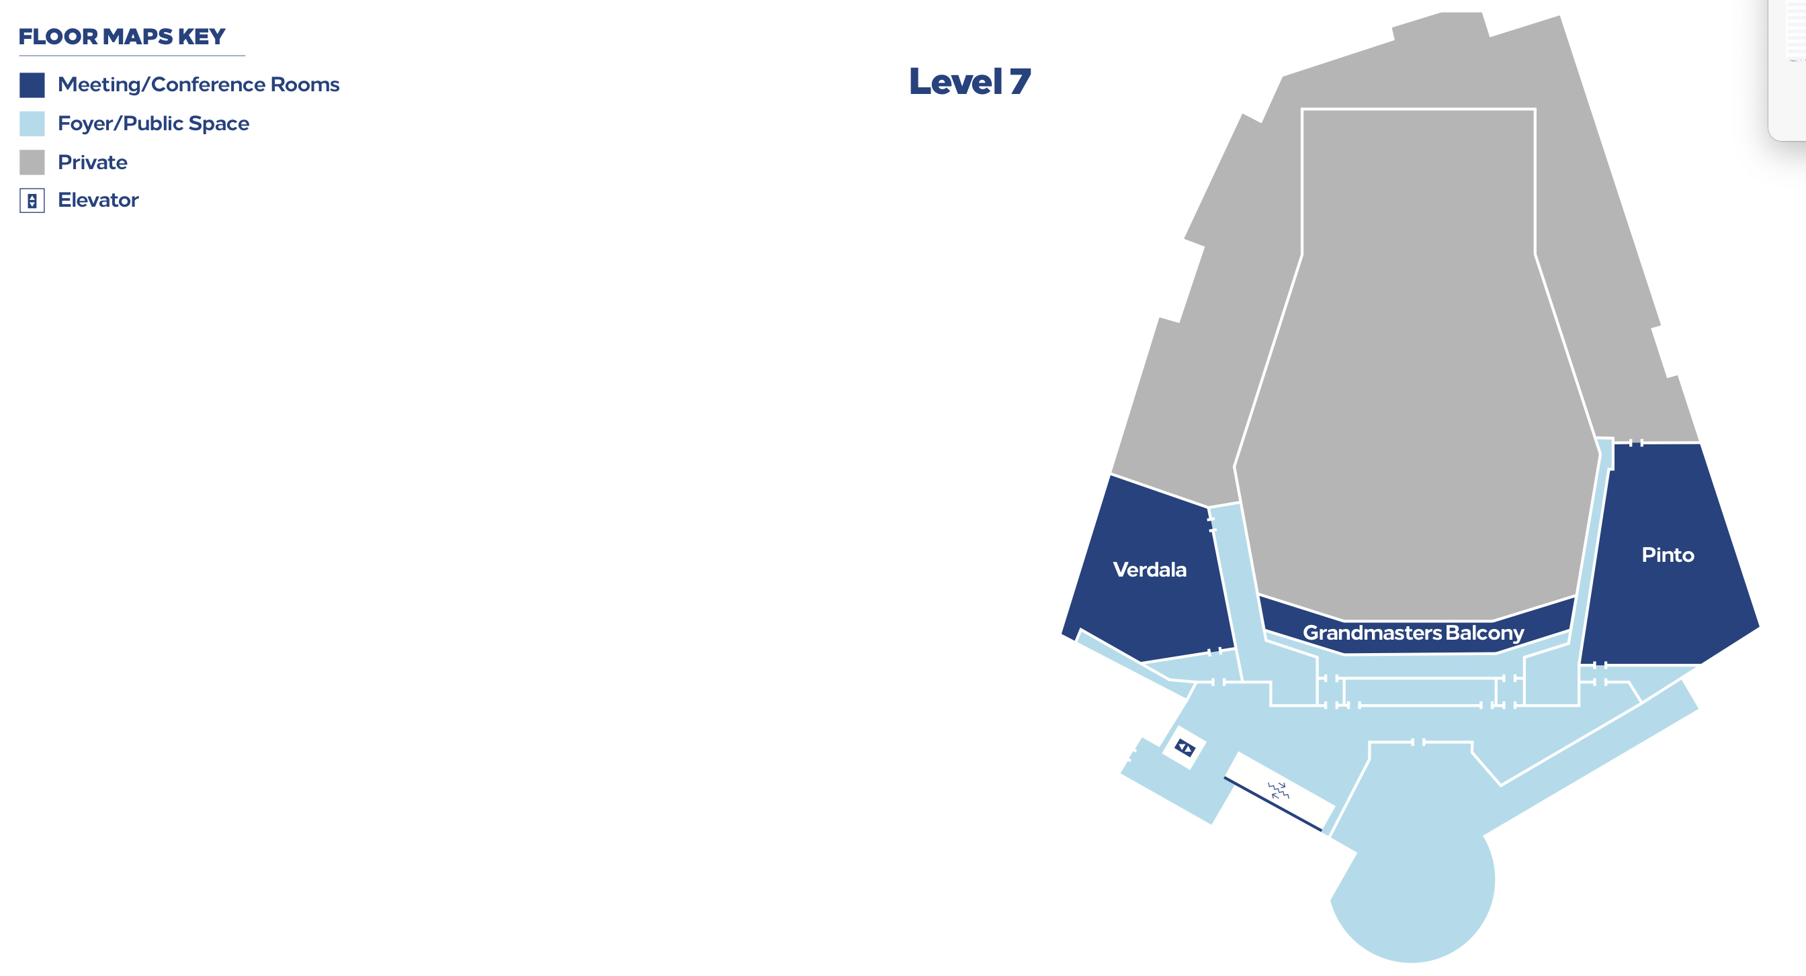
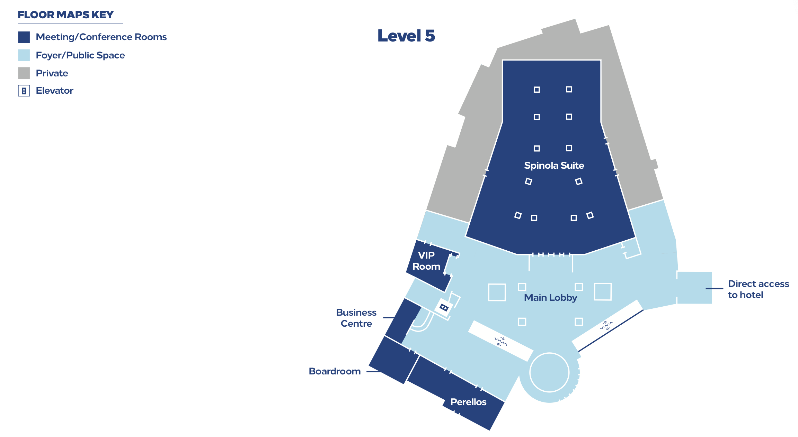
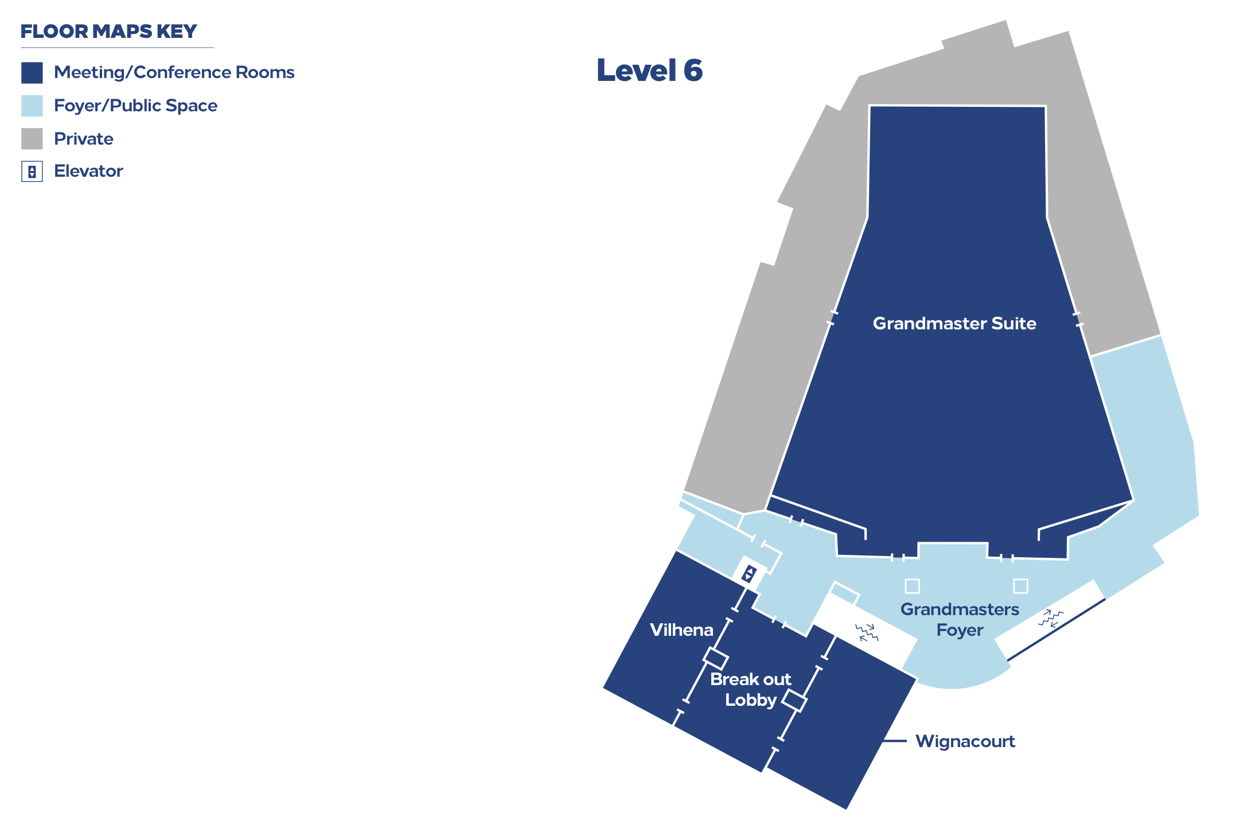
Meeting rooms for RAN4#115
    RAN4 meeting rooms:
  Main session: Grandmasters suite, Level 6,（300 persons）
  RRM session: Vihena+Wignacourt+breakout Lobby, Level 6,（100）
  BDaT session: Pinto, Level 7,（80）
  Ad hoc session: Verdala, Level 7,（50）
  Breakout Room: Perellos, Level 5, (50)

Slide 10
Tdoc request & allocation
During the meeting, the tdoc number for revision or new tdoc will be allocated by session chairs according to the requests
  Based on the online discussions, session chairs will allocate tdoc numbers with help of MCC.
  During coffee break, the delegates can request the tdoc from session chairs in person. Please do not send email to request tdoc numbers, because it is inconvenient for session chairs to check and reply the email timely during the face-to-face meeting.
  Email thread like “[1xx][X00] XXX_Session - tdoc request”WON´T be used for tdoc request and allocation since it is difficult for session chairs to handle email during face-to-face meeting.
For basket WIs, maintenance or other special topics, session chairs will allocate the Tdoc number for revision or new tdocs based on the recommendation in the topic moderators´ summary.
For TEI, if you plan to trigger a new topic which has no corresponding WI code and have to submit CR(s) with TEI-xx as the work item code for this topic, please contact session Chairs first, because TEI topics are under monitoring by RAN
  Please submit the CRs by providing a TEI identifier and include it in the title of CRs.
    Example of TEI identifier: [n77_Canada], which should be put in the tail of the tdoc title, e.g., UE RF requirements for … [n77_Canada]
    TEI identifier should be provided for all the CRs with TEI18/TEI17 as WI code, otherwise the CRs cannot be approved officially
    If CRs correspond to the previous release but the agreement in the group is to change it from Rel-18/17, the WI code of the previous release WID plus TEI18/TEI17 should be used as WI code, e.g., Work item code: NR_pos_enh-Core, TEI18, for which no TEI identifier is needed.
    If TEI17 Cat-F CR was approved, the WI code for its Rel-18 Cat-A CR should be TEI17 rather than TEI18.
  The first CRs of one TEI topic to introduce a new should be prepared as Cat-B CRs. The CRs which correct the specification for the previous TEI topics should be submitted as Cat-F or Cat-A. In theory the TEI Cat-F CR is supposed to correct the functionality of previous TEI Cat-B CR(s).
  Please refer to RP-240858 for the detailed rule of TEI.
  Proponents of TEI CRs shall explicitly check during the quarter that all relevant work is completed in all RAN WGs before asking approval from RAN plenary. (Conclusions of RP-241618)

Slide 11
Guidance for essential corrections of a CR
    To control the workload of maintenance work and to allocate more time for Rel-19 and Rel-20 work, it is expected that only CRs with essential changes will be agreed in the future meetings
  Essential corrections include: complete references, remove [ ], resolve TBDs, stabilize parameters and references
    The CRs for other actions will be judged for agreement case by case
  The CRs with WI code of NR_newRAT-Core will be reviewed more strictly. The essential correction of functionality introduced in Rel-15 is expected to start from Rel-15, but the bar to agree Rel-15 CR would be high and will be judged case by case.
    It is expected for the proponents to provide discussion papers to clarify the rationale behind the changes.
  Encourage companies to review CRs carefully

