Slide 1
RAN4#114 meeting schedule
3GPP TSG-RAN WG4 Meeting #114
Athens, Greece, 17th – 21st February, 2025
Agenda Item: 2
RAN4 Chair: Xizeng Dai
Vice Chair: Gene Fong, Shan Yang

Slide 2
Monday
Venue Time | RAN4 Main | RAN4 RRM (RAN4 Breakout1) | RAN4 BDaT (RAN4 Breakout2 ) | Ad hoc room (RAN4 Breakout3)
9:00-9:20 | 1. Opening of the meeting 2. Approval of the agenda 3. Letters / reports from other groups / meetings
9:30-10:30 | Rel-19 Spectrum [108] HPUE_NR_bands (8) [110] HPUE_Basket_EN-DC (11) [111] HPUE_Basket_CADC_SUL (37) [112] LTE_NR_Other_basket (32) | Rel-19 [214] NR_IoT_NTN_req_test_enh (15) [211] NR_FR1_lessthan_5MHz_BW_Ph2 (10) | Rel-19 Demod [323] NR_demod_Ph5_Part1_General_BS (18) | RRM Ad-hoc: [219] FS_NR_AIML_Mob, Chaired by Fahad Syed Muhammad (Nokia)
11:00-13:00 | [113] NR_LTE_TN_Bands (78) [114] NR_IoT_NTN_Bands (to trigger discussions) [115] NR_mmWave_protect (15) Rel-19 non-spectrum [120] NR_SL_intraB_CA_ITS_part1 (4) [121] NR_SL_ intraB_CA_ITS_part2 (1) [122] NR_FR1_5MHz_BW_Ph2 (5) | [218] NR_RRM_Ph5_Part2 (27) RRM Ad-hoc (12:00 - 13:00) [222] NR_duplex_evo, Chaired by Yanze Fu (Samsung) | [324] NR_demod_Ph5_Part2_UE (17) [322] NR_SCM (30) | BDaT Ad-hoc: SBFD [306] NR_duplex_evo_General [307] NR_duplex_evo_BSRF Chaired by Jackson Wang (Samsung) and Xiang Gao (Huawei)
13:00-14:30 | Lunch break
14:30-16:30 | [134] A-IoT_device (29) [135] A-IoT_BSCW (19) | [217] NR_RRM_Ph5_Part1 (14) Coffee break: [207] Rel-18 NR_Mob_enh2 | [322] NR_SCM (30) cont NGSO testing [325] NTN_testing_NGSO_channel_model (9) Rel-19 BSRF [303] NR_BS_RF_Part2_CLTA (3) | Main Ad-hoc : [117] NR_ENDC_RF_Ph4_part2Chaired by Tina(Yuanyuan) Zhang (Samsung)
17:00-18:00 | [135] A-IoT_BSCW (Cont.) [119] FS_NR_IMT (24) | [215] NR_NTN_Ku_bands (10) | [305] NR_ATG_enh (12) | Main Ad-hoc(16:30~18:00): [124] FS_NR_DL_Frag_Carrier Chaired by Henry Fu (Mediatek)
18:00-19:30 | Main Ad-hoc: [131] NR_AIML_air_part1 Chaired by Vali (Qualcomm) | RRM Online: [212] NonCol_intraB_ENDC_NR_CA_Ph2 (9) [216] NR_ATG_enh (6) | BDaT Ad-hoc: BSRF E-EIRP [302] NR_BS_RF_Part1_E_EIRP, Chaired by Fei Xue (ZTE) | RRM Ad-hoc: [220] [221] NR_MIMO_Ph5, Chaired by Yanze Fu (Samsung)

Slide 3
Tuesday
Venue Time | RAN4 Main | RAN4 RRM (RAN4 Breakout1) | RAN4 BDaT (RAN4 Breakout2 ) | Ad hoc room (RAN4 Breakout3)
8:30-10:30 | [118] NR_ENDC_RF_Ph4_part3 (30) [117] NR_ENDC_RF_Ph4_part2 (43) | [226] NR_Mob_Ph4_Part1 (27) Coffee break: [208] Rel-18 Netw_Energy_NR | Rel-19 UE RF NTN [310] NR_NTN_Ph3_UE_RF (13) [311] NR_IoT_NTN_less_than_5MHz_UERF (23) | RRM Ad-hoc: [225] NR_LPWUS, Chaired by Xusheng (vivo)
11:00-13:00 | [127] NR_FR1_7MHz_BW (23) [116] NR_ENDC_RF_Ph4_part1 (29) | [227] NR_Mob_Ph4_Part2 (12) [222] NR_duplex_evo (30) | [311] NR_IoT_NTN_less_than_5MHz_UERF (23) (cont) Rel-19 UE & SAN RF NTN [309] NR_NTN_Ph3_General_SAN_RF (1) [312] NR_IoT_NTN_less_than_5MHz_BSRF (4) [315] IoT_NTN_Ph3 (5) [314] NR_NTN_Ku_Band_UE_SAN_RF (13) | BDaT Ad-hoc: SCM [320] NR_SCM, chaired by Alexander Hamilton (Nokia)
13:00-14:30 | Lunch break
14:30-16:30 | [125] NR_PC2_RedCap_UE (12) [126] NR_LBCA_Sw (19) [136] NR_LPWUS_UERF (46) After 15:30 | [213] NR_LBCA_Sw (12) [219] FS_NR_AIML_Mob (35) Coffee break: [205] Rel-18 NR_NTN_enh | Ku band [313] NR_NTN_Ku_Band_General (21) Rel-19 IoT NTN [317] IoT_NTN_TDD_General (3) Merged into [318] [318] IoT_NTN_TDD_UE_SAN_RF (3) | BDaT Ad-hoc LPWUS (14:30~15:30) [308] NR_LPWUS, Chaired by Leo (Huawei) BDaT Ad-hoc (15:30 – 16:30) [324] NR_demod_Ph5_Part2_UE Chaired by Karsten Petersen (Nokia)
17:00-18:00 | [136] NR_LPWUS_UERF (Cont.) | [219] FS_NR_AIML_Mob (35) Cont. | [318] IoT_NTN_TDD_UE_SAN_RF (cont) HAPS & 5G Broadcast [316] HAPS_operating_bands (1) [319] 5G_Broadcast_bands (5) | Main Ad hoc (16:30~18:00): [134/135] A-IoT Chaired by Xiaoran Zhang
18:00-19:30 | Main Ad-hoc: [118] NR_ENDC_RF_Ph4_part3 Chaired by Ron (AT&T) | RRM Ad-hoc: [217][218] NR_RRM_Ph5, Chaired by Jerry Cui (Apple) | BDaT Ad-hoc: Ku band [313] NR_NTN_Ku_Band_General, Chaired by Moray Rumney (Eutelsat) | BDaT Ad-Hoc: Demod Maintenance [320] Demod_Maintenance_Part1 chaired by Axel Mueller (Nokia) [321] Demod_Maintenance_Part2 chaired by Manasa Raghavan (Apple)

Slide 4
Wednesday
Venue Time | RAN4 Main | RAN4 RRM (RAN4 Breakout1) | RAN4 BDaT (RAN4 Breakout2 ) | Ad hoc room (RAN4 Breakout3)
8:30-10:30 | [131] NR_AIML_air_part1 (56) [132] NR_AIML_air_part2 (28) | [220] NR_MIMO_Ph5_Part1 (13) [221] NR_MIMO_Ph5_Part2 (12) | BDaT Ad-Hoc: Rel-19 demod (8:30 – 9:30) [323] NR_demod_Ph5_Part1_General_BS chaired by Jingzhou Wu (CTC) Rel-19 OTA (starts at 9:30) [329] NR_FR2_OTA (5) [328] MIMO_OTA_Ph3 (9) | Main Ad-hoc: [136] NR_LPWUS_UERF Chaired by Ruixin Wang (vivo)
11:00-13:00 | [123] NonCol_intraB_ENDC_NR_CA (25) [124] FS_NR_DL_Frag_Carrier (29) | [225] NR_LPWUS (25) | [328] MIMO_OTA_Ph3 (9) (cont) [327] TRP_TRS_Ph3 (22) | RRM Ad-hoc: [226] [227] Rel-19 NR_Mob_Ph4, Chaired by Qiming Li (Apple)
13:00-14:30 | Lunch break
14:30-16:30 | [124] FS_NR_DL_Frag_Carrier (Cont.) [133] NR_MIMO_Ph5_UE (12) [130] NR_ATG_enh (19) | [229] NR_NTN_Ph3_Part1 (14) [230] NR_NTN_Ph3_Part2 (13) | [327] TRP_TRS_Ph3 (22) (cont) Rel-19 BSRF [308] NR_LPWUS (7) [304] NR_BS_RF_Part3_OTA_TRP (9) [331] BSRF_Simplify_CoLo_Coex (4) BDaT Ad-hoc: OTA (16:00 – 18:00) [327] TRP_TRS_Ph3 chaired by Ruixin Wang (vivo) [328] MIMO_OTA_Ph3 chaired by Siting Zhu (CAICT) | RRM Ad-hoc: [228] NR_XR_Ph3, Chaired by Rafael Paiva (Nokia)
17:00-18:00 | Rel-19 NTN [128] NR_IoT_NTN_HPUE_part1 (26) | [230] NR_NTN_Ph3_Part2 (13) Cont. [231] IoT_NTN_Ph3 (2) [232] IoT_NTN_TDD (5) | BDaT Ad-hoc: OTA (16:00 – 18:00) (cont) [327] TRP_TRS_Ph3 chaired by Ruixin Wang (vivo) [328] MIMO_OTA_Ph3 chaired by Siting Zhu (CAICT) | Main Ad hoc (16:30~18:00): [105] NR_Baskets_Part_1 Chaired by Iwo Angelow (Nokia) [106] NR_Baskets_Part_2 Chaired by Per Lindell (Ericsson)
18:00-19:30 | Main Ad-hoc: [132] NR_AIML_air_part2 Chaired by Tom (Ericsson) | RRM Ad-hoc: [223] [224] Netw_Energy_NR_enh, Chaired By Zhixun Tang (Ericsson) | Rel-19 BSRF E-EIRP [302] NR_BS_RF_Part1_E_EIRP (17) | Main Ad hoc [101~104] UERF_maintenance (selected topics), Chaired by Haijie Qiu (Xiaomi)

Slide 5
Thursday
Venue Time | RAN4 Main | RAN4 RRM (RAN4 Breakout1) | RAN4 BDaT (RAN4 Breakout2 ) | Ad hoc room (RAN4 Breakout3)
8:30-10:30 | Rel-19 NTN [129] NR_IoT_NTN_HPUE_part2 (16) [114] NR_IoT_NTN_Bands (22) | [223] Netw_Energy_NR_enh_Part1 (16) [224] Netw_Energy_NR_enh_Part2 (15) | BDaT LS reply (none) Rel-19 SBFD [306] NR_duplex_evo_General (21) [307] NR_duplex_evo_BSRF (17) | RRM Ad-hoc: Reserved
11:00-13:00 | [114] NR_IoT_NTN_Bands (Cont) Rel-19 basket WI [105] NR_Baskets_Part_1 (40) [106] NR_Baskets_Part_2 (64) [107] LTE_Baskets (19) R4-2501653 Progress update and next steps for the CA database Maintenance [137] NR_reply_LS_UE_RF (3) | [228] NR_XR_Ph3 (15) Rel-18 [208] Netw_Energy_NR (9) [204] NR_MG_enh2 (19) | Early return to BDaT critical topics | Main Ad hoc: [128/129] NR_IoT_NTN_HPUE_part1/2 Chaired by Runsen Tang (Samsung)
13:00-14:30 | Lunch break
14:30-16:30 | [101] Upto_R16_UERF_maintenance (72) [102] R17_UERF_maintenance (28) [103] R18_UERF_maintenance_Part1 (52) [104] R18_UERF_maintenance_Part2 (39) R4-2501624 Introducing Tx switching for 3Tx UEs in Rel-19 TEI | Up to Rel-18 [201] Maintenance_up_to_R16 (30) [202] Maintenance_R17 (30) [203] Maintenance_R18 (49) [209] RRM_Spec_Improvement (3) [206] NR_pos_enh2 (12) [205] NR_NTN_enh (23) [207] NR_Mob_enh2 (31) | Maintenance [301] BSRF_Maintenance (45) [320] Demod_Maintenance_Part1 (34) [321] Demod_Maintenance_Part2 (14) [326] OTA_Maintenance_Part2 (1) | BDaT Ad-hoc(14:30~15:30): BDaT Ad-hoc (15:30 – 16:30): TBD
17:00-18:00 | Rel-19 non-spectrum [131] NR_AIML_air_part1 (cont) [132] NR_AIML_air_part2 (cont) [131] NR_AIML_air_part1 (cont, CSI) | Early Return to | Early return to (if any) BDaT Ad-hoc: BSRF E-EIRP [302] NR_BS_RF_Part1_E_EIRP, Chaired by Fei Xue (ZTE) | Main Ad-hoc: (16:30~18:00) [116] NR_ENDC_RF_Ph4_part1 Chaired by Leo(Ye) Liu (Huawei)
18:00-19:30 | Early Return to Rel-19 selected topics [132] NR_AIML_air_part2 (cont) [131] NR_AIML_air_part1 (cont) | Early Return-to or Ad-hoc | BDaT Ad-hoc: BSRF E-EIRP (cont) | BDaT Ad-hoc: 2nd SCM [320] NR_SCM, chaired by Alexander Hamilton (Nokia)

Slide 6
Friday
Venue Time | RAN4 Main | RAN4 RRM | RAN4 BDaT | Ad hoc room
8:00-10:30 | Return to (no NTN topic) | Return to | Return to [310] NR_NTN_Ph3_UE_RF [314] NR_NTN_Ku_Band_UE_SAN_RF (UE RF only) [311] NR_IoT_NTN_less_than_5MHz_UERF [315] IoT_NTN_Ph3 [318] IoT_NTN_TDD_UE_SAN_RF Return to (Other topics)
11:00-13:00 | Return to (start with NTN topics) | Return to | Return to [326] OTA_Maintenance [327] TRP_TRS_Ph3 [328] MIMO_OTA_Ph3 [329] NR_FR2_OTA Return to (Other topics)
13:00-14:00 | Lunch break
14:00-15:00 | Return to (final round) | Return to (final round) | Return to (final round)
15:00 (or earlier time) -16:00 | 12 New or revised Rel-19 WID/SID 13 Any other business Presentation of RAN4 Chair candidates 14 Close of the meeting

Slide 7
Appendix

Slide 8
General Aspects
The face-to-face meeting will take place during February 17th ~ 21st, 2025.
  Three sessions in three separate rooms: Main, RRM, BDaT(BSRF_Demod_test). 1-Way GoToWebinar (GTW) conference calls will be set each session and 1-way MS teams will be set for ad hoc in the best effort way. A number of ad hoc sessions will be arranged (refer to meeting schedule).
  Moderator will be designated to provide the summary for a topic before the meeting. In online discussions, session chairs will handle topics based on the moderator summary. Moderator does not need update the summary by collecting comments during the meeting.
  Deadline for Tdoc request & submission deadline: February 7th (Friday) 2025, 23:59 UTC.
  Other deadlines can be found in the following slides.
Please find one picture for meeting flow below and details in the corresponding slides.
For chairs
For moderator
For delegates
Pre-meeting (February 10~14)
Quiet Period
1st round (February 17~20)
2nd round (Feb 20, 21)
Quiet Period
Post-meeting process (February 24~27)
Mon
Tue
Wed
Thu
Fri
Sat/Sun
Mon
Tue
Wed
Thu
Fri
Sat/Sun
Mon
Tue
Wed
Thu
NWM flag process Slide #16
Moderators trigger nwm for maintenance before Sunday
Flag for maintenance @nwm
WF/CR template
Draft TS/TR
Slide #9
Slide #15
Pre-RAN Action
MCC 3GU parsing tool
Slide #10/11
Slide #18
Topic Moderator & summary: slide #5
Moderator assignment before Mon
Draft summary for topics
Summary review & comments
Formal tdoc of summary submission by Saturday
Online discussions &
GTW conference call (US/China meeting)
Upload CR for maintenance 2:30pm on Thursday
TOHRU (US/China meeting)
Tdoc request (new&revision)
Upload tdocs (10.10.10.10) &
How to access contributions
List of email threads for post-meeting
Submission of tdoc of post-meeting
Comments
Approve tdocs for post-meeting
Slide #7
Slide #12
Post-meeting process: slide #14
Registration
Slide #13
Initial list for block approval for basket
Deadline for flag for block approval
Updated list for block approval
Slide #8
Slide #17
Tdoc number request & submission
Slide #3/4/23/24
Basket WIs Block approval: slide #6
Meeting schedule & Ad hoc chair assignment
Provided before meeting
Update of meeting notes per day
Tdoc allocation
Check-in
Slide #13
Slide #18/21
Slide #8
Slide #22
Meeting room
Quiet Period (0:00 am ~ 7:00 am meeting venue Local time
No email are expected in RAN4 reflector

Slide 9
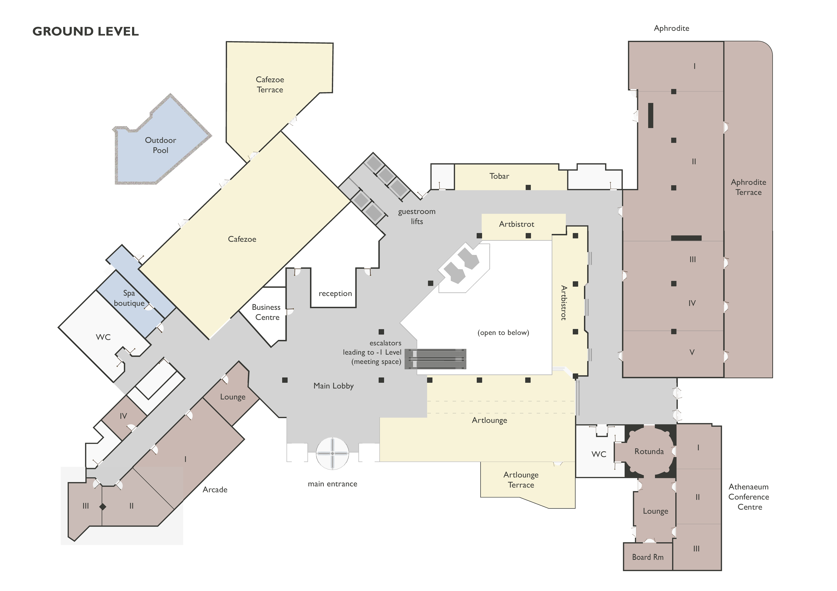
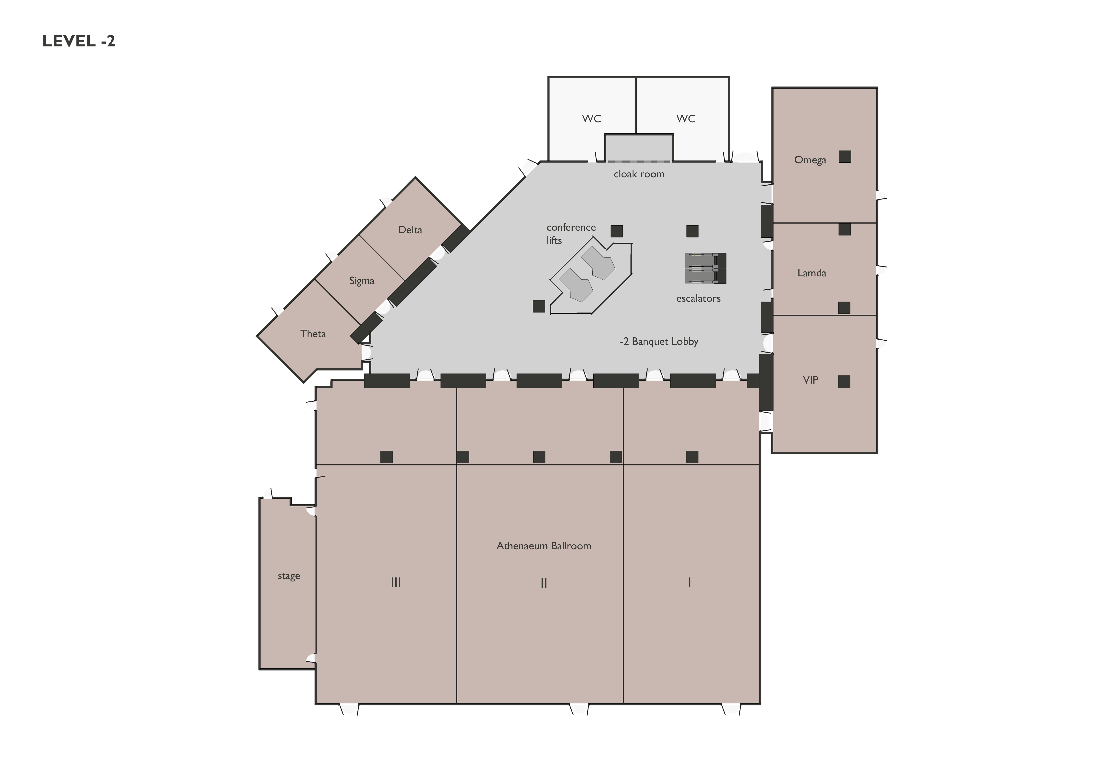
Meeting rooms for RAN4#114
    RAN4 meeting rooms:
  Main session: Aphrodite I&II (206）
  RRM session: Aphrodite V (100)
  BDaT: Omega (70）
  Ad hoc session: Theta (20)
Aphrodite I,II
RAN4
Omega
RAN4
Theta
RAN4
Aphrodite V
RAN4

