Slide 1
RAN4#110 meeting schedule
3GPP TSG-RAN WG4 Meeting #110
Athens, GR, 26 Feb – 01 Mar, 2024
Agenda Item: 2
RAN4 Chair: Xizeng Dai
Vice Chair: Gene Fong, Shan Yang

Slide 2
Monday
Venue Time | RAN4 Main | RAN4 RRM | RAN4 BDaT | Ad hoc room
9:00-9:20 | 1. Opening of the meeting 2. Approval of the agenda 3. Letters / reports from other groups / meetings
9:30-10:30 | Spectrum related [114] LTE_NR_Other_WI AI 7.14, 7.21, 7.22, 7.23 (20) [117] HPUE_LTE_FDD_B14 AI 9.3 (12) | [205] FR2_multiRx_part1 (45) [206] FR2_multiRx_part2 (28) | BSRF & EMC Maintenance [302] NR_ATG_BSRF (5) [303] NR_FR1_lessthan_5MHz_BW_BSRF (3) [304] NR_LTE_EMC_enh (11) | BDaT Ad-hoc [307] NR_NTN_enh_Part3 chaired by Yiran Jin (Samsung)
11:00-13:00 | [109] LTE_NR_HPUE_FWVM AI 7.15 (7) [110] HPUE_Basket_EN-DC AI 7.16(14) [111] HPUE_Basket_Intra-CA_TDD AI 7.17 (3) [112] HPUE_Basket_inter-CA_SUL AI 7.18(33) [113] HPUE_Basket_FDD AI 7.19, 7.20(34) | [206] FR2_multiRx_part2 (28) Cont. (0.5 hour) [209] NR_MG_enh2_part1 (48) [210] NR_MG_enh2_part2 (38) | Repeater/IAB [308] NR_netcon_repeater_RF (17) [309] NR_netcon_repeater_RFConformance (8) [310] NR_mobile_IAB_RF (9) BDaT Ad-hoc (if time available) [304] NR_LTE_EMC_enh chaired by Aurelian Bria (Ericsson) | BDaT Ad-hoc 11:00 – 12:00 [316] NR_HST_FR2_enh_Demod chaired by Yunchuan Yang (Samsung) 12:00 – 13:00 [332] NR_MIMO_OTA_enh chaired by Xuan Yi (CAICT)
13:00-14:30 | Lunch break
14:30-16:30 | [113] HPUE_Basket_FDD AI 7.19, 7.20(Continue) Non-spectrum related [123] FR2_multiRx_UERF_part1 AI 8.3.1 (10) [133] NR_MIMO_evo_DL_UL_UERF AI 8.21, 8.21.1 (10) [121] FR2_enh_req_Ph3_part1 AI 8.2.2 (3) [122] FR2_enh_req_Ph3_part2 AI 8.2.1 (2) Feature list [140] NR_LTE_Rel-18_feature_list AI 10 (8) | [204] NR_ENDC_ RF_FR1_enh2 (1) [212] NonCol_intraB_ENDC_NR_CA (7) [215] NR_ATG (30) [233] IoT_NTN_enh (13) | NTN [305] NR_NTN_enh_Part1 (5) [306] NR_NTN_enh_Part2 (7) [307] NR_NTN_enh_Part3 (7) Demod [312] RF_FR1_enh2_Demod (26) | RRM Ad-hoc: NR_Mob_enh2 Chaired by Qiming Li (Apple)
17:00-18:00 | Main Ad-hoc: [141] NR_AIML_air Chaired by Vali (Qualcomm) | [226] NR_MIMO_evo_DL_UL (36) | [312] RF_FR1_enh2_Demod (26) (cont) BDaT Ad-hoc (if time available) [320] NR_NTN_enh_SAN_UE_demod chaired by Tricia Li (Huawei) | Main Ad-hoc: [104] NR_2Rx_XR AI 6.3.1 Chaired by Steven Chen (Apple)
18:00-19:30 |  | [232] Netw_Energy_NR (37) [216] NR_FR1_lessthan_5MHz_BW (16) | BDaT Ad-hoc (Demod) [314] NR_FR2_multiRX_DL_Demod chaired by Pierpaolo Vallese (Qualcomm) | BDaT Ad-hoc (OTA) [331] NR_FR1_TRP_TRS_enh chaired by Ruixin Wang (vivo)

Slide 3
Tuesday
Venue Time | RAN4 Main | RAN4 RRM | RAN4 BDaT | Ad hoc room
8:30-10:30 | Non-spectrum related [143] NR_power_class AI 12.2.1 (23) [115] NR_3Tx-4Rx_WI AI 7.24, 7.25, 6.2.4 (25) | RRM Ad-hoc: chaired by Andrey Chervyakov [217] NR_pos_enh2_part1 (47) [218] NR_pos_enh2_part2 (31) [219] NR_pos_enh2_part3 (17) Coffee break discussion: less than 5MHz | Demod [317] NR_ATG_Demod (17) [318] NR_FR1_lessthan_5MHz_BW_demod (21) [313] NR_RF_FR2_req_Ph3_Demod (13) [316] NR_HST_FR2_enh_Demod (12) (start) | Main Ad-hoc: [145] n101_coexist chaired by Dominique everaere (Ericsson)
11:00-13:00 | [130] NR_NTN_enh_UERF AI 8.18.5 (25) [102] R17_UERF_maintenance AI 5.3 TEI NTN only (6) [116] IoT_NTN_extLband AI 9.2 (4) | [220] NR_MC_enh (7) [213] NR_HST_FR2_enh_part1 (6) [214] NR_HST_FR2_enh_part2 (12) [223] NR_DualTxRx_MUSIM (35) | BSRF [303] NR_FR1_lessthan_5MHz_BW_BSRF (3) Demod [316] NR_HST_FR2_enh_Demod (12) (cont) [320] NR_NTN_enh_SAN_UE_demod (14) | RRM Ad-hoc: 1) NR FR2 multi-Rx chain WI, Chaired by Qian Yang (vivo) (1hour) 2) NR ATG WI, Chaired by Xiaoran Zhang (CMCC) (1 hour)
13:00-14:30 | Lunch break
14:30-16:30 | [128] NR_pos_enh2_UERF AI 8.14.1 (3) [129] NR_MC_enh_UERF AI 8.15.1 (9) [131] NR_cov_enh2_part1 AI 8.19.1, 8.19.1.1 (8) [132] NR_cov_enh2_part2 AI 8.19.1.2 (8) | RRM Ad-hoc: NR_NTN_enh Chaired by Haijie Qiu | [314] NR_FR2_multiRX_DL_Demod (27) [323] NR_MIMO_evo_DL_UL_demod (16) | Main Ad-hoc: [105] NR_Baskets_Part_1 chaired by Dominique Brunel (Skyworks)
17:00-18:00 | [118] FR1_enh2_part1 AI 8.1.1, 8.1.1.3, (6) [119] FR1_enh2_part2 AI 8.1.1.1 (7) [120] FR1_enh2_part3 AI 8.1.1.2 (4) | [224] NR_NTN_enh (54) | [322] NR_netcon_repeater_Demod (16) BDaT Ad-hoc [320] NR_NTN_enh_SAN_UE_demod chaired by Tricia Li (Huawei) | BDaT Ad-hoc [318] NR_FR1_lessthan_5MHz_BW_demod chaired by Dimitri Gold (Nokia)
18:00-19:30 | Main Ad-hoc: [146] ITU_WP5D_LSReply Chaired by Johan Sköld (Ericsson) | RRM Ad-hoc: MGs enhancement WI Chaired by Ato Yu (MediaTek) | BDaT Ad-hoc (Demod) [319] NR_demod_enh3_Part1 chaired by Jingzhou Wu (China Telecom) | BDaT Ad-hoc [306] NR_NTN_enh_Part2 SAN RF chaired by Dominique Everaere

Slide 4
Wednesday
Venue Time | RAN4 Main | RAN4 RRM | RAN4 BDaT | Ad hoc room
8:30-10:30 | [134] NR_SL_enh2_UERF_part1 AI 8.22.1, 8.22.1.1 (17) [135] NR_SL_enh2_UERF_part2 AI 8.22.1.2/4 (1) [136] NR_SL_enh2_UERF_part3 AI 8.22.1.3 (9) [137] NR_redcap_enh_UERF AI 8.23.1 (1) [138] Netw_Energy_NR AI 8.26.1 (3) [124] NonCol_intraB AI 8.7.1 (8) | [221] NR_Mob_enh2_part1 (67) [222] NR_Mob_enh2_part2 (29) Coffee break discussion: NES | Demod [315] NonCol_intraB_ENDC_NR_CA_Demod (6) [327] Netw_Energy_NR_demod (7) [324] NR_SL_enh2_demod (5) | RRM Ad-hoc: 1) [201] R16 maintenance Chaired by Li Zhang (Huawei) (45min) 2) [202] [203] R17 and R18 Maintenance Chaired by Yang Tang (Apple) (1hour 15min)
11:00-13:00 | [126] NR_ATG_UERF_part2 AI 8.9.2 (11) [127] NR_FR1_lessthan_5MHz_BW AI 8.10.1/2 (9) Reply LS and RAN task [145] n101_coexist AI 13.2, AI 5.1.1 (37) [142] NR_reply_LS_UE_RF AI 12 [144] Release_indep AI 13.1 (25) | [231] NR_mobile_IAB (7) [207] NR_RRM_enh3_part1 (23) [208] NR_RRM_enh3_part2 (11) | Demod [328] NR_DSS_enh (12) | Main Ad-hoc: [130] NR_NTN_enh_UERF AI 8.18.5 Chaired by Fei Xue (ZTE)
13:00-14:30 | Lunch break
14:30-16:30 | [146] ITU_WP5D_LSReply AI 12 [141] NR_AIML_air AI 11.1 (51) | [211] NR_BWP_wor (24) (1 hour) [234] Reply_LS (19) [230] NR_SL_relay_enh (8) Coffee break discussion: R16 NFG (Nokia) | OTA [331] NR_FR1_TRP_TRS_enh (32) [332] NR_MIMO_OTA_enh (19) | RRM Ad-hoc: 1) FR2 HST enh, Chaired by Jackson (Samsung) (1 hour 10 minutes) 2) Network Energy Saving chaired Zhongyi Shen (Huawei) (50 minutes)
17:00-18:00 | [141] NR_AIML_air AI 11.1 (Continue) [104] NR_2Rx_XR AI 6.3.1 (14) | [229] NR_redcap_enh (16) | OTA Continue OTA (close no later than 17:30) | BDaT Ad-hoc [323] NR_MIMO_evo_DL_UL_demod chaired by Lili Wang (Samsung)
18:00-19:30 | Main Ad-hoc: [140] NR_LTE_Rel-18_feature_list Chaired by Xiaoran Zhang (CMCC) | RRM Ad-hoc: Chaired by Yang Tang [227] NR_SL_enh2_part1 (6) [228] NR_SL_enh2_part2 (11) | BDaT Ad-hoc (Demod) 17:30 – 18:30 [325] NR_redcap_enh_Demod chaired by Kazuyoshi Uesaka (Ericsson) 18:30 – 19:30 [326] NR_mobile_IAB_demod chaired by Nicholas Pu (Ericsson) | RRM Ad-hoc: R18 NR Positioning Chaired by Iana Siomina (Ericsson)

Slide 5
Thursday
Venue Time | RAN4 Main | RAN4 RRM | RAN4 BDaT | Ad hoc room
8:30-10:30 | Basket WI [105] NR_Baskets_Part_1 AI 7.1 (21) [106] NR_Baskets_Part_2 AI 7.3~7.8 (64) [107] NR_Baskets_Part_3 AI 7.9~7.13 (115) [108] LTE_Baskets AI 9.1 (10) | [225] NR_netcon_repeater (5) Return to Ad-hoc minutes: NR_SL_enh2 NR_ATG NR_HST_FR2_enh Netw_Energy_NR FR2_multiRx NR_MG_enh2 | Demod [319] NR_demod_enh3_Part1 (26) [321] NR_cov_enh2_demod (14) | RRM Ad-hoc: NR Positioning Chaired by Iana Siomina (Ericsson)
11:00-13:00 | Maintenance [101] Upto_R16_UERF_maintenance AI 4.1, 4.7 (145) | Maintenance [201] Maintenance_up_to_R16 (137) [202] [203] Maintenance_R17_R18 (215) | [326] NR_mobile_IAB_demod (5) [329] IoT_NTN_Demod (13) [325] NR_redcap_enh_Demod (10) | RRM Ad-hoc: NR_MIMO_evo_DL_UL Chaired by Yanze Fu (Samsung)
13:00-14:30 | Lunch break
14:30-16:30 | [102] R17_UERF_maintenance AI 5.1, 5.2.1 (84) [103] R18_UERF_maintenance AI 6.1, 6.2, 6.2.1, 6.2.2.2, 6.2.6, 6.2.7, 6.2.8.1, 6.3.2 (70) | Return to Ad-hoc minutes: NR_pos_enh2 NR_MIMO_evo_DL_UL Early Return to: NR_NTN_enh | Maintenance [301] BSRF_Maintenance (66) [311] Demod_Maintenance (22) [330] OTA_Maintenance (10) Early return to | RRM Ad-hoc: reserved
17:00-18:00 | Return to feature list [140] NR_LTE_Rel-18_feature_list AI 10 (8) Early return to | Early return to | Early return to
18:00-19:30 | Main Ad-hoc: Chaired by Xiang Gao (Huawei) [131] NR_cov_enh2_part1 [132] NR_cov_enh2_part2 | Early return to | BDaT Ad-hoc reserved | Main Ad-hoc #2: [104] NR_2Rx_XR AI 6.3.1 Chaired by Steven Chen (Apple)

Slide 6
Friday
Venue Time | RAN4 Main | RAN4 RRM | RAN4 BDaT | Ad hoc room
8:30-10:30 | Return to | Return to | Return to
11:00-13:00 | Return to | Return to | Return to
14:00-16:00 | Return to (final round) | Return to (final round) | Return to (final round)
16:00-17:30 | 13 Revision of the Work Plan 14 Any other business 15 Close of the meeting

Slide 7
Appendix

Slide 8
General Aspects
The face-to-face meeting will take place during February 26th ~ March 1st, 2024.
  Three sessions in three separate rooms: Main, RRM, BSRF_Demod_test(BDaT). 1-Way GoToWebinar (GTW) conference calls will be set each session and 1-way MS teams will be set for ad hoc. A number of ad hoc sessions will be arranged (refer to meeting schedule).
  Moderator will be designated to provide the summary for a topic before the meeting. In online discussions, session chairs will handle topics based on the moderator summary. Moderator does not need update the summary by collecting comments during the meeting.
  Deadline for Tdoc request & submission deadline: February 19th (Monday) 2024, 23:59 UTC.
  Other deadlines can be found in the following slides.
Please find one picture for meeting flow below and details in the corresponding slides.
For chairs
For moderator
For delegates
Pre-meeting (Feb 19~23)
Quiet Period
1st round (Feb 26~29)
2nd round (Feb 29 ~ Mar 1)
Quiet Period
Post-meeting process ( Mar 4~7)
Mon
Tue
Wed
Thu
Fri
Sat/Sun
Mon
Tue
Wed
Thu
Fri
Sat/Sun
Mon
Tue
Wed
Thu
NWM flag process Slide #16
Moderators trigger nwm for maintenance before Sunday
Flag for maintenance @nwm
WF/CR template
Draft TS/TR
Slide #9
Slide #15
Pre-RAN Action
MCC 3GU parsing tool
Slide #10/11
Slide #18
Topic Moderator & summary: slide #5
Moderator assignment before Mon
Draft summary for topics
Summary review & comments
Formal tdoc of summary submission by Saturday
Rel-18 feature list/UE capability
Online discussions &
GTW conference call (US/China meeting)
Upload CR for maintenance 2:30pm on Thursday
TOHRU (US/China meeting)
Tdoc request (new&revision)
Upload tdocs (10.10.10.10) &
How to access contributions
Rel-18 feature list/UE capability
List of email threads for post-meeting
Submission of tdoc of post-meeting
Comments
Approve tdocs for post-meeting
Slide #23
Slide #7
Slide #12
Post-meeting process: slide #14
Registration
Slide #13
Initial list for block approval for basket
Deadline for flag for block approval
updated list for block approval
Slide #8
Slide #17
Tdoc number request & submission
Slide #3/4
Basket WIs Block approval: slide #6
Meeting schedule & Ad hoc chair assignment
Provided before meeting
Update of meeting notes per day
Tdoc allocation
Check-in
Slide #13
Slide #18/21
Slide #8
Slide #22
Meeting room
Quiet Period (0:00 am ~ 7:00 am meeting venue Local time
No email are expected in RAN4 reflector

Slide 9
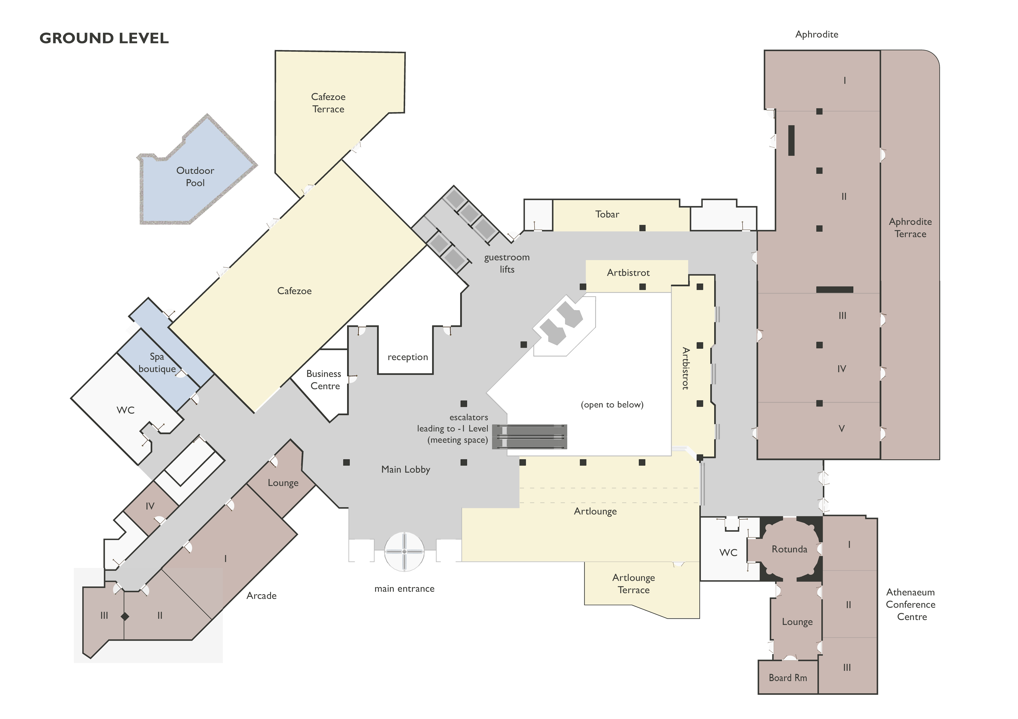
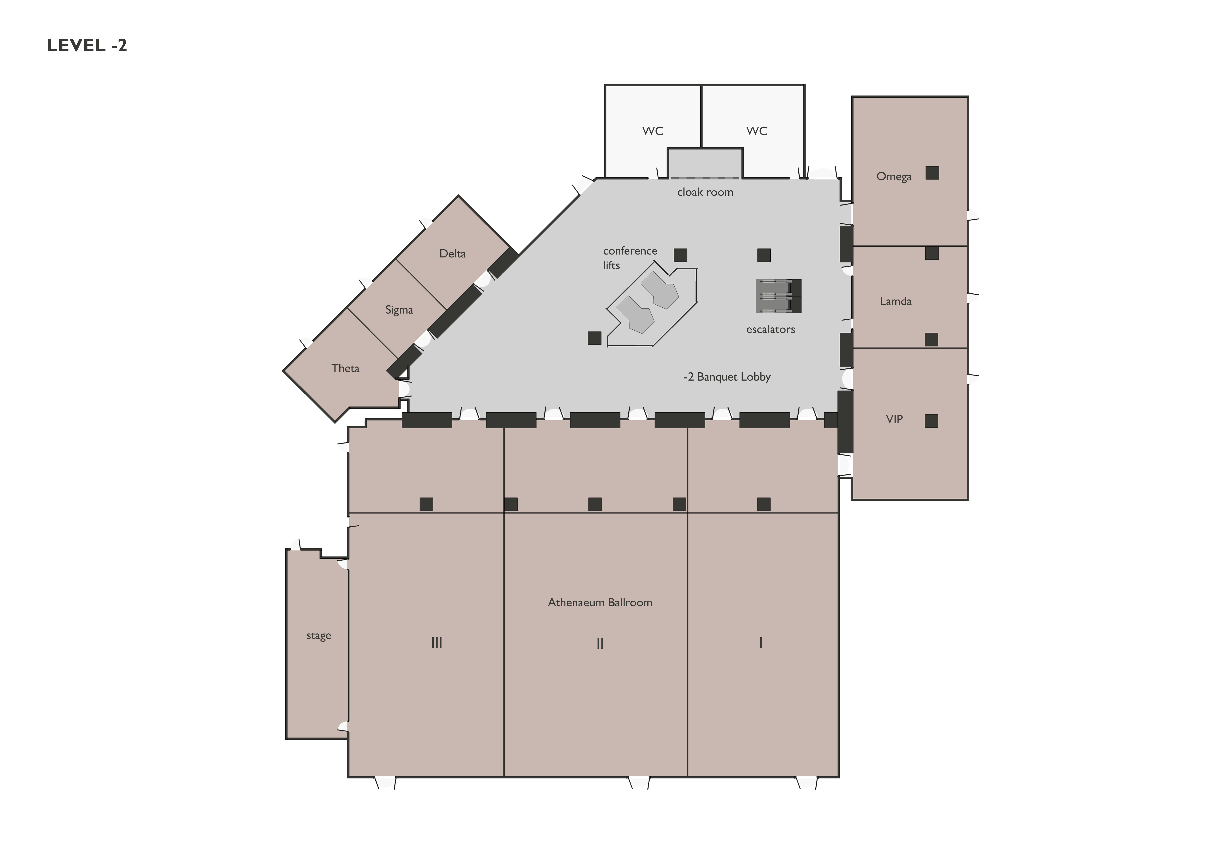
Meeting rooms
    RAN4 meeting rooms: @ InterContinental
  Main session: Aphrodite I&II (251)
  RRM session: Arcade I & II (100)
  BDaT (BSRF_Demod_test): Aphrodite V (70)
  Ad hoc session: Theta (20)
Aphrodite I,II
RAN4
Theta
RAN4
Aphrodite V
RAN4
Arcade I,II
RAN4

