Slide 2
Hosted by

Slide 3
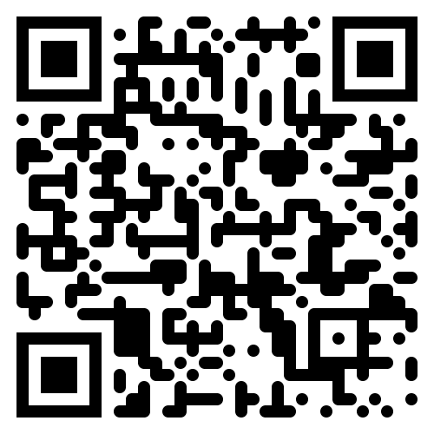
Visit the 3GPP Chicago website for updated meeting information:
https://3gppmeetings.atis.org/chicago2023/
For inquiries during the meeting contact:
chicago2023@atis.org

Slide 4
Meeting Hours
There are limits on meeting times:
Monday: 9:00 AM – 7:00 PM
Tuesday/Wednesday/Thursday: 8:00 AM – 7:00 PM
Friday: 8:00 AM – 4:00 PM
*Please note, meeting times will be strictly observed to avoid incurring union overtime. Outside of the stipulated meeting hours, the venues’ AV, screens, projectors or microphones may not be used. Personal projectors may not be used at any time.
Please consult agenda documents for individual working groups for specific meeting times for each working group.

Slide 5
Coffee Breaks
Monday – Thursday
Morning Coffee Break: 10:30 AM – 11:00 AM
Afternoon Coffee Break: 3:30 PM – 4:00 PM
Friday
Morning Coffee Break (only): 10:30 AM – 11:00 AM
Hilton Chicago – Salon A
Palmer House – Sixth Floor

Slide 6
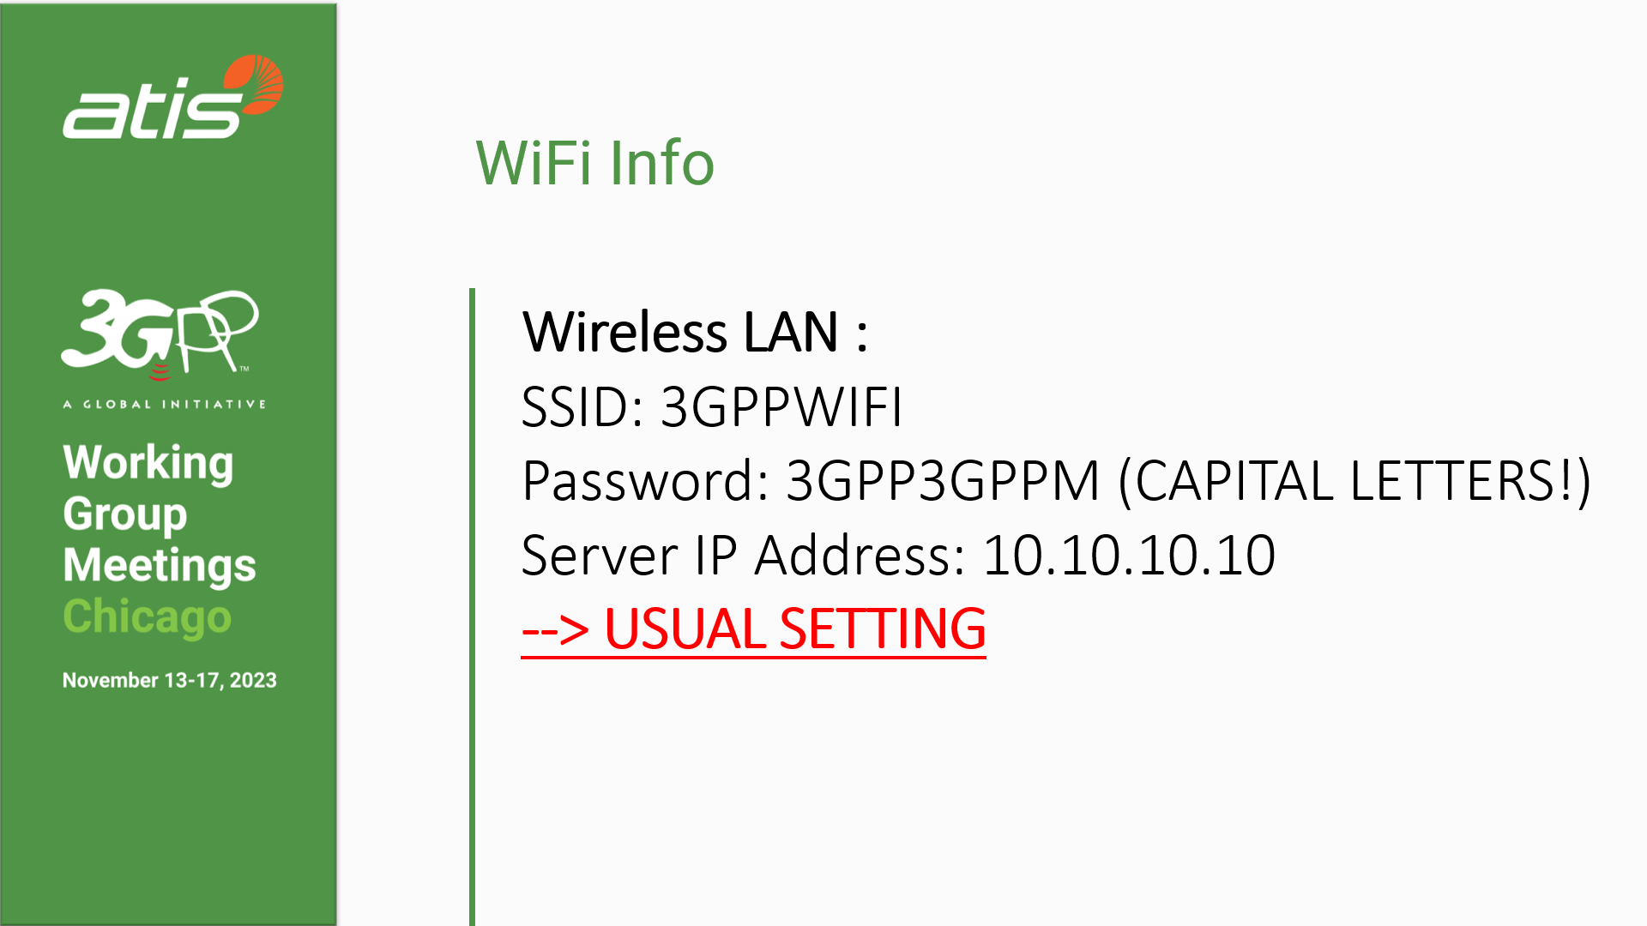

Slide 7
Welcome to Chicago!
Explore Chicago by visiting these top attractions
The Art Institute of Chicago: Witness an art collection that spans centuries and continents, from the impressionists to modern-day maestros.
Millennium Park and Cloud Gate: Reflect on art and nature at the iconic “Bean” and the beautifully landscaped park surrounding it.
Navy Pier: Dive into fun with carnival rides, boat tours, and a plethora of entertainment options.
Magnificent Mile: Indulge in a shopping spree on this glamorous stretch of Michigan Avenue, brimming with luxury stores and gastronomic delights.
Willis Tower Skydeck: Elevate your perspective with panoramic views from the heart of the city.
Riverwalk: Wander alongside the meandering Chicago River, flanked by cafes, bars, and vibrant art.
Architectural Boat Tour: Glide through Chicago’s heart and learn about the giants of architecture that define the city’s skyline.
Museum Campus: Satisfy your curiosity at renowned institutions like the Adler Planetarium, Shedd Aquarium, and Field Museum.

Slide 8
For more dining options visit our website:
Lunch Options
Chicago Hilton
720 South Bar & Grill (Modern American Dining)
Hilton North Lobby
Kitty O’Sheas (Trad. Irish Pub)
Hilton South Lobby
Eleven City Diner (Diner/Deli)
1112 S Wabash Ave
Cafecito (Cuban Cafe/Coffee House)
(Pick-up/Delivery Only)
26 E Congress Pkwy
Palmer House
Lockwood Restaurant and Bar (Modern American Dining)
Lobby Level-Palmer House
Grillroom (American)
33 W Monroe St
The Village (Italian)
71 W Monroe St
Hot Woks Cool Sushi (Sushi/Pan-Asian)
Millennium Park, 30 S Michigan Ave

Slide 9
Security/Registration
Delegates are responsible for printing their own identity badges using the link provided in their registration acknowledgment email.
Pick up your Chicago lanyard and badge holder at the 3GPP registration desk
Hilton Chicago - Salon A
Palmer House 6th Floor
There is no QR code or scanning at the meeting rooms.
For security, only delegates wearing meeting lanyards with pre-printed badges will be permitted to enter the meeting rooms and coffee breaks.
Security is not provided in the meeting rooms; you are responsible for your own equipment.

Slide 13
~40 mins from O’Hare Airport to either hotel
Uber, Lyft, taxis and other rideshares available for ~$40-$50
O’Hare Airport to Hilton Chicago
O’Hare Airport to Palmer House
Hilton Chicago: 720 S Michigan Ave, Chicago, IL 60605
+1 (312) 922-4400
Palmer House: 17 E Monroe St, Chicago, IL 60603
+1 (312) 726 7500
Notes:
Supplementary slide info

Slide 15
ATIS Wishes 3GPP Delegates A Successful Meeting
Notes:
Same for both hotels

