Slide 1
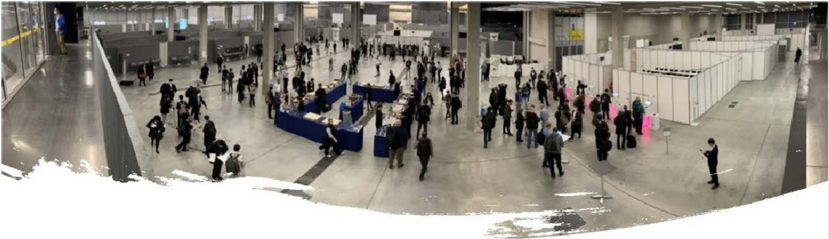
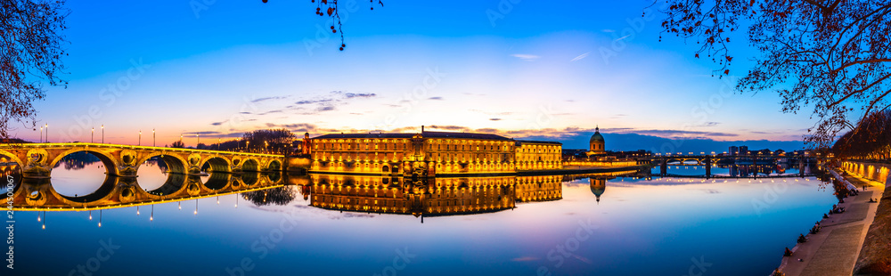
RAN4#108
Toulouse
August 21-25 2023

Slide 2
Logistics
The MEETT is opened from 07:30 to 20:30
3GPP coaches: https://goo.gl/maps/DV6U3qGxqwuA3FbA6
  Stop A: Jean Jaurès 07:00.
  Stop B: Compans Cafarelli 07:15.
  Stop C: place Alain Fournier (Courtyard) 07:00
  Stop D: roundabout Emile Dewoitine (Radisson, Pullman, Ibis) 07:15
  Stop E: Mc Donald's roundabout porte de Bordebasse (Ibis,Première classe) departure 07:30
  Return coaches will depart the MEETT at 19:00, 19:30, 20:00
  On Friday afternoon we will organise coaches to the airport
  The underground car park is free of charge

Slide 3
Helpdesk - IT
Emmanuelle.Wurffel@etsi.org
or +33 4 92 94 4266 (line forwarded to my mobile phone)
Christophe.Volnay@etsi.org (IT)
Aldric.Hiegel@etsi.org (IT)
Wireless LAN: SSID: 3GPPWIFI
Password: 3GPP3GPPM (CAPITAL LETTERS!)
IP address: 10.10.10.10
one-way remote participants will be able to listen only

Slide 4
Breaks – Lunch breaks
Outdoor coffee break + Social Event + Bar (on sale coffee and snack)
  07.30-08.30 coffee and snacks on sale
  10:30-11:00 (all week) coffee break outdoor
  16:30-17:00 (except on Friday) coffee break outdoor
Lunch area: Several options will be available on site:
  MEETT restaurant: A daily 2 courses menu for 20€
  Food trucks with a variety of cuisines:
  Grillade/Hot dog |Poké bonheur |Wood smoke |Kumquat |Tommys | Cosy
  There will be tables and chairs in the main avenue
  OPENING HOURS: from 11.45 to 14.30
  Outside by Tram or car: Shopping mall "Centre Commercial Blagnac" (https://blagnac.klepierre.fr/ ): supermarket, cafeteria, Subway, Starbucks...

Slide 5
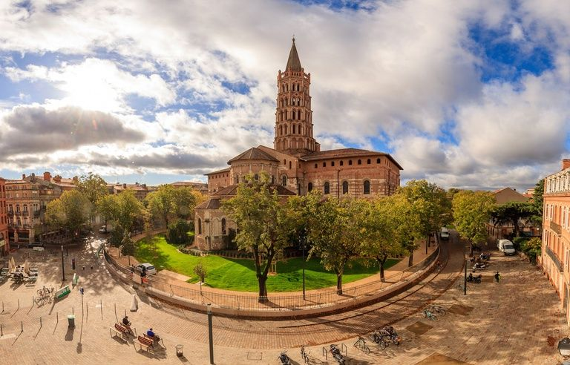
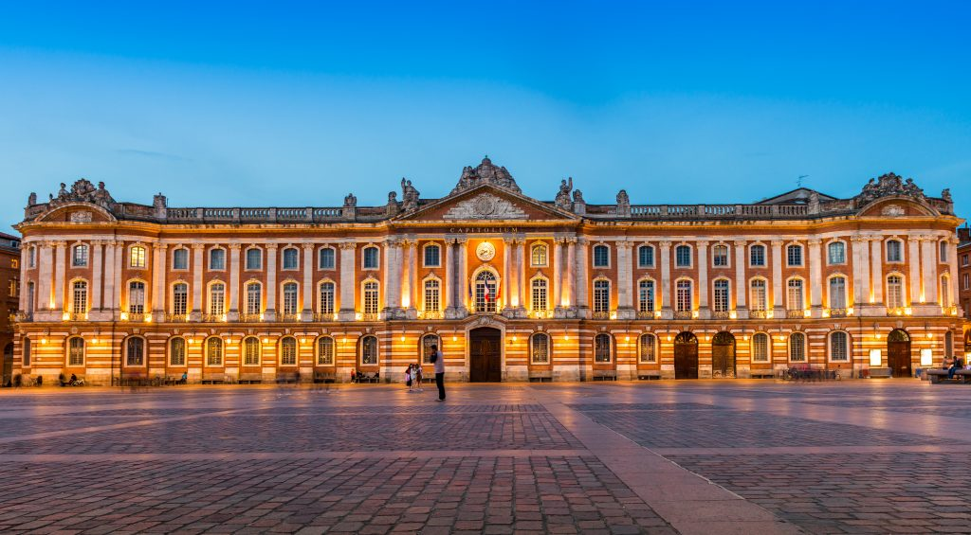
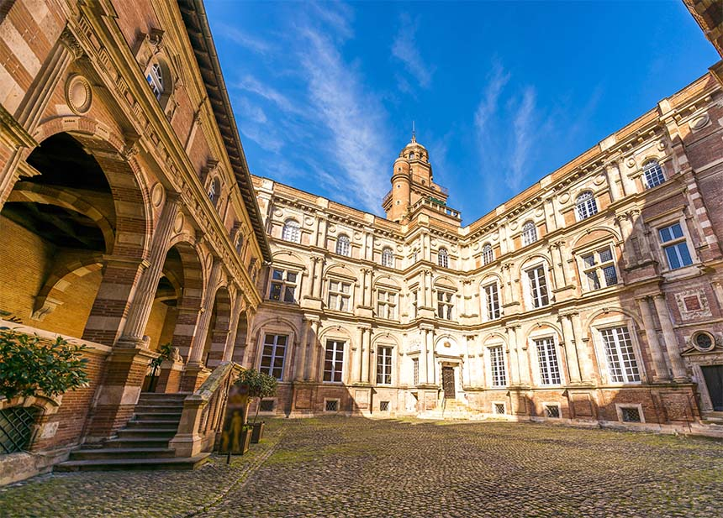
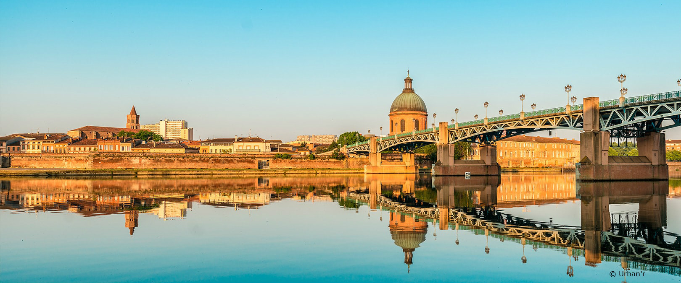
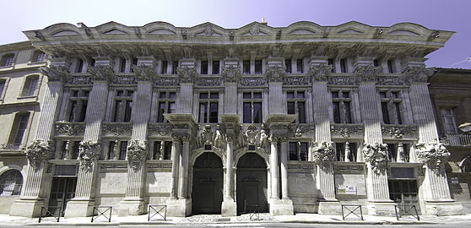
About Toulouse: “la ville rose” – “the pink city”
Named after the red bricks used everywhere
Capitole city hall:
Have a drink or diner in the “arcade” facing it
St Sernin Cathedral:
2nd largest Roman style church
Walk along the river Garonne
(but avoid the warm hours)
Renaissance buildings: Hotel D’assezat
Hotel de pierre

Slide 6
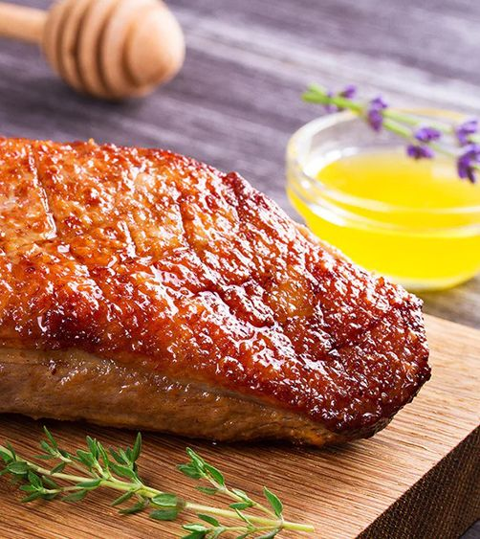
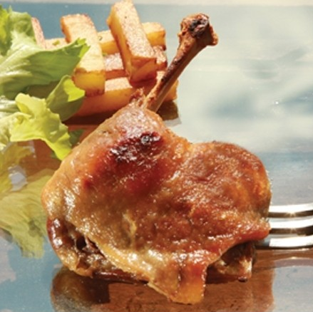
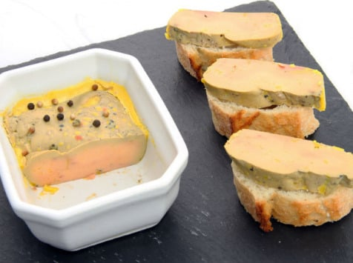
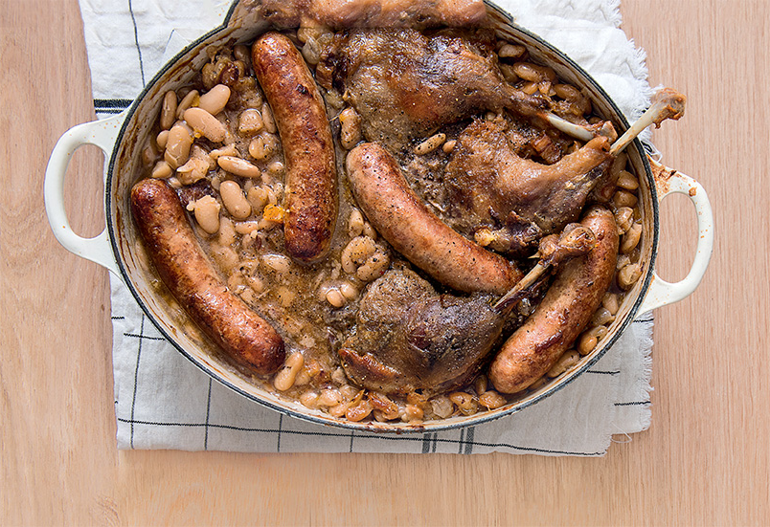
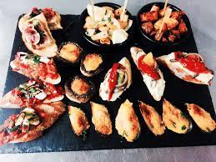
About Toulouse: food
Go beyond the Cassoulet….
(may not be the lightest in those warm days of August)
…Everything Duck from the neighbor Gers
…Tapas from the large Spanish origin community
Traffic is light in August and Restaurants are open late so
do not hesitate to have dinner downtown

Slide 7
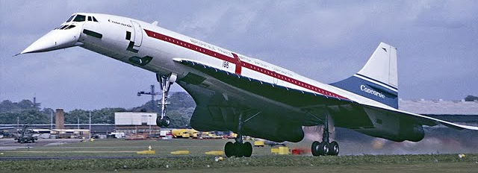
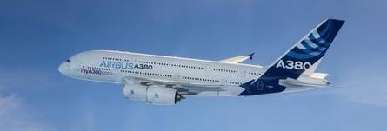


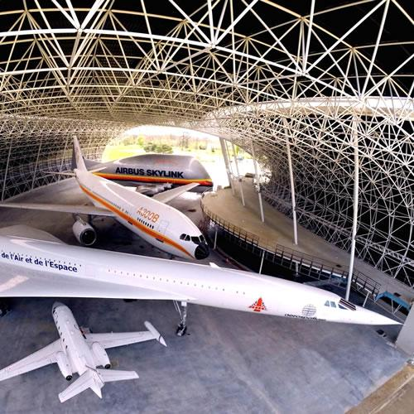
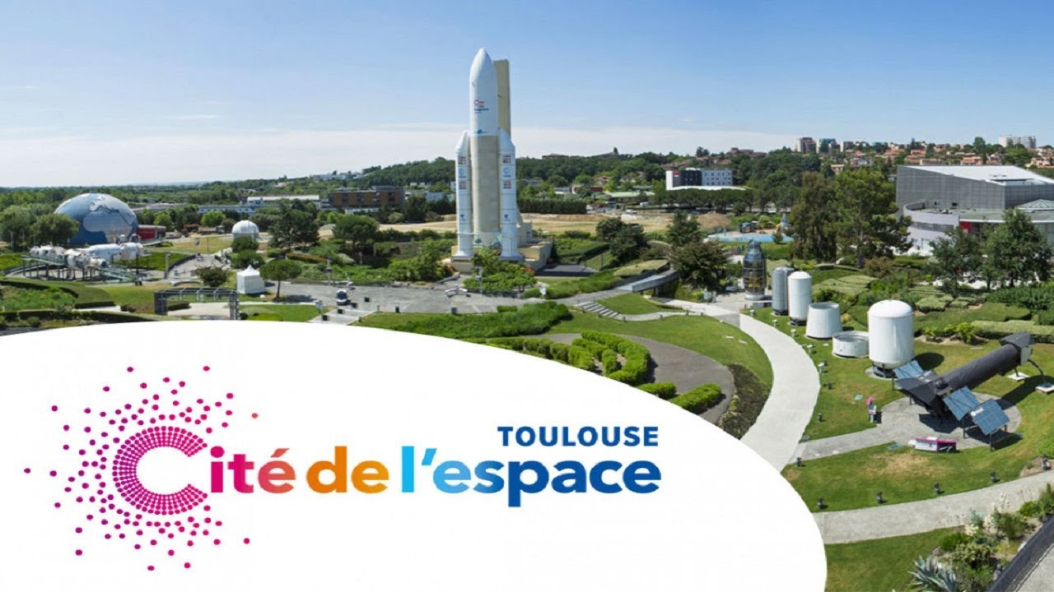

About Toulouse: Space and Aeronautics
Pioneers of Airmail started from here to Africa and south America
A famous one: Antoine de Saint-Exupery wrote
“The little prince”
“Night flight”
Concorde and a lot of Airbus were/are constructed just the other side of the airport
Learn more about this in the local museums

Slide 8

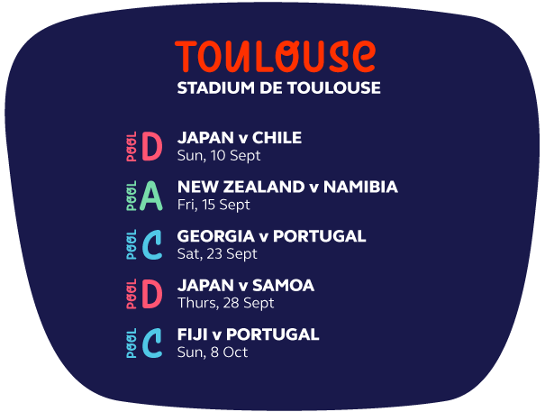
About Toulouse: A rugby Stronghold
2023 Rugby World Cup
in September
The “Stade” holds the highest number of champion title in France “top 14” and European Rugby championship
And 2023 French champion

Slide 9
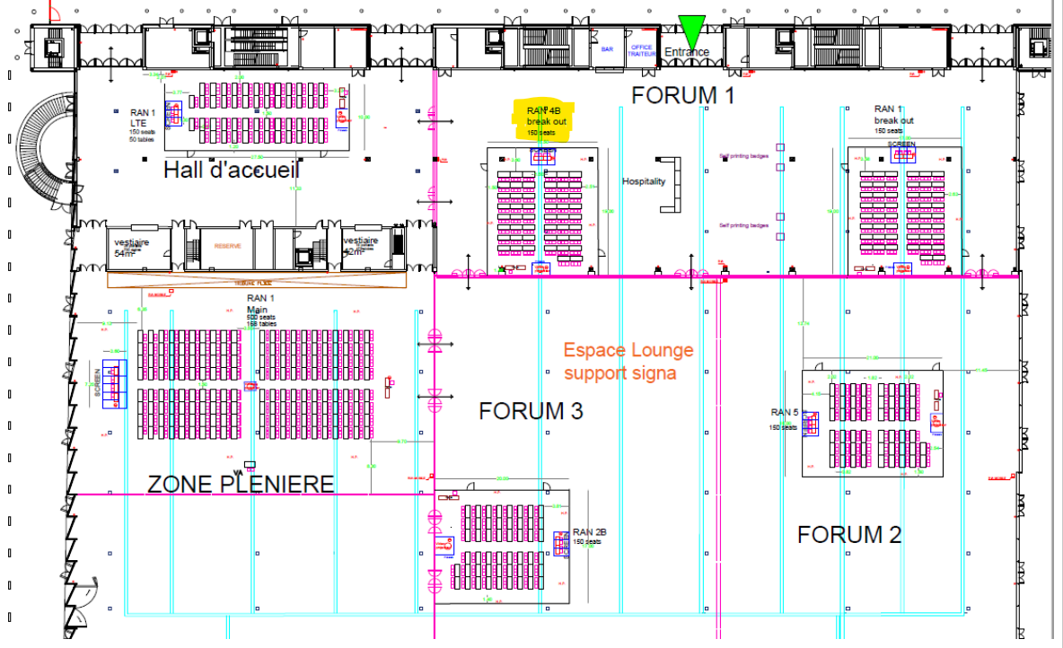
Meeting Rooms: 1st floor

Slide 10
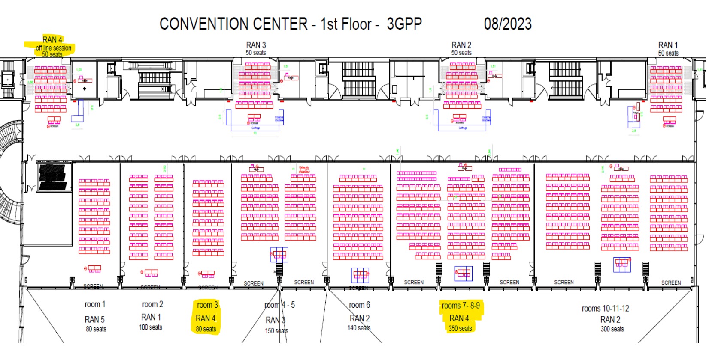

Slide 11
COVID19 Where to get tested (if needed)?
Downtown Toulouse:
Laboratoire INOVIE CBM Tlse Compans 0561212331
  5 BD Maréchal Leclerc
Laboratoire INOVIE CBM Jean Jaurès 0561627979
  71 allées Jean-Jaurès
Do not forget to bring your ID and please write on a paper your email address - Payment by credit card.

Slide 12
Enjoy your meeting in Toulouse!

