Slide 1
RAN4#108 meeting schedule
3GPP TSG-RAN WG4 Meeting #108
Toulouse, France, August 21 – August 25, 2023
Agenda Item: 2
RAN4 Chair: Xizeng Dai
Vice Chair: Haijie Qiu, Andrey Chervyakov

Slide 2
Monday
Venue Time | RAN4 Main | RAN4 RRM | RAN4 BSRF_Demod_Test | Ad hoc room
9:00-9:20 | 1. Opening of the meeting 2. Approval of the agenda 3. Letters / reports from other groups / meetings AI 13 R4-2311288
9:30-10:30 | Spectrum related [109] LTE_NR_HPUE_FWVM AI 7.16 (5) [110] HPUE_Basket_EN-DC AI 7.17 (28) [111] HPUE_Basket_Intra-CA_TDD AI 7.18 (3), AI 7.19 (2) [112] HPUE_Basket_inter-CA_SUL AI 7.20 (18) [113] HPUE_Basket_FDD AI 7.21 (3), AI 7.22 (16) [114] LTE_NR_Other_WI AI 7.14 (4) | Rel-18 RRM [206] NR_ENDC_ RF_FR1_enh2 (1) [218] NR_FR1_lessthan_5MHz_BW (12) | R18 Demod [108][322] NR_FR2_multiRX_DL_Demod AI 8.7.4 (22) | Main Ad-hoc: [144]/[145] NR_cov_enh2_part1/2 Chaired by Xiang Gao (Huawei)
11:00-13:00 | [114] LTE_NR_Other_WI AI 7.23 (2), AI 7.24 (3), AI 7.25 (3), 7.26 (11), 7.27 (3), AI 9.2 (1) [118] NR_FDD_ULn28_DLn75_n76 AI 7.32 (5) [119] US_900MHz AI 7.33 (30) [120] NR_NTN_channel_30MHz AI 7.34 (10) [121] LTE_terr_bcast_bands_UERF AI 9.3.3 (2) | [207] FR2_multiRx_part1 (35) [208] FR2_multiRx_part2 (31) | [108][326] NR_demod_enh3_Part1 AI 8.18.1 (32) [108][327] NR_demod_enh3_Part2 AI 8.18.2 (4) | Main Ad hoc: [142] NR_MC_enh_UERF Chaired by Shan Yang (China Telecom)
13:00-14:30 | RAN4 Vice Chair Election
14:30-16:30 | [116] NR_700800900_combo_enh AI 7.30 (25) [125] FS_NR_sub1GHz_combo_enh AI 8.3 (7) Non-spectrum related [132] FR2_multiRx_UERF_part1 AI 8.7.1 (3), AI 8.7.2 (4), AI 8.7.2.2 (12) | [215] NR_HST_FR2_enh_part1 (16) [216] NR_HST_FR2_enh_part2 (14) [235] NR_IDC_enh (7) | FR2-2 BS conformance [108][302] NR_ext_to_71GHz_BSRF_Maintenance AI 5.2.6.1, 5.2.6.2 (19) R18 RF [108][332] LS_NTN_R5-233672 AI 10.2.3 (10) [108][309] NR_NTN_enh_Part1 AI 8.26.1 (9) | RRM Ad-hoc: R18 NR Mobility enh WI Chaired by Qiming Li (Apple)
17:00-18:20 | [133] FR2_multiRx_UERF_part2 AI 8.7.2.1 (2) [130] FR2_enh_req_Ph3_part1 AI 8.6.1 (1), AI 8.6.3 (21) | [214] NonCol_intraB_ENDC_NR_CA (3) [217] NR_ATG (29) | [108][311] NR_NTN_enh_Part3 AI 8.26.2 (11) [108][310] NR_NTN_enh_Part2 AI 8.26.3 (2) | BS Ad hoc: [108][322] NR_FR2_multiRX_DL_Demod Chaired by Jahidur Rahman (Qualcomm)
18:20-19:20 | Main Ad-hoc: [143] NR_NTN_enh_UERF Chaired by Fei Xue (ZTE) | RRM Ad-hoc: R18 MGs enhancement WI Chaired by Ato Yu (MediaTek) | BS Ad hoc: [108][329] FS_NR_FR2_OTA_enh Chaired by Bin Han (Qualcomm) | BS Ad hoc: [108][319] RF_FR1_enh2_Demod_Part1 Chaired by Tricia Li (Huawei)

Slide 3
Tuesday
Venue Time | RAN4 Main | RAN4 RRM | RAN4 BSRF_Demod_Test | Ad hoc room
8:00-10:30 | [130] FR2_enh_req_Ph3_part1 AI 8.6.1 (1), AI 8.6.3 (Cont) [131] FR2_enh_req_Ph3_part2 AI 8.6.2 (14) [146] NR_MIMO_evo_DL_UL_UERF AI 8.29.2 (12) | [211] NR_MG_enh2_part1 (43) [212] NR_MG_enh2_part2 (31) | R18 RF [108][306] FS_NR_duplex_evo_Part1 AI 8.19.1, 8.19.2.2.1, 8.19.2.2.2, 8.19.2.3, 8.19.3 (28) | RRM Ad-hoc: R18 NR FR2 multi-Rx chain WI Chaired by Qian Yang (vivo)
11:00-13:00 | [129] NR_channel_raster_enh AI 8.5 (14) [142] NR_MC_enh_UERF AI 8.23.1 (2), AI 8.23.2 (12) [124] FS_SimBC AI 8.1 (20) | [223] NR_Mob_enh2_part1 (56) [224] NR_Mob_enh2_part2 (31) | [108][307] FS_NR_duplex_evo_Part2 AI 8.19.2.2.3, 8.19.2.2.4, 8.19.2.4 (9) [108][308] FS_NR_duplex_evo_Part3 AI 8.19.2.1 (16) | BS Ad hoc: [108][330] NR_FR1_TRP_TRS_enh Chaired by Ruixin Wang (vivo)
13:00-14:30 | RAN4 Vice Chair Election
14:30-16:30 | [126] FR1_enh2_part1 AI 8.4.1.3 (21) [127] FR1_enh2_part2 AI 8.4.1.1 (9) [128] FR1_enh2_part3 AI 8.4.1.2 (13) | cont. [209] NR_RRM_enh3_part1 (26) [210] NR_RRM_enh3_part2 (6) | R18 Demod [108][325] NR_ATG_Demod AI 8.13.5 (25) [108][323] NonCol_intraB_ENDC_NR_CA_Demod AI 8.11.4 (8) | BS Ad hoc: [108][331] NR_MIMO_OTA_enh Chaired by Xuan Yi (CAICT)
17:00-18:20 | [134] NonCol_intraB AI 8.11.1 (2), AI 8.11.2 (13) [115] NR_3Tx-4Rx_WI AI 7.28 (3), AI 7.29 (35) | [213] NR_BWP_wor (40) | [108][319] RF_FR1_enh2_Demod_Part1 AI 8.4.3.1 (41) [108][320] RF_FR1_enh2_Demod_Part2 8.4.3.2 (8) | Main Ad hoc: [130]/[131] FR2_enh_req_Ph3_part1/2 Chaired by Hisashi Onozawa (Nokia)
18:20-19:20 | Main Ad-hoc: [101] Upto_R16_UERF_maintenance Chaired by Jinqiang Xing (OPPO) | RRM Ad-hoc: R18 NR ATG WI / Chaired by Xiaoran Zhang (CMCC) | BS Ad-hoc: [108][326] NR_demod_enh3_Part1 Chaired by Shan Yang (CTC) | RRM Ad-hoc: R18 FR2 HST / Chaired by Jackson (Samsung)

Slide 4
Wednesday
Venue Time | RAN4 Main | RAN4 RRM | RAN4 BSRF_Demod_Test | Ad hoc room
8:00-10:30 | [140] FS_NR_AIML_air AI 8.21 (40) [143] NR_NTN_enh_UERF AI 8.26.4 (6) | [228] NR_MIMO_evo_DL_UL (24) [229] NR_SL_enh2_part1 (10) [230] NR_SL_enh2_part2 (12) [232] NR_SL_relay_enh (6) | OTA [108][329] FS_NR_FR2_OTA_enh AI 5.2.5 (R4-2311231), 8.2 (15) [108][330] NR_FR1_TRP_TRS_enh AI 8.15 (34) | RRM Ad-hoc: 1) R18 NR Positioning Chaired by Muhammad Kazmi (Ericsson) (1h 45min) 2) R18 Network Energy Saving chaired Zhongyi Shen (45min)
11:00-13:00 | [117] LTE_NR_NTN_LSband AI 7.31 (16) [122] IoT_NTN_extLband AI 9.4 (12) [123] IoT_NTN_FDD_LS_band AI 9.5 (10) | [219] NR_pos_enh2_part1 (37) [220] NR_pos_enh2_part2 (26) [221] NR_pos_enh2_part3 (8) | [330] continued [108][331] NR_MIMO_OTA_enh AI 5.2.5, 8.16 (25) | BS Ad-hoc: [108][306] FS_NR_duplex_evo_Part1 Chaired by Jackson Wang (Samsung)
13:00-14:30 | RAN4 Vice Chair Election (if needed)
14:30-16:30 | [139] FS_NR_LPWUS AI 8.20 (13) [144] NR_cov_enh2_part1 AI 8.27.1 (7) [145] NR_cov_enh2_part2 AI 8.27.2 (10) [141] NR_pos_enh2_UERF AI 8.22.1 (11), AI 8.22.2 (1) | cont. [225] NR_DualTxRx_MUSIM (45) [226] NR_NTN_enh (31) | R18 RF [108][312] NR_netcon_repeater_RF AI 8.28.1, 8.28.2, 8.28.3 (19) [108][313] NR_netcon_repeater_RFConformance AI 8.28.4 (5) | RRM ad-hoc: RRM maintenance 1) [204] NR_redcap (46) Chaired by Santhan Thangarasa (Ericsson) – 40min 2) [201] Maintenance_up_to_R16 Chaired by Li Zhang (Huawei) (80min)
17:00-18:20 | [147] NR_SL_enh2_UERF_part1 AI 8.30.1 (2), AI 8.30.2 (1), AI 8.30.2.1 (18) [148] NR_SL_enh2_UERF_part2 AI 8.30.2.2 (5), AI 8.30.2.4 (2) [149] NR_SL_enh2_UERF_part3 AI 8.30.2.3 (9) | cont. [236] IoT_NTN_enh (5) | [108][314] NR_mobile_IAB_RF AI 8.33.2, 8.33.3 (5) [108][315] LTE_terr_bcast_bands_BSRF AI 9.3.4 (3) [108][304] NR_FR1_lessthan_5MHz_BW_BSRF AI 8.14.3 (13) | Main Ad-hoc: [134] NonCol_intraB Chaired by Yasuki Suzuki
18:20-19:20 | Main Ad-hoc: [105] NR_Baskets_Part_1 Chaired by Dominique Brunel (Skyworks) | RRM Ad-hoc: R18 MUSIM chaired by Xusheng Wei (vivo) | BS Ad-hoc: [108][308] FS_NR_duplex_evo_Part3 Chaired by Xiaoran Zhang (CMCC) | Main Ad-hoc: [139] FS_NR_LPWUS Chaired by Ruixin Wang (Vivo)

Slide 5
Thursday
Venue Time | RAN4 Main | RAN4 RRM | RAN4 BSRF_Demod_Test | Ad hoc room
8:00-10:30 | [150] NR_redcap_enh_UERF AI 8.31.1 (14) [151] Netw_Energy_NR AI 8.34.2 (4), AI 8.34.3 (11) [153] NR_reply_LS_UE_RF AI 10 (11) | [231] NR_redcap_enh (10) [227] NR_netcon_repeater (5) [233] NR_mobile_IAB (6) [234] Netw_Energy_NR (21) | R18 Demod [108][324] NR_HST_FR2_enh_Demod AI 8.12.5 (25) [108][321] NR_RF_FR2_req_Ph3_Demod AI 8.6.4 (8) [108][328] NR_netcon_repeater_Demod AI 8.28.6 (7) | RRM Ad-hoc: RRM maintenance: 1) [202] Maintenance_R17 Chaired by Yang Tang (Apple)
11:00-13:00 | [154] RAN_task_UERF AI 11 (3) [152] NR_LTE_UAV AI 8.35 (7), AI 9.7 (4) [135] NR_HST_FR2_enh_UERF AI 8.12.2 (2), AI 8.12.3 (6) [136] NR_ATG_UERF_part1 AI 8.13 (1), AI 8.13.1 (11) [137] NR_ATG_UERF_part2 AI 8.13.2 (21) | [237] Reply_LS (32) RRM maintenance [201] Maintenance_up_to_R16 (101) | Demod maintenance [108][317] Demod_Maintenance AI 4.5, 5.2.6.5, 5.2.4 (71) [108][318] IoT_NTN Demod_Maintenance AI 6.8.5 (13) | Main Ad-hoc: [126] FR1_enh2_part1 Chaired by Leo Liu (Huawei) 90min Main Ad-hoc: [128] FR1_enh2_part3 Chaired by Yuta (NTT DOCOMO) 30min
13:00-14:30 | RAN4 Vice Chair Election (if needed)
14:30-16:30 | [138] NR_FR1_lessthan_5MHz_BW AI 8.14.1 (9), AI 8.14.2 (5) Reserve 0.5h for some earlier return to. Basket WI [105] NR_Baskets_Part_1 AI 7.1 (26) [106] NR_Baskets_Part_2 AI 7.3~7.8 (75) [107] NR_Baskets_Part_3 AI 7.9- 7.13 (112) [108] LTE_Baskets AI 9.1 (7) | [202] Maintenance_R17 (104) [203] NR_NTN_solutions (22) [204] NR_redcap (46) [205] LTE_NBIOT_eMTC_NTN_req (20) [222] NR_MC_enh (4) | R18 RF [108][305] NR_LTE_EMC_enh AI 4.3, 8.17 (15) RF maintenance [108][316] IoT_NTN_SANRF AI 6.8.1 (8) [108][301] BSRF_Maintenance AI 4.2, 5.2.1 (100) | BS Ad-hoc: [108][324] NR_HST_FR2_enh_Demod Chaired by Yunchuan Yang 60min TBD reserved for BS Session
17:00-18:20 | Rel-15/16/17/18 maintenance [101] Upto_R16_UERF_maintenance AI 4.1 (155) [102] R17_spectrum_maintenance AI 5.1 (50) [103] R17_nonspectrumUERF_maintenance AI 5.2.2 (52) [104] R18_spectrum_maintenance AI 6 (16) | (cont.) | Early return to | Main Ad-hoc: [132/133] FR2_multiRx_UERF_part1/ Chaired by Steven Chen (Apple)
18:20-19:20 | Main Ad hoc: [140] FS_NR_AIML_air Chaired Vali (Qualcomm) | RRM Ad-hoc: Reserved | BS Ad-hoc: [108][312] NR_netcon_repeater_RF Chaired by Fei Xue (ZTE) | Main Ad hoc: [152] NR_LTE_UAV Chaired by Johannes Hejselbaek

Slide 6
Friday
Venue Time | RAN4 Main | RAN4 RRM | RAN4 BSRF_Demod_Test | Ad hoc room
8:00-10:30 | Return to | Return to | Return to
11:00-13:00 | Return to | Return to | Return to
14:00-16:00 | Return to (final round) | Return to (final round) | Return to (final round)
16:00-17:00 | 12 Revision of the Work Plan 13 Any other business (Event for Haijie, Andrey) 14 Close of the meeting

Slide 7
Appendix

Slide 8
RAN4 Vice Chair elections
An election for two Vice Chairs of RAN WG4 will be held during RAN WG4 meeting #108 in Toulouse (FR), 21 to 25 August 2023 using the new 3GPP voting application tool.
Candidatures (CV + supporting letters) for these positions should be uploaded and should ideally be received by Monday 14 August 2023.
The list of the candidatures received will then be posted on the 3GPP website as well on the usual elections page.
For more details, please check and refer to the email “Elections to be held in RAN4#108”from MCC in RAN4 reflector and the email “P-CR for corporate group voting restrictions as approved by PCG”forwarded from PCG in RAN4 reflector.
For 3GPP voting application tool, please refer to the following link for guidance on how to cast a ballot and create a proxy.
https://help.3gpp.org/index.php?title=3GPP_voting_tool
For the rule of voting, please refer to 3GPP procedure (Article 22, 28)
Please make sure that you register and check in timely and correctly.
The arrangements for voting and outcome announcement
The voting is planned to be scheduled during lunch break starting from Monday. One round of voting per day. Please refer to the previous slides.
The voting result is planned to be announced just before the afternoon session, if there is no delay of calculation of voting results.
And if the next round of voting is needed, it will be announced after the afternoon coffee break.
A social event will be held in the joint session in Main room on Friday afternoon before the end of the meeting to thank Haijie and Andrey great efforts and contributions to RAN4!

Slide 9
General Aspects
The face-to-face meeting will take place during August 21st ~ August 25th, 2023.
Three sessions in three separate rooms: Main, RRM, BSRF_Demod_test. GoToWebinar (GTW) conference calls will be set each session. And the remote participant can be supported. TOHRU will be used. A number of ad hoc sessions will be arranged (see Slide #7).
Moderator will be designated to provide the summary for a topic before the meeting. In online discussions, session chairs will handle topics based on the moderator summary. Moderator does not need update the summary by collecting comments during the meeting.
Deadline for Tdoc request & submission deadline: August 11th (Friday) 2023, 23:59 UTC.
Other deadlines can be found in the following slides.
One picture of meeting flows. See details in the corresponding slides.
For chairs
For moderator
For delegates
Pre-meeting (August 14~18)
Quiet Period
1st round (August 21~August 24)
2nd round (August 24~25)
Quiet Period
Post-meeting process ( August 28~31)
Mon
Tue
Wed
Thu
Fri
Sat/Sun
Mon
Tue
Wed
Thu
Fri
Sat/Sun
Mon
Tue
Wed
Thu
Tdoc number request & submission August 11th
Slide #3/4
NWM flag process Slide #16
Chairs trigger nwm: feedback maintenance & spectrum related
Flag maintenance & spectrum @nwm
WF/CR template
Draft TS/TR
Slide #9
Slide #15
Pre-RAN Action
MCC 3GU parsing tool
Slide #18/21
Slide #10/11
Slide #18
Topic Moderator & summary: slide #5
Moderator assignment before Mon
Draft summary for topics
Summary review & comments
Formal tdoc of summary submission by Saturday
VC elections: Slide #23
Online discussions &
GTW conference call
TOHRU
Tdoc request (new&revision)
Upload tdocs (10.10.10.10) &
How to access contributions
Slide #7
List of email threads for post-meeting
Submission of tdoc of post-meeting
Comments
Approve tdocs for post-meeting
Slide #12
Slide #8
Post-meeting process: slide #14
Initial list for block approval for basket
Deadline for flag for block approval
updated list for block approval
Slide #17
Registration
Slide #13
Check-in
Slide #13
Basket WIs Block approval: slide #6
Meeting schedule & Ad hoc chair assignment
Provided before meeting
Update of meeting notes per day
Tdoc allocation
Meeting room: Slide #22
Slide #8
Quiet Period (0:00 am ~ 7:00 am meeting venue Local time (UTC+9)
No email are expected in RAN4 reflector

Slide 10
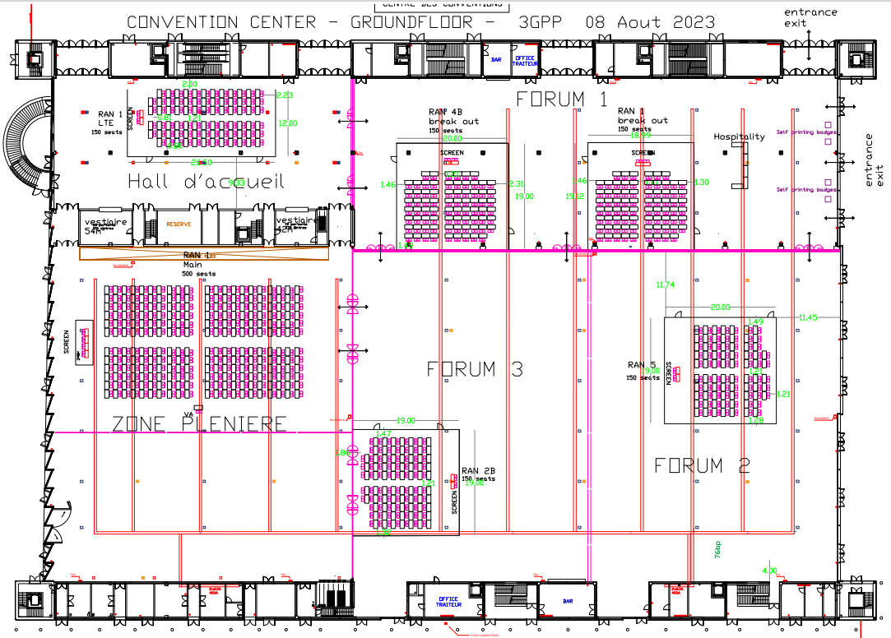
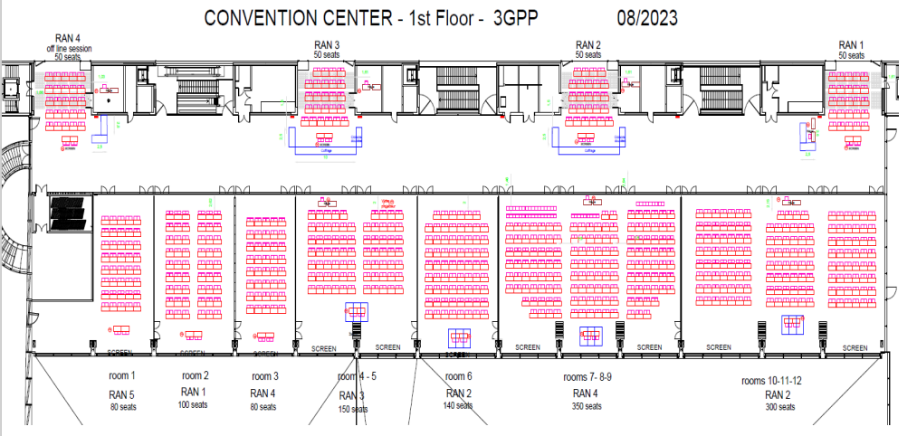
Meeting rooms
RAN4 meeting rooms: @ MEETE
Main Session: Room 7-8-9 (350) on 1st Floor
RRM Session: Room 4B (150) on the Ground Floor
BSRF_Demod_test: Room 3 (80) on the 1st Floor
RAN4 ad hoc meeting room: @ MEETE
Ad hoc room: RAN4 offline session (50) on the 1st floor
Ad hoc room
RRM Session
BSRF_Demod_Test Session
Main Session

