Slide 1
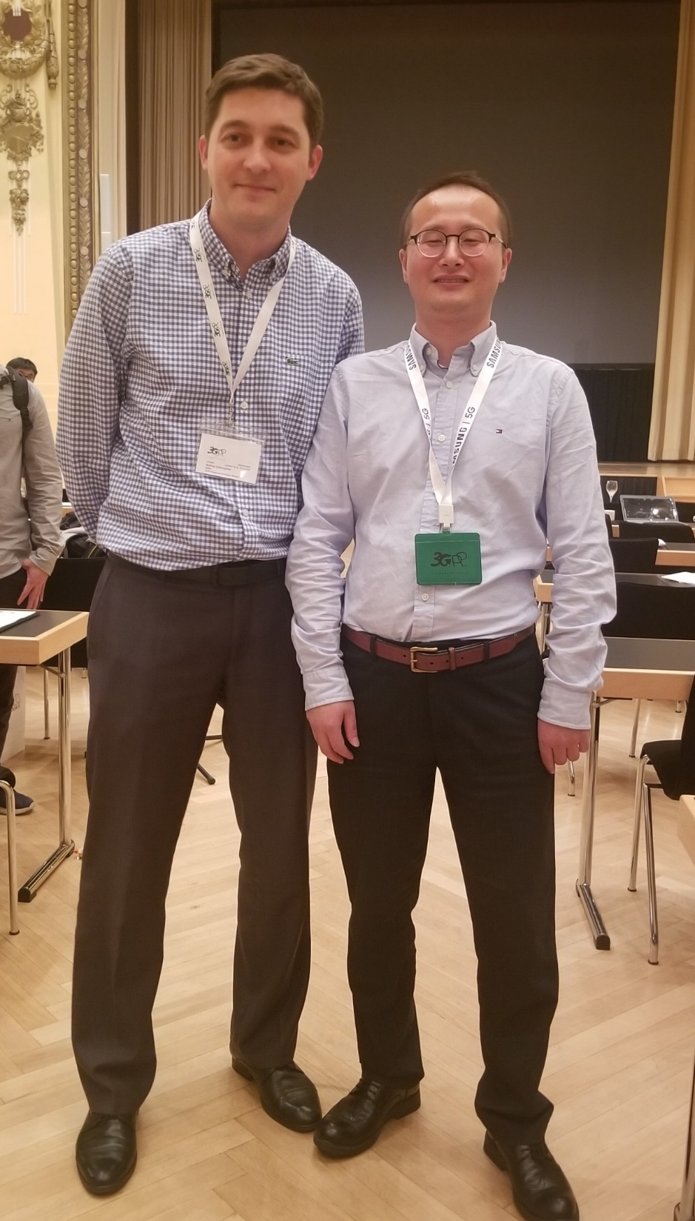
Haijie Qiu
Andrey Chervyakov
3GPP RAN4 Vice Chair
(2019.08 – 2023.08)

Slide 2




As Vice Chair of 3GPP RAN4 over the last four years,
You have shown unwavering dedication and leadership.
This badge is a token of our appreciation of all your efforts and achievements.
-Your 3GPP Friends

Slide 3
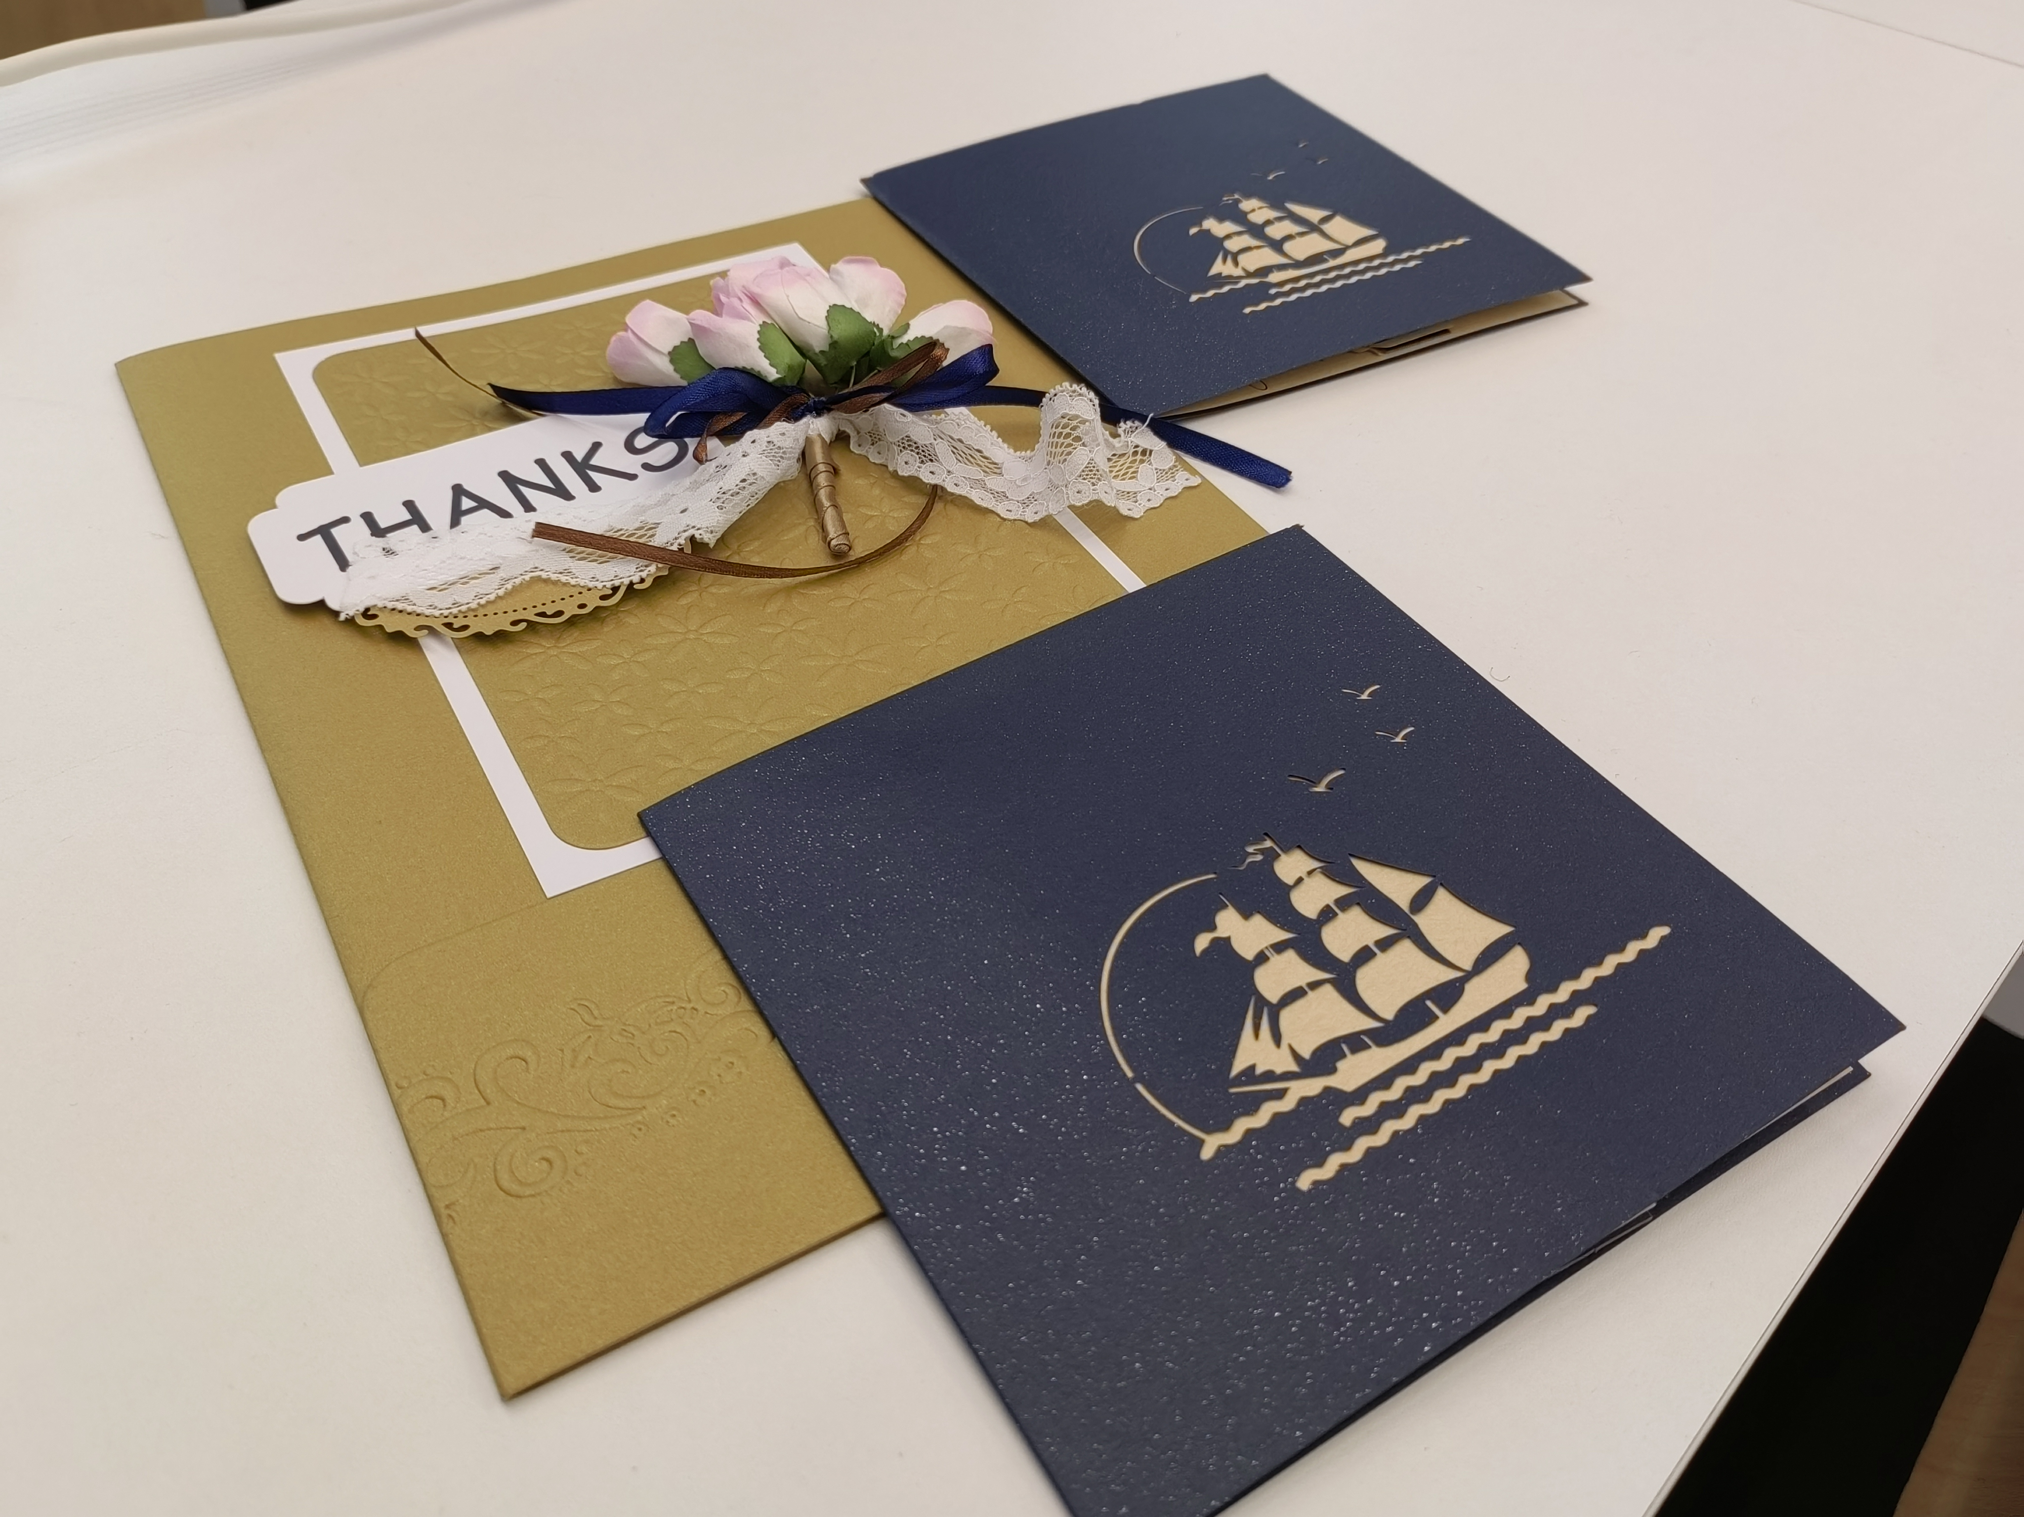
As Vice Chair of 3GPP RAN4 over the last four years,
You have shown unwavering dedication and leadership.
This card is a token of our appreciation of all your efforts and achievements.
-- Your 3GPP Friends

Slide 4
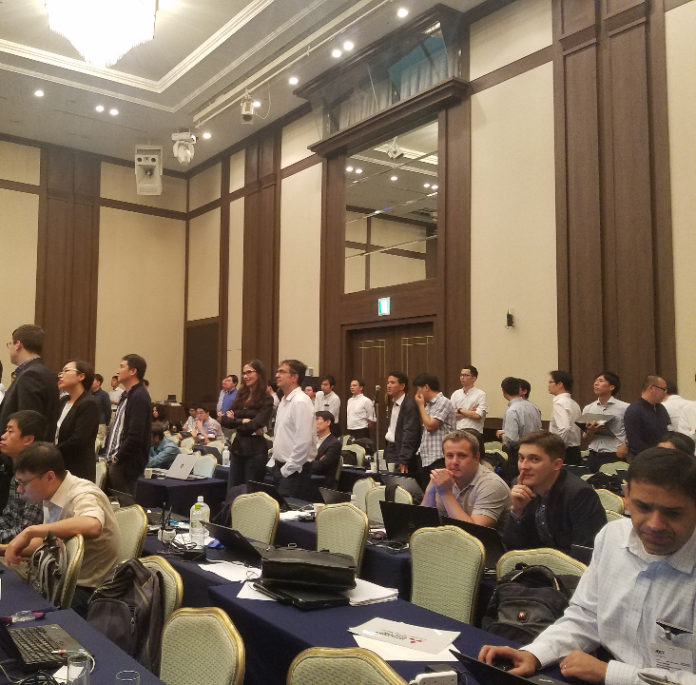
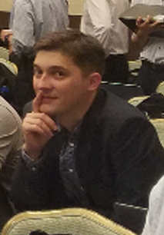
Oh. She looks at me. Should I comment a bit?
When Andrey is young

Slide 5
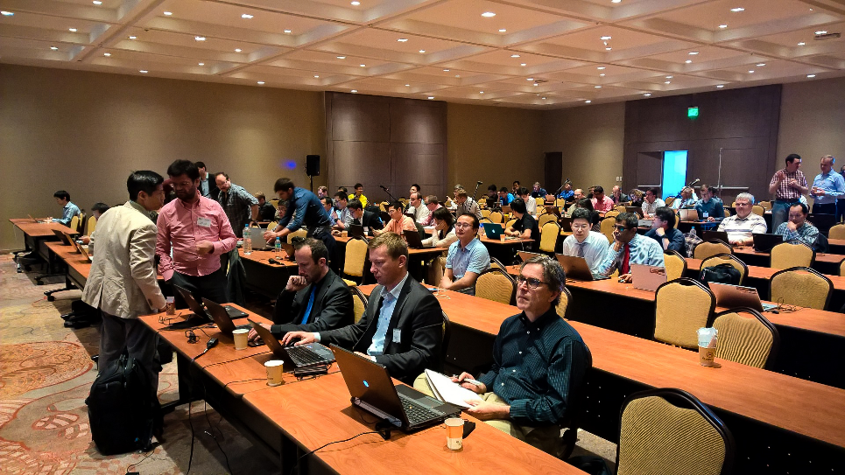
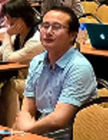
Can they stop murmuring?
I cannot hear clearly!
When Haijie is young

Slide 6
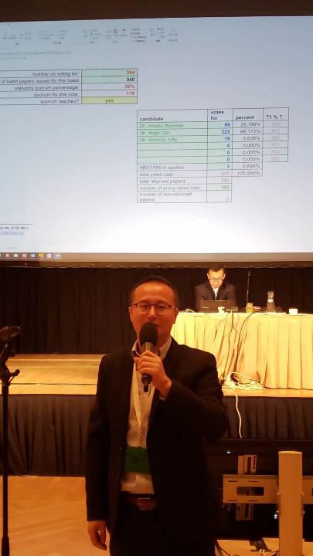
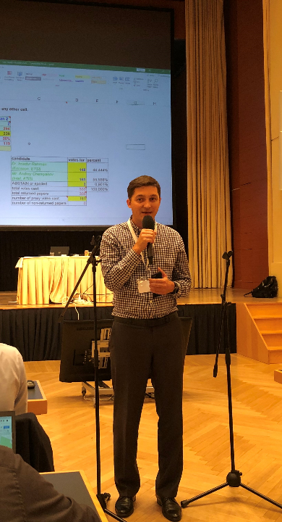
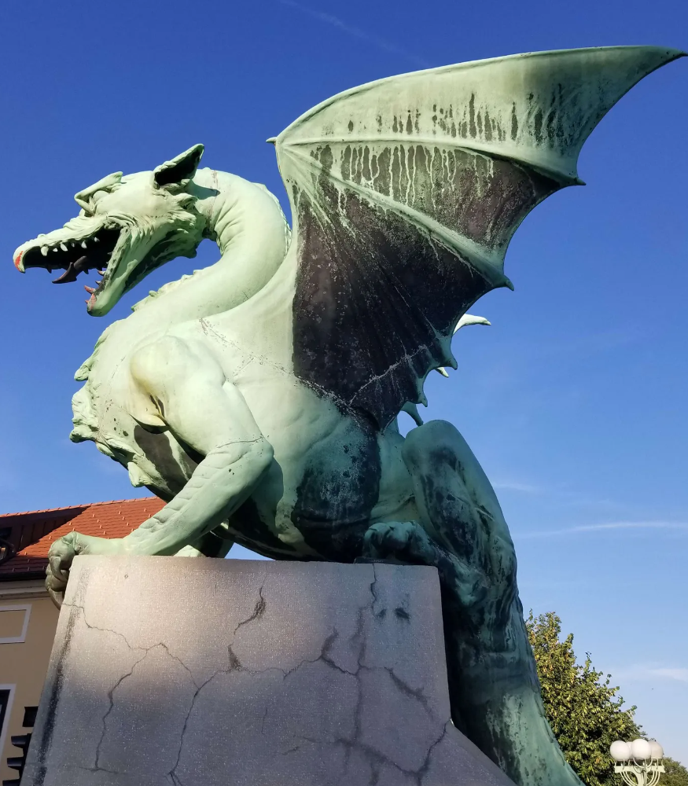
Our Big Days: August 2019
Speech after getting elected
We should improve RAN4 efficiency !!!
Ljubljana

Slide 7
Hmm, this guy comments on me. Let us talk later
Our Big Days: August 2019
Speech after getting elected
We should improve RAN4 efficiency !!!
Ljubljana

Slide 8
Hard-working, No sleep, Best RRM sessions!!
Hmm, this guy comments on me. Let us talk later
Our Big Days: August 2019
Speech after getting elected
We should improve RAN4 efficiency !!!
Ljubljana

Slide 9
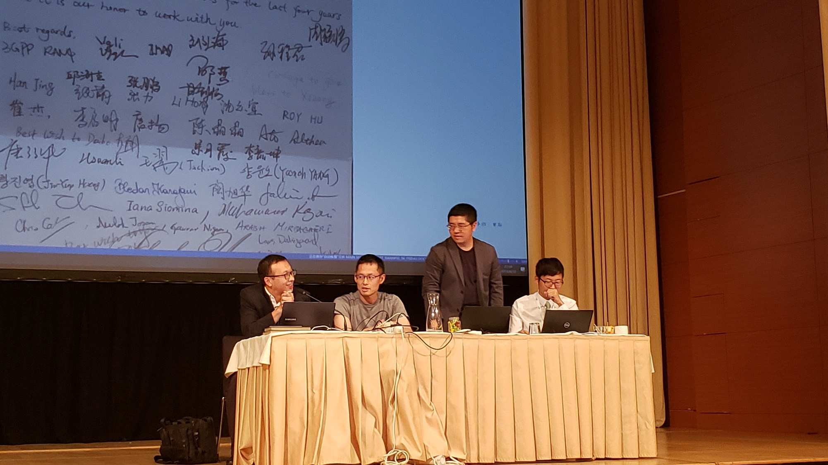
We wish You (Haijie, Andrey) all the best in Vice Chair career next four years!
Celebration for Umeda-San and Xizeng and Handover to Haijie and Andrey

Slide 10
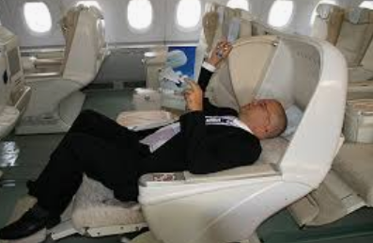
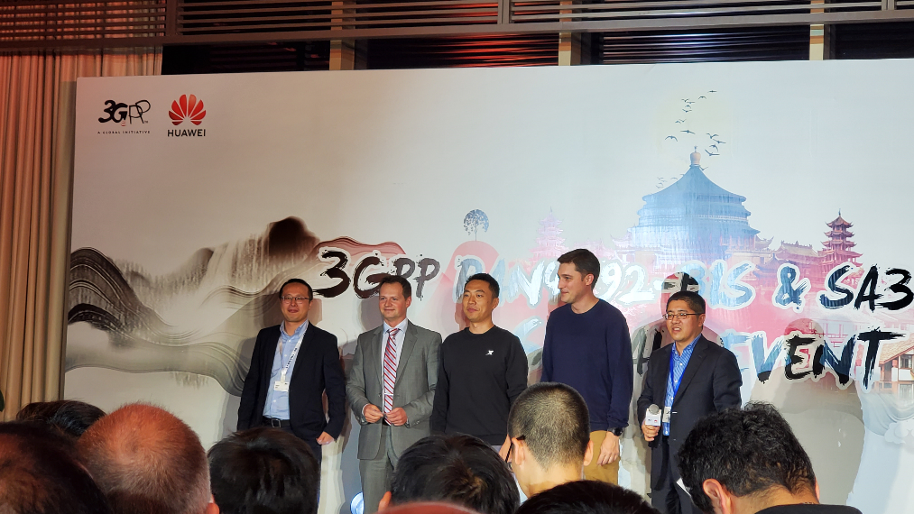

Our Vice Chair life should look like this…
First meeting serving RAN4 as Vice Chair @Social event Chongqing 2019

Slide 11
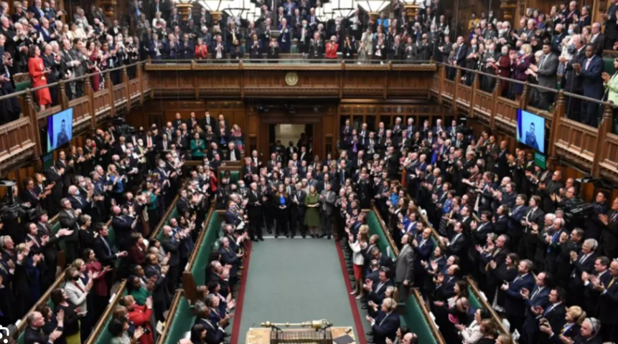
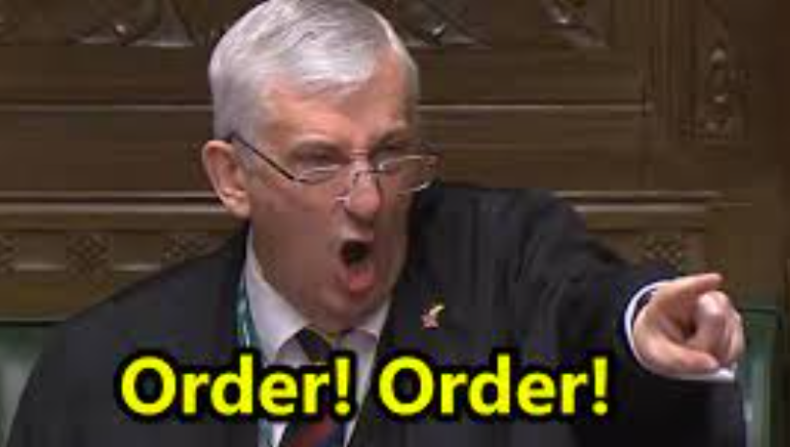
Our Vice Chair life should look like this…
First meeting serving RAN4 as Vice Char @Social event Chongqing 2019

Slide 12
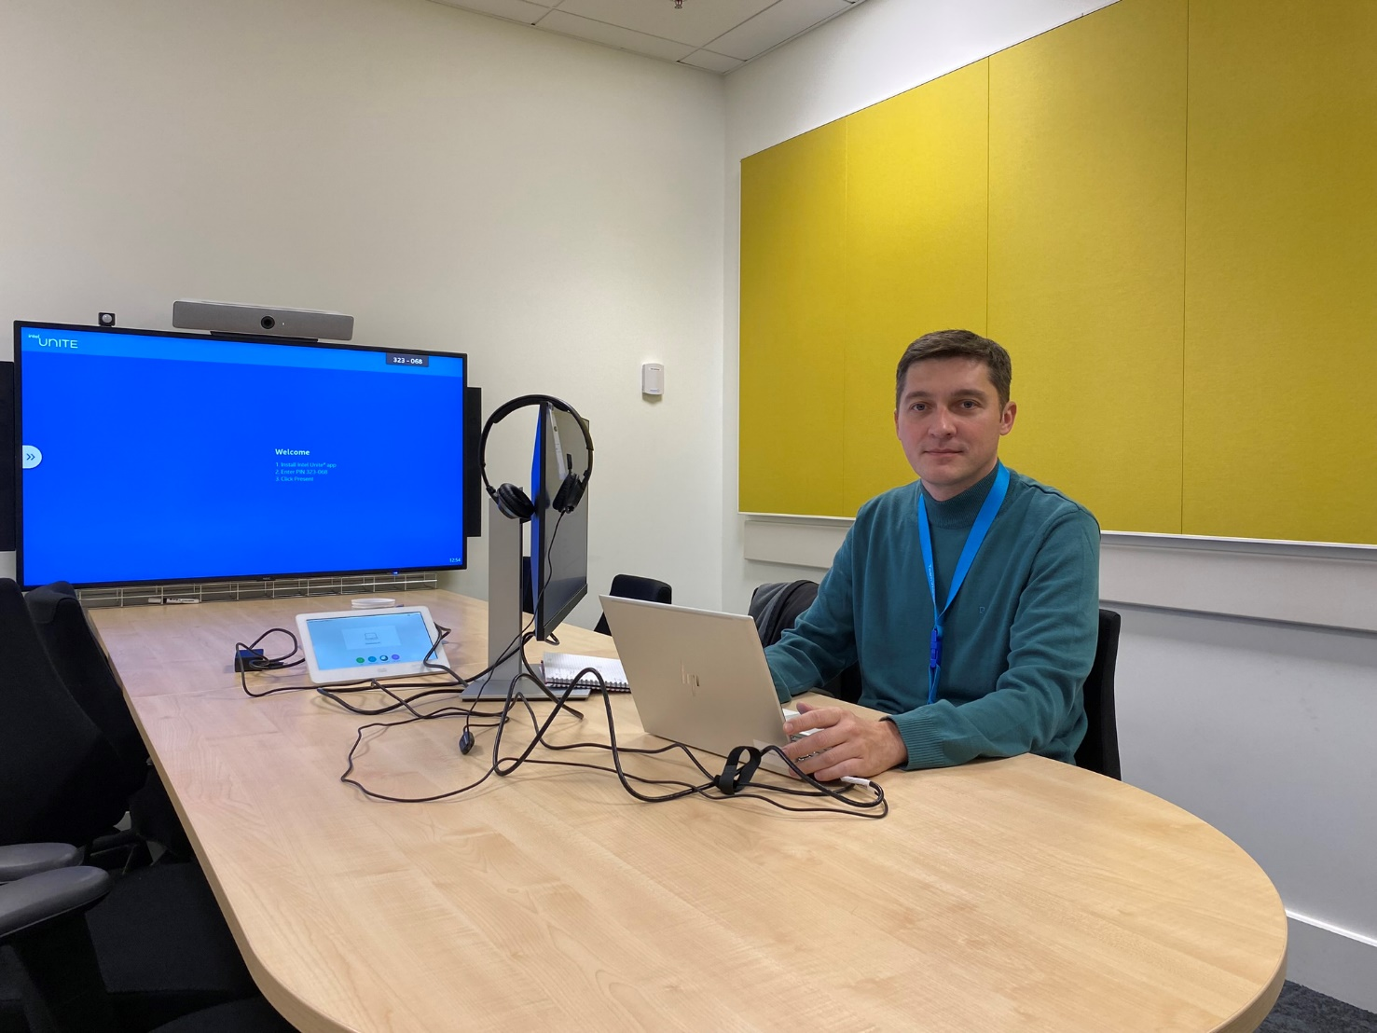
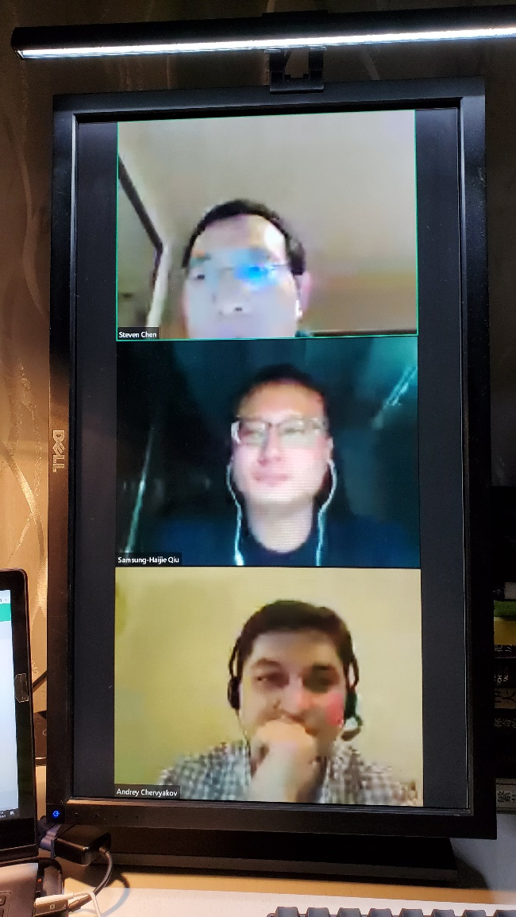

Outbreak of Covid-19
Remote Chair
But in fact it is like this ...
Speak to the screan

Slide 13
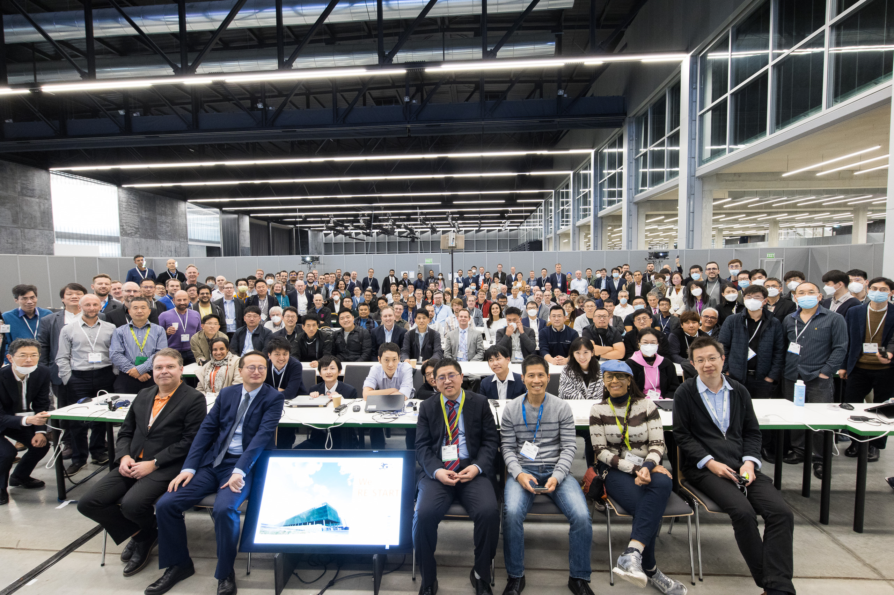
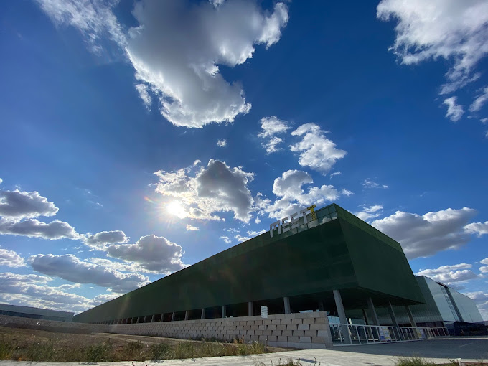

@ RAN4#105 in Toulouse
@ RAN4#106 in Athens
We (RAN4)
RE-START F2F!

Slide 14
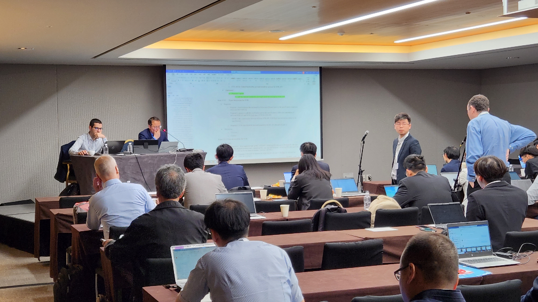
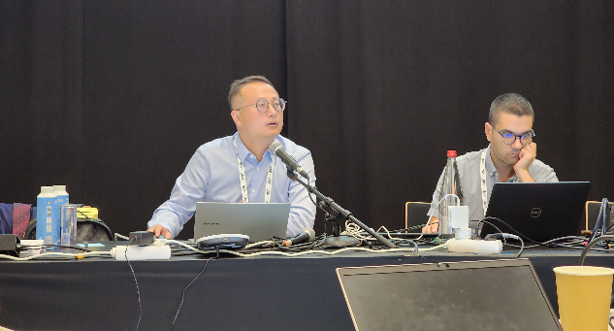
True
Leader
They are listening
They are thinking
They are debating

Slide 15
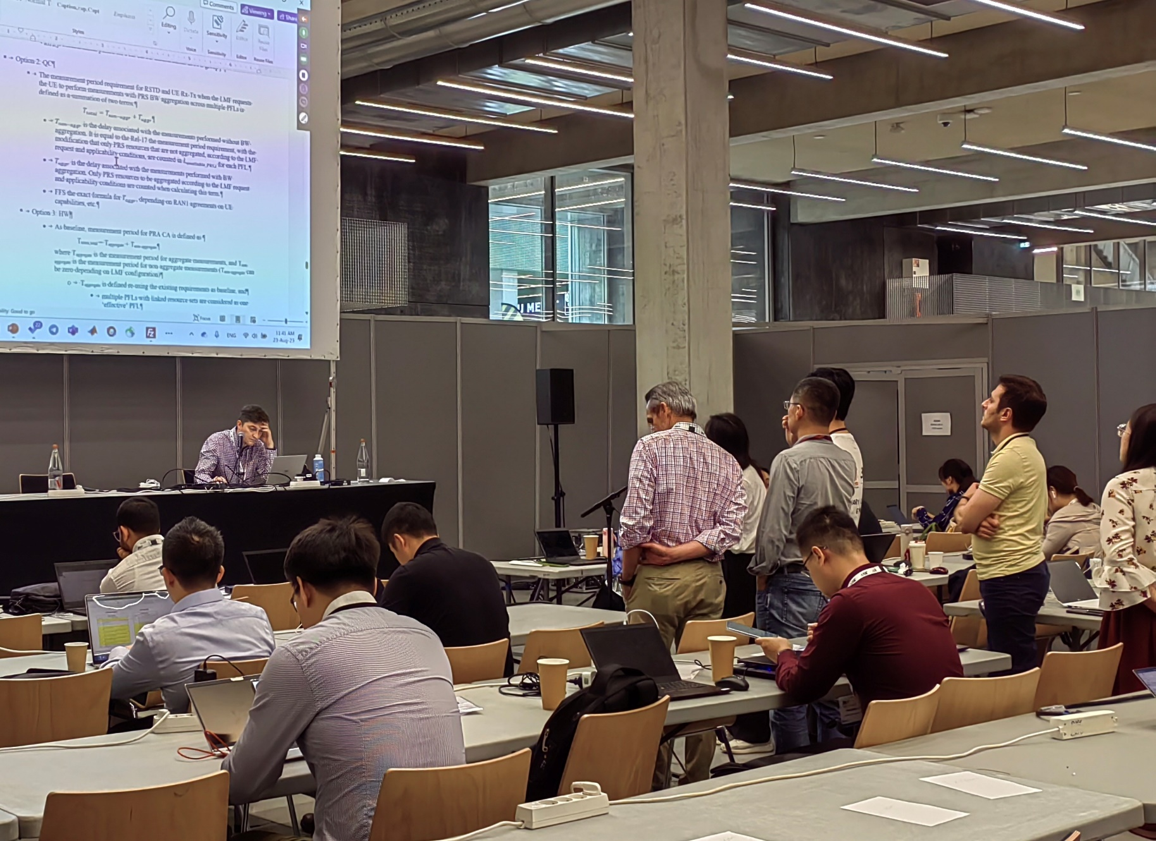
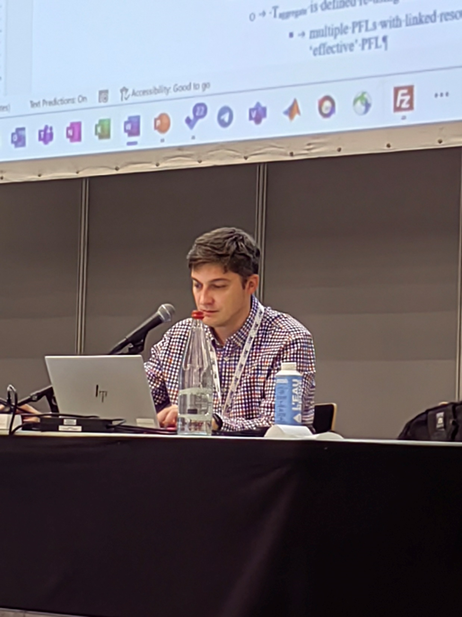
True
Leader
They are listening
They are thinking
They are debating

Slide 16
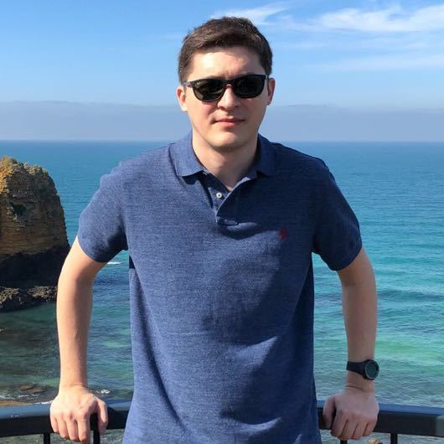

He is a superman in RAN4,
So Cool!

Slide 17
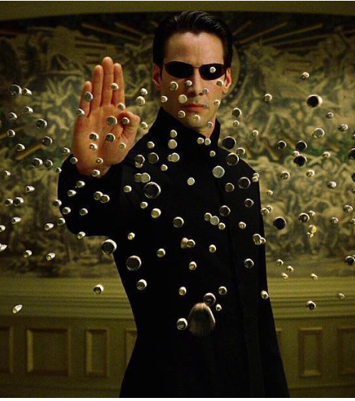
He is a superman in RAN4,
Hi RRM experts, Stop commenting! We need compromise!

Slide 18
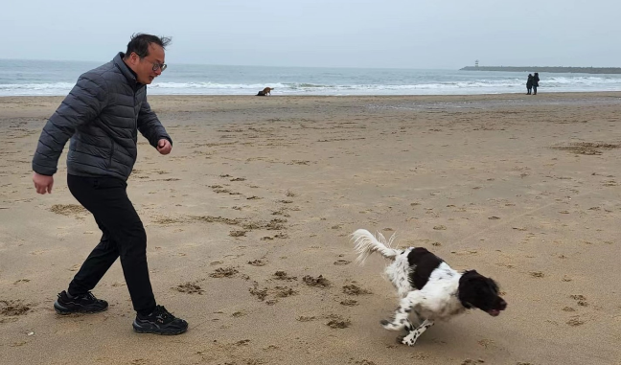

He is a superman in RAN4 (hmm, not only in RAN4)
Chasing Truth, enhancement, excellence for ever!

Slide 19

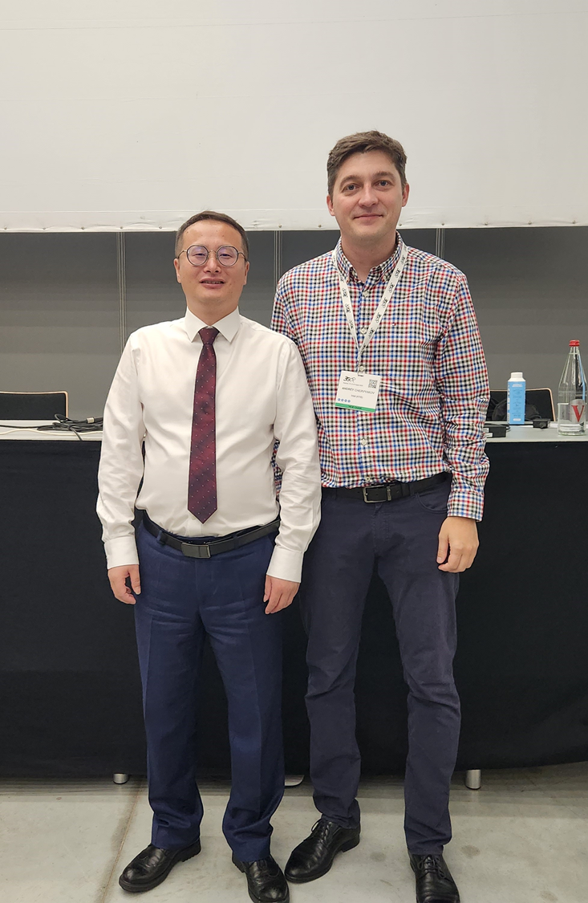
Time really flies
Four years passed
But you are still
That Young Man!
@ Ljubljana Aug 2019
@Toulouse Aug 2023

Slide 20
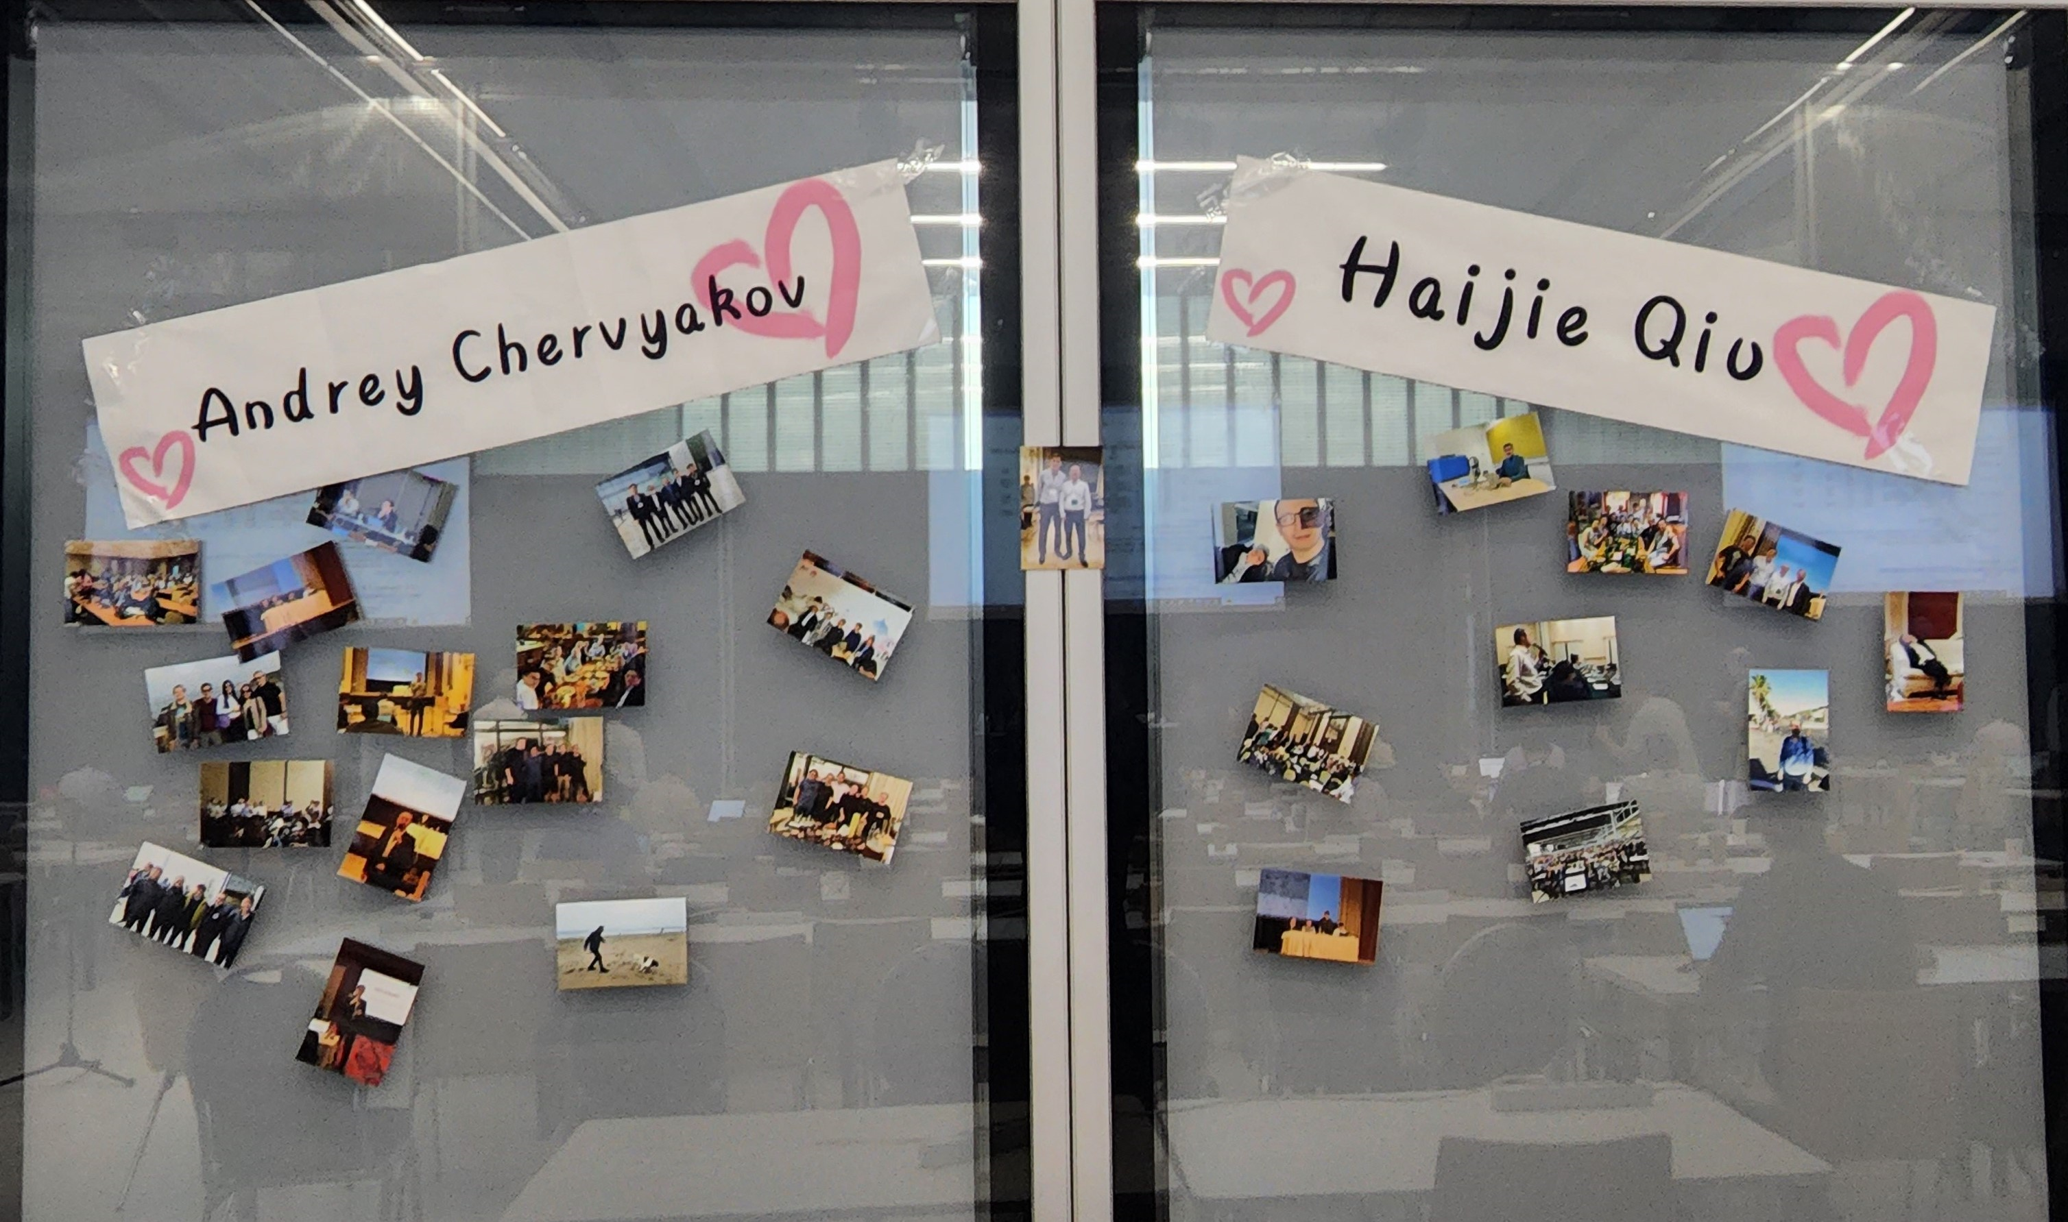
Thank you, Haijie!
Thank you, Andrey!

Slide 21
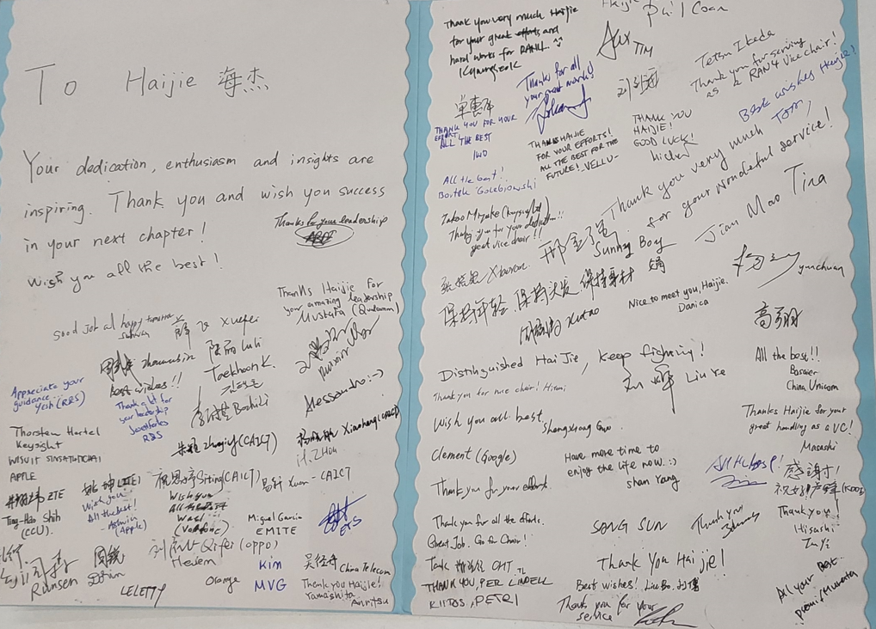

Slide 22
