Slide 1
RAN4#104-e RRM session GTW schedule
Week 1
August 15 / Mon 13:00 -16:00 UTC | [104-e][221] NR_feMIMO_RRM_1: Sub-topic #2-6-1, #2-6-2, #1-4-1 [104-e][222] NR_feMIMO_RRM_2: Sub-topic #1-2, #2-1 and #3-2 | 120 minutes
 | [104-e][216] NR_UE_pow_sav_enh: Sub-topic #2-1-1, #2-1-2, #2-2-1, #2-2-2 | 40 minutes
 | [104-e][217] NR_SL_enh_RRM: Sub-topic #1-1. #1-2 | 20 minutes
Augstu 16 / Tue 13:00 -16:00 UTC | [104-e][223] NR_redcap_RRM_1, [104-e][224] NR_redcap_RRM_2 | 120 minutes
 | [104-e][227] LTE_NR_DC_enh2 | 60 minutes
August 17 / Wed 13:00 -16:00 UTC | [104-e][225] NR_pos_enh_1, [104-e][226] NR_pos_enh_2 | 120 minutes
 | [104-e][206] NR_HST_FR2_RRM_1, [104-e][207] NR_HST_FR2_RRM_2 | 60 minutes
August 18 / Thu 13:00 -16:00 UTC | [104-e][214] NR_NTN_solutions_RRM_1, [104-e][215] NR_NTN_solutions_RRM_2 | 90 minutes
 | [104-e][218] NR_ext_to_71GHz_RRM_1, [104-e][219] NR_ext_to_71GHz_RRM_2 | 90 minutes
August 19 / Fri 13:00 -16:00 UTC (R17) | [211][212][213] NR_MG_enh | 120 minutes
 | [205] NR_HST_FR1_enh | 20 minutes
 | [230] NR_SmallData_INACTIVE | 40 minutes
Week 2
Mon 13:00 -16:00 UTC (R17) | [208][209][210] NR_RRM_enh2 | 120 minutes
 | [228] NR_IIOT_URLLC_enh | 30 minutes
 | [203] FR1 / [204] FR2 / [229] SL Relay / [231] NB&MTC | 30 minutes
Tue 13:00 -16:00 UTC (R18) | [240] LS_reply | 60 minutes
 | [234] NR_RRM_enh3 | 60 minutes
 | [235] NR_MG_enh2 | 60 minutes
Wed 13:00 -16:00 UTC (R18) | [237] NR_Mob_enh2 | 60 minutes
 | [233] FR2_multiRx_RRM | 30 minutes
 | [236] NR_ATG_RRM | 30 minutes
 | [238] NR_DualTxRx_MUSIM | 30 minutes
 | [239] LTE_NBeMTC_NTN_RRM | 30 minutes
Thu 13:00 -16:00 UTC (R17) | Early return to R17 topics | 120 minutes
 | [202] Maintenance_R17_RRM | 60 minutes
Fri 13:00 -16:00 UTC | TBA | 180 minutes

Slide 2
Email discussion procedures/timelines
Pre-meeting
Quiet Period
1st round (Aug 15~19)
Quiet Period
2nd round (Aug 22 ~ Aug 26)
Thu (Aug 11)
Fri (Aug 12)
Aug 13 – Aug 14
Mon (Aug 15)
Tue (Aug 16)
Wed (Aug 17)
Thu (Aug 18)
Fri (Aug 19)
Sat/Sun
Mon (Aug 22)
Tue (Aug 23)
Wed (Aug 24)
Thu (Aug 25)
Fri (Aug 26)
00:00 UTC
kicks off 2nd by 4:00 UTC
Main & BS
GTW session 3:00-6:00 UTC
Main & BS
GTW session 3:00-6:00 UTC
Main & BS
GTW session 3:00-6:00 UTC
Main & BS
GTW session 3:00-6:00 UTC
Quiet period 3:00 Sat-23:00 Sun UTC
Final checking window
Wed 19:00 –
Thu 16:00 UTC
08:00 UTC
Meeting starts
8:00 UTC
2nd round formal summary
8:00 UTC
Chair update report & Tdoc number before
11:59 UTC
RRM session chaired by Meng Zhang (Intel)
2nd round draft summary
11:59 UTC
12:00 UTC
Companies need feed back if tdoc is submitted in wrong agenda or tdoc is missing from email summary
RRM
GTW session 13:00-16:00 UTC
(Xizeng)
RRM
GTW session 13:00-16:00 UTC
(Xizeng)
RRM
GTW session 13:00-16:00 UTC
(Xizeng)
RRM
GTW session 13:00-16:00 UTC
(Xizeng)
RRM
GTW session 13:00-16:00 UTC
(Meng Intel)
Main, BS & RRM
GTW session 13:00-16:00 UTC
Main, BS & RRM
GTW session 13:00-16:00 UTC
Main, BS & RRM
GTW session 13:00-16:00 UTC
Main, BS & RRM
GTW session 13:00-16:00 UTC
Main, BS & RRM
GTW session 13:00-16:00 UTC
16:00 UTC
Window closes &final comments
16:00 UTC
Initial summary 17:00 UTC
Delay allowed
Comments on initial summary, checking agenda
17:00 UTC
Companies need provide comments as early as possible
1st round comments & responses
17:00 UTC
1st round formal summary
17:00 UTC
Companies need provide drafts & revisions as early as possible
2nd round initial drafts & revisions (deadline for new tdoc# request)
17:00 UTC
2nd round comments & responses
17:00 UTC
2nd round final formal Tdoc submission
17:00 UTC
Meeting closes
17:00 UTC
24:00 UTC
Share 2nd round final draft Tdoc
19:00 UTC
Chair announce which topics will continue
23:59 UTC
Strict deadline for new tdoc number request
Note 1: Comments and tdocs submitted after the deadlines will not be considered
Note 2: Basket WIs email discussion procedures/timelines are not included.
Note 3: During quiet periods, no email should be sent out.
Timeline for moderator
Deadline for comments and tdoc
GTW session (Main+BS, or Main+BS+RRM)
GTW session (RRM only)

Slide 3
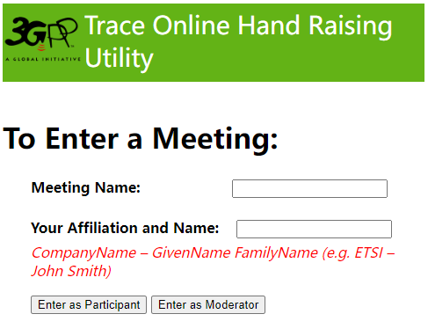
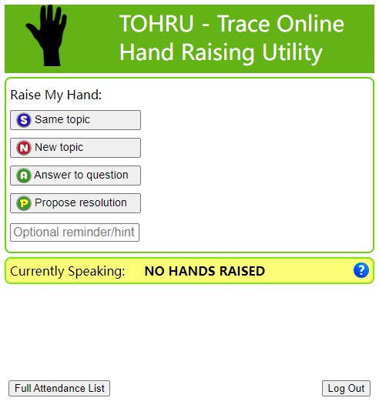
Guidance of TOHRU for GTW
TOHRU (Trace Online Hand Raising Utility) will be used for GTW
3GPP TOHRU will be used in this meeting
Hyperlink: https://tohru.3gpp.org/
Together with the invitation for the GotoWebinar MCC provides you with a "Meeting name" individually after your registeration
Meeting name (TOHRU Meeting IDs):
Main session: RAN4_Main
RRM session: RAN4_RRM
BSRF_Demod_testing session: RAN4_BSRF
Enter your name
<represented company>, <first name> <family name> e.g.: XY Telecom - Peter Mustermann
Need to manually push "Refresh Queue" or use "Automatically refresh queue every 3 seconds", since this is different from the original TOHRU tool.
The other buttons are similar as the previous external TOHRU tool
Please find references at
https://www.3gpp.org/ftp/tsg_ran/WG4_Radio/TSGR4_104-e/Invitation

