Slide 1
RAN4#104-e BSRF_Demod_Test session GTW schedule
Week 1
Tue 3:00 – 6:00 UTC (Rel-17 Demod) | [321] Performance enhancement: Topic #1 (MMSE-IRC issue 1-1), Topic #2 (CRS-IM sub topic 2-1. 2-2, 2-4) | 90 minutes
 | [326] NR_cov_enh_Demod: Topic #1 (PUSCH), Topic #2 (PUCCH) | 45 minutes
 | [329] NR_IIOT_URLLC_enh_Demod: Sub-topic #1 (introduction of requirements), #2 (Test parameters) pending on available time | 45 minutes
Wed 3:00 – 6:00 UTC (Rel-17 RF Conformance) | [308] NTN SAN RF conformance: Topic#1, #2, #3 [307] NTN SAN RF maintenance: Sub-topic 1-2 | 90 minutes
 | [310] FR2-2 BSRF: Topic #1, #2, #3 | 90 minutes
Thu 3:00 – 6:00 UTC (Rel-17 Demod+ OTA) | [328] Redcap Demod: Issue 3-3-1 | 15 minutes
 | [327] FeMIMO Demod: Topic #1, #2, #3, #4 | 45 minutes
 | [331] MIMO OTA: Topic #2, Sub topic #3-1 | 60 minutes
 | [332] TRP_TRS: Topic #3 | 60 minutes
Fri 3:00 – 6:00 UTC (Rel-17 RF) | [305]/[306] Repeater RF conformance: -[305]: Topic #1, 2, 3 -[306]: Topic #1, 2 | 120 minutes
 | [311] eIAB RF conformance: Topic #1, #2 | 60 minutes
Week 2
Mon 13:00 -16:00 UTC (Rel-17 Demod) | [322/323] NTN Demod: TBA | 90 minutes
 | [324/325] FR2-2 Demod: TBA | 90 minutes
Tue 13:00 -16:00 UTC (Rel-18 OTA+RF) | [334] FR2 Test method enhancement: TBA | 60 minutes
 | [314] FS_BS_RF_evo: TBA | 60 minutes
 | [315] FS_NR_duplex_evo: TBA | 60 minutes
Wed 13:00 -16:00 UTC (Rel-17+Rel-18 RF) | [309] NTN UE RF maintenance: TBA | 60 minutes
 | [317] IoT_NTN: TBA | 60 minutes
 | FFS (Reserved for maintenance) | 60 minutes
Thu 13:00 -16:00 UTC (Return to Rel-17 ) | TBA | 180 minutes
Fri 13:00 -16:00 UTC (Final Round) | TBA | 180 minutes

Slide 2
Email discussion procedures/timelines
Pre-meeting
Quiet Period
1st round (Aug 15~19)
Quiet Period
2nd round (Aug 22 ~ Aug 26)
Thu (Aug 11)
Fri (Aug 12)
Aug 13 – Aug 14
Mon (Aug 15)
Tue (Aug 16)
Wed (Aug 17)
Thu (Aug 18)
Fri (Aug 19)
Sat/Sun
Mon (Aug 22)
Tue (Aug 23)
Wed (Aug 24)
Thu (Aug 25)
Fri (Aug 26)
00:00 UTC
kicks off 2nd by 4:00 UTC
Main & BS
GTW session 3:00-6:00 UTC
Main & BS
GTW session 3:00-6:00 UTC
Main & BS
GTW session 3:00-6:00 UTC
Main & BS
GTW session 3:00-6:00 UTC
Quiet period 3:00 Sat-23:00 Sun UTC
Final checking window
Wed 19:00 –
Thu 16:00 UTC
08:00 UTC
Meeting starts
8:00 UTC
2nd round formal summary
8:00 UTC
Chair update report & Tdoc number before
11:59 UTC
RRM session chaired by Meng Zhang (Intel)
2nd round draft summary
11:59 UTC
12:00 UTC
Companies need feed back if tdoc is submitted in wrong agenda or tdoc is missing from email summary
RRM
GTW session 13:00-16:00 UTC
(Xizeng)
RRM
GTW session 13:00-16:00 UTC
(Xizeng)
RRM
GTW session 13:00-16:00 UTC
(Xizeng)
RRM
GTW session 13:00-16:00 UTC
(Xizeng)
RRM
GTW session 13:00-16:00 UTC
(Meng Intel)
Main, BS & RRM
GTW session 13:00-16:00 UTC
Main, BS & RRM
GTW session 13:00-16:00 UTC
Main, BS & RRM
GTW session 13:00-16:00 UTC
Main, BS & RRM
GTW session 13:00-16:00 UTC
Main, BS & RRM
GTW session 13:00-16:00 UTC
16:00 UTC
Window closes &final comments
16:00 UTC
Initial summary 17:00 UTC
Delay allowed
Comments on initial summary, checking agenda
17:00 UTC
Companies need provide comments as early as possible
1st round comments & responses
17:00 UTC
1st round formal summary
17:00 UTC
Companies need provide drafts & revisions as early as possible
2nd round initial drafts & revisions (deadline for new tdoc# request)
17:00 UTC
2nd round comments & responses
17:00 UTC
2nd round final formal Tdoc submission
17:00 UTC
Meeting closes
17:00 UTC
24:00 UTC
Share 2nd round final draft Tdoc
19:00 UTC
Chair announce which topics will continue
23:59 UTC
Strict deadline for new tdoc number request
Note 1: Comments and tdocs submitted after the deadlines will not be considered
Note 2: Basket WIs email discussion procedures/timelines are not included.
Note 3: During quiet periods, no email should be sent out.
Timeline for moderator
Deadline for comments and tdoc
GTW session (Main+BS, or Main+BS+RRM)
GTW session (RRM only)

Slide 3
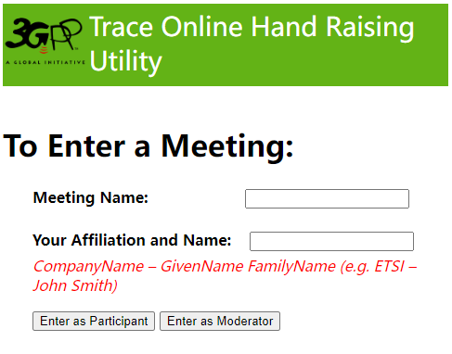
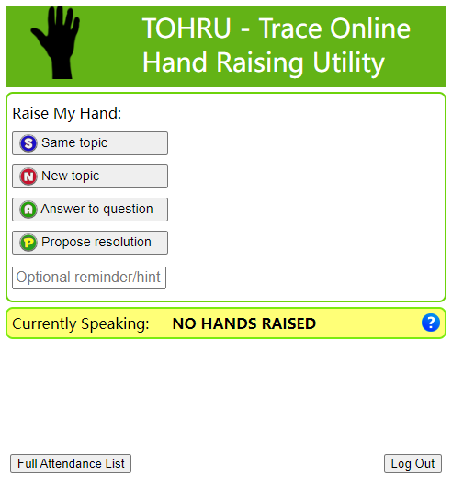
Guidance of TOHRU for GTW
TOHRU (Trace Online Hand Raising Utility) will be used for GTW
3GPP TOHRU will be used in this meeting
Hyperlink: https://tohru.3gpp.org/
Together with the invitation for the GotoWebinar MCC provides you with a "Meeting name" individually after your registeration
Meeting name (TOHRU Meeting IDs):
Main session: RAN4_Main
RRM session: RAN4_RRM
BSRF_Demod_testing session: RAN4_BSRF
Enter your name
<represented company>, <first name> <family name> e.g.: XY Telecom - Peter Mustermann
Need to manually push "Refresh Queue" or use "Automatically refresh queue every 3 seconds", since this is different from the original TOHRU tool.
The other buttons are similar as the previous external TOHRU tool
Please find references at
https://www.3gpp.org/ftp/tsg_ran/WG4_Radio/TSGR4_104-e/Invitation

