Slide 1
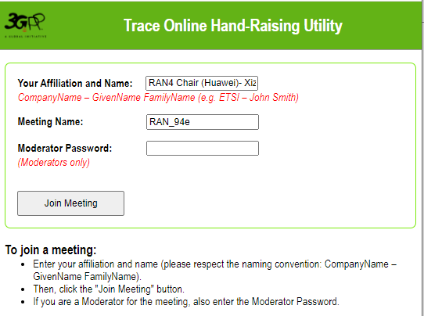
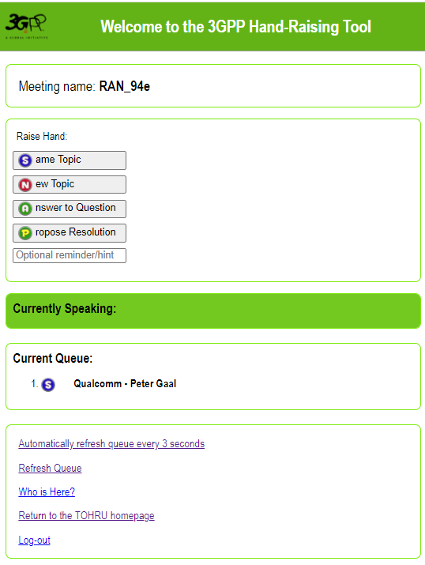
Guidance of TOHRU for GTW
TOHRU (Trace Online Hand Raising Utility) will be used for GTW
3GPP TOHRU will be used in this meeting (previously RAN4 used external TOHRU tool)
Hyperlink: https://www.3gpp.org/tohru/
Together with the invitation for the GotoWebinar MCC provides you with a "Meeting name" individually after your registeration
Meeting name (TOHRU Meeting IDs):
Main session: RAN4_Main
RRM session: RAN4_RRM
BSRF_Demod_testing session: RAN4_BSRF
Enter your name
<represented company>, <first name> <family name> e.g.: XY Telecom - Peter Mustermann
Need to manually push "Refresh Queue" or use "Automatically refresh queue every 3 seconds", since this is different from the original TOHRU tool.
The other buttons are similar as the previous external TOHRU tool

