Slide 1
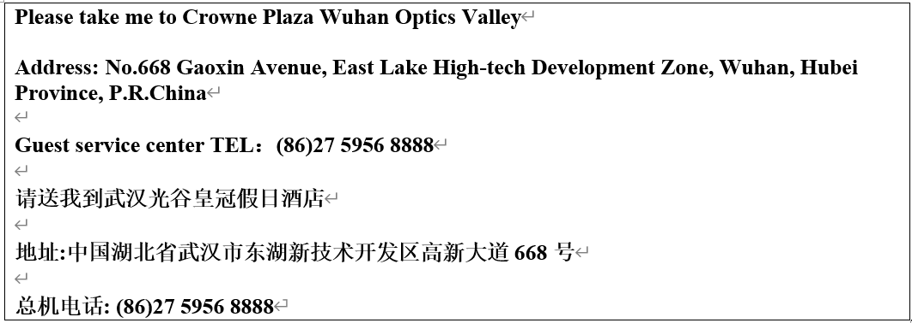
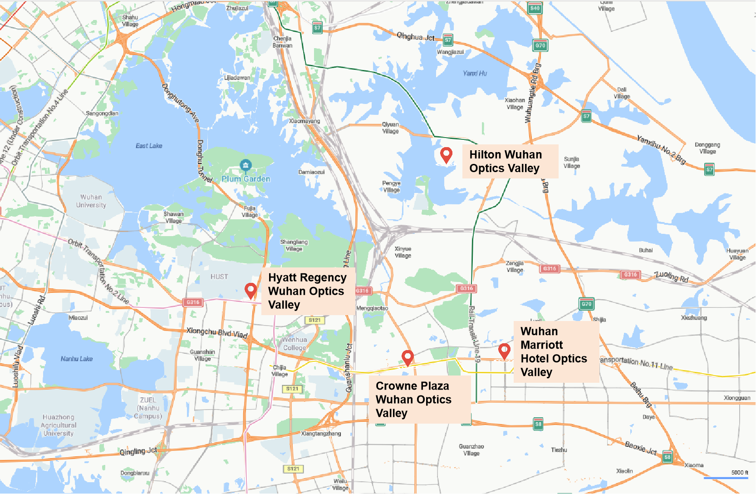
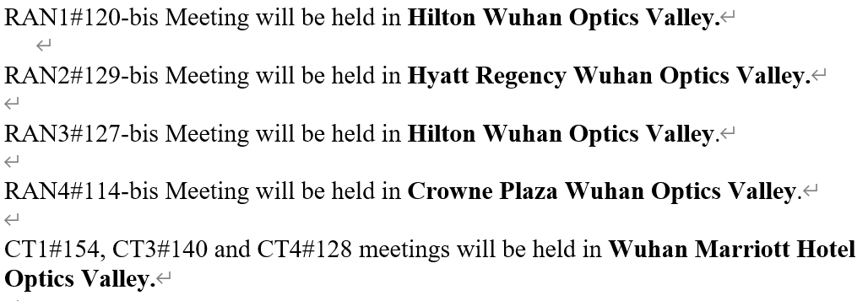
RAN4 meeting hotel
    RAN4 meeting hotel: Crowne Plaza Wuhan Optics Valley

Slide 2
RAN4 Chair Elections:
Guidance and arrangement
    Rule for WG chair elections:
  The rules concerning 3GPP elections and other votes can be found in the following 3GPP Working Procedure articles at https://www.3gpp.org/dynareport?code=elections-technical-votes
  Voting list can be found at https://portal.3gpp.org/VotingTool/Vote/VotingRights?groupID=382&meetingID=60592
    Voting tool:
  The 3GPP voting tool will be used for casting the ballot for RAN4 Chair elections in RAN4#114bis (https://portal.3gpp.org/VotingTool/)
  To use voting tool, you first need use your EOL account to log in.
  Chair highly recommended that you cast your vote in RAN4 meeting rooms via voting tool.
    Candidates information:
  Please find the candidate information for RAN4 Chair elections at https://portal.3gpp.org/VotingTool/Vote/DetailList/1157
    Registration for casting a vote:
  The registration deadline for f2f participants and remote access is 31 Mar 2025 09:00 (GMT+08:00) Beijing time.
  Check-in (Annex H of 3GPP working procedure): An Individual Member is considered checked in if a delegate registered for that Individual Member is checked in at the time the ballot closes.
  Please make sure that you register and check-in on time for casting a vote.
    1st Round Ballot:
  April 08 (Tuesday) 09:00~13:45 (GMT+8, Beijing time). The announcement of results will be held at 14:00 in main session
    2nd Round Ballot (planned)
  April 08 (Tuesday) 14:10~18:00 (GMT+8, Beijing time). The announcement of results will be held at 18:10 in main session
    Other additional round ballot might be needed, if candidate number is more than 2.

Slide 3
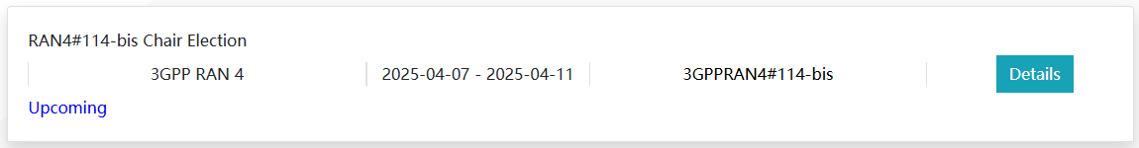
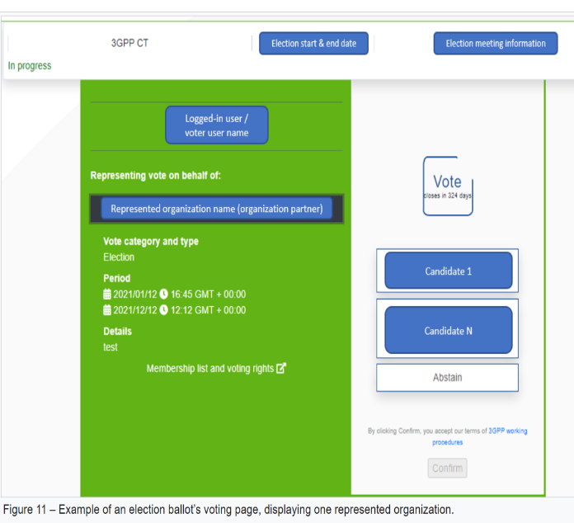
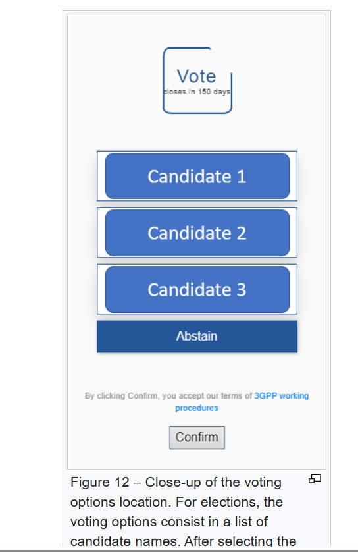
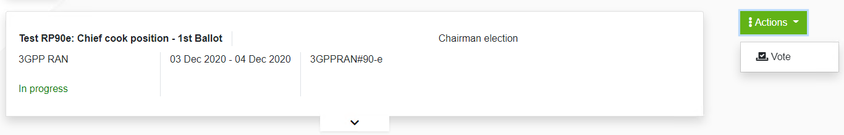
RAN4 Chair Elections:
Additional guidance of voting tool
    How to cast a vote?
  To cast a vote, the logged-in user shall be registered and checked in at the meeting (provided the vote is not done by correspondence), access the voting page, and proceed as follows:
    1. Select the voting member organization on behalf of which the user wants to cast a vote, from the options visible in Figure 1
    2. Select the desired voting option on the right (i.e., a candidate name or “abstain” for elections) The possible voting options are displayed in Figure 2.
Figure 1
Figure 2
    It will read “In progress” during the election period, and “closed” after the election is over
    Example is provided above. And please click Action → Vote

