Slide 1
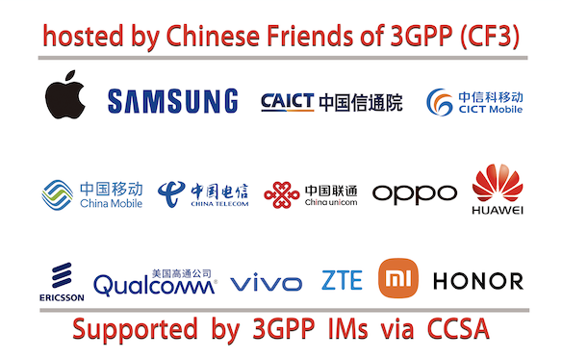
CCSA and CF3 has the pleasure of welcoming you to
3GPP RAN3#125-bis
Hefei, China, 14-18 October, 2024

Slide 2
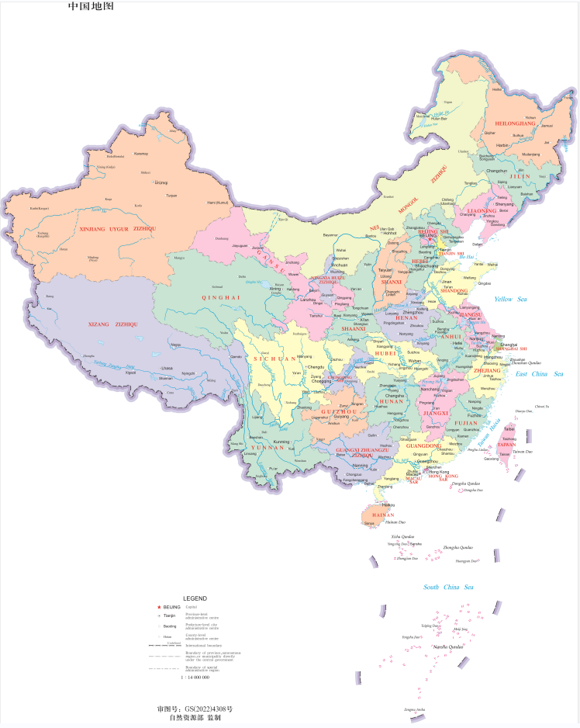
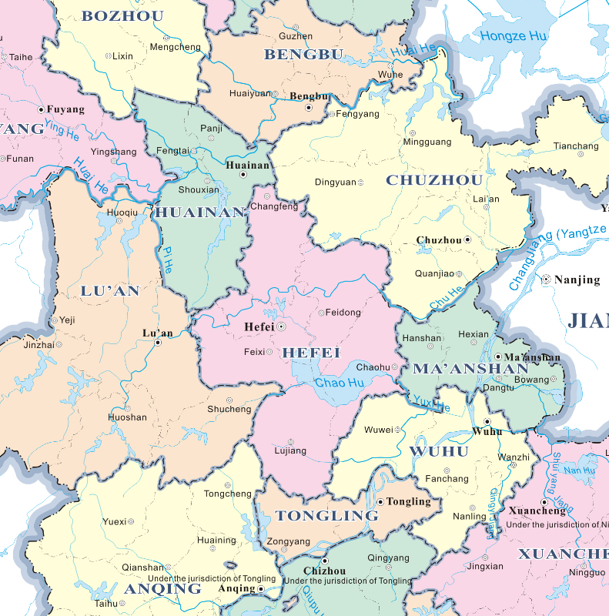

Hefei’s Location in China Map

Slide 3
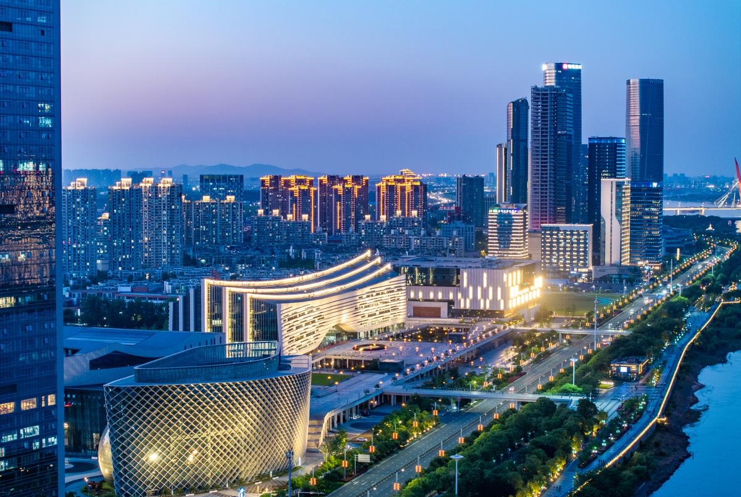
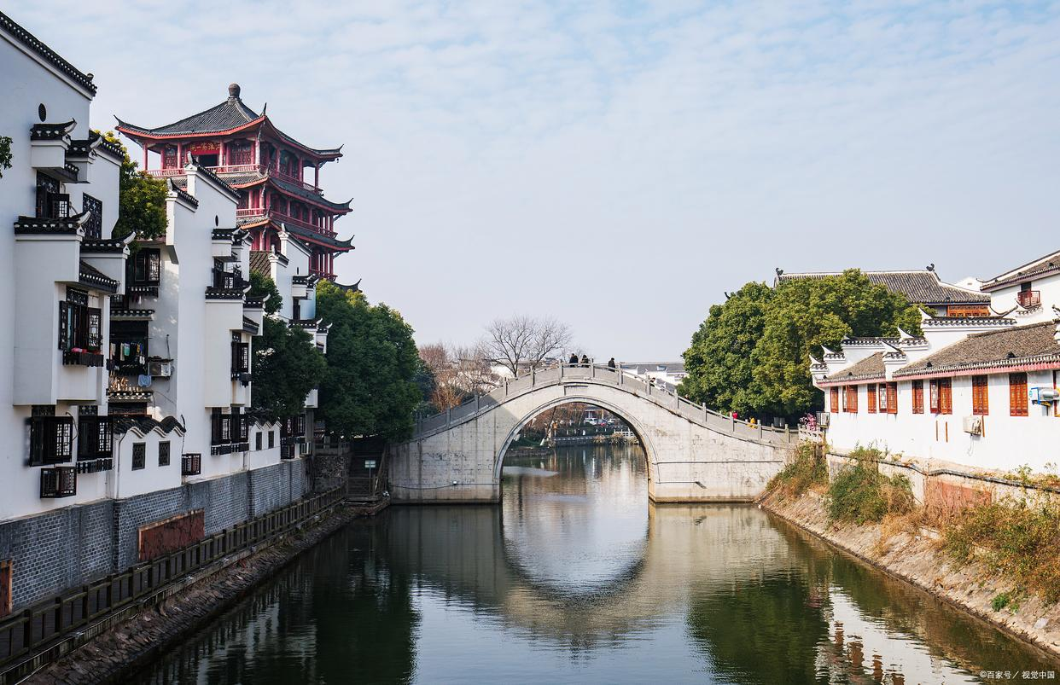
Brief Introduction of Hefei
Hefei, referred to as "Lu" or "He" in ancient times, known as Luzhou, Luyang, Hefei, is a prefecture-level city in Anhui Province. It is located in the central part of Anhui Province, in the west wing of the Yangtze River delta, surrounded by Chaohu Lake.
Hefei is one of the important cradles of Chinese civilization. The East Fei River and the South Fei River both originate here, hence the name. It is an important administrative center, commercial port and military town in the Jianghuai region, known as "the right throat of the Huai River, Jiangnan Lip Tooth," "the first county of the Jianghuai River, Wu Chu Yaochong," "the hometown of the Three Kingdoms, the hometown of Bao Zheng, and the cradle of the Huai Army." It is also the central city of the G60 Science and Technology Innovation Corridor, the strategic dual-node cities of the Belt and Road Initiative and the Yangtze River Economic Belt, the comprehensive national scientific centre, the member cities of the World Alliance of Science and Technology Cities, and the national pilot cities of science and technology innovation.

Slide 4
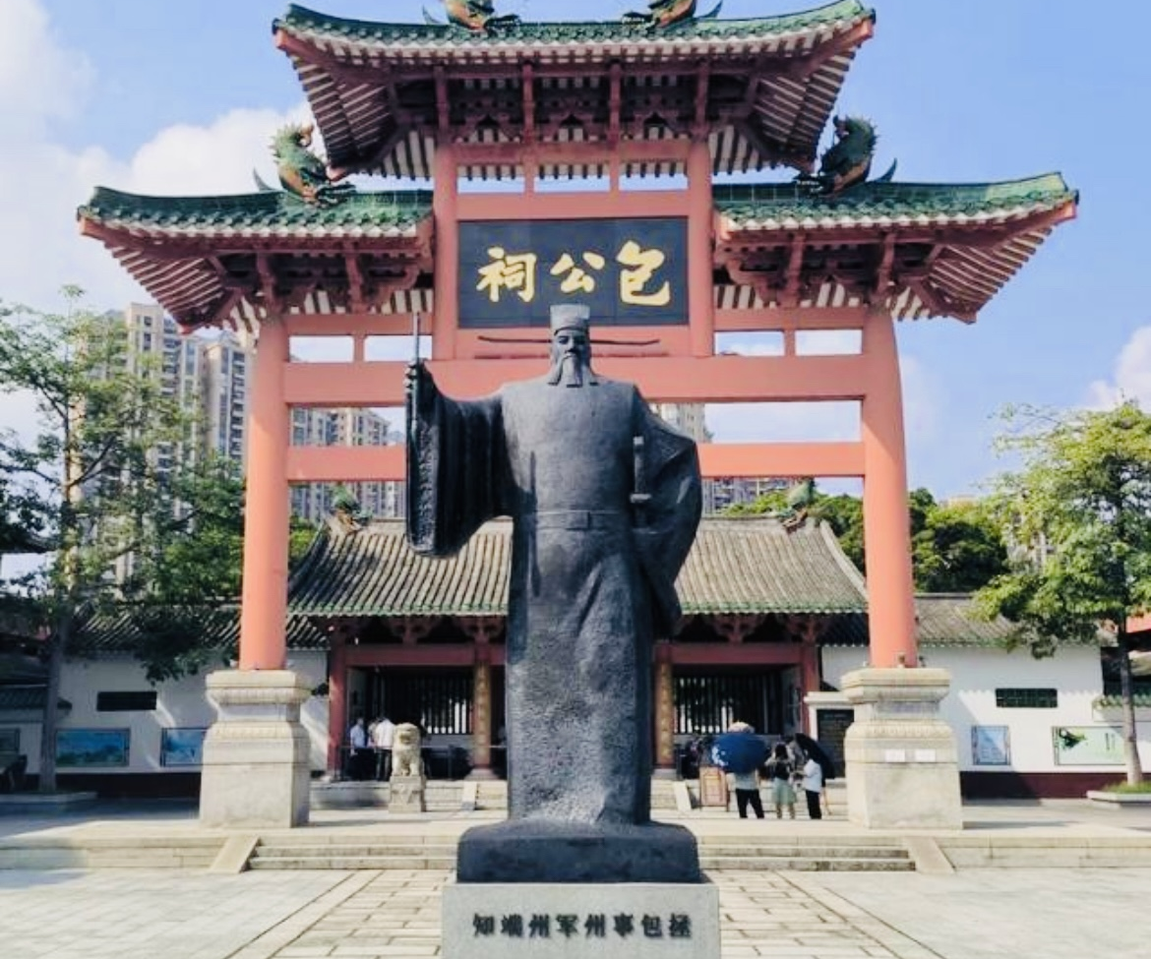
Hefei’s Attractions
Bao Ancestral Hall in Hefei
Bao Ancestral Hall, the full name of Bao Xiaosu Ancestral Hall, is located in Hefei, Anhui Province, on a mound in the eastern section of Huancheng South Road. It is a memorial hall for Bao Zheng, a minister of the Northern Song Dynasty. It was built in the Ming Dynasty and rebuilt in the Qing Dynasty. It covers an area of 10,000 square meters. Bao Gong Temple consists of a closed courtyard with white walls and green tiles. The main building is Bao Gong Ting Hall, sitting Bao Zheng tall statue, wall embedded black stone Bao Gong carved image, the majesty is not A, the performance of the "untouchable" black-faced Bao Gong's awe-inspiring righteousness. The west side of the pavilion is equipped with a corridor of curved pavilions; In the east there are 16 Longjing Pavilion stands, there are ancient wells, the number "Lian Quan." On September 8, 1981, Baogong Temple was announced by the Anhui Provincial People's Government as a provincial cultural relics protection unit in Anhui Province.

Slide 5
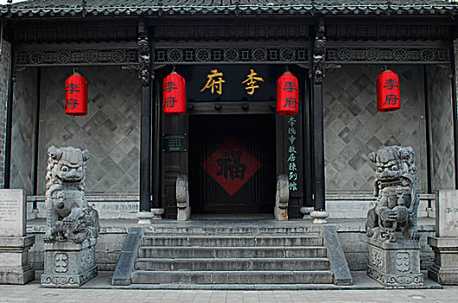
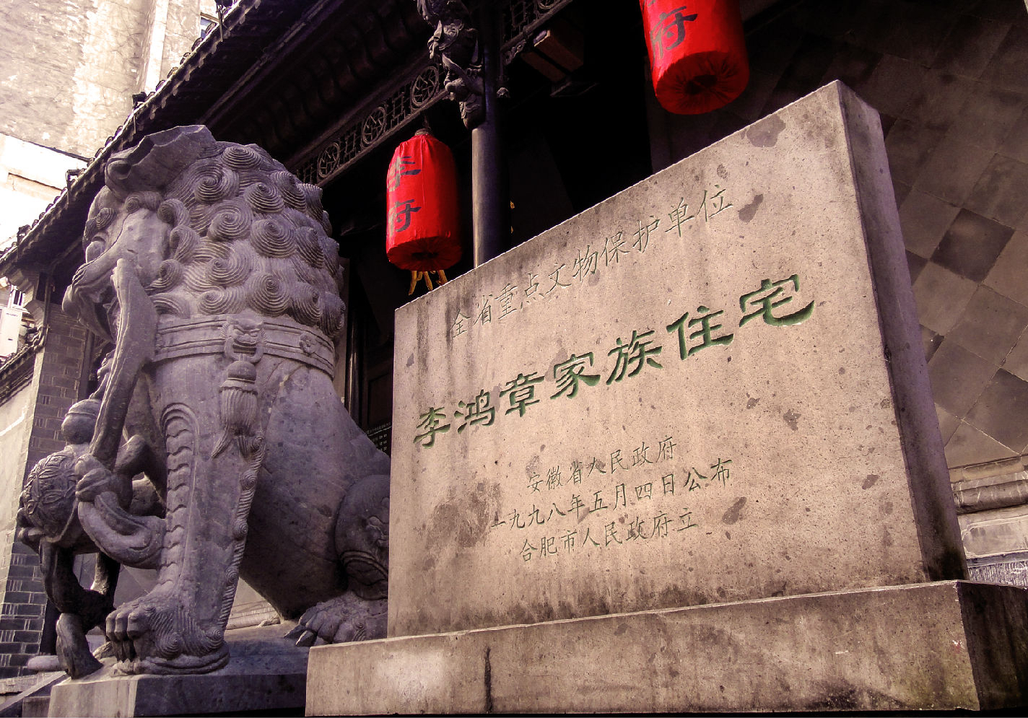
Hefei’s Attractions
Former Residence of Li Hongzhang
Hefei Li Hongzhang former residence, located in Hefei, Anhui Province, Luyang District, Huaihe Road, the middle section of the pedestrian street No. 208, is the late Qing Dynasty Li Hongzhang's home, typical of the late Qing Dynasty Jianghuai residential architecture. The former residence of Li Hongzhang covers an area of 3500 square meters and consists of the Li Mansion and the Huai Department Exhibition Hall.
The Li Mansion covers an area of 2000 square meters and the Huai Department Exhibition Hall covers an area of more than 1500 square meters. Li Fu is divided into five from south to north, followed by the foyer, lobby, the hall and Zouma Zhuan Xin Lou. The former residence is not only one of the "Top Ten Scenic Spots" of Hefei, but also the first choice of the public. It is listed as a national key cultural relics protection unit and a national AAAA tourist attraction.

Slide 6
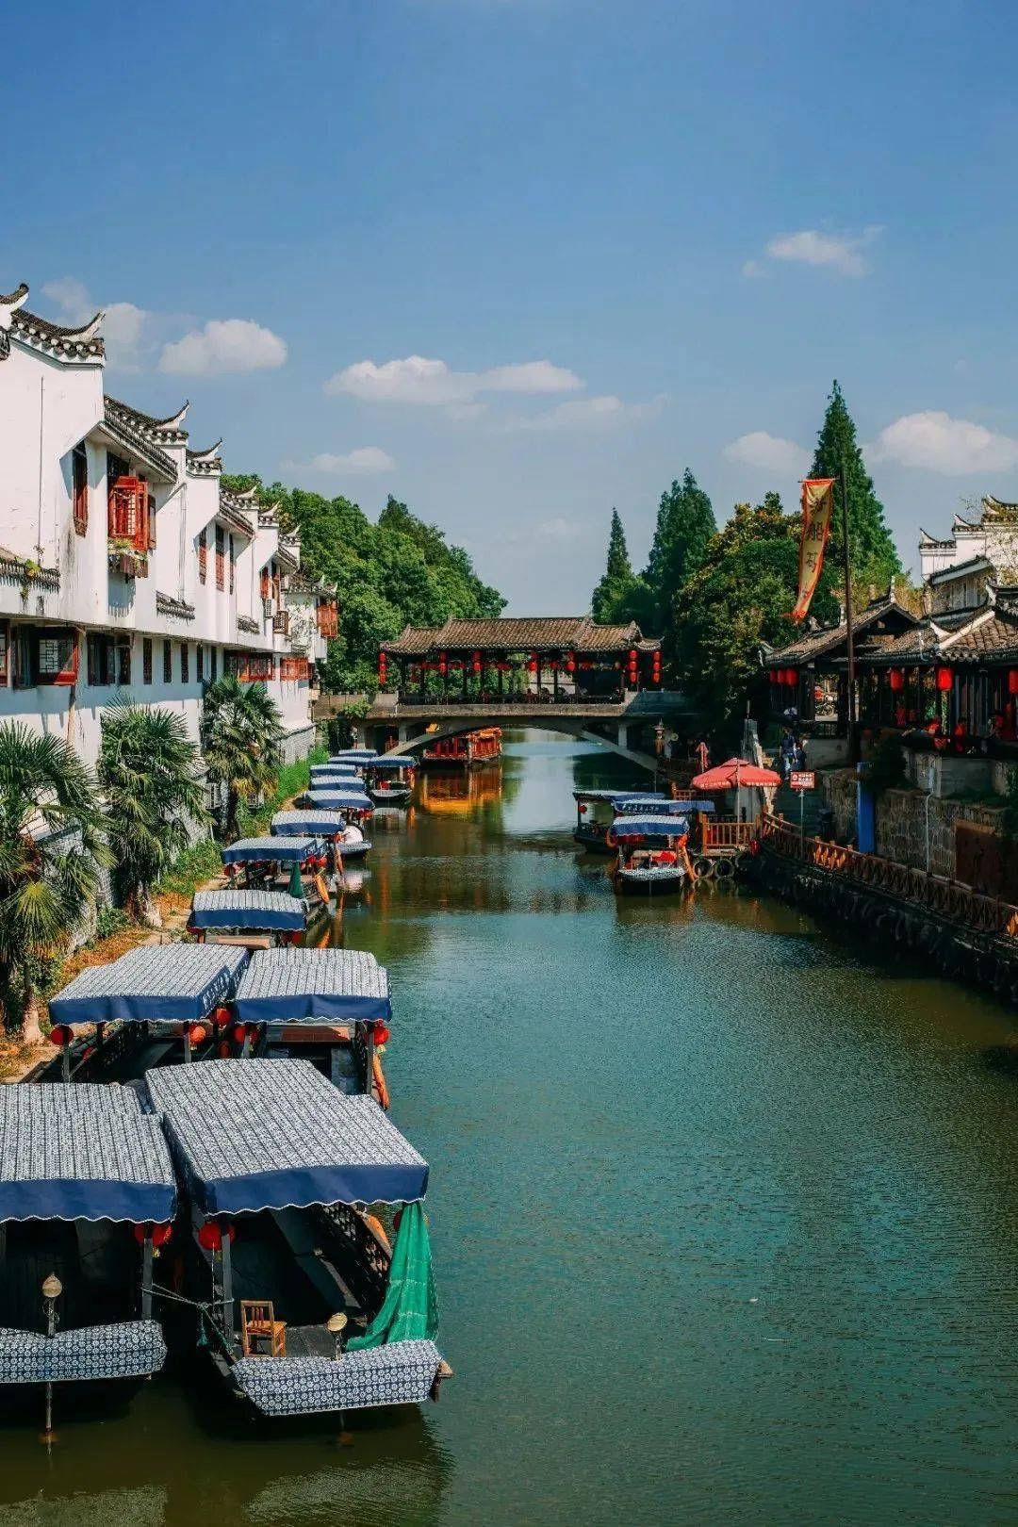
Hefei’s Attractions
Sanhe Ancient Town
Sanhe Ancient Town, the ancient name of Que Zhu, Que Wei (Zhu), Que An, is China's historical and cultural town, the national AAAAA level tourist attractions, located in the southern tip of Feixi County, Hefei City, Anhui Province, is located at the junction of Feixi, Lujiang, Shucheng, the ancient town with a total area of 2.9 square kilometers. Three River town was originally Chaohu in the high Island, due to sedimentation, gradually become land. In the late Northern and Southern Dynasties, said the three rivers, Ming and Qing Sanhe Town. Three River town has Fengle River, Hang River port, small Nanhe convergence in the territory, the new river flows eastward about 15 kilometers into Chaohu. In the town, there are ancient city walls, ancient artillery, the old site of the Taiping Army Command, Ying Wang Palace, One Lane, Ten thousand thousand meters, Li Fu grain warehouse, He Lu, Liu Tong Xinglong Zhuang, and other historical relics. It is the birthplace of the Lu opera. The ancient town has special products such as rice dumplings, beef sugar, sweet sugar, malt sugar, dried tea, and rice wine.

Slide 7

Hefei’s Attractions
Chaohu lake
Chaohu Lake, a large freshwater lake in central Anhui Province, belongs to the Yangtze River Basin and is one of the five largest freshwater lakes in China. It is not only geographically important, but also historically, culturally and ecologically significant. Chaohu has rich aquatic resources to whitebait, beautiful white shrimp and lake crab "three fresh" known, while the lake is rich in fish resources, such as lake coilia, red culter, "four big fish," carp, crucian carp and so on. In addition, Chaohu has good navigation conditions and a number of ports and docks along the lake, which have promoted the economic development of the local and surrounding areas. Chaohu Lake is not only an important natural resource, but also a tourist attraction. Laoshan Island scenic area, tulip highland scenic area and Chaohu wetland park are tourists favorite places. These scenic spots not only show the natural beauty of Chaohu Lake, but also provide a rich tourist experience.

Slide 8
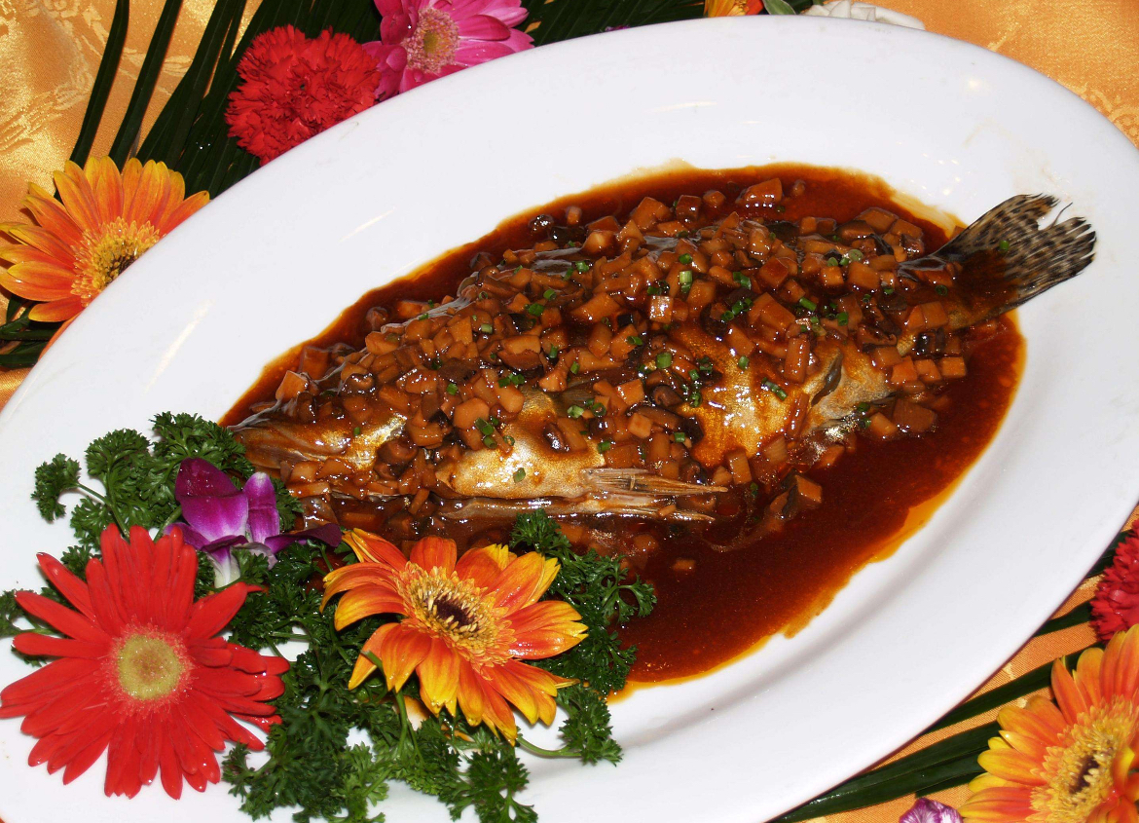
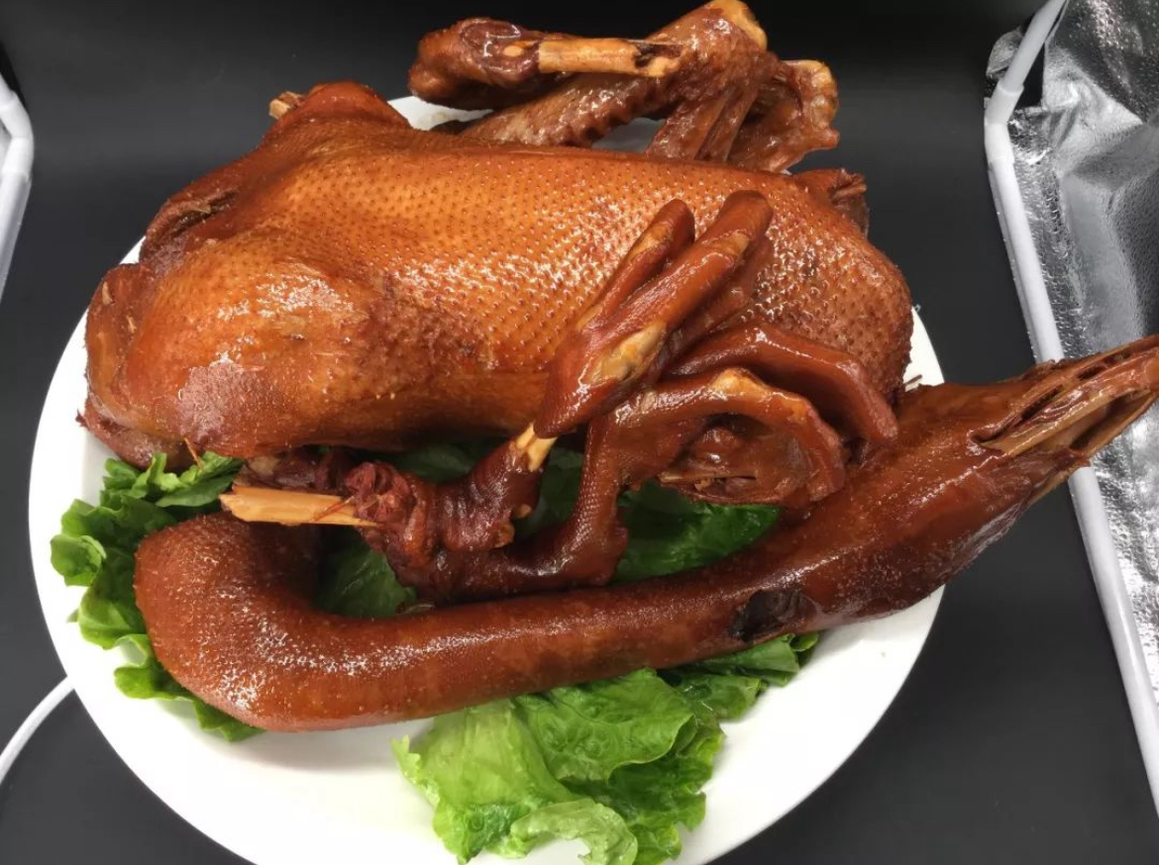
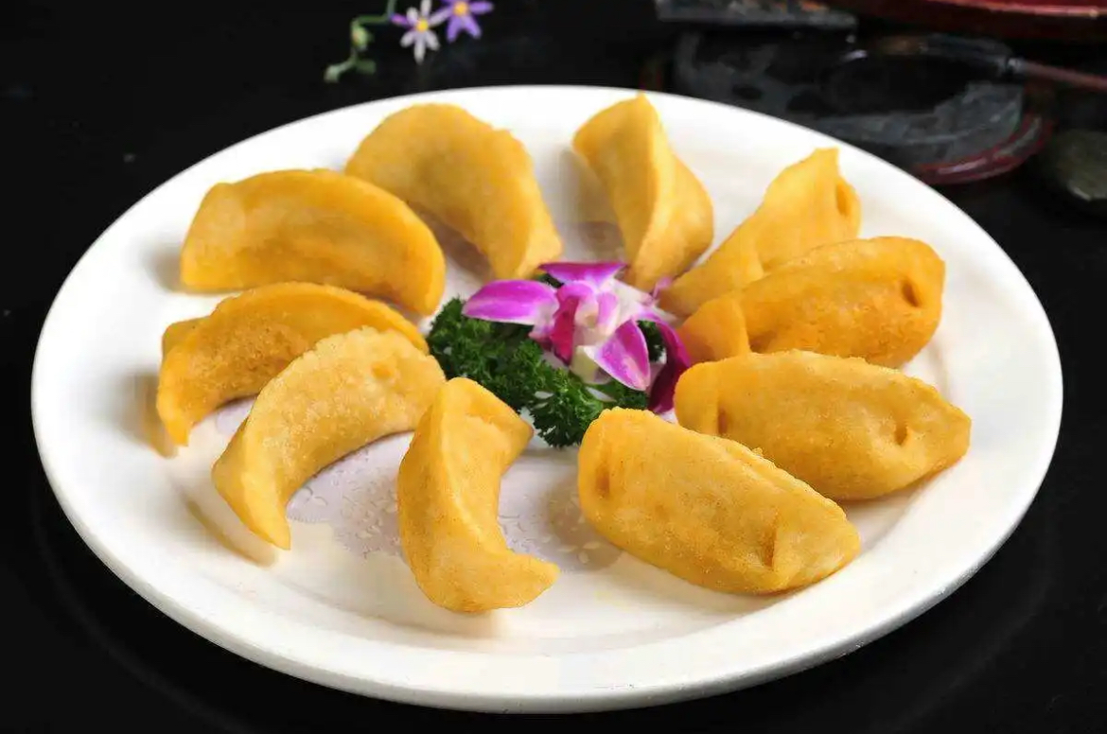
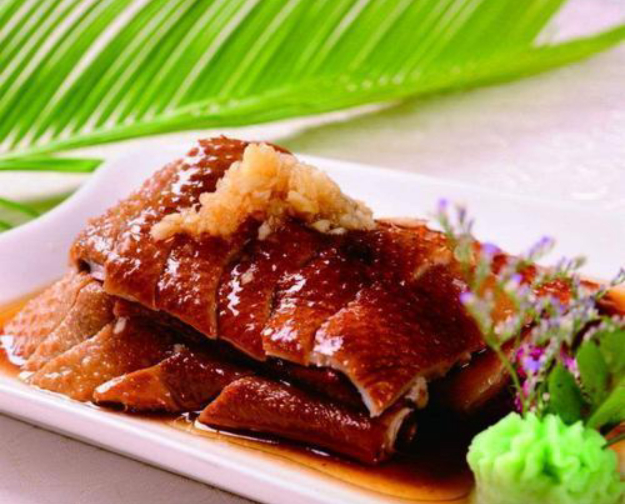
Local Food
Preserved mandarin fish（臭鳜鱼）
Wu Shan Gong Goose （吴山贡鹅）
Three Rivers Rice Dumplings （三河米饺）
Luzhou roast duck （庐州烤鸭）

Slide 9
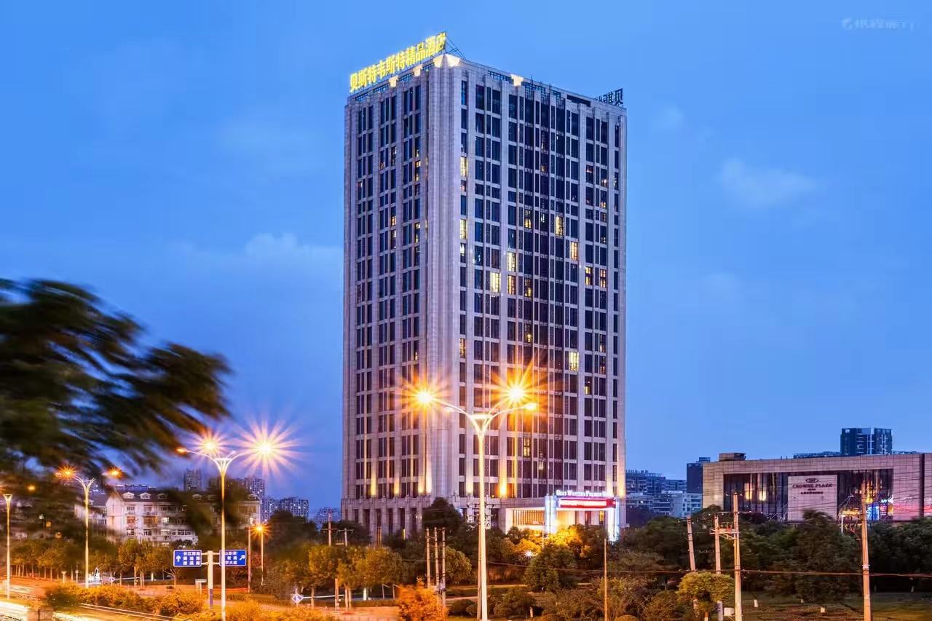
Hotel
Best Western Premier Hotel Hefei
Best Western Premier Hotel Hefei is a top brand under the world's largest single hotel group, Best Western. The hotel is located at the intersection of Mount Huangshan Road and West 2nd Ring Road, Shushan District, Hefei, adjacent to 1912 Bar Street.
Please take me to Best Western Premier Hotel Hefei,
address:Building B, No.598, Huangshan Road, High-tech Zone, Hefei, Anhui 230088
Tel:0551-62971777
请送我去合肥贝斯特韦斯特精品酒店
地址：合肥市蜀山区黄山路598号B座
电话：0551-62971777

Slide 10
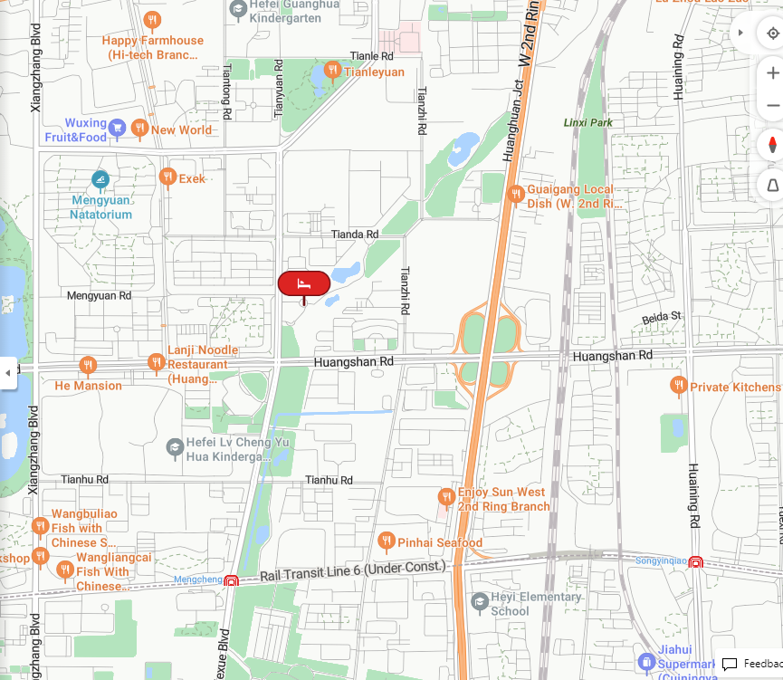
Hotel Location
Best Western Premier Hotel Hefei

Slide 11
Meeting Room Allocation-MON
Date | Time | Event | Function room/Capacity
14th Oct (MON) | 9:00-20:00 | RAN3-1 | Huangshan Hall (25F)/120
 | 9:00-20:00 | RAN3-2 | Huasong Hall (25F)/30
 | 10:30-11:00/ 16:30-17:00 | Coffee Break | Foyer

Slide 12
Meeting Room Allocation-TUE
Date | Time | Event | Function room/Capacity
15th Oct (TUE) | 8:30-20:00 | RAN3-1 | Huangshan Hall（25F）/120
 | 8:30-20:00 | RAN3-2 | Huasong Hall（25F）/15
 | 10:30-11:00/ 16:30-17:00 | Coffee Break | Foyer

Slide 13
Meeting Room Allocation-WED
Date | Time | Event | Function room/Capacity
16th Oct (WED) | 8:30-20:00 | RAN3-1 | Huangshan Hall（25F）/120
 | 8:30-20:00 | RAN3-2 | Huasong Hall (25F)/15
 | 10:30-11:00/ 16:30-17:00 | Coffee Break | Foyer

Slide 14
Meeting Room Allocation-THU
Date | Time | Event | Function room/Capacity
17th Oct (THU) | 8:30-20:00 | RAN3-1 | Huangshan Hall（25F）/120
 | 8:30-20:00 | RAN3-2 | Huasong Hall (25F)/15
 | 10:30-11:00/ 16:30-17:00 | Coffee Break | Foyer

Slide 15
Meeting Room Allocation-FRI
Date | Time | Event | Function room/Capacity
18th Oct (FRI) | 8:30-17:00 | RAN3-1 | Huangshan Hall（25F）/120
 | 8:30-17:00 | RAN3-2 | Huasong Hall (25F)/15
 | 10:30-11:00 | Coffee Break | Foyer

Slide 16


Time: 19:10 - 20:30
Date: 15 October, 2024 (Tuesday）
Venue：Fiesta Café（菲亚斯特咖啡厅）, 2F, Crowne Plaza
Sponsored by:
Welcome Social Event

Slide 17
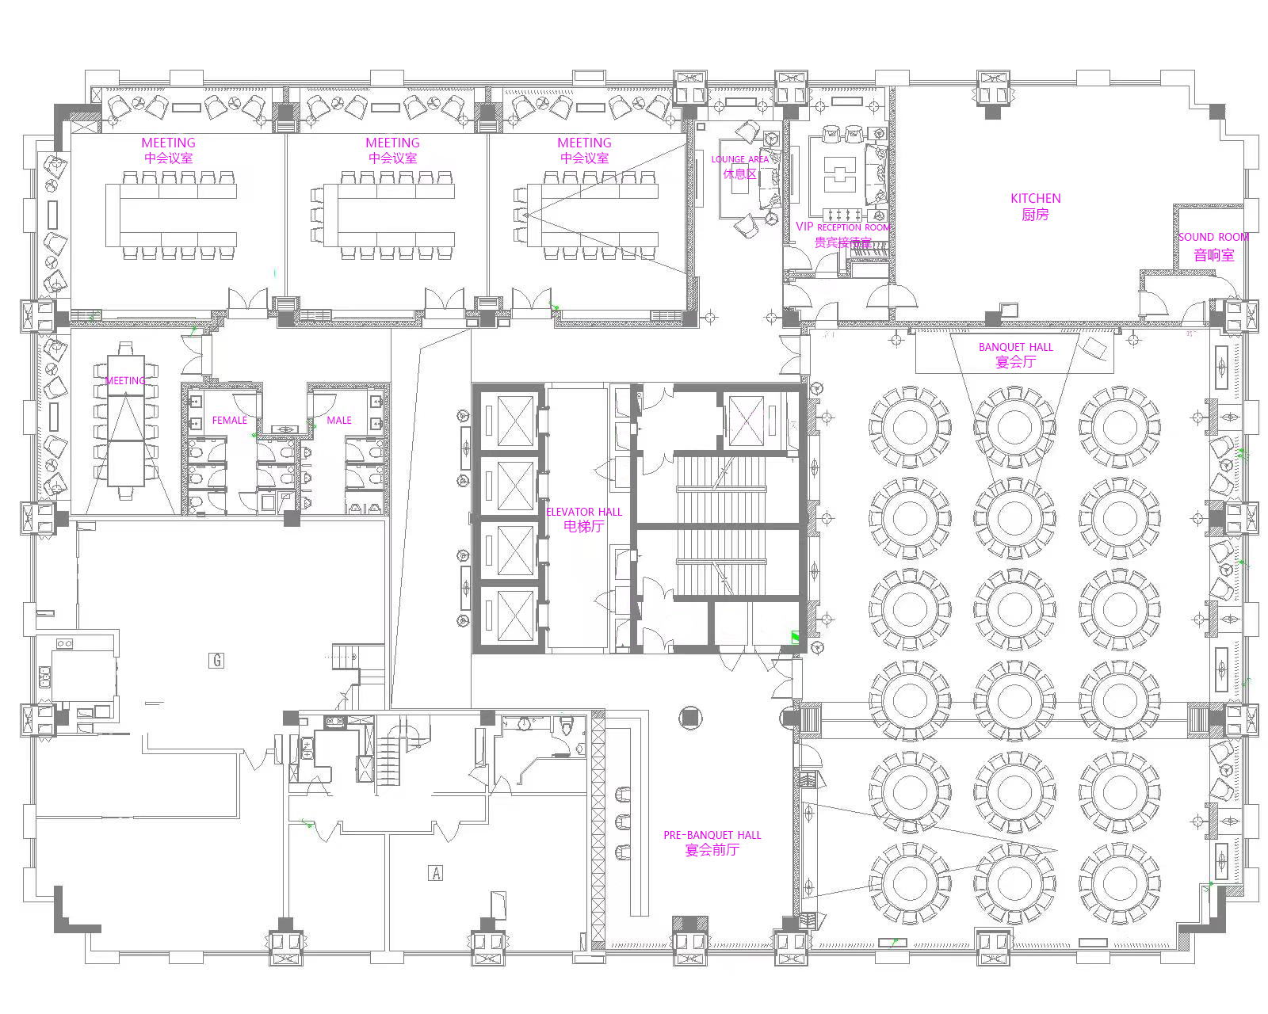
Meeting Room Map
23th floor

Slide 18
Chinese restaurant room menu
Menu | unit price
Tomato and egg noodles | twenty-eight yuan
Noodles with Shredded Pork and pickled Chinese cabbage | Thirty-eight yuan
Braised beef noodle | forty-eight yuan
Pork Intestine noodles | forty-eight yuan
Beef rice | forty-eight yuan
Sautéed Shredded Pork with Green Pepper rice | Thirty-eight yuan
Tomato egg rice | twenty-eight yuan
Green pepper, potato, shredded pork rice | twenty-eight yuan
Note: Delivery requires an additional 15% service fee
Ordering hotline: 0551-62971777 ext. 1077
Business hours: 11:00-14:00 17:00-21:00

Slide 19
Dreamland Cafe menu
Menu | unit price
Tuna Sandwich | fifty-eight yuan
Bacon Sandwich | fifty-eight yuan
Bacon Cheese Beef Burger | seventy-eight yuan
Sirloin Steak | one hundred and sixty-eight yuan
Roasted Lamb Chop | one hundred and sixty-eight yuan
Fruit Salad | forty-eight yuan
Vegetable Salad | forty-five yuan
Cream Spaghetti | fifty-eight yuan
Note: Delivery requires an additional 15% service fee
Ordering hotline: 0551-62971777 ext. 2658
Business hours: 07:00-14:00

Slide 20


How to Use Alipay and WeChat Pay
Alipay and WeChat Pay are two important payment methods in China. Learning how to use them will make your travel to China much easier. Click on the PDF link below to learn more.

Slide 21
Meeting Staff
If you need any assistance during your stay, you may go to staff at the Information desk outside the meeting room.For any emergency please contact us at:
CCSA Mr. Fu Jiang (+86-13488771245)

Slide 22
Have a successful meeting and
enjoy your stay in Hefei!

