Slide 1


THANKS FOR 4 YEARS
3GPP RAN3

Slide 2
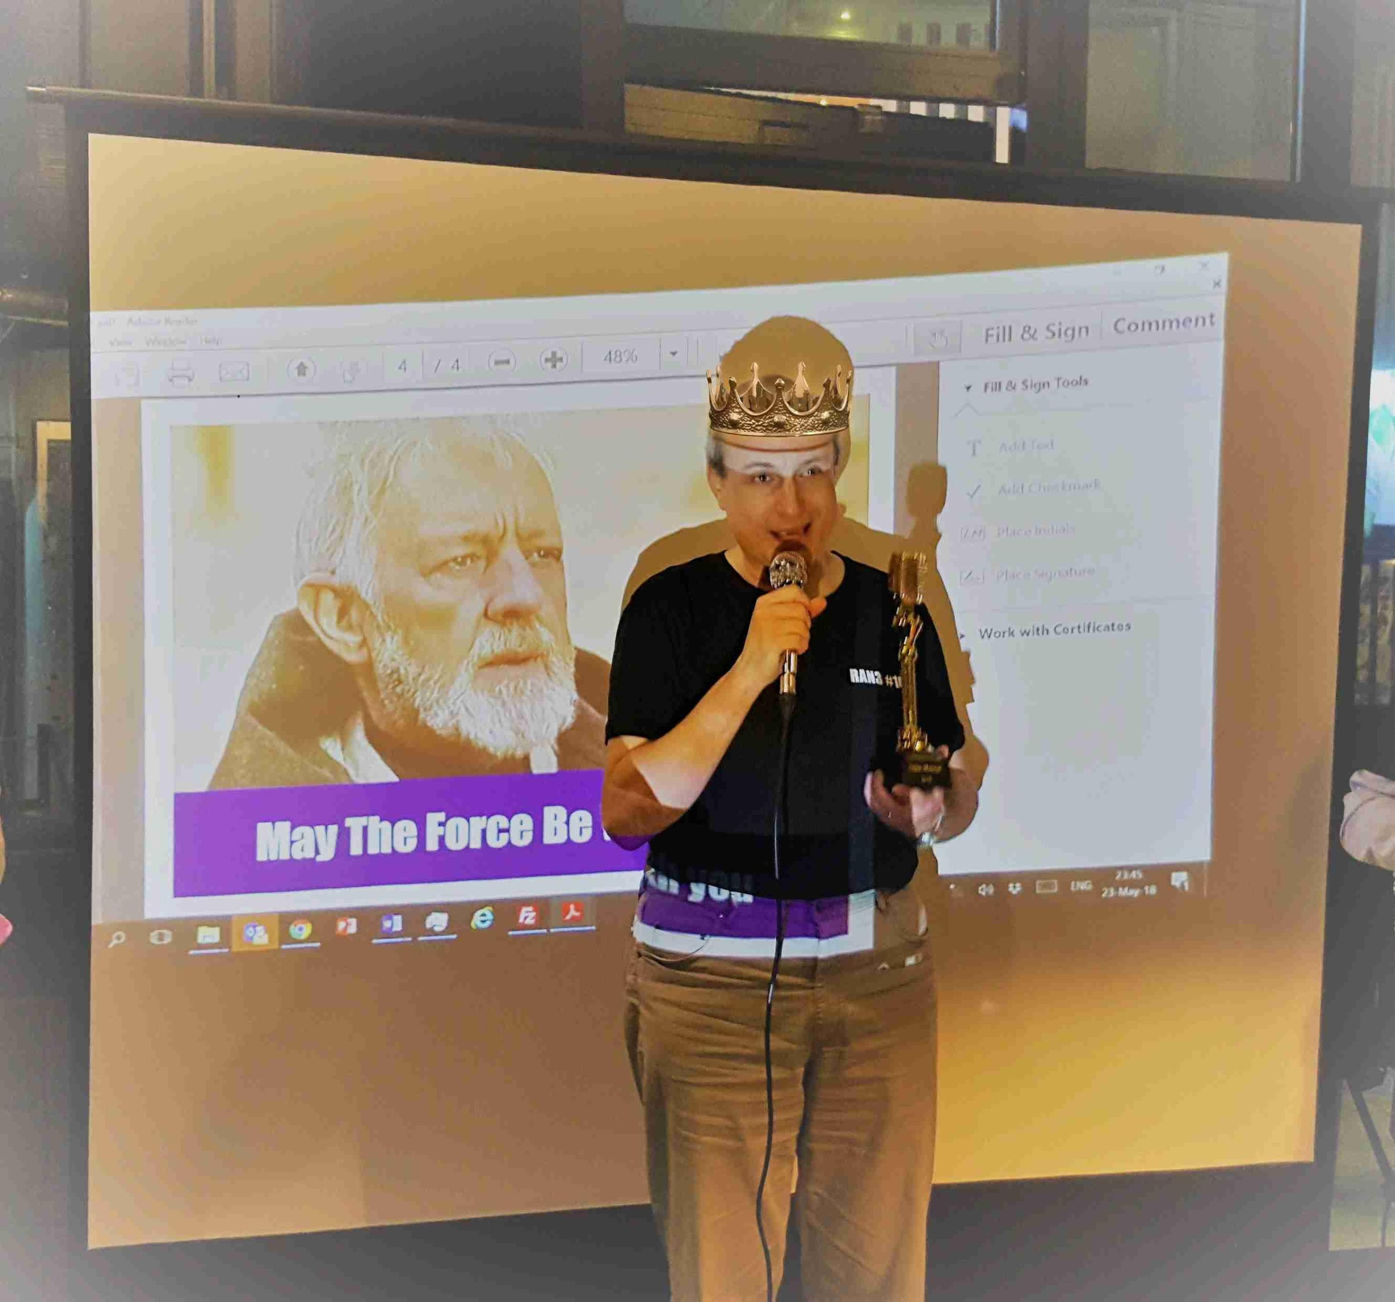
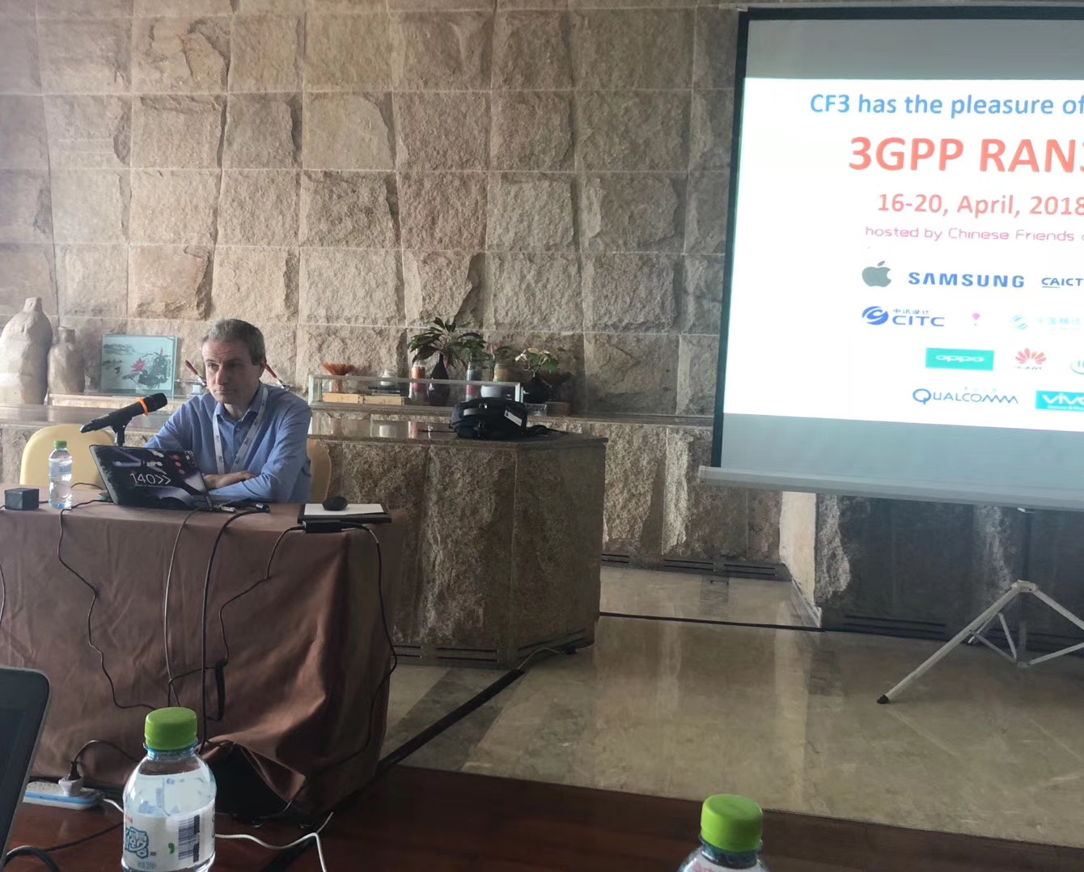
To Gino
Gino, thanks for your excellent leadership and setting up a super-efficient working model for RAN3 e-meetings, impressed by your amazing job for the last 4 years ! It’s my honor and pleasure to work with you in RAN3!
Wish you the best in the future.
ZTE - Yin Gao
It is a great honor to have completed many difficult tasks while you were presiding over RAN3. I am very impressed by your seriousness and professionalism.
I wish you all the best in your future work.
ZTE - Dapeng Li
Gino, thanks very much for your contribution to chairing the RAN3 session. Your patience and carefulness always make the controversial sessions well-arranged.
May you have a successful career in your future.
ZTE – Zijiang Ma

Slide 3
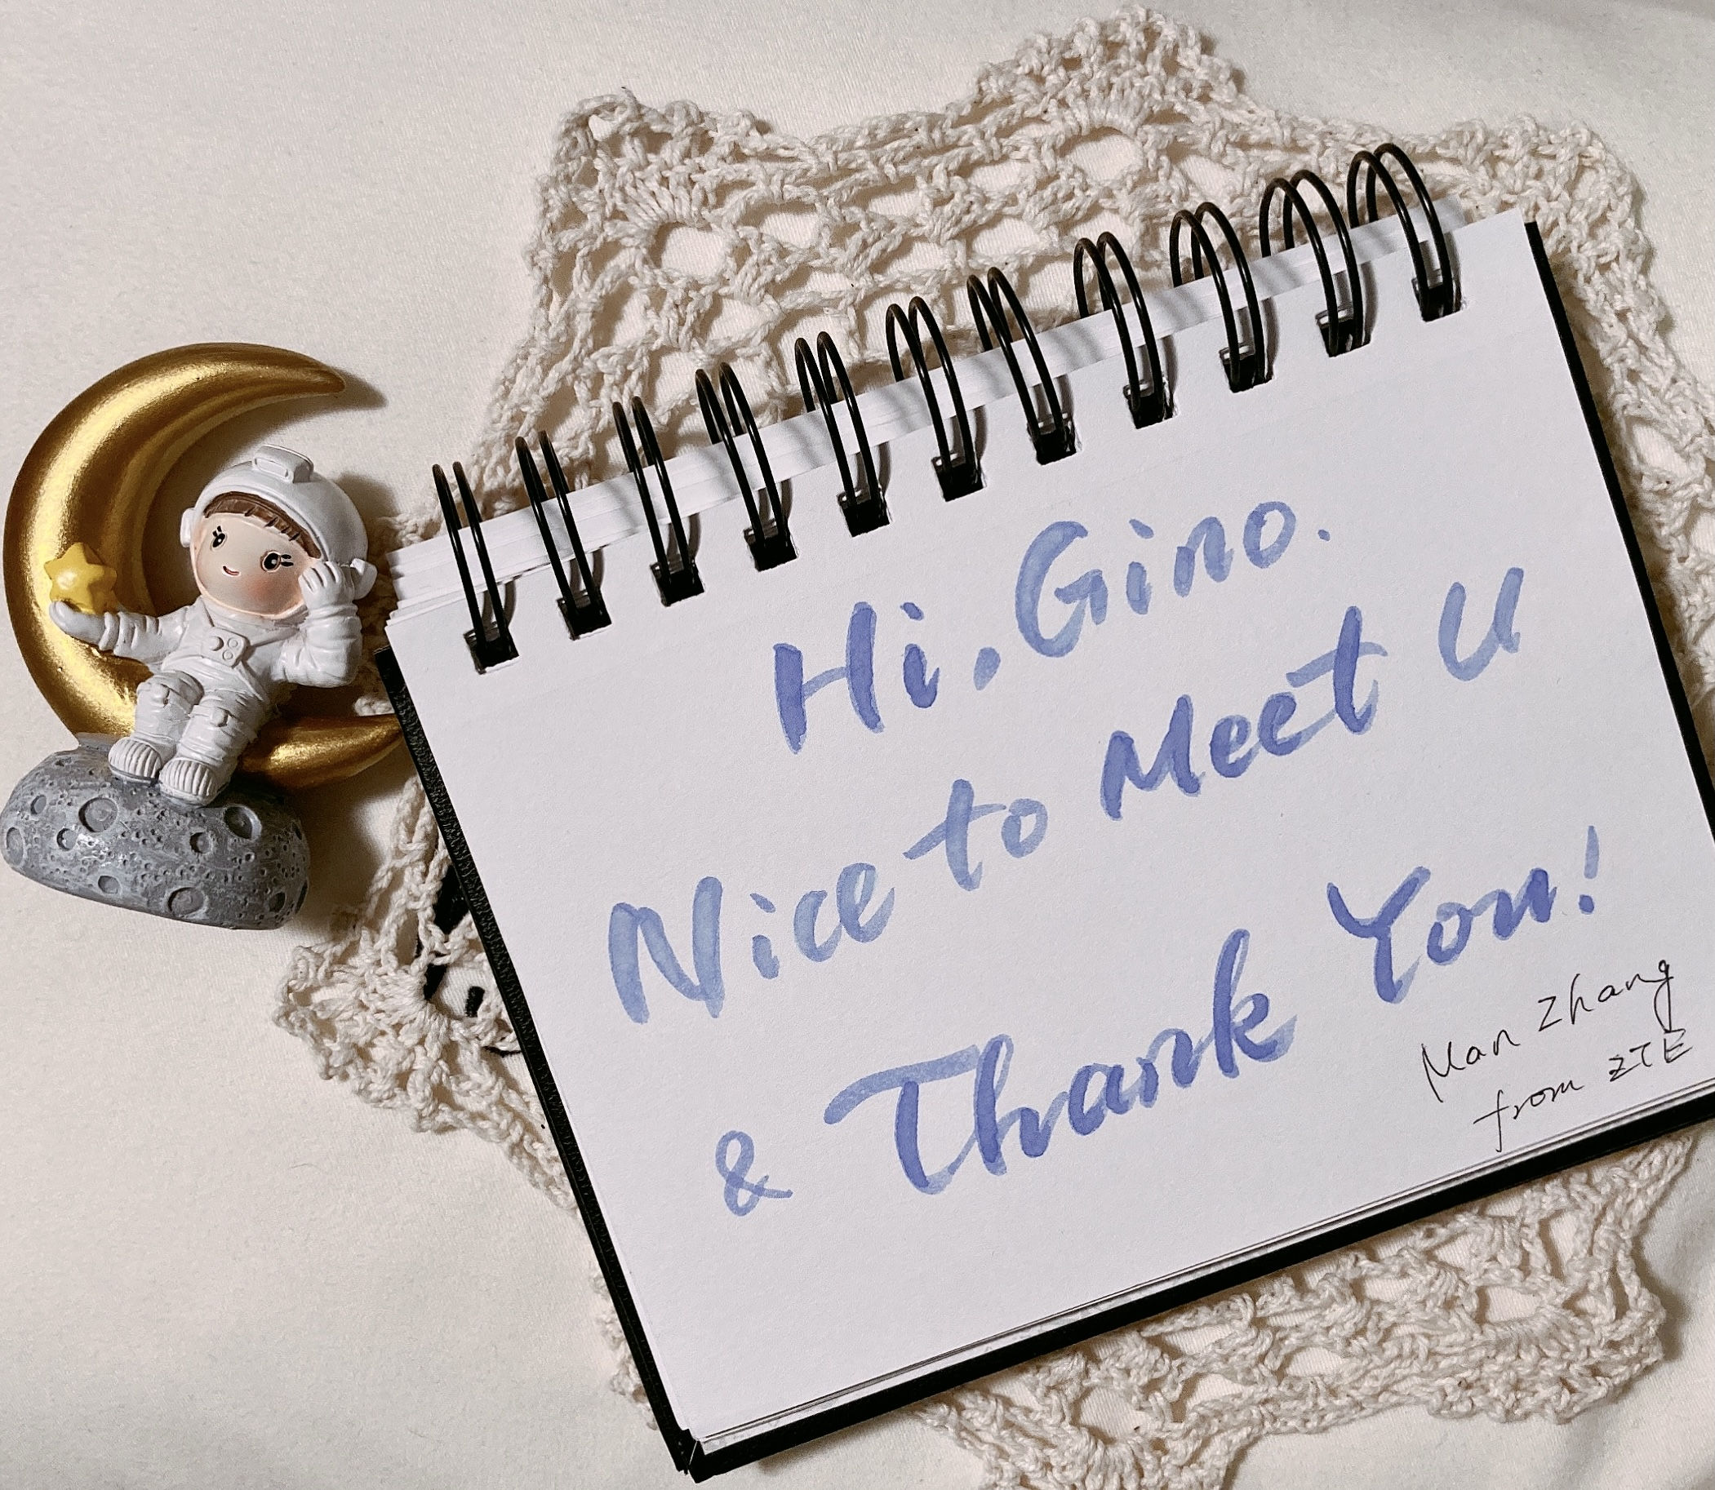
To Gino
Dear Gino,
I am a fresher in the RAN3 family. I haven’t even seen you so far, but I can see from the pictures that you are supposed to be an amiable and respectable person. Under your leadership, discussions on all subjects are proceeding smoothly.
Hope to see you in future meetings. Wish you all the best in the future.
ZTE – Jiajun Chen
Dear Gino,
Thanks for your devotion to RAN3 in the past four years. I remember that the first time I met you was April, 2018, the RAN3#99bis meeting. When you heard that it was my first time to attend RAN3 meeting, you gave me your card and encouraged me to be confident.
Really appreciate it! Wish you the best in the future!
ZTE – Jiren Han
Thank you Gino, you made RAN3 meeting so much fun!(Sigh.. Do I still have the opportunity to get a reward from RAN3 Chairman?)
ZTE – Qi Tao

Slide 4
To Gino
Thanks a lot for your great leadership and services you have devoted for the sake of RAN3.
For the past 4 years, each and every meeting, I was able to feel your dedication to conduct and improve our meeting discussions in an effective and efficient manner, which I truly believe your commitment as RAN3 chairman is the very reason for our successful accomplishments.
I’ve learned a lot through watching your well-arranged chairing, navigating heated discussions smoothly, and (mostly importantly) ensuring progress and world-class specifications at every moment, while enjoying your humor and masterful voice :)
Best wishes for your next mission, with a hope that your passion still remains here for RAN3. I will be looking forward to meeting you face to face in the near future.
Intel - Jaemin Han

Slide 5
To Gino
I have never met you due to a pandemic situation, but thank you for your hard work as RAN3 chair. You were my first chair since I have started MCC work in 2020, and although there were a lot of inexperienced work of me, but thanks to you, the meeting have gone well without any major problems.
Thank you again for leading the RAN3 meeting with great leadership.
I am looking forward to meeting you face to face in 2022 when the pandemic is over.
MCC - Young IK
Thank you very much, Gino for your great leadership! RAN3 needs a strong leader, in both RAN3 protocols expertise and how to manage meeting, and through your leadership you have proven being such a leader.
Thank you for guidance on SI/WI organization with and without specific allocated TU. I wish you continued success personally and professionally!
Vivo – Boubacar Kimba

Slide 6
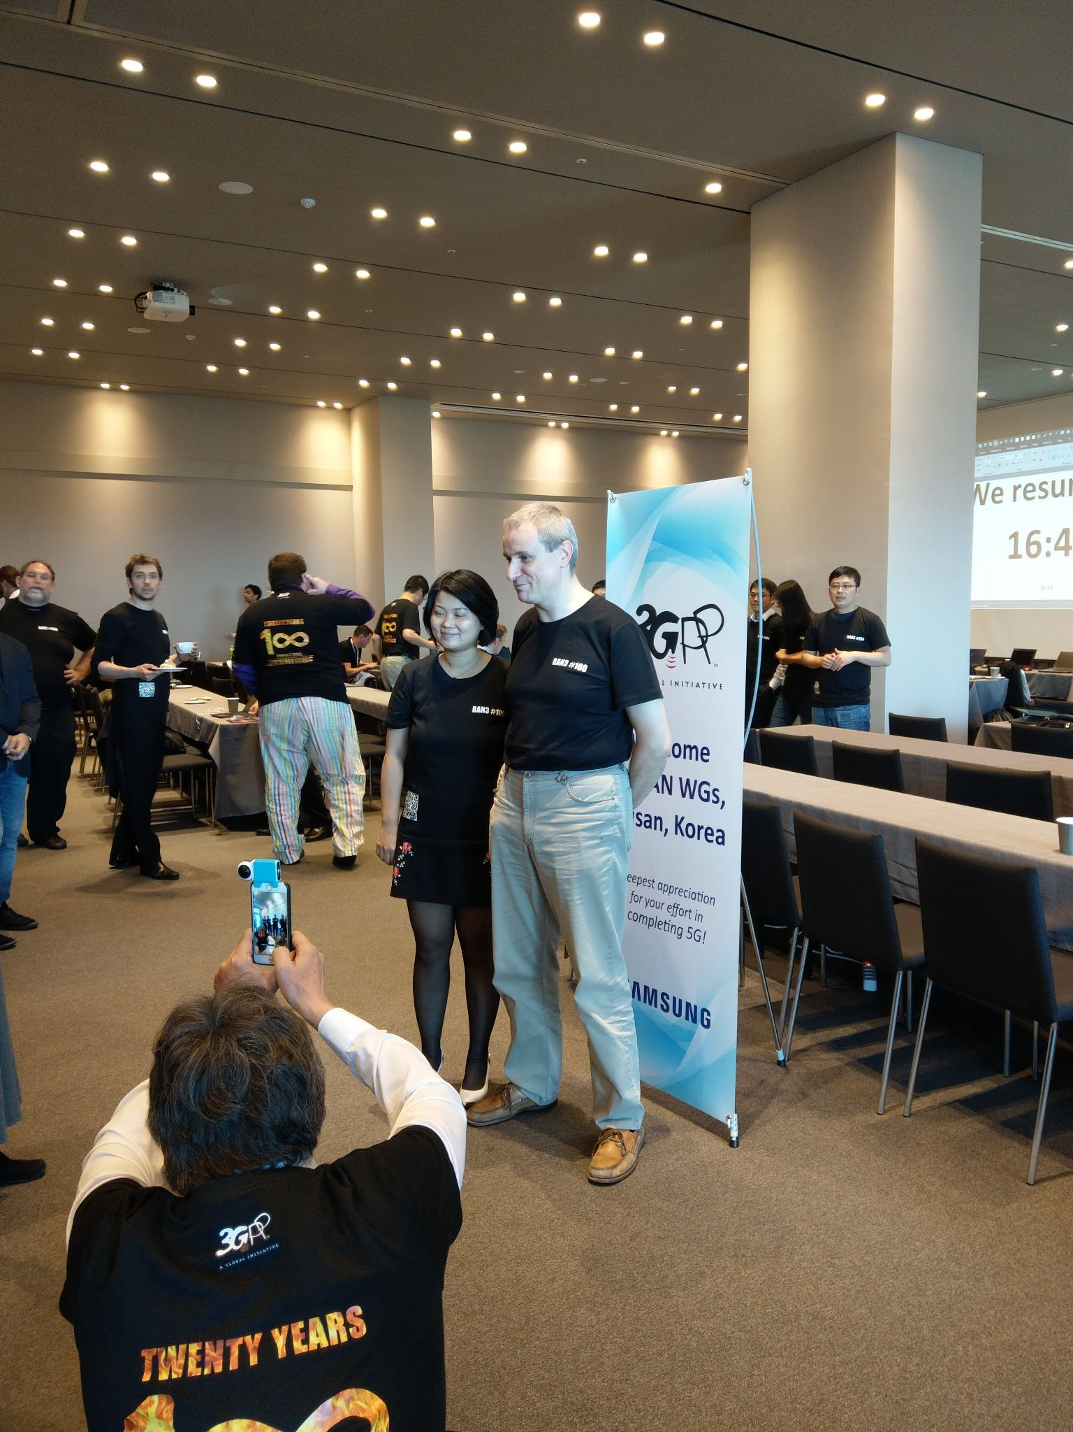
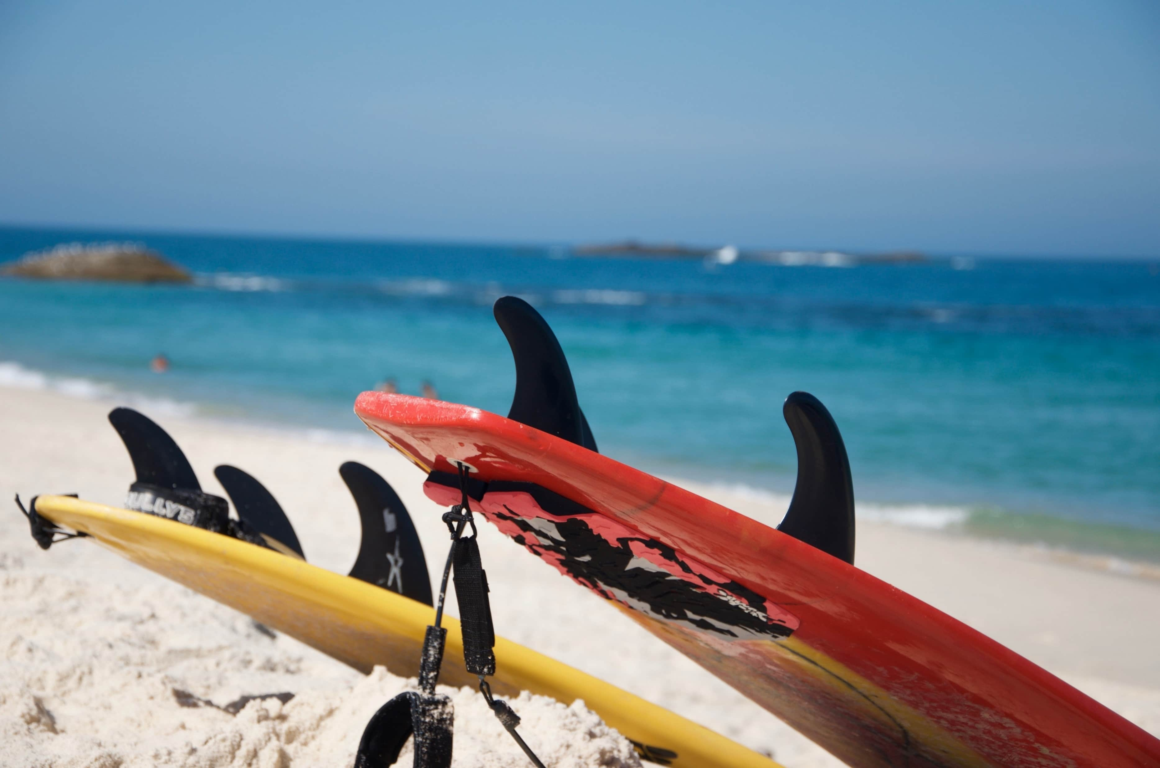
To Gino
It has been a pleasure to join RAN3 with you as our chairman since the Sanya and Busan meeting back in early 2018 when we were still free to travel around the world. I do learn a lot from you for the meeting protocols and I am also impressed by your efficiency and humor in conducting RAN3 meetings.
Thank you for moving the RAN3 specifications forward and the kindness in getting a fresh RAN3 delegate on board. Cheers!
Google – Jing-Rong Hsieh

Slide 7
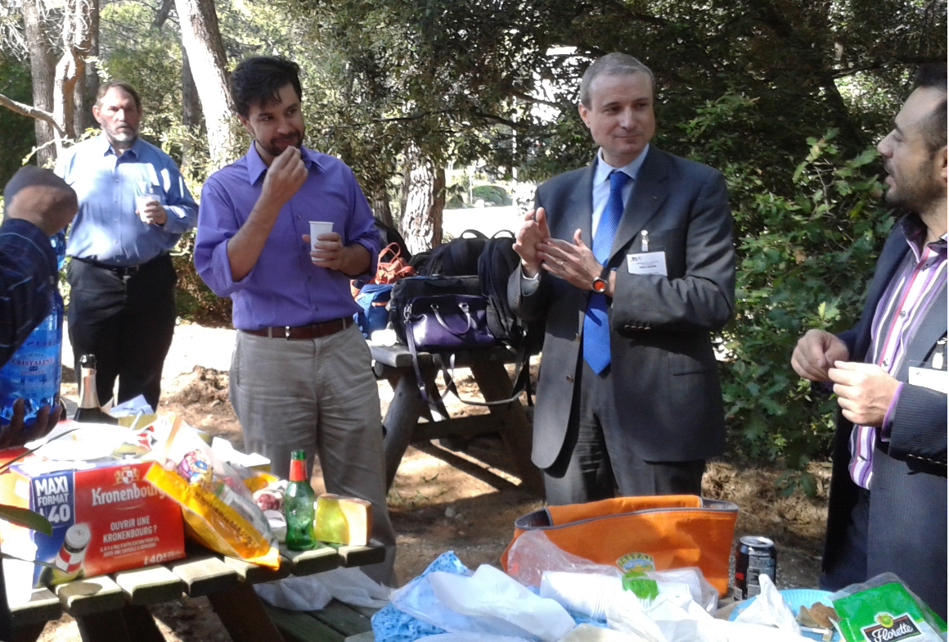
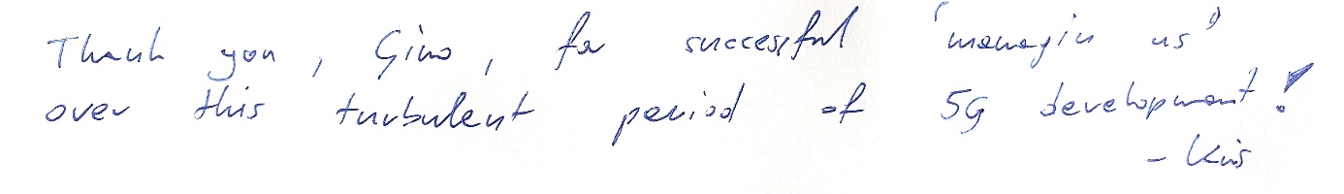
To Gino
Thank you Gino for a successful 4-years term. It was not easy to drive us through the turbulent period and you managed it. I hope you stay in RAN3 and we can celebrate this event soon face to face in the new “vaccinated world” - with food and wine around the team as below:
Nokia - Philippe G.
It has been a very eventful 4 years... Thanks for managing us through both a novel technology and a novel virus. Best wishes for whatever comes next, hopefully it will still involve RAN3!
Nokia – Sean

Slide 8
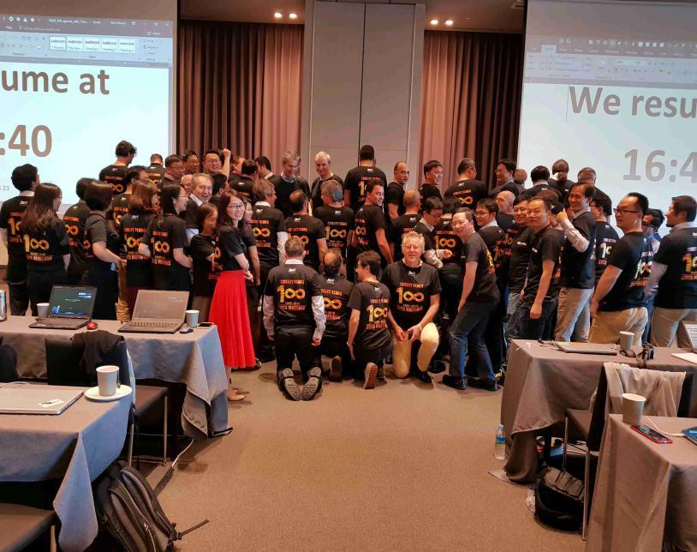
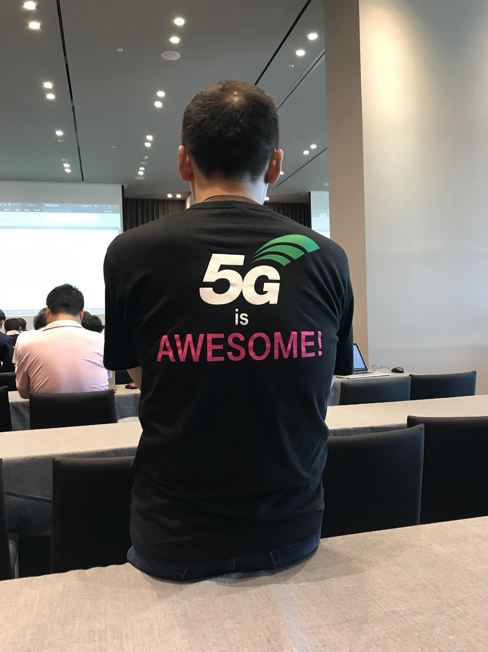
To Gino
Thanks Gino for 4 years chairing, we have achieved many fruitful result in RAN3 specifications, that lead also for future more advanced possibilities to have 3GPP as the world specifications.
NEC - Chenghock Ng

Slide 9
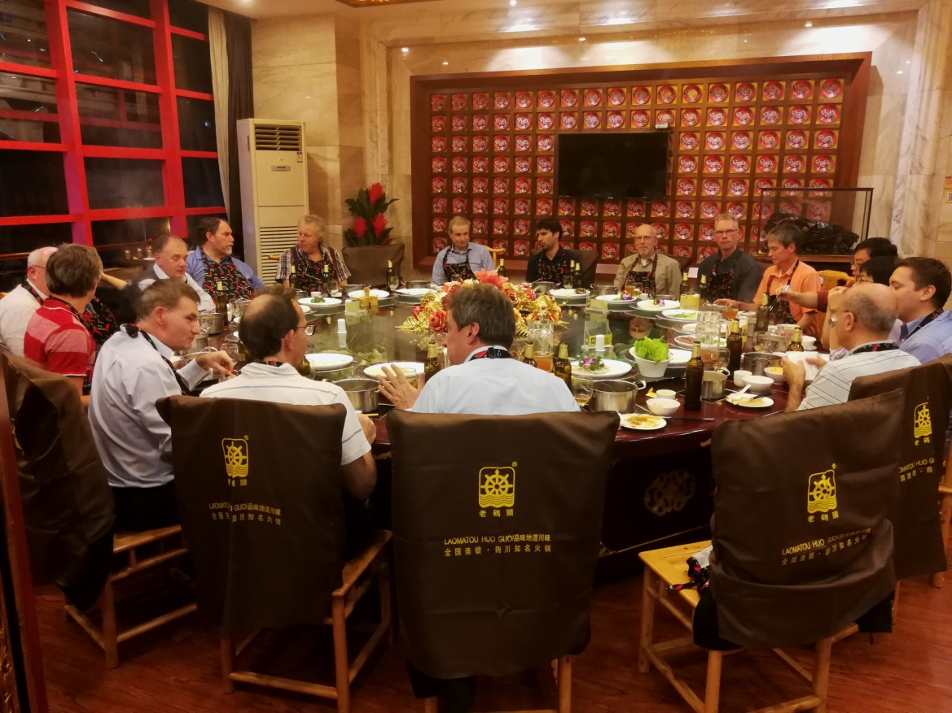
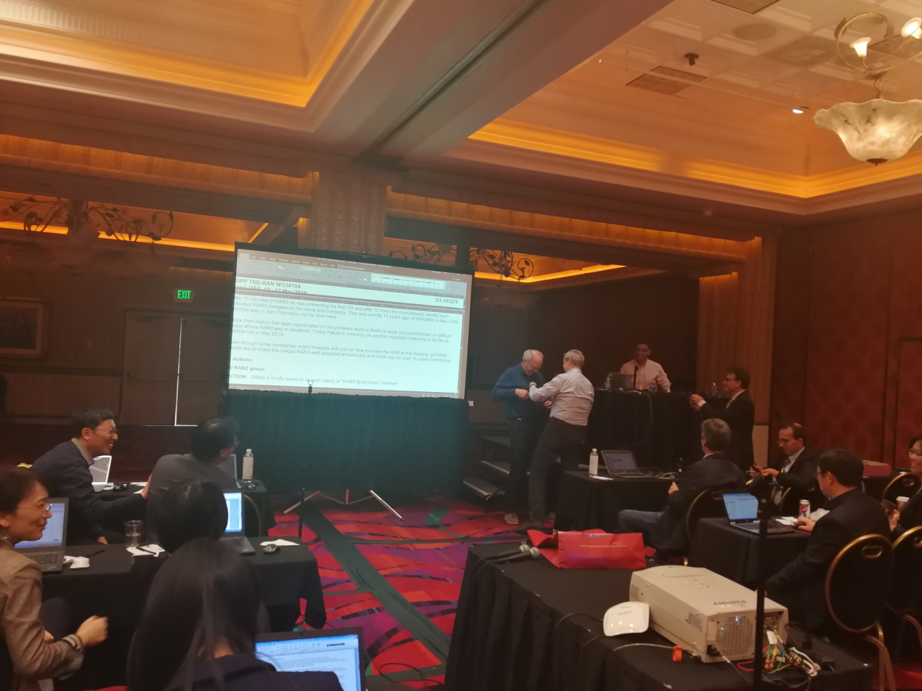
To Gino
Thanks Gino for your leadership in the past four years with fairness, openness and efficiency. You are actually the first RAN3 Chairman that I was staying with since the time taking office to the time outgoing the chairman position. We received significant support and guidance from you on many aspects e.g., TU allocation, SI/WI organization, way forward on some contentious topics.
Hope to have a face-to-face party with you in the near future, and have a chance to taste the delicious food cooked by you.
CMCC - Liang LIU

Slide 10
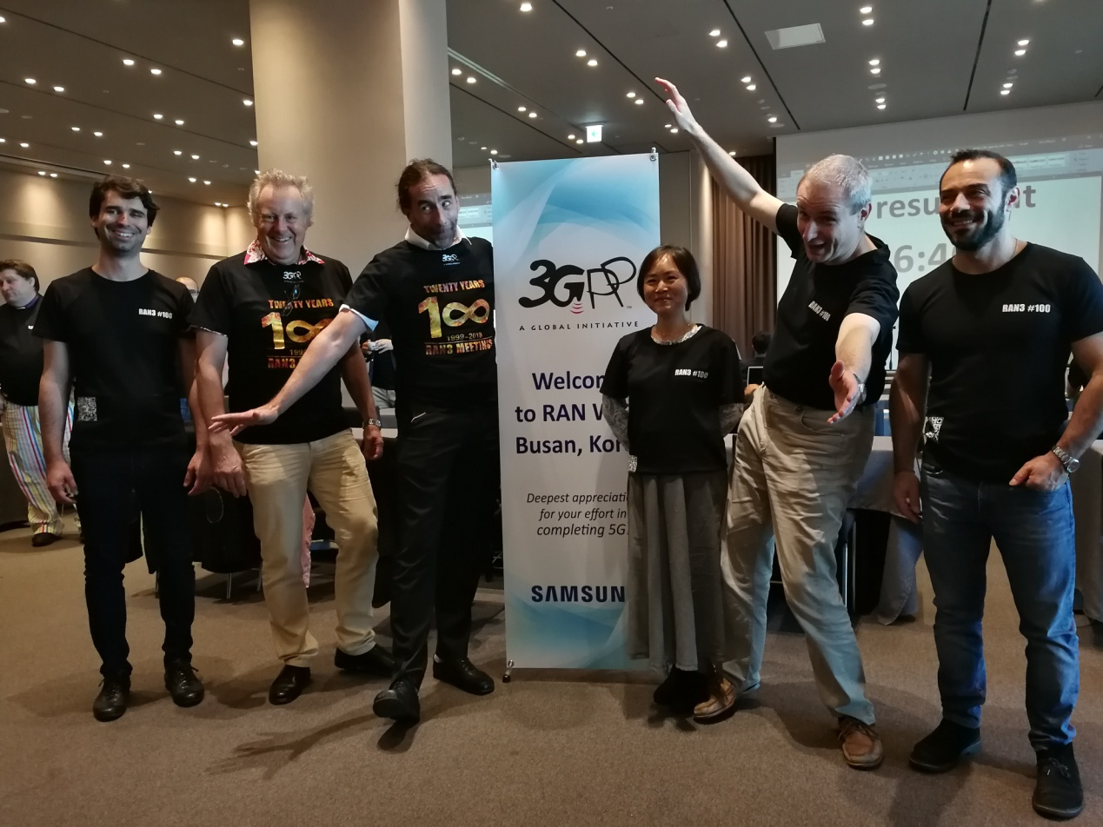
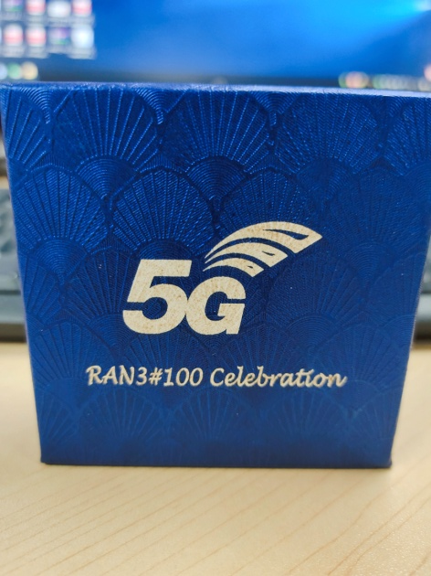
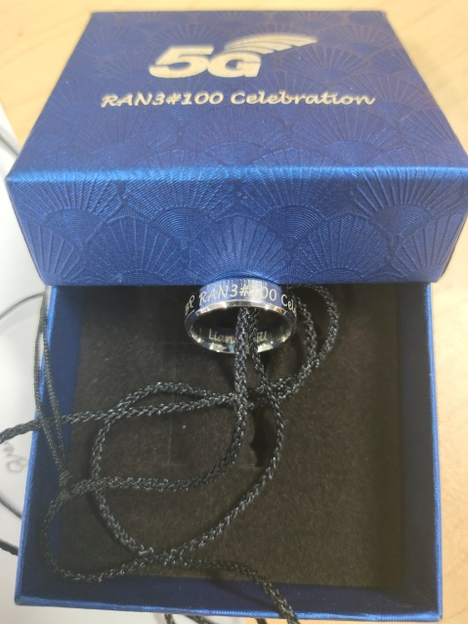
To Gino
I really appreciate your chairmanship with the spirit of equality, transparency and efficiency. Wish you happy and healthy life, and hope to meet you face-to-face in the very near future.
CMCC - Xingyu Han
Thanks to Gino for your leadership in presiding over 3GPP meetings in last four years. Under your leadership, meetings run smoothly and remain orderly, and delegates in all companies work at a consensus in specification decisions. Wish you happiness, and joy in your future life.
CMCC - Miaoqi Zhang

Slide 11
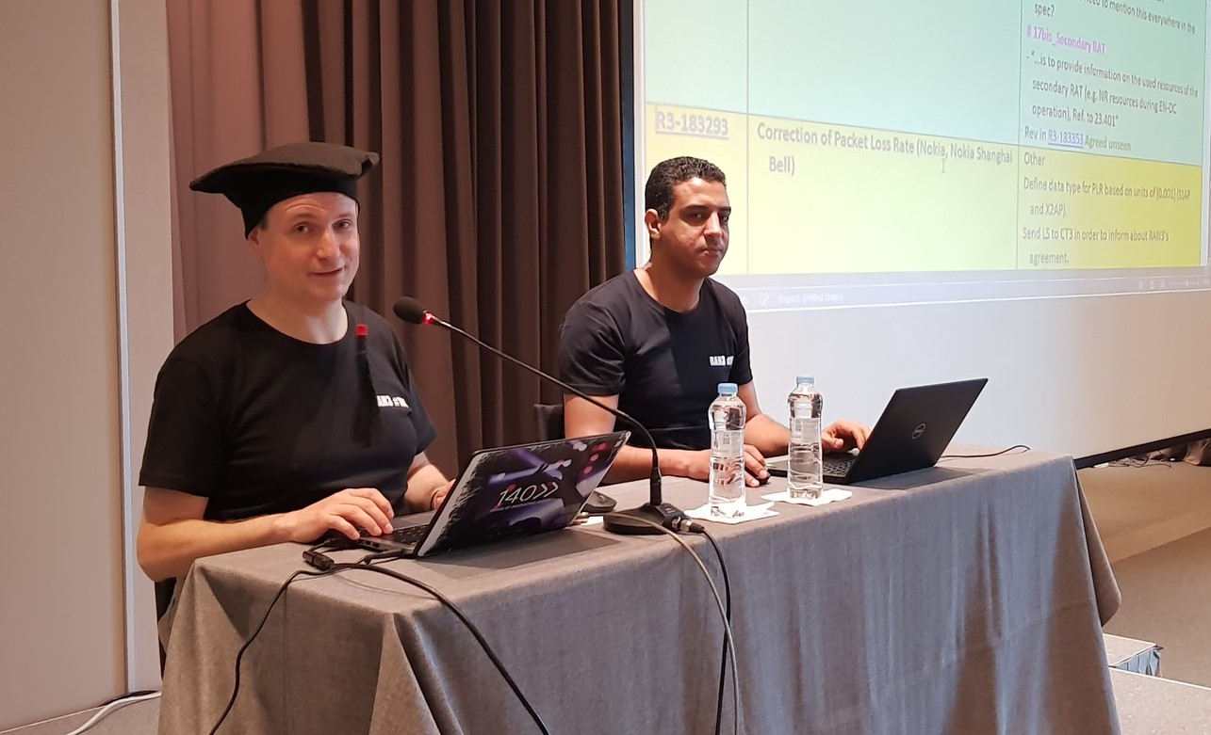
To Gino
Thank you, Gino for your hard work, foresight, and wisdom, through all of the last four years, and also for handling the refactoring of RAN3 meetings in this new age. It takes a special person to do this job in a fair and relaxed manner, and you have obviously achieved a very high Zen level in the last few year!
I will miss your smooth style, and your handling of the most awkward work items with good humour – working through occasional cacophony to eventually get RAN3 singing in reasonable harmony. But things have to change, and I wish you all the success in whatever new challenges you set your mind to next.
QC - Luis
Best wishes and many thanks, Gino for your contributions to RAN3 as Chair. Although we couldn’t meet in person, I felt at ease in the online meetings with your smooth and efficient moderation and found your meeting minutes and guidance in RAN3 reflector very useful as a new delegate. Wish you the best and hope to meet you soon in person.
QC - Shankar

Slide 12
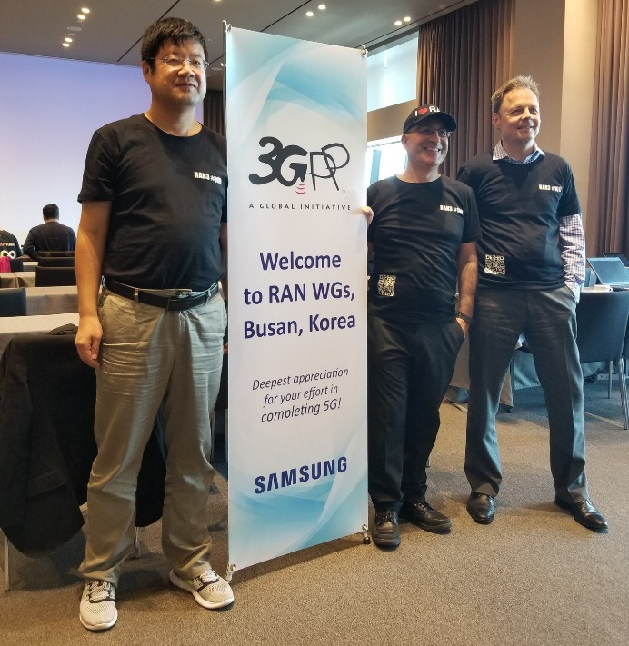
To Gino
Thanks Gino for the great work, in the most important stage of 5G standard design, leading RAN3 accomplished the standard work on time with good quality.
Wish you have greater success in the future.
QC - Xipeng
I have seen RAN3 only through the glasses of IAB. In this series of study/work items, you were the crucial figure who knew how to lead the crowd out of a chaos of conflicting views they kept circulating in merciless discussions. I was always impressed how you managed to capture the essential point of an issue within a few seconds after we had debated the topic for days and were lost in a myriad of details. I am happy that we had you as a chairman, and I thank you for your guidance, the interest you took in our work, the patience you had to settle our disputes, and the overtime you allocated to IAB! I wish you all the best for your next endeavour!
QC - Georg
The Qualcomm Delegation respectfully salutes you at RAN3#100!

Slide 13
To Gino
Thank you very much for your hard work. It is not easy to manage the group under such difficult situation.
Appreciate very much your effort which guarantees the good progress in RAN3 group.
Hope you could have a good rest after this meeting.☺
CATT - Aijuan
Thank you Sasha for your great efforts in the past four years as RAN3 vice chairman.
It is my great honor to work with you on the SON/MDT topic. Your spirit of fairness, openness and efficiency is impressive.
I wish you all the best for your next endeavour!
Lenovo/Motorola Mobility - Mingzeng
Thanks for the 4 years you lead our RAN3 team moving on and on.
There’re several labels on you, Chairman, knowledgeable, professional, powerful, fairness, patient, humorous…
It’s a good experience to work with you, and study from you. Wish you have a brighter future.
CATT - Jiancheng SUN

Slide 14
To Gino
Thank you very much Gino for having managed the RAN3 planet with such efficiency in a pleasant, consensual and harmonious manner during these 4 years.
You made the RAN3 planet turn round, smoothly and surely on its 5G orbit !
All the best for the future period and I hope we will meet soon again in F2F.
Orange - Pascal

Slide 15
To Gino
Thanks Gino for your great leadership during the last 4 years. It has been crucial to deliver 5G RAN3 specifications to the whole industry and drive RAN3 through the turbulent period in e-meeting environments.
I hope you can take a good break and all the best wishes for your next step.
Looking forward to the face to face meeting especially in Milan☺
Samsung - Lixiang
Thank you, Gino, for doing what can be a thankless job ☺. In particular, for your great leadership during the last 4 years.
I wish you the best for a good rest over the summer and hope that your future includes RAN3.
InterDigital - Jim

Slide 16
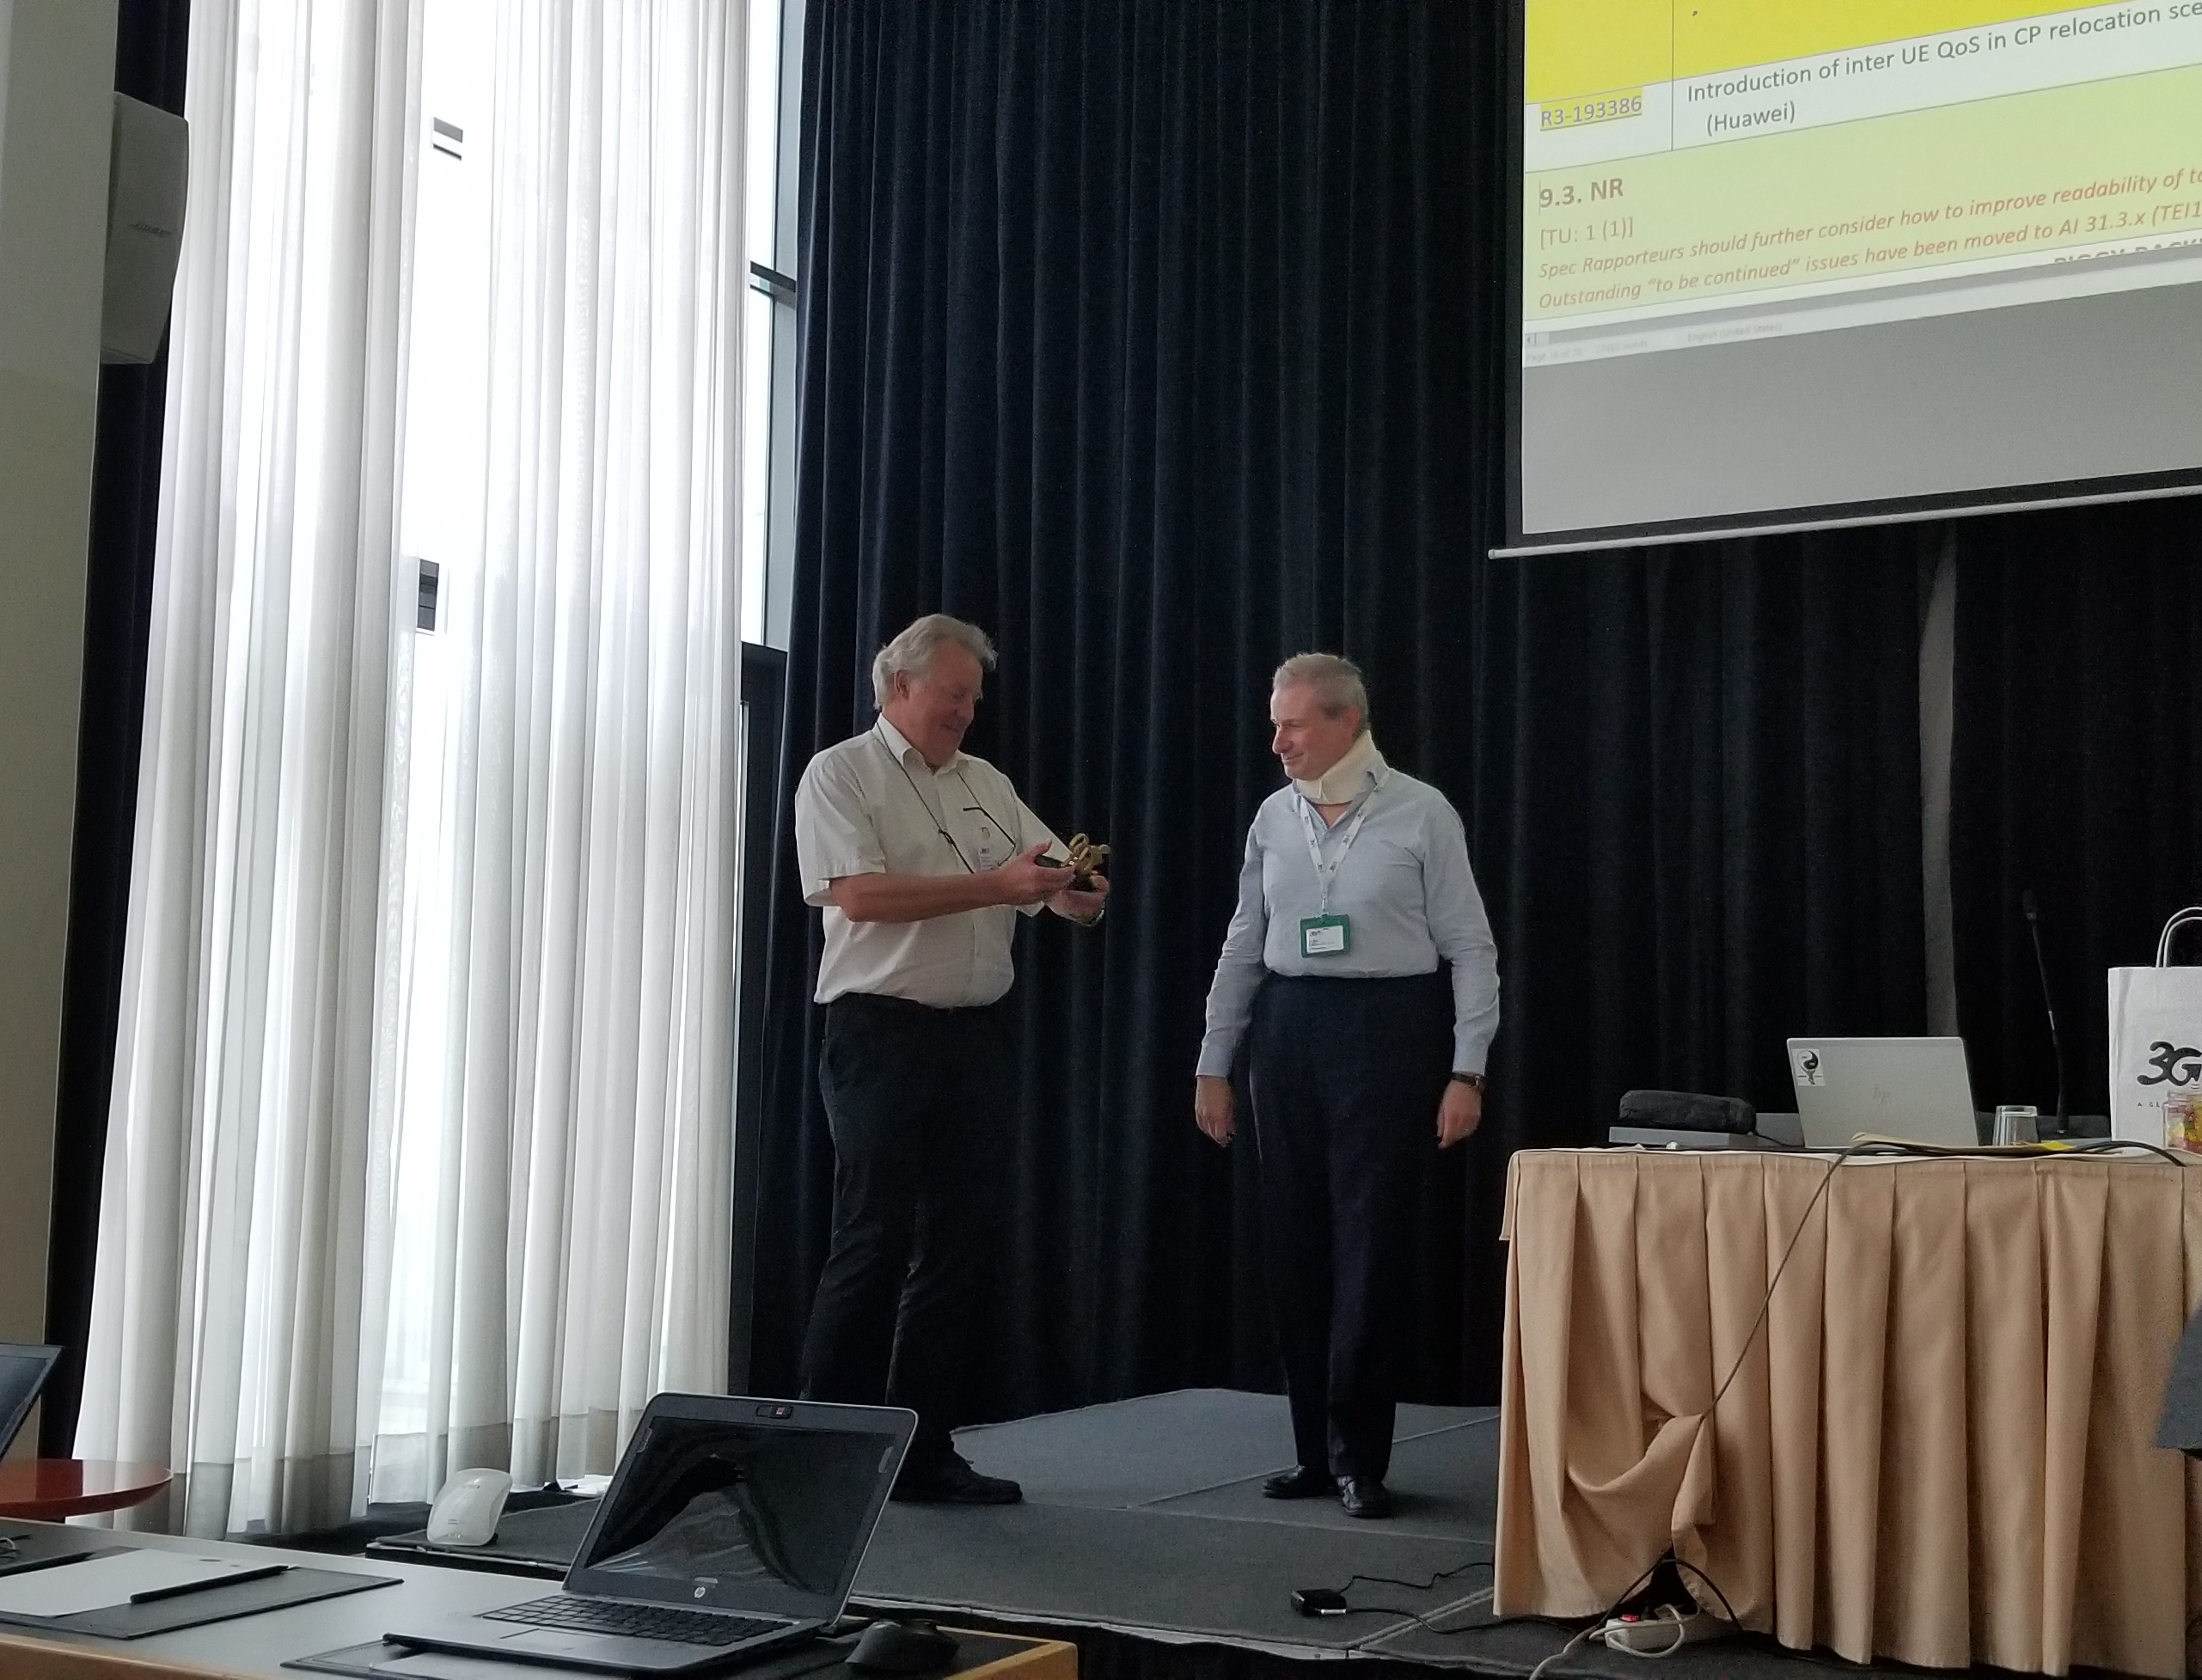
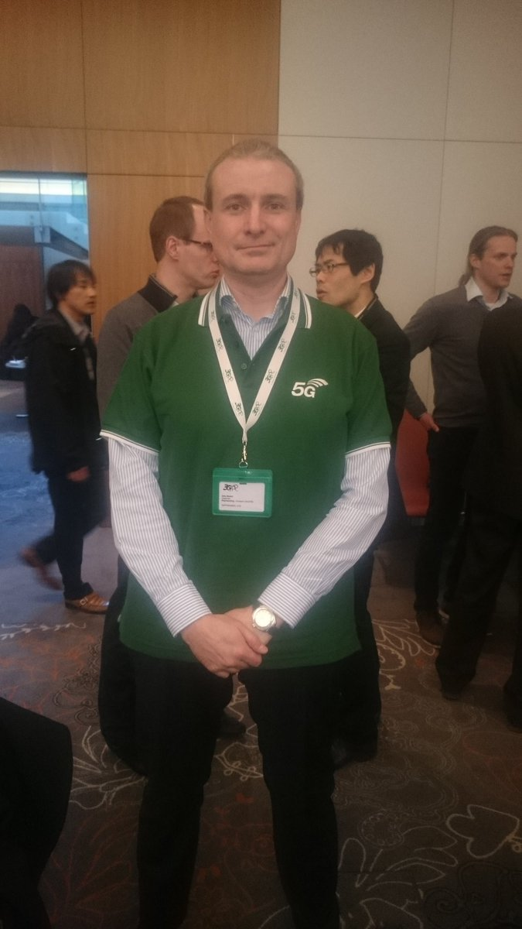
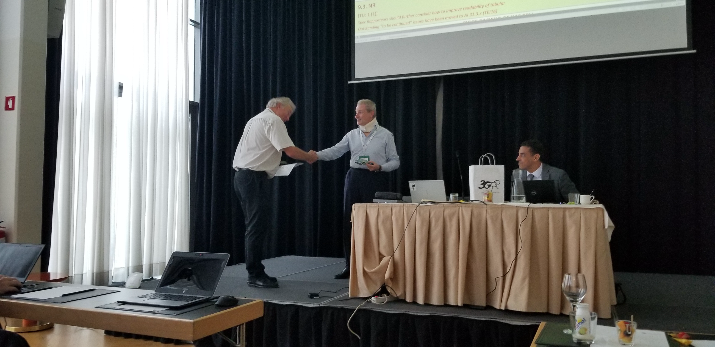
To Gino
Thanks Gino for your leadership in the past four years with passion, fairness and efficiency.
I still remembered you were keeping work with enduring a neck ache and the moment you saw martin off on behalf of RAN3.
How time flew! Now, your term of service is end, but fortunately we still can work with you in RAN3 and get your help and guidance！
Wish you could enjoy a happy and relaxing vacation after this meeting.
China Telecom – Jiang Zheng

Slide 17
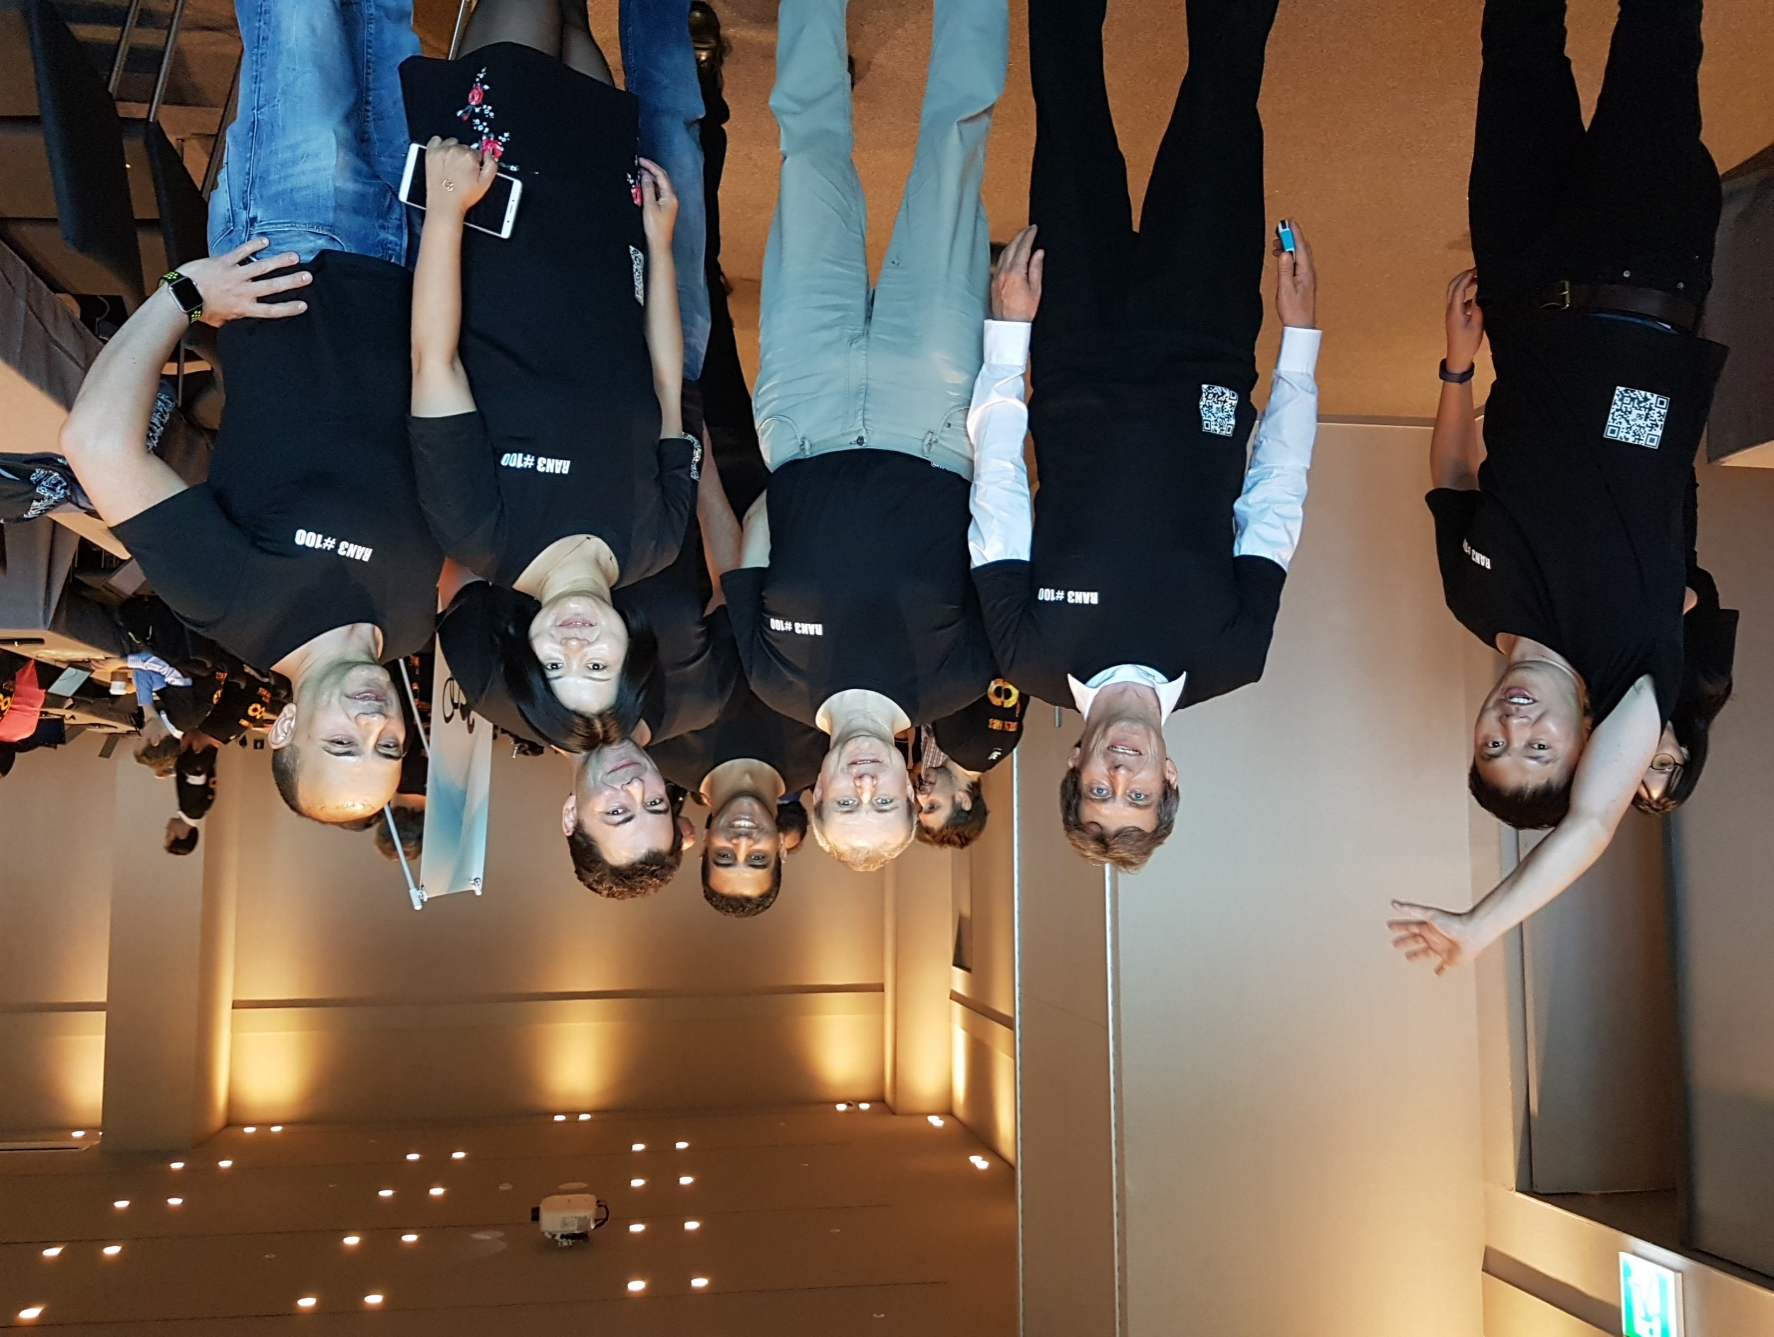

To Gino
Gino,
It was definitely one of the highlights of my standards career to serve as a vice chairman in your team. You guided RAN3 through pretty rocky waters of defining the NG-RAN architecture. Under your leadership RAN3 have made and all the fundamental decisions that eventually made 5G possible. I’m happy to have taken a part in that and I’m thankful to you for the opportunity you gave me to learn and grow under your guidance.
I wish you all the best in your standards career and personal life and I hope you will still occasionally invite me to RAN3 dinners in the plenary ;)
Sasha Sirotkin

Slide 18

In your day, we will work together, so the OARS will paddle fast and the shore will be clear.
May you have a smooth sailing and successful career in your future life.
- All RAN3 Delegates

