Slide 1
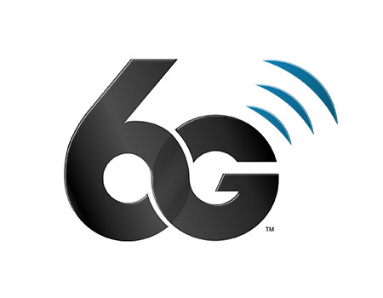
SA2#170 FS_6G_ARC
(Drafting#1)
Rapporteurs:
Malla Reddy Sama (NTT DOCOMO)
Stefan Rommer (Ericsson)

Slide 2
Agenda
Sync on tdoc handling as shared by the pen-holders on the reflector.
Tdoc handling (see in next slides): To make our drafting sessions effective and inclusive, we kindly ask for your support
  For presenters: Please keep presentations brief and to the point. The goal is to allow more time for constructive discussion rather than walking us through every detail on the tdoc.
  For commenters: We kindly ask that comments focus on the main aspects such as concern (objections) or suggested changes. Please try to avoid going in circles or adding unnecessary detail, and we kindly ask everyone to keep interventions concise, so that the majority of participants have the opportunity to comment.
  (Think of it as “espresso-style” comments: short, strong, and energizing ☕🙂)

Slide 3
Drafting tdoc list
20.6.1.2 | S2-2507056 | P-CR | Approval | 23.801-01: [WT#1.2, all topics] Work task 1.2 Resiliency scope | Nokia | Rel-20 | FS_6G_ARC | Handle
20.6.0 | S2-2506494 | P-CR | Approval | 23.801-01: [WT#1.x] On energy-related aspects | Nokia, NEC | Rel-20 | FS_6G_ARC | Handle
20.6.0 | S2-2506636 | P-CR | Approval | 23.801-01: [General aspects, Energy efficiency] End-to-end energy saving and energy efficiency | vivo | Rel-20 | FS_6G_ARC | Merge into S2-2506494
20.6.0 | S2-2506322 | P-CR | Approval | 23.801-01: Identifying 5G features to be supported by the 6G system | Qualcomm Incorporated, Ericsson, Nokia, MediaTek, Verizon, Orange | Rel-20 | FS_6G_ARC | Handle
20.6.0 | S2-2507053 | DISCUSSION | Endorsement | Process for adopting 5G features for 6G day-1 | Nokia, Qualcomm, Verizon, AT&T | Rel-20 |  | Handle
20.6.0 | S2-2507207 | P-CR | Approval | 23.801-01: [General aspects] Architecture Assumptions and Requirements on Energy Efficiency | NTT DOCOMO, KPN N.V., AT&T, Deutsche Telekom | Rel-20 | FS_6G_ARC | Only focus on Assumption Used as a baseline
20.6.0 | S2-2506576 | P-CR | Approval | 23.801-01: [General aspects] Architecture Requirements for 6G | LG Electronics | Rel-20 | FS_6G_ARC | Used as a baseline

