Slide 1
WELCOME
WELCOME

Slide 2
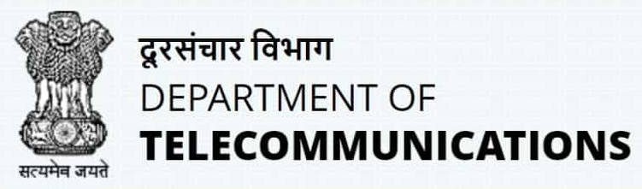



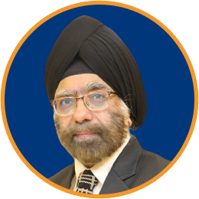
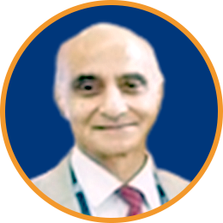
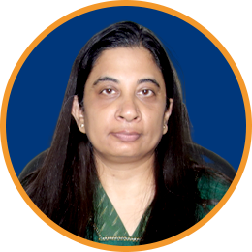
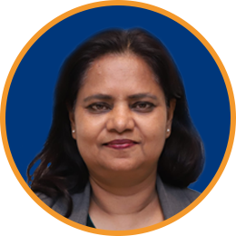
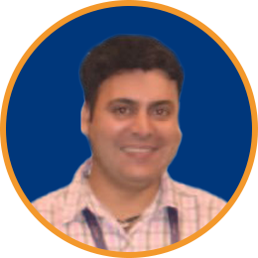
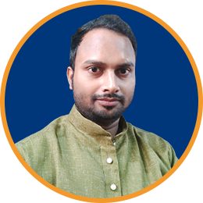







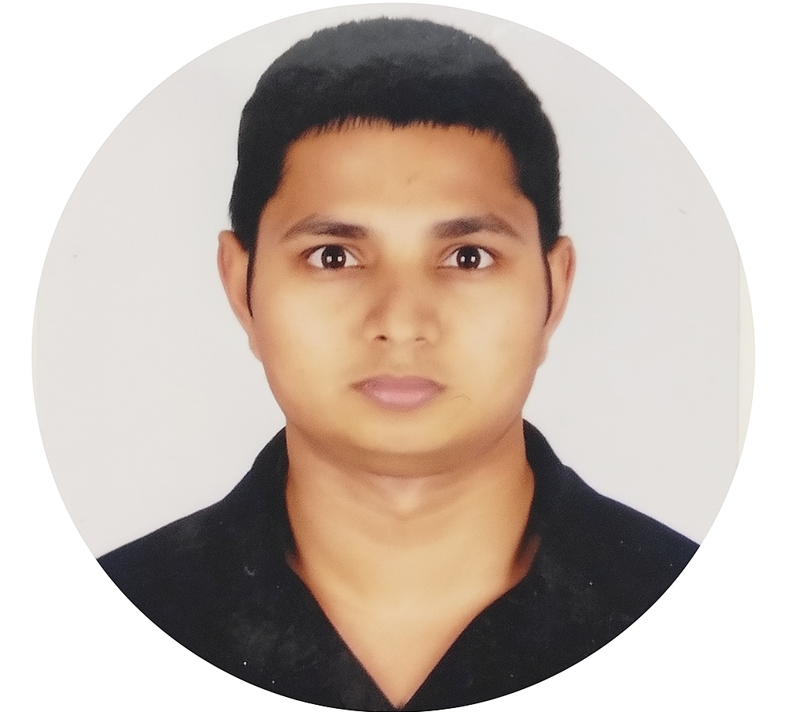
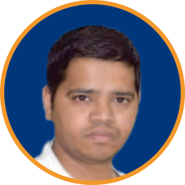


Thank You!
Government of India – DoT, MEA, MHA & MeitY
TSDSI Secretariat
Sponsors
Kuljit Singh
PK Jaswal
Shefali Sinha
Platinum Sponsor
Gold Sponsor
Silver Sponsor
Anupam Sinha
Harsh Arora
Asif Iqbal
Bronze Sponsors
Event Partner
AV Partner
Rajesh Vasudev
Rahul Roy

Slide 3
Bangalore (Bengaluru) - History
Bengaluru is the capital and largest city of the southern Indian state of Karnataka. It has a population of more than 8 million and a metropolitan population of around 11 million, making it India's third most populous city (census 2011).
  References suggest that a city existed here dates to around 517 AD (Based on temple inscriptions and early references)
To give a sense of how old the city is:
  The Nageshvara temple goes back to 1200 years (860 AD).
  Chokkanatha Swamy temple in Bangalore dates to 1200 AD.
  All lakes in Bangalore are man made, Bellandur lake is around 2000-year-old, as are Begur and Hebbal lakes (based on the idols and inscriptions that have been found near the lake) Ulsoor and Sankey tank are the youngest lakes (Post 1537)
Medieval Bangalore:
  In 1537, Kempe Gowda, a feudal ruler under the Vijayanagar Empire (1336-1646), established a mud fort (called Bangalore Fort), which is considered the foundation of the modern city of Bengaluru.
  Interested in the history of Bangalore? https://www.youtube.com/watch?v=HKzE-PfovXA

Slide 4
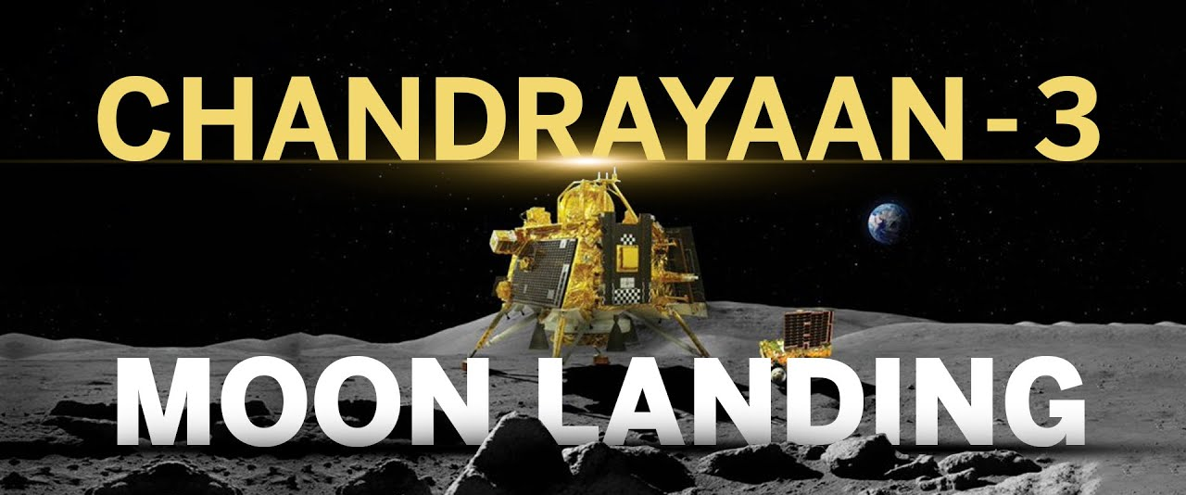
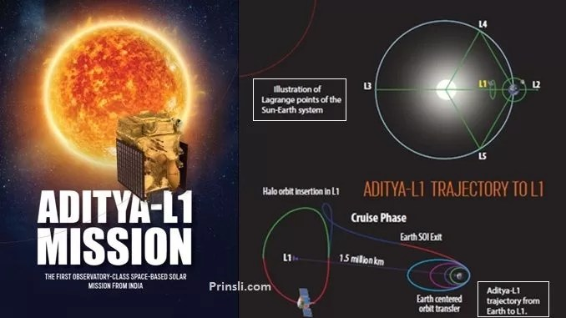
Today’s Bangalore!
The city is widely regarded as the "Silicon Valley of India", as the largest IT hub of the country, and the “Start-up city” of India, with 52 start-up unicorns (~50%).
Bangalore contributes to one-third of India's total IT exports, 40% of Global Capability Centers (GCC), home to 400 of the Fortune-500 companies.
The Indian Space Research Organization (ISRO) is headquartered in Bangalore.
Chandrayaan-3 successfully landed on the South Pole of the moon (world’s first!)
Interesting Fact: Cost of Chandrayaan 3 was $75 million, less than Interstellar's budget of $165 million
Aditya-L1 mission launched on Sep 2023, and placed into halo orbit close to the Sun

Slide 5
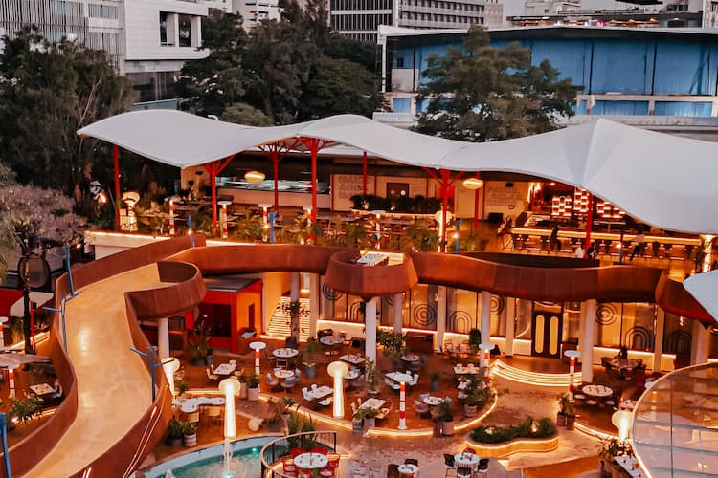
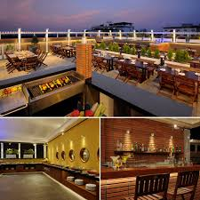
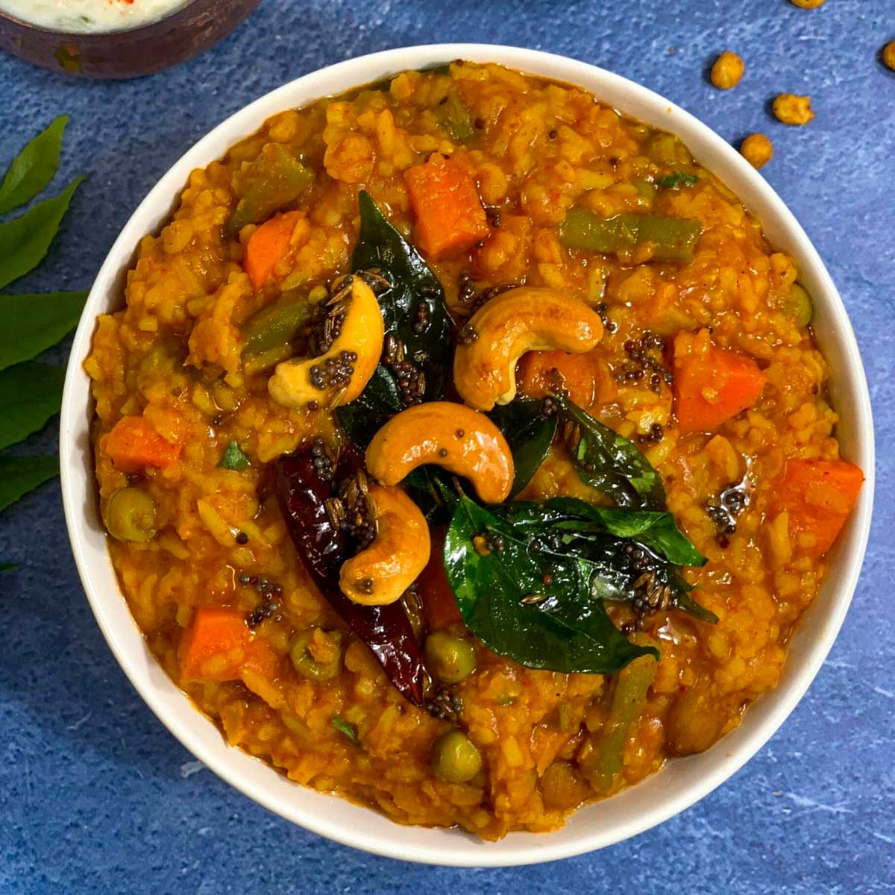
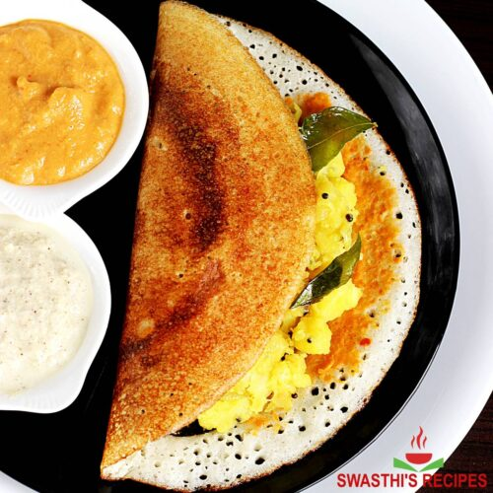
Bangalore – Food / Beer
Bangalore is considered as the brewery capital of India with 100+ microbreweries (all brewing their own beer)
List of breweries in Bangalore:
https://www.zomato.com/bangalore/microbrewery
ABSOLUTE LOCAL FOOD - MUST TRY
Bisi Bele Bath is a spicy, rice-based dish with origins in the state of Karnataka
Masala Dosa is crispy crepe made of fermented rice and lentil batter is served with flavorful spiced potato curry.
Maize & Malt Brewery
Windmills Craftworks Brewery

Slide 6
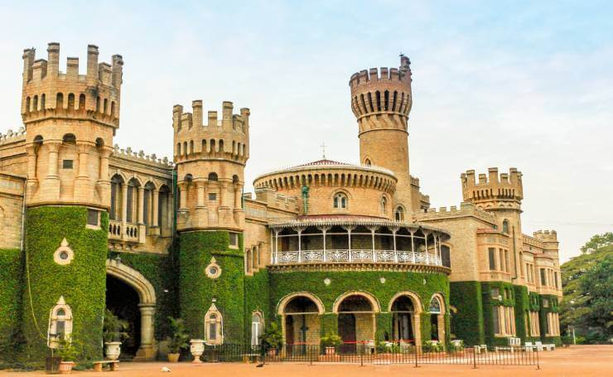
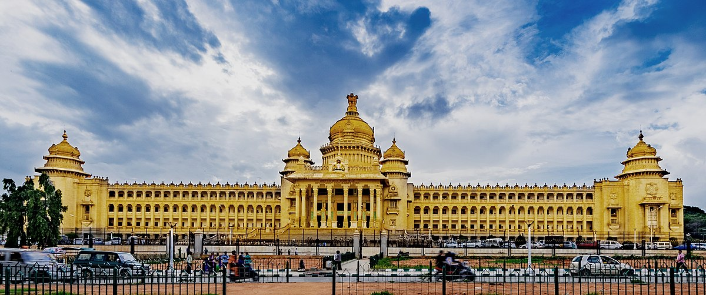
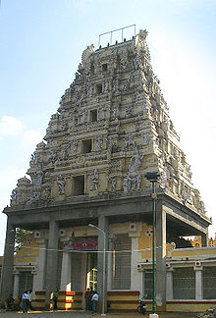
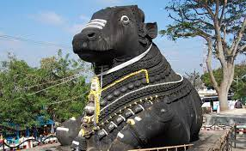
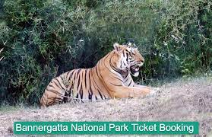
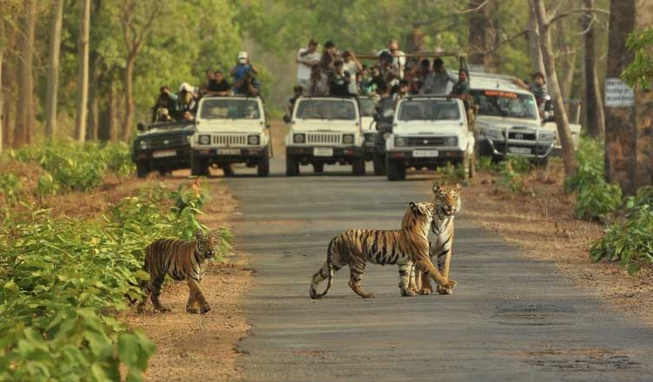
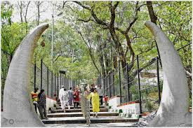
Bangalore – Places to see
You will find advice on Google
for other places to visit in
Bangalore
BUT
The absolute MUST visit Places
Vidhana Soudha
(Karnataka State Assembly)
The Bangalore Place
(Modelled after Windsor Castle)
Bannerghatta National Park and the Tiger Safari
The Bull Temple

Slide 7

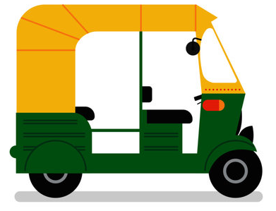
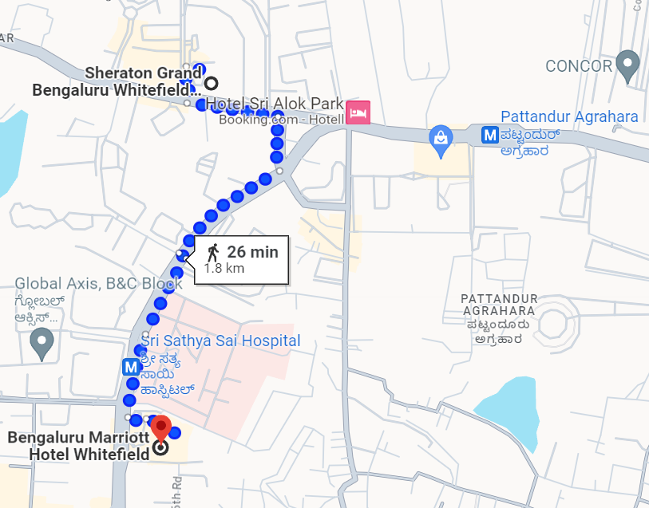

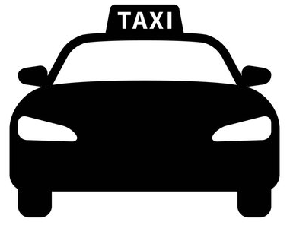
Local Commute - Whitefield
PURPLE LINE
Sri Sathya Sai Hospital Metro Station
Ticketing is in L1 floor. Fare is INR 10 to Pattandur Agrahara Metro Station
Platforms are in L2 level. Take Platform 1 towards Pattandur Agrahara Metro Station (Refer map)
Take Exit point B to exit into the side of Sri Sathya Sai Hospital (which is in the side of BMHW)
Pattandur Agrahara Metro Station
Ticketing is in L1 floor. Fare is INR 10 to Sri Sathya Sai Hospital Metro Station
Platforms are in L2 level. Take Platform 2 towards Sri Sathya Sai Hospital Metro Station (Refer map)
Take Exit point A (Thigalarapalya side) to exit into the side to walk towards SGBW
Take Exit point B (Pattandur Agrahara side) to reach the Park Square Mall
(SGBW)
“Auto”
“Rickshaw”
“Auto Rickshaw”
Pattandur Agrahara Metro Station
1.1Km (16 mins walk from SGBW)
3 mins journey
The Ticket media are:
Tokens (for single journey) – Pay by cash or Paytm/UPI at ticketing counter (Credit card not accepted)
Contactless Smart Cards (for multiple journeys)
QR code based Ticket (Chatbot service through WhatsApp: +918105556677) – Allows credit card payment
Sri Sathya Sai Hospital Metro Station
350m (5 mins walk from BMHW)
The best way to avail transport services of “Auto” and “Taxi” is to use the Apps – Uber or Ola.
(BMHW)

Slide 8
Meeting Logistics
Coffee Breaks (morning and afternoon)
  Morning: 10:30 to 11:00am
  Afternoon: 04:30 to 05:00pm
Lunch
  01:00 to 02:30pm
  Only with Coupons*
  *Can be purchased for 800 INR (<10 USD), if you are not eligible (i.e. if you are not staying at the meeting hotel under 3GPP group rate).

Slide 9
Shuttle Service
Free shuttle service between the meeting hotels throughout the day from 7am to 8pm
Shuttle service can be used by all 3GPP delegates (regardless of your hotel stay)
You may be asked to present your 3GPP badge when boarding for security reasons

Slide 10
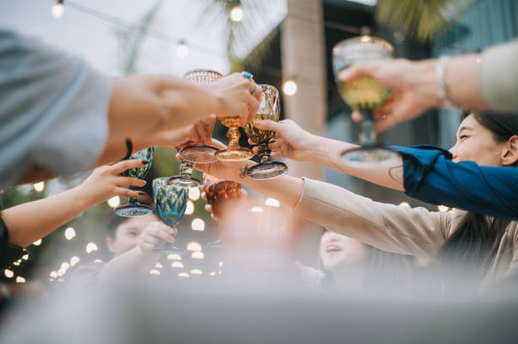
Social Event: Aug 27th (Wed), 7:30pm onwards
Venue: Sheraton Grand Hotel – Convention Center (RAN1 Main)
[PLEASE BE ON TIME, and MUST ATTEND☺]

Slide 11
Experience India – A Marketplace of Stories
Venue: Marriott (Tue), Sheraton (Wed) – 1pm onwards
Curated “Experience India” – a living marketplace that brings together the very best of Indian craftsmanship, design, and innovation, where heritage meets innovation
  Here, you will discover:
  ✨ Handwoven sarees, stoles, and textiles that tell stories older than history, yet styled for
  the world of today — from the Ajrakh fabrics of Gujarat to the Kantha embroidery of Bengal.
  ✨ Women-led brands reimagining skincare,home décor — proof that India’s entrepreneurial
  spirit is powered by diversity and resilience.
  ✨ Sustainable crafts — from block-printed linens to upcycled dolls, from wooden serveware
  to handmade soaps — each carrying the promise of mindful living.
  ✨ Cultural keepsakes — Channapatna toys, mandala art, ethnic jewelry, artisanal teas,
  coffees, and fragrances — souvenirs not just to take home, but to take India home.
  ✨ Live experiences — try your hand at block printing or enjoy a caricature sketch — carrying
  with you not just a product, but a memory.

Slide 12
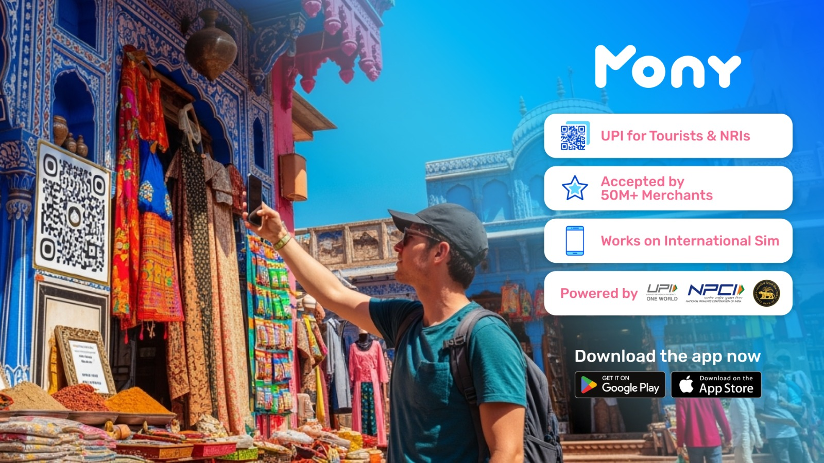
Mony App – Mobile payment (UPI-enabled)
[Sign-up near Registration/TSDSI Help Desk]

Slide 13

For further help/information please visit the TSDSI Help Desk at the respective hotels

