Slide 1
Thank you and farewell,
Marc Grant

Slide 2
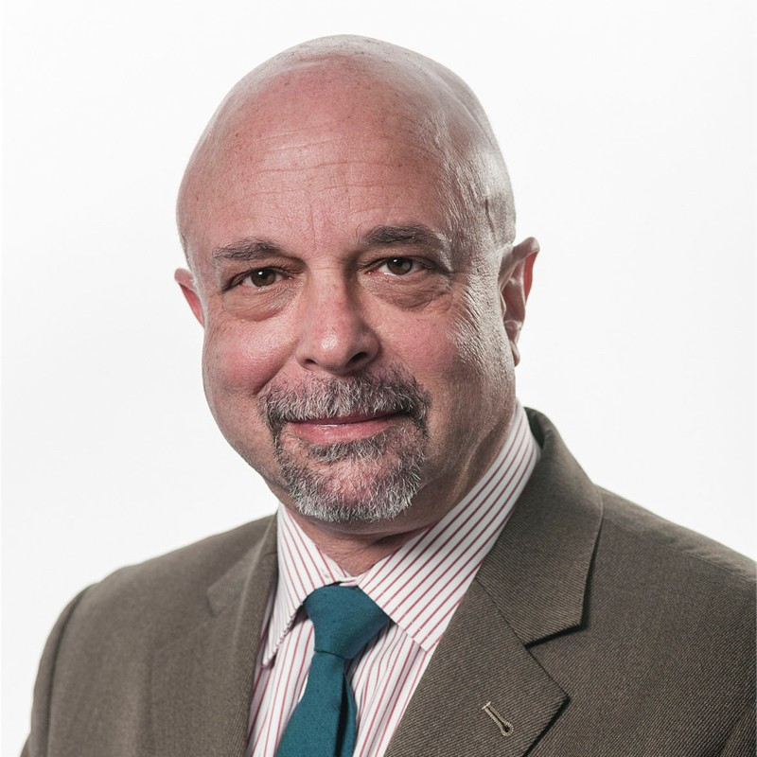
TSG RAN4 Vice-Chair (2007~2009)
TSG RAN Vice-Chair (2011~2013)
Chair of ITU-R SWG Radio Aspects (IMT requirements)
Board member ETSI (2008-2024)

Slide 3
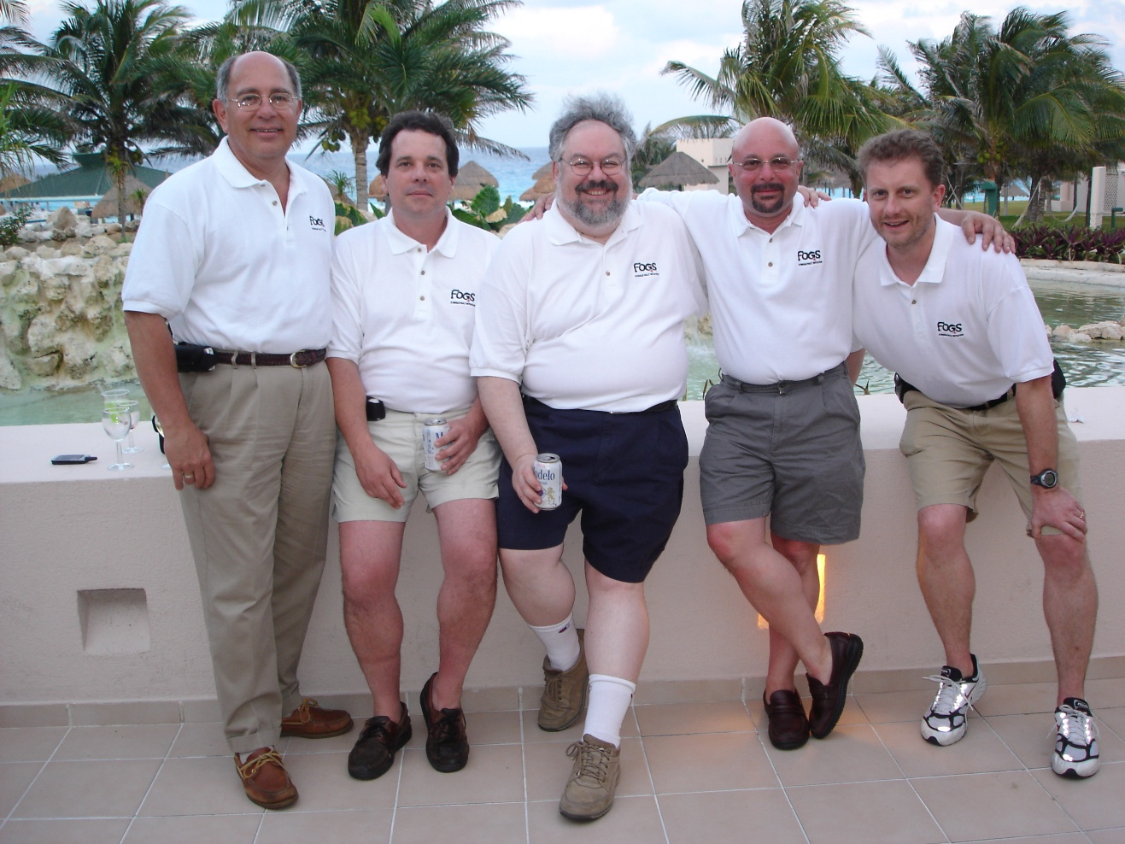
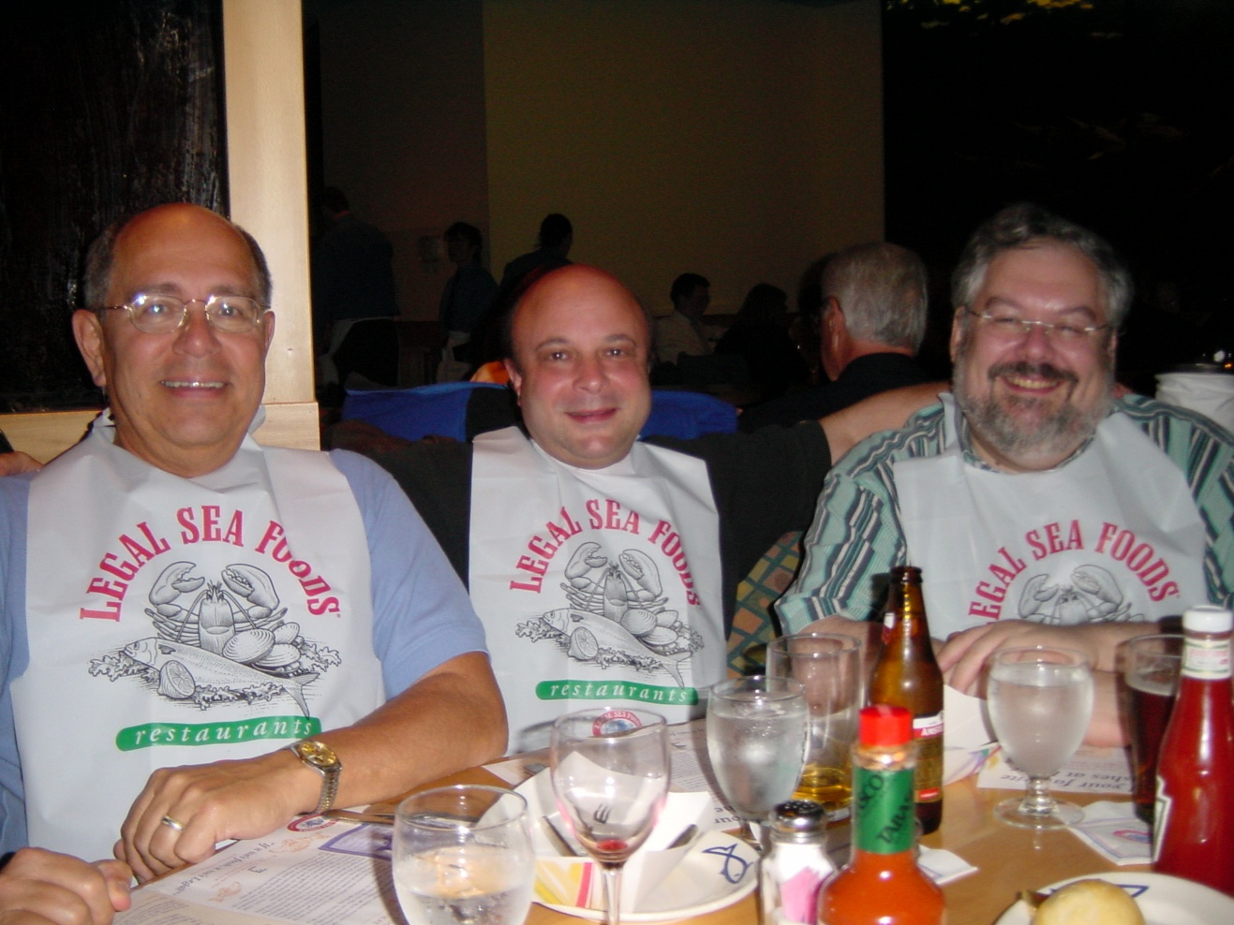

Slide 4
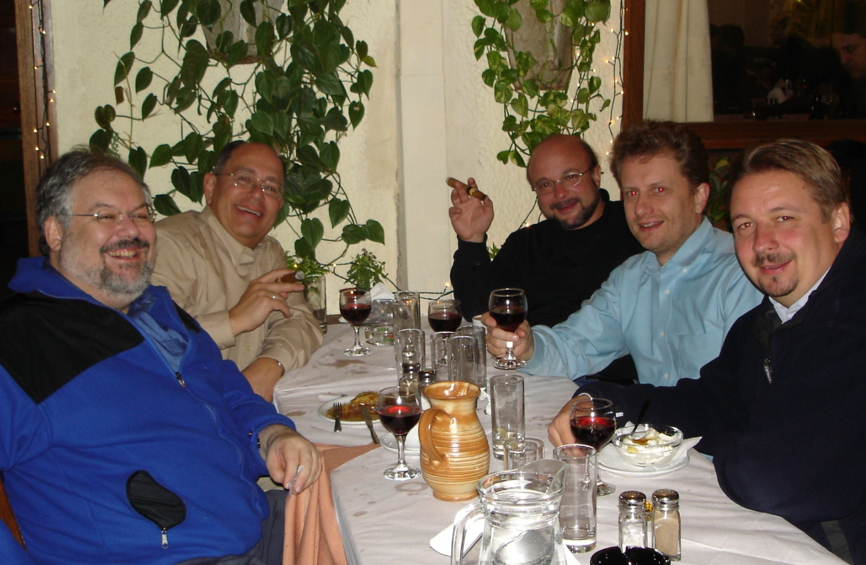
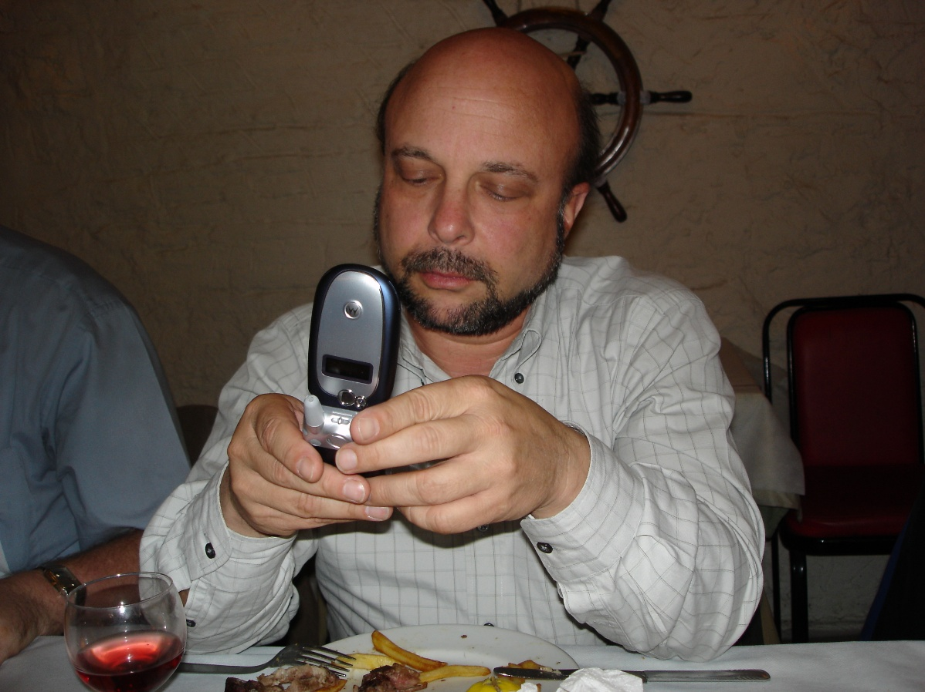

Slide 5
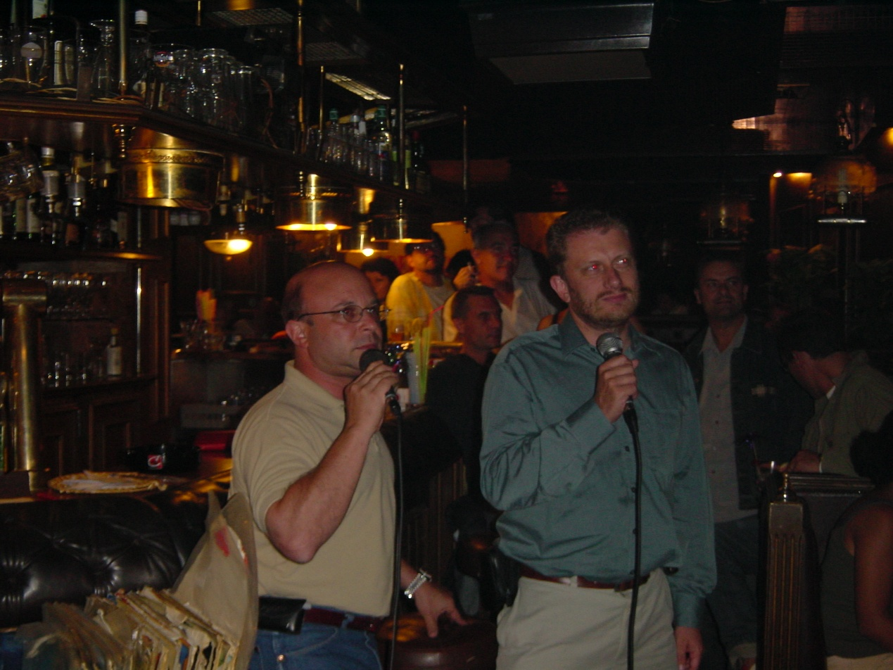
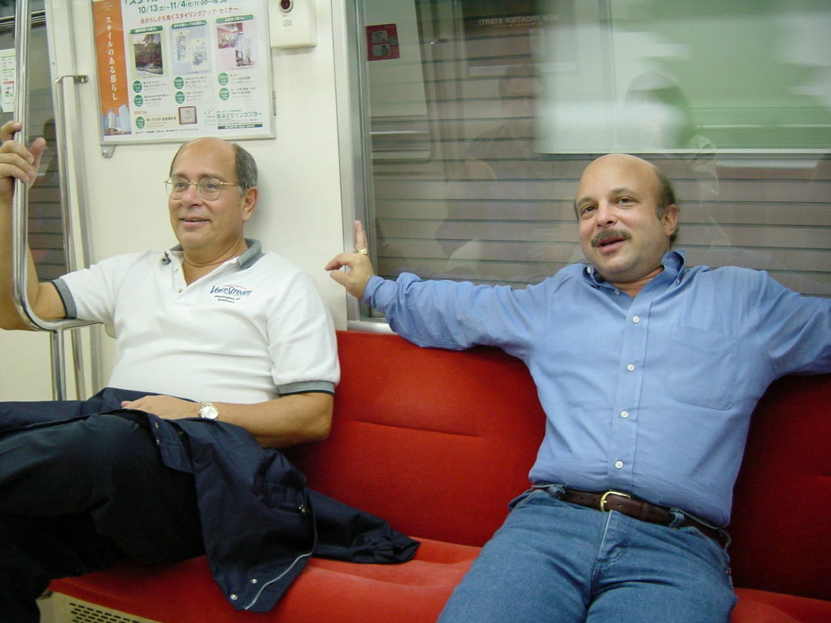

Slide 6
