Slide 1
SA5 Rel-18 and Rel-19 work progress SA5#154, 15 – 19 Apr, 2024
Zou Lan, 3GPP SA5 Chair, HUAWEI

Slide 2
Content
Release 18 progress update
Release 19 work plan
2024 SA5 meeting calendar

Slide 3
Overview of Rel-18 SA5 OAM WIs/SIs
Altogether 50 WIs/Sis are completed , including 26 SIs and 24 Wis.
Rel-18 OAM&P Studies
Intelligence and Automation
1 | (Completed) Study on enhancement of autonomous network levels | China Mobile, Huawei | FS_eANL | SP-211446
2 | (Completed) Study on evaluation of autonomous network levels | China Mobile, Huawei | FS_ANLEVA | SP-211445
3 | (Completed) Study on enhanced intent driven management services for mobile networks | Huawei, Ericsson | FS_eIDMS_MN | SP-211450
4 | (Completed) Study on intent-driven management for network slicing | Ericsson, Huawei | FS_NETSLICE_IDMS | SP-220278
5 | (Completed) Study on AI/ ML management | Intel, NEC | FS_AIML_MGMT | SP-211443
6 | (Completed) Study on Enhancement of the management aspects related to NWDAF | China Telecom | FS_MANWDAF | SP-211435
7 | (Completed) Study on Fault Supervision Evolution | China Mobile, Huawei | FS_FSEV | SP-220153
8 | (Completed)Study on measurement data collection to support RAN intelligence | Intel, China Mobile | FS_MEDACO_RAN | SP-220488
Management Architecture and Mechanisms
9 | (Completed) Study on Enhancement of service based management architecture | Huawei, Ericsson | FS_eSBMA | SP-211451
10 | (Completed) Study on Basic SBMA enabler enhancements | Nokia | FS_eSBMAe | S5-221506
11 | (Completed) Study on Management Aspects of URLLC | China Unicom | FS_URLLC_Mgt | SP-220146
12 | (Completed) Study on Management Aspects of 5GLAN | China Mobile | FS_5GLAN_Mgt | SP-220324
13 | (Completed) Study on Management of Cloud Native Virtualized Network Function | China Mobile | FS_MCVNF | SP-220150
14 | (Completed) Study on Management Aspects of 5G MOCN Network Sharing Phase2 | China Unicom | FS_MANS_ph2 | SP-220151
15 | (Completed) Study on continuous integration continuous delivery support for 3GPP NFs | Lenovo | FS_CICDNS | SP-211427
16 | (Completed) Study on Management of Trace/MDT phase 2 | Nokia | FS_5GMDT_Ph2 | SP-220152
17 | (Completed)Study on YANG PUSH (stopped at SA5#144e) | Ericsson | FS_YANG | SP-200765
18 | (Completed) Study on Management Aspects of IoT NTN Enhancements | China Unicom | FS_IOT_NTN | SP-220490
19 | (Completed) Study on Data management phase 2 | Nokia | FS_MADCOL_ph2 | SP-220842
Rel-18 Operations, Administration, Maintenance and Provisioning (OAM&P)
Intelligence and Automation
1 | (Completed) Self-Configuration of RAN Nes | China Mobile, Huawei | RANSC | SP-211431
2 | (Completed) Management Data Analytics phase 2 | Intel, NEC | eMDAS_Ph2 | SP-220981
3 | (Completed) AI/ML management | Intel, NEC | AIML_MGT | SP-230335
4 | (Completed) Intent driven Management Service for Mobile Network phase 2 | Huawei, Ericsson | IDMS_MN_ph2 | SP-230180
Management Architecture and Mechanisms
5 | (Completed) Service based management architecture | Huawei, Ericsson, Nokia | eSBMA | SP-230174
6 | (Completed) Network slicing provisioning rules | Ericsson | NSRULE | SP-211449
7 | (Completed) Network slice provisioning enhancement | Samsung | eNETSLICE_PRO | SP-211434
8 | (Completed) Management of Trace/MDT phase 2 | Nokia | 5GMDT_Ph2 | SP-221163
9 | (Completed) 5G performance measurements and KPIs phase 3 | China Telecom, Intel | PM_KPI_5G_Ph3 | SP-220489
10 | (Completed) Enhancement of QoE Measurement Collection | Ericsson | eQoE | SP-200193
11 | (Completed) Additional NRM features phase 2 | Nokia | AdNRM_ph2 | SP-220351
12 | (Completed) Management Aspects related to NWDAF | China telecom | MANWDAF | SP-230181
13 | (Completed) Enhanced Edge Computing Management | Samsung, Intel | eECM | SP-220154
14 | (Completed) Management Aspect of 5GLAN | China Mobile Com. Corporation | 5GLAN_Mgt | SP-230175
15 | (Completed) Management Aspects of NTN | China Unicom,CATT | OAM_NTN | SP-230183
16 | (Completed) methodology for deprecation | Ericsson | OAM_MetDep | SP-220843
17 | (Completed) Management of cloud-native Virtualized Network Functions | China Mobile,Huawei,AsiaInfo | MCVNF | SP-230764
18 | (Completed) Management Aspect of 5G Network Sharing Phase2 | China Unicom, Ericsson | MANS_ph2 | SP-230629
19 | (Completed) Management Aspects of URLLC | China Unicom | URLLC_Mgt | SP-230631
20 | (Completed) Management aspects of 5G system supporting satellite backhaul | China Telecom | OAM_5GSATB | SP-231445
Support of New Services
21 | (Completed) Access control for management service | Nokia | MSAC | SP-210859
22 | (Completed) Enhancements of EE for 5G Phase 2 | Huawei | EE5GPLUS_Ph2 | SP-211441
23 | (Completed) Management of non-public networks phase 2 | Huawei | OAM_NPN_Ph2 | SP-230184
24 | (Completed) Network and Service Operations for Energy Utilities | Samsung | NSOEU | SP-230632
Support of New Services
20 | (Completed)Study on enhancement of management of non-public networks | Huawei | FS_OAM_eNPN | SP-211436
21 | (Completed) Study on new aspects of EE for 5G networks Phase 2 | Huawei | FS_EE5G_Ph2 | SP-211440
22 | (Completed) Study on Network and Service Operations for Energy Utilities | Samsung | FS_NSOEU | SP-211622
23 | (Completed) Study on Key Quality Indicators(KQIs)for 5G service experience | Huawei | FS_KQI_5G | SP-211433
24 | (Completed) Study on Deterministic Communication Service Assurance | Huawei | FS_DCSA | SP-211442
25 | (Completed) Study on management aspects of network slice management capability exposure | Alibaba | FS_NSCE | SP-220142
26 | (Completed) Study on alignment with ETSI MEC for Edge computing management | Huawei | FS_MEC_ECM | SP-220147

Slide 4
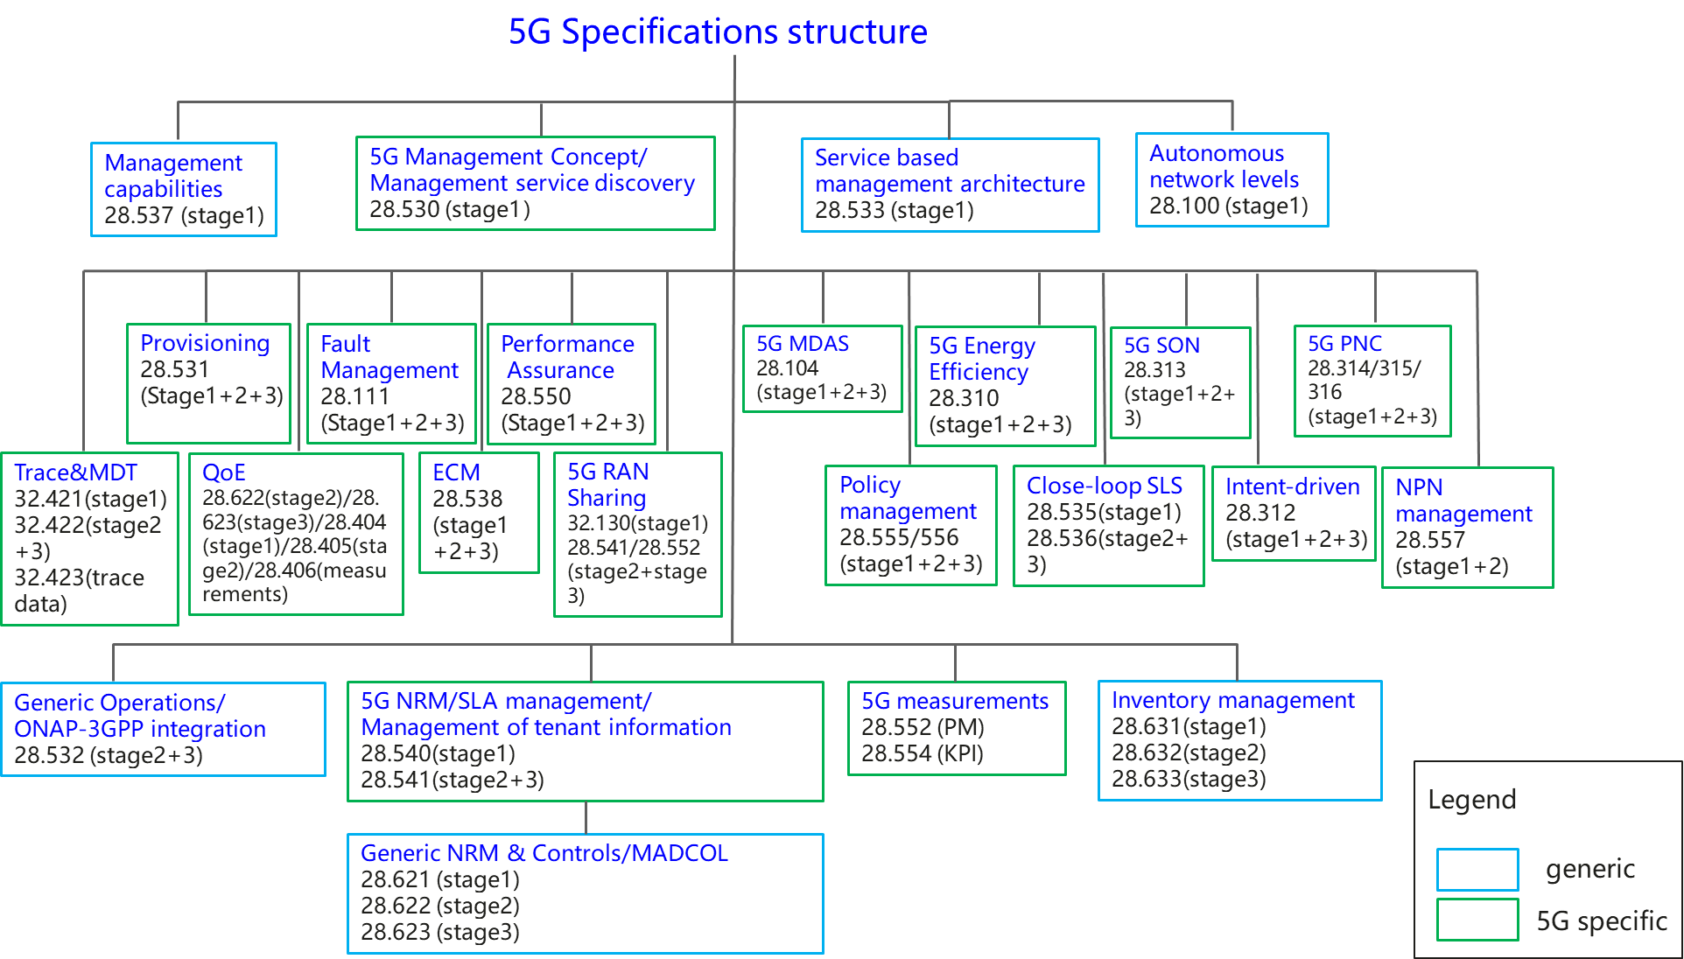
Overview of SA5 5G specifications
 | 5G related management features | Related specifications
1 | 5G management capabilities (Heart beat) | TS 28.537,TS 28.532
2 | Network and service management concept | TS 28.530
3 | Network management service based management architecture | TS 28.533
4 | Management and orchestration; Levels of autonomous network | TS 28.100
5 | Network and Network slicing management related specifications
5.1 | Network and Network slicing provisioning | TS 28.531,TS 28.532,TS 28.540,TS 28.541
5.2 | Network and Network slicing fault supervision | TS 28.545,TS 28.532
5.3 | Network and Network slicing performance assurance | TS 28.550,TS 28.532,TS 28.540,TS 28.541,TS 28.552, TS 28.554
5.4 | NRM | TS 28.540,TS 28.541
6 | ONAP-3GPP integration | TS 28.532
7 | Trace and MDT management | TS 32.421,TS 32.422, TS 32.423
8 | QOE Management | TS 28.622, TS 28.623, TS 28.404, TS 28.405,TS 28.406
9 | Inventory management | TS 28.631, TS 28.632, TS 28.633
10 | Management data collection control and discovery (MADCOL) | TS28.533, 28.532,28.622, 28.623
11 | 5G RAN Sharing | TS 32.130, TS 28.541,TS 28.552
12 | Edge Computing Management | TS 28.538
13 | Energy efficiency related specifications | TS 28.310,TS 28.532,TS 28.552,TS 28.554
14 | Management Data Analytics | TS 28.104
15 | 5G SON management | TS 28.313,TS 28.541
16 | Plug and Connect | TS 28.314,TS 28.315, TS 28.316
17 | Policy management | TS 28.555, TS 28.556
18 | Close-loop SLS | TS 28.535, TS 28.536
19 | Intent-driven management | TS 28.312
20 | Management service discovery | TS 28.530,TS 28.533
21 | SLA management | TS 28.540,TS 28.541, TS 28.531, TS 28.550
22 | NPN management | TS 28.557
23 | Management of tenant information | TS 28.530, TS 28.531,TS 28.533,TS 28.550,TS 28.552,TS 28.541
List of SA5 specifications: https://portal.3gpp.org/Specifications.aspx?q=1&series=22&releases=all&draft=False&underCC=False&withACC=False&withBCC=False&numberNYA=False

Slide 5
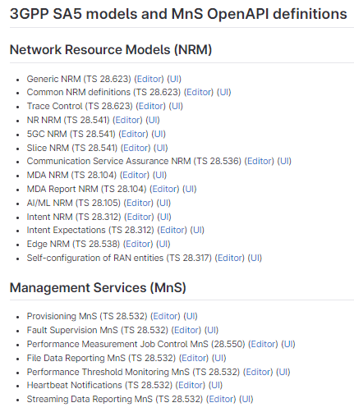
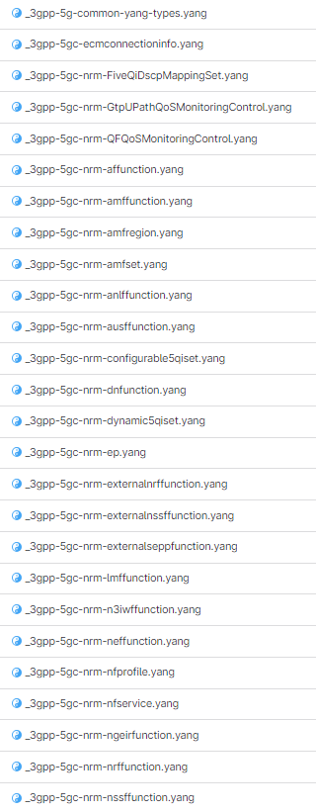
Rel-18 SA5 Stage 3 in forge
SA5 Stage3 includes OpenAPI (OAM and CH) and YANG (OAM only) solutions, there are 33 yaml files and 100 YANG files.
OpenAPI solution is captured in https://forge.3gpp.org/rep/all/5G_APIs (3GPP unified stage3 repository) and https://forge.3gpp.org/rep/sa5/MnS/-/tree/Rel-18/OpenAPI (SA5 stage3 repository)
YANG solution is captured in https://forge.3gpp.org/rep/sa5/MnS/-/tree/Rel-18/yang-models (SA5 stage3 repository)
Example of SA5 OpenAPI and YANG solutions

Slide 6
Release 19 timeline – figure with SA5 (planned so far)
Release 19 timeline
2023
2024
2025
2026
TSGs
#99
#100
#101
#102
#103
#104
#105
#106
#107
#108
#109
#110
#111
#112
Mar.
Jun.
Sep.
Dec.
Mar.
Jun.
Sep.
Dec.
Mar.
Jun.
Sep.
Dec.
Mar.
Jun.
SA1 Stage 1 80%
100%
Management requirements (SA5)
RAN Rel-19 workshop
RAN Content def.
RAN4
content def.
SA Rel-19
Workshop
St.2 Content approval
Stage 2 (SA2, SA6,…) Normative
Stage 2 (SA5) Normative supporting SA&RAN
OAM:
Sep 2024: finalize Rel-19 studies which plan to have corresponding normative work in Rel-19.
Sep 2025: finalize all Rel-19 work items, majority work items are preferable to be finalized in Jun 2025.
RAN1
RAN Completion (RAN2/3/4core)
RAN4_Perf
Stage 3 (CT & SA including SA5)
ASN.1 & Open APIs
Now

Slide 7
Rel-19 OAM Study / Work Items
21 topics including: 13 OAM prime features and 8 OAM support to network features (in red background).
 |  | Abbr. | Acronym | Title | UID | rapp | Tdoc | Type
Intelligence and Automation | 1 | AIML | FS_AIML_MGT_Ph2 | Study on AI and ML management phase 2 | 1020007 | Intel, NEC | SP-231780 | SID
 | 2 | MDA | FS_eMDAS_Ph3 | Study on Management Data Analytics (MDA) – Phase 3 | 1020019 | Huawei | SP-231726 | SID
 | 3 | IDM | FS_IDMS_MN_Ph3 | Study on intent driven management services for mobile networks phase 3 | 1020008 | Huawei, Ericsson | SP-231737 | SID
 | 4 | CCL | FS_CCLM | Study on Closed Control loop management | 1020009 | Samsung, Nokia | SP-231735 | SID
 | 5 | NDT | FS_NDT | Study on Management aspect of Network Digital Twin | 1020018 | CMCC | SP-231727 | SID
Management Architecture and Mechanisms | 6 | CMO | FS_Cloud_OAM | Study on cloud aspects of management and orchestration | 1020010 | Microsoft,CMCC | SP-231781 | SID
 | 7 | MSEC | FS_SECM | Study on Enablers for Security Monitoring | 1020016 | Nokia | SP-231736 | SID
 | 8 | SBMA | FS_SBMA_Ph3 | Study on SBMA enhancement phase 3 | 1020011 | Huawei, Ericsson | SP-231725 | SID
 | 9 | PTM | FS_PlanM | Study on Plan management | 1020033 | Nokia, Ericsson | SP-231721 | SID
 | 10 | MADCOL | MADCOL_Ph2 | Data Management phase 2 | 1020025 | Nokia | SP-231746 | WID
 | 11 | SEPM | FS_Data_SREP | Study on data management, regarding subscriptions and reporting | 1020012 | Ericsson | SP-231732 | SID
 | 12 | PM | PM_KPI_5G_Ph4 | 5G performance measurements and KPIs phase 4 | 1020026 | China Telecom, ZTE | SP-231747 | WID
 | 13 | AdNRM | AdNRM_Ph3 | 5G Advanced NRM features phase 3 | 1020027 | Nokia, Huawei | SP-231745 | WID
 | 14 | TMQ | TraceQoE_OAM | Subscriber and Equipment Trace and QoE collection management | 1020028 | Ericsson | SP-231748 | WID
 | 15 | NTNM | FS_ NTN_OAM_Ph2 | Study on Management Aspects of NTN Phase 2 | 1020013 | China Unicom, CATT | SP-231733 | SID
 | 16 | IABM | FS_NR_mobile_IAB_OAM | Study on Management of IAB Nodes | 1020014 | Ericsson | SP-231729 | SID
 | 17 | RedcapM | FS_NR_RedCap_OAM | Study on management aspects of RedCap feature | 1020017 | China Unicom, Asiainfo | SP-231734 | SID
 | 18 | NWDAFM | FS_NWDAF_OAM_Ph2 | Study on Enhancement of Management Aspects related to NWDAF Phase 2 | 1020020 | China Telecom | SP-231724 | SID
 | 19 | NSM | FS_NetShare_OAM_Ph3 | Study on Management of Network Sharing Phase 3 | 1020015 | China Unicom | SP-231731 | SID
Support of New Services | 20 | EE | FS_Energy_OAM_Ph3 | Study on energy efficiency and energy saving aspects of 5G networks and services | 1020021 | Huawei, Samsung | SP-231723 | SID
 | 21 | Mexpo | FS_MExpo | Study on Enhanced OAM for management exposure to external consumers | 1020022 | Nokia | SP-231728 | SID

Slide 8
3GPP SA5 meeting calendar (2024)
Meeting info | DateTime | Location
SA5#153 | 29 Jan 2024 – 2 Feb 2024 | Sevilla, ES
SA5#154 | 15 Apr 2024 - 19 Apr 2024 | Changsha , CN
SA5#155 | 27 May 2024 - 31 May 2024 | Jeju, KR
SA5#156 | 19 Aug 2024 - 23 Aug 2024 | Maastricht , NL
SA5#157 | 14 Oct 2024 - 18 Oct 2024 | India , IN
SA5#158 | 18 Nov 2024 - 22 Nov 2024 | Orlando , US

Slide 9
Useful 3GPP SA5 links
3GPP SA5 Wiki page: https://forge.3gpp.org/rep/sa5/MnS/-/wikis/home
3GPP SA5 TS 28 series specifications:
https://portal.3gpp.org/Specifications.aspx?q=1&series=22&releases=all&draft=False&underCC=False&withACC=False&withBCC=False&numberNYA=False
3GPP SA5 TS 32 series specifications:
https://portal.3gpp.org/Specifications.aspx?q=1&series=26&releases=all&draft=False&underCC=False&withACC=False&withBCC=False&numberNYA=False

Slide 10
Thank you!

