Slide 1
Discussion on the closure of R18 IoT NTN UEConTest WI
3GPP TSG-RAN5 Meeting #102 R5-240070r3
Athens, Greece, February 26 – March 1 , 2024
China Mobile, MediaTek, Keysight

Slide 2
The impacted TS for R18 IoT NTN UEConTest WI
TS/TR No. | Remaining Issues | Tdocs submitted at RAN5#102 to finalize the WI
TS 36.521-4 | Both R18 NB-IoT and eMTC NTN RF/Demod conformance test cases to be completed at RAN5#102 with editorial/core spec alignment CRs except for the ones with testability issues, no core req specified, core req being not applicable. | CMCC: R5-240072, R5-240074 MTK: R5-240031, R5-240097, R5-240144, R5-240099, R5-240098, R5-240145, R5-240198, R5-240137 R&S: R5-241358; Keysight: R5-240862, R5-241384, R5-241387, R5-241388
TS 36.521-3 | All the common parts in cl.3&4, and the NB-IoT NTN parts in cl.13 to be completed at RAN5#102 with technical/core spec alignment/editorial CRs. The eMTC NTN parts in cl.14 is not kicked off. | MTK: R5-240210, R5-240211, R5-240214, R5-240200, R5-240035, R5-240023, R5-240024, R5-240029, R5-240030, R5-240219 R&S: R5-241250, R5-241249, R5-241248, R5-241247, R5-241246, R5-241245, R5-241244 Keysight: R5-240615, R5-240922, R5-241176, R5-241385, R5-241386, R5-241389
TS 36.521-2 | The test applicabilities for all the completed R18 IoT NTN RF & Demod & RRM test cases (for NB-IoT NTN only) to be completed at RAN5#102 with jumbo CR. | CMCC: R5-240073 MTK: R5-240206, R&S: R5-241359
TS 36.508 | To be completed at RAN5#102 with CRs for cl.8. | CMCC: R5-240075; MTK: R5-240215; R&S: R5-241347, Keysight: R5-241382, R5-241383, R5-241390
TS 36.509 | No changes needed. TS 36.509 will be removed from the “Impacted existing TS/TR” in revised WID. | N/A
TR 36.903 | The TT&MU are introduced for all the R18 NB-IoT NTN RRM test cases. To be completed at RAN5#102 with technical CRs. Nothing for R18 eMTC NTN RRM test cases yet. | MTK: R5-240217, 240025
TR 36.904 | To be completed at RAN5#102 with CR to introduce grouping of test cases in cl.5A. The details for TT&MU for all the R18 NB-IoT&eMTC NTN RF test cases are captured in Annex F of TS 36.521-4 . | CMCC: R5-240076
TR 36.905 | The TPs are introduced for all the completed R18 NB-IoT and eMTC NTN RF conformance test case. | Keysight: R5-241391
TS 36.523-2 | Done. | N/A
TS 36.523-3 | Progress of TTCN development of the new protocol test cases is tracked in MCC TF160 reports to RAN5/RAN.
Notes:
38533 R5-240202 Addition and correction to the NTN related abbreviations in 38.533
38.521-5 R5-240201 Addition and correction to the NTN related abbreviations in 38.521-5

Slide 3
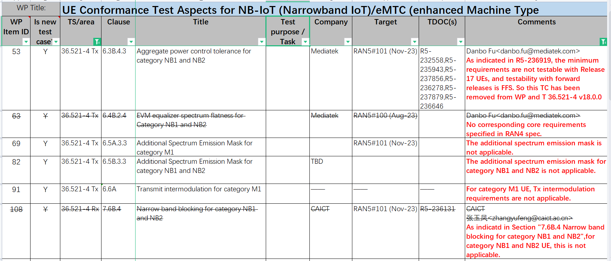
The details of the incomplete test cases in TS 36.521-4

Slide 4
Observations & Proposals
Observation 1: There is alredy clear and urgent industry commercialization deployment plan for NB-IoT NTN, but no clear deployment plan for eMTC NTN yet.
Observation 2: For the RF and Demod testing, all the RF and Demod test cases for R18 NB-IoT and eMTC NTN UEs are completed.
Observation 3: For the RRM testing, all the RRM test cases for R18 NB-IoT NTN UEs are completed, while the RRM test cases for R18 eMTC NTN UEs are not kicked off yet.
Observation 4: For all the NB-IoT/eMTC NTN test cases in “LTE_NBIOT_eMTC_NTN_req-UEConTest”, they apply to Rel-17 and forward UEs.
Observation 5: For the RRM reselection and re-establishment testing, there is no protocol procedure defined on how to transfer neighbor cell ephemeris to NB-IoT NTN UEs in GSO (not GEO), which is pending on RAN4 discussion (R4-2400663).
Proposal 1: To close “LTE_NBIOT_eMTC_NTN_req-UEConTest” at RP#103 without completion of R18 eMTC NTN RRM test cases. The RRM test cases for Rel-18 eMTC NTN could be addressed in the corresponding TEI WI once there is clear industry commercialization deployment plan for eMTC NTN in the future.
Notes:
reselection, re-establishment

Slide 5
Thank you!

