Slide 1
IoT_NTN_TDD
Introduction of IoT-NTN TDD mode
RP-243293, Dec, 2024, RAN#106, Iridium Satellite LLC
Objective
- TN deployment is not expected in this band
- The feature is not intended to be applicable to existing 3GPP band
- LEO @600 and @1200 km, with set-1 satellite parameters as reference scenarios (TR 36.763)
- Target the 1616-1626.5 MHz MSS allocated band
- Standalone deployment with anchor and non-anchor carriers (i.e. carrier(s) used only for NB-IoT)
- Earth fixed Tracking area, with either Earth fixed cells or Earth moving cells for NGSO
- The new NB-IoT NTN TDD consists of non-overlapping set of usable contiguous UL subframes (U) and set of usable contiguous DL subframes (D), and guard periods, which is periodic every N radio frames, with N=9 for the target MSS allocated band.
Specify a new NB-IoT TDD NTN mode based on minimum necessary changes to the NB-IoT NTN FDD frame structure and procedures, including:
  Definition, configuration (if needed) and signaling (if needed) of the periodic pattern, necessary adaptation (if needed) and associated UE procedures [RAN1, RAN2]
    Support a pattern with a period of 9 radio frames for the target MSS allocated band, where D=U=8 with a fixed guard period.
      RAN1 to consider whether there is a need for a mechanism to achieve an adjustable guard period for the purpose of allowing deployment with the TDD frame structure of the legacy system operating in the target MSS allocated band.
  Other necessary impacts on higher layers [RAN2]
  RRM and RF core requirements [RAN4]
Specify a new NB-IoT TDD operating NTN band for the MSS allocation spanning 1616-1626.5 MHz for DL and UL, based on the outcome of the study, to be used as example band for this WI [RAN4].
  Specify band numbering
  Specify SAN and UE RF characteristics
  Specify DL and UL channelization.
  Specify channel bandwidth as 200 kHz
  Note1: No NTN-NTN coexistence study needed.
  Note2: Leverage existing work as much as possible for TN-NTN coexistence of adjacent bands
Note3: Reuse the existing RAN4 requirements as much as possible (no intention to have any relaxation of the RF emissions requirements)
RAN1, TU = Core X, Perf Y

Slide 2
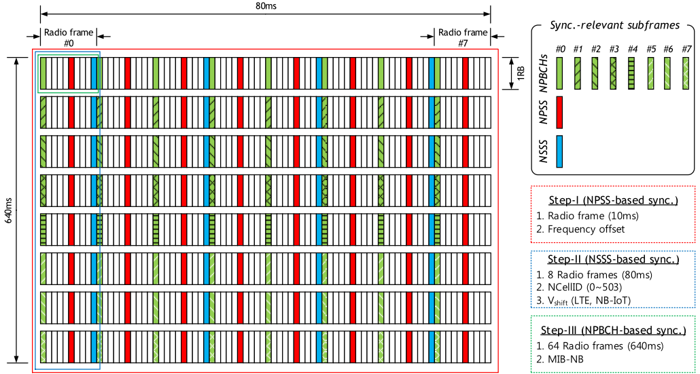
RAN1 (RAN1#119, Dec. 2024)
Agreements
Radio frame structure for FDD NB-IoT
D = [3 4 5 6 7 8 9 0]
For initial access (including SIB1 reception), the impact of the TDD pattern assuming N=9 and D=8
Channel | Legacy NB-IoT NTN | TDD NB-IoT NTN
NPSS | Once every 10ms | Once every 90ms
NSSS | Once every 20ms | Once every 180ms
NPBCH | 64 transmissions in 640ms TTI | 7 or 8 transmissions in 640ms TTI, depending on relative phase of TDD pattern and 640ms TTI (11.11% of the time 8 transmissions, 88.89% of the time 7 transmissions)
SIB1 | Once every 20ms (within the set of 16 consecutive frames), up to 8 transmissions within 160ms | 0 or 1 transmissions within 160ms (1 transmission 88.89% of the time, 0 transmissions 11.11% of the time)

Slide 3
General aspects
RRM requirements in IoT-NTN TDD mode in this WI are defined for earth-moving cells and are not applicable for earth-fixed cells.
Target Coverage: Normal coverage only
Target SNR in AWGN: -1 dB
Requirement applicability: Capture in specification clearly that the new requirements are applicable only for the new punctured TDD Frame structure where N=9 and D=U=8, as described in the WID.
Information: recorded in the Session Chair’s meeting minutes.
  Altitude of Iridium satellites is approximately 780 km.
  <Thales, Iridium> With Earth Moving Beams for NTN TDD NB-IoT WI, RAN4 RRM should consider a maximum visibility time of a cell for 83.02 seconds (600 km cell diameter) and a minimum visibility time of a cell for 25.33 seconds (200 km cell diameter).

Slide 4
Systematic analysis for RRM requirement definition
Q1: Which reference signals (NPSS, NSSS, NRS) are required for measurement or evaluation in the respective requirements?
Q2: How many samples of the reference signal(s) are needed in a normal coverage scenario with SNR ≥ -1 dB?
Cell reselection (4.6A.2)
  Tdetect: NPSS, NSSS, [NPBCH]
  Tmeasure: NRS
  Treselection: NRS
Cell measurement in connected mode (8.14A)
  Detection for neighbour cell (8.14A.6): NPSS, NSSS, [NPBCH]
  Measurement: NRS
RRC re-establishment (6.5A)
  Detection for unknown cell: NPSS, NSSS, [NPBCH]
  Measurement: NRS
RRC Connection redirection to Non-Anchor Carrier (6.9A)
  NA
RLM (7.23A)
  NRS
Detection:
  12 NPSS subframes + 2 NSSS subframes + 1 NSSS subframe = 12*90 + 3*180 ms = 1.62 sec
SI acquisition:
  8 NPBCH subframes = 720 ms
Measurement:
  8 NRS subframes = 180 ms
  According to TS 36.306, NSSS- and NPBCH-based RRM measurements are optional, and they apply only to FDD.
FFS
NPDCCH simulation is needed based on RAN1 resource allocation design with Rmax = [16]

Slide 5
Systematic analysis for RRM requirement definition
QC simulations results (R4-2507806)
Configurations for the link level simulations of NPSS / NSSS / NPBCH in RAN1
Link level simulation results for NPSS, NSSS and NPBCH under different algorithms with N=9 and D=8
Parameter | Value
Carrier frequency | 1.6GHz
Channel model | NTN TDL-C rural, 30 degrees
Frequency error / timing drift (including XO error) | 34 ppm for NPSS / NSSS (24ppm Doppler + 10ppm XO error) 0.1ppm for NPBCH
Variation of frequency error / variation of timing drift | 0.27ppm/s for NPSS / NSSS 0 for NPBCH
UE velocity | 3km/h
Target performance | For NPSS/NSSS: 99% detection probability with 0.1% false alarm rate FFS: How to define correct detection, including successful timing / frequency estimation / cell ID detection. For NPBCH: 1% BLER For the channels / signals above, acquisition delay shall be reported for the corresponding detection probability
Other assumptions (e.g. combining length, frequency error hypothesis, etc.) | To be reported and justified by companies
Channel | Algorithm | Delay | SNR (dB)
NPSS | Autocorr 1-shot | 90ms | 4.2
 | Autocorr 2-shots “keep trying” | 180ms | 0.4
 | Autocorr 4-shots “keep trying” | 360ms | -1.6
 | Xcorr 1-shot | 90ms | 0.7
 | Xcorr 2-shots “keep trying” | 180ms | -3.6
 | Xcorr 4-shots “keep trying” | 360ms | <-5
NSSS | Xcorr 1-shot | 180ms | -2.5
 | Xcorr 2-shots with combining | 360ms | -7
NPBCH | Combine 280ms (4 NPBCH) | 280ms | 3.1
 | Combine 640ms (8 NPBCH) | 640ms | -1
 | Decode 1.27s (“keep trying” with 8 combining + 7 combining) | 1.27s | -3.7

